Slide 1
Delivering High Impact School Based Multi-Agency Early Intervention to Prevent Exclusion
Presented by Dirk Pittard
Principal at St Wilfrid’s Academy
#IQMFamily

Slide 2
Rationale/intent/starting points
The acute needs and poor outcomes of children with SEND or in AP, means the right targeted support is essential. The complex underlying needs of the SEND and AP cohort mean that they can be some of the most disengaged children and young people in the education system. These needs often manifest as challenging or disruptive behaviour which can have a severe impact on their education and that of other pupils. The aim of a multi-agency approach is that with intervention, these needs and risks are reduced.
#IQMFamily

Slide 3
Rationale/intent/starting points
Misbehaviour
This can include violent or threatening behaviour, damage to school property, sexual misconduct, racist behaviour, bullying, drug or alcohol related incidents, or carrying an offensive weapon
Persistent disruptive behaviour
A child may be permanently excluded if they have a history of disruptive behaviour and the school feels they can't do anymore
Serious one-off offense
A child may be permanently excluded for a single serious offense, such as assaulting a pupil or member of staff, or bringing a knife or drugs into school
#IQMFamily

Slide 4
Target Outcomes of the Model:
• Improved School attendance
• Reintegration with education (including mainstream education)
• Reduced NEETs
• Improved Socio-emotional and mental health wellbeing
• Higher Academic Attainment
There is currently an independent evaluation funded by the Youth Endowment Fund that is assessing the impact of the model on these outcomes through the DfE APST Pilot programme.
#IQMFamily

Slide 5
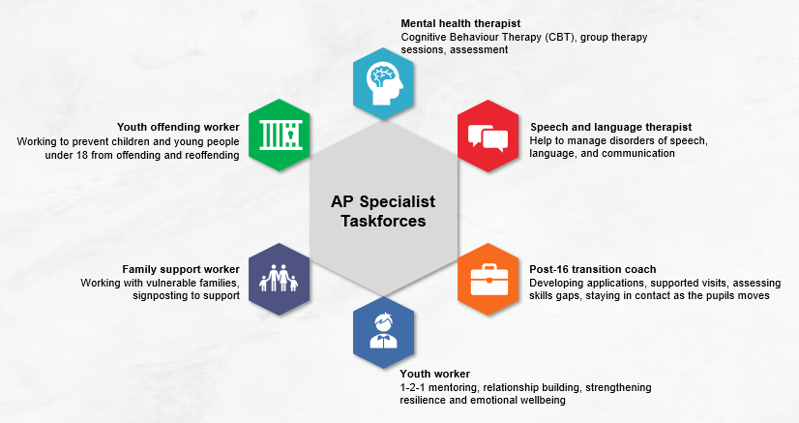
What could this look like?
#IQMFamily

Slide 6
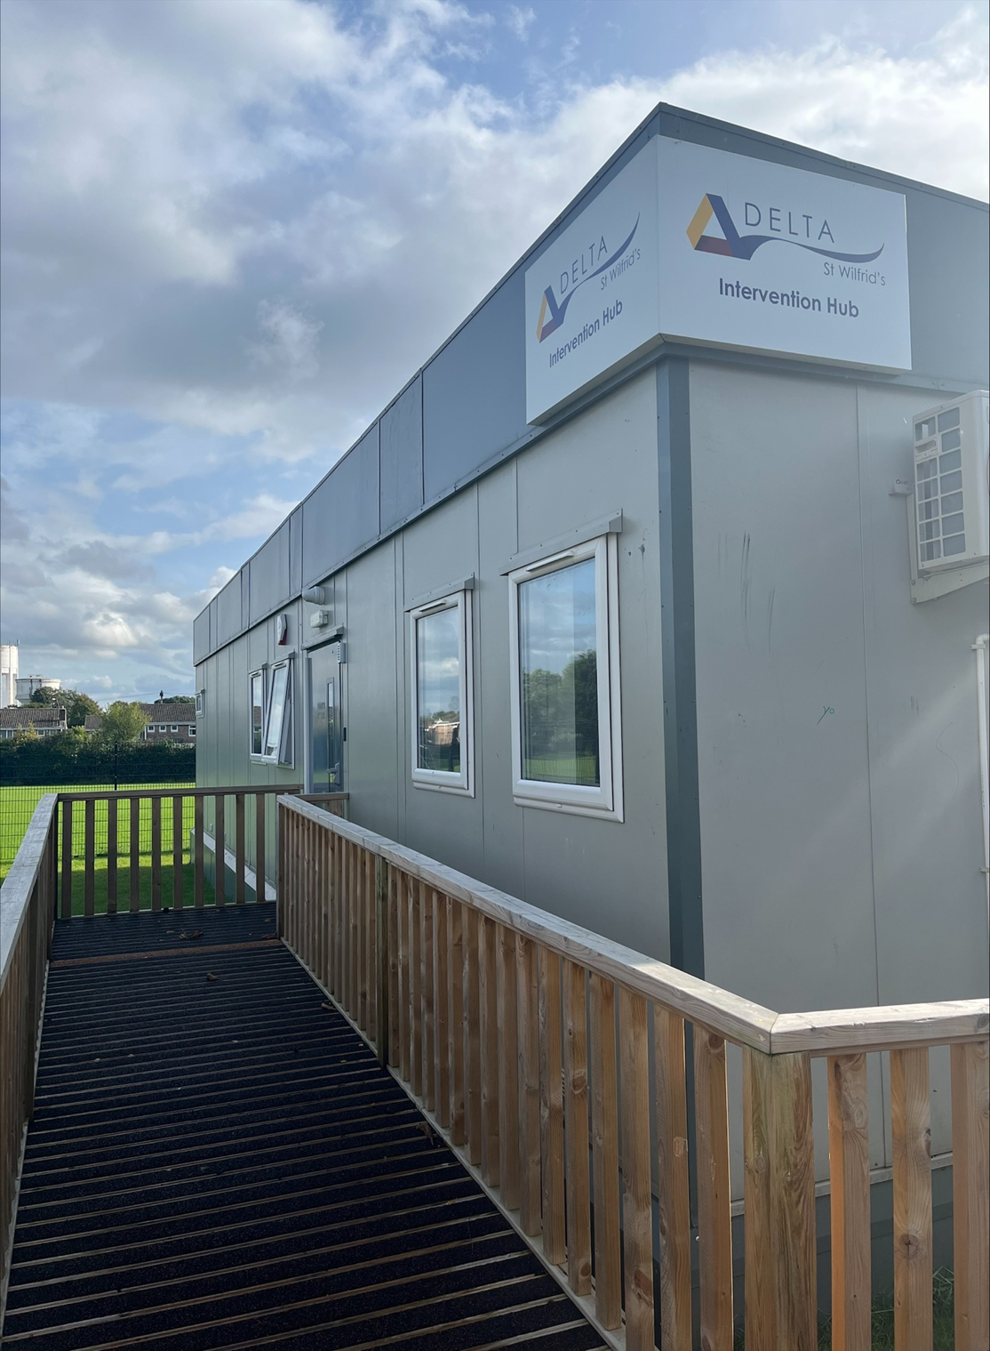
How does this look at St. Wilfrid’s Academy in Doncaster?
Mental Health Therapist
Post 16 Transition Careers Specialist
Family Support Worker
Early Help Co-Ordinator
Youth Justice Officer
Speech and Language Therapists
SENCO/Intervention Lead
Leadership Oversight

Slide 7
Let’s hear from the team!
Danny Hannam, Youth Justice Worker
Liza Justice, Early Help
https://youtu.be/dSx73O7xQzM
#IQMFamily

Slide 8
Impact
Multi–Agency Approach, based on school site but operating from a separate building sharing the car park. Hours of operation extended beyond the school day and allowing for evening interventions.
The APST are regularly in the building, supporting learners and building relationships. This has made it easier to engage with parents and carers in the home.
Early Help ‘RAG’ rate every student and are able to expedite referrals through the system, cutting down on red tape. Average time from referral to work starting is now 2 days (if not hours) down from 6 weeks plus!
Youth Justice Work has seen earlier intervention have a greater effect. The YJW has seen his caseload double, however the majority of interventions are now pre-court rather then post-court.
Trauma informed interventions start with the Councillor / Mental Health Worker in our ‘Wellbeing Suite’ and interwove throughout the school meaning more time is spent getting to the route cause of negative behaviours
#IQMFamily

Slide 9
Dramatic Results
St Wilfrid’s Academy is a 125 place Alternative Provision Free School in Doncaster providing short term assessment and turn around places for pre Key Stage 4 students and longer term places for year 10 and 11 students. On average, more then 200 students access provision each year, all either at risk of or having been permanently excluded.
The 2023/24 KS4 cohort, on arrival had an average FTE per student of 12.6 days in 22/23. The total days lost learning through FTE were 754 days.This dropped dramatically to 79 FTE and 65 days lost learning following referral.
Similarly there have been dramatic attendance gains, with students making an average uplift of 19.16% attendance, on joining St Wilfrid’s. 40% made a 20%+ improvement in attendance on joining the Academy.
#IQMFamily

Slide 10
Impact & Evidence
In November, the Youth Endowment Fund as part of their evidence in practice series, ran a session which focussed on the work and learning from the Department of Education’s Alternative Provision Specialist Taskforces (APSTs). This 2-year programme aims to keep pupils that are in alternative provision – including those who have been excluded from school – engaged in education, getting them back on track with their studies and preventing them from being criminally exploited.
The Youth Endowment “Virtual Learning Café Event: Alternative Provision: Keeping Children in Education & Safe from Violence”
A replay of the event can be viewed here.
#IQMFamily

Slide 11
Impact & Evidence
The St. Wilfrid’s APST has supported over 400 students from 41 different schools since November 2021.
#IQMFamily

Slide 12
Pitfalls/obstacles/learning points
Don’t get hung up with the potential financial cost of a multi-agency approach. All of these professionals already exist within your Local Authority.
The question needs to be HOW or WHO needs to convince them to change there working practice.
Build on existing relationships:
SENCO Network
NHS School Nursing
CAMHS
Educational Psychologists
Look at local professional sports clubs for mentor programmes.
#IQMFamily

Slide 13
Key takeaways or quick wins for colleagues
If there is one in your area, consider approaching the existing APST Pilot School for support. There may be the possibility to refer students into the AP for Multi-Agency support only. The student stays dual registered.
The SEND and AP Improvement plan (March 2023) has raised the profile of Multi-Agency Support and the work piloted by the APST has been evaluated and shown to have proven impact. With many Local Authorities now aware and open to building on the pilot, it may be the perfect time to approach local Early Help, Youth Justice and the NHS directly and offer to ‘host’ a hub in your school.
#IQMFamily

Slide 14
Questions
#IQMFamily

