Slide 1
Creating an AP offer in a Secondary School
Presented by Mark Tilling
Headteacher of High Tunstall
College of Science
Inspire | Support | Achieve
#IQMFamily

Slide 2
“
Creating an AP offer in a Secondary School
Inspire | Support | Achieve
#IQMFamily

Slide 3
Identifying the need
Huge number of local suspensions
450% increase in PEX in the locality
800% increase in EHE in the locality
Reduction in local support services
Increasing deprivation rates
Falling attendance rates
Creating the solution
#IQMFamily

Slide 4
“
Creating an AP offer in a Secondary School
“Taking the plunge and opening an AP for yourself is daunting, getting it right is so important! The way forward is to have belief it will make a difference to young people.”
Inspire | Support | Achieve
#IQMFamily

Slide 5
Plan it well
Resources
Curriculum
Timetable
Desired outcomes
#IQMFamily

Slide 6
It’s evolution, not revolution!
Mainstream
The Welly
Shine
ASD/Medical ARP
Shine
Create
Reach
ASD/Medical ARP
MLD ARP
ASD/Medical ARP
2010 -2015
2015-2020
2020 - present
#IQMFamily

Slide 7
Resources: Phase 1 2014-2020
Poorly resourced
No planned Curriculum
Dealing with Huge Social Issues rather than Education
Poor Attendance
Increasing Suspensions
Staying alive for some was a success
#IQMFamily

Slide 8
Resources: Phase 2 2020-present
Resourced to the cost of £500,000
Alternative and Mainstream Staff Engaged
A well sequenced and planned Curriculum
Social Issues dealt with but left at the door
Attendance expected
Suspensions decreasing
Moving on important
#IQMFamily

Slide 9
In 2023 we became a…
#IQMFamily

Slide 10
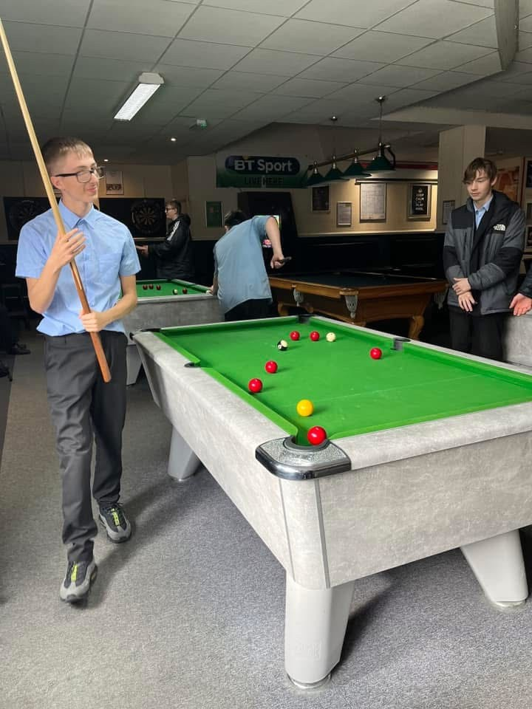
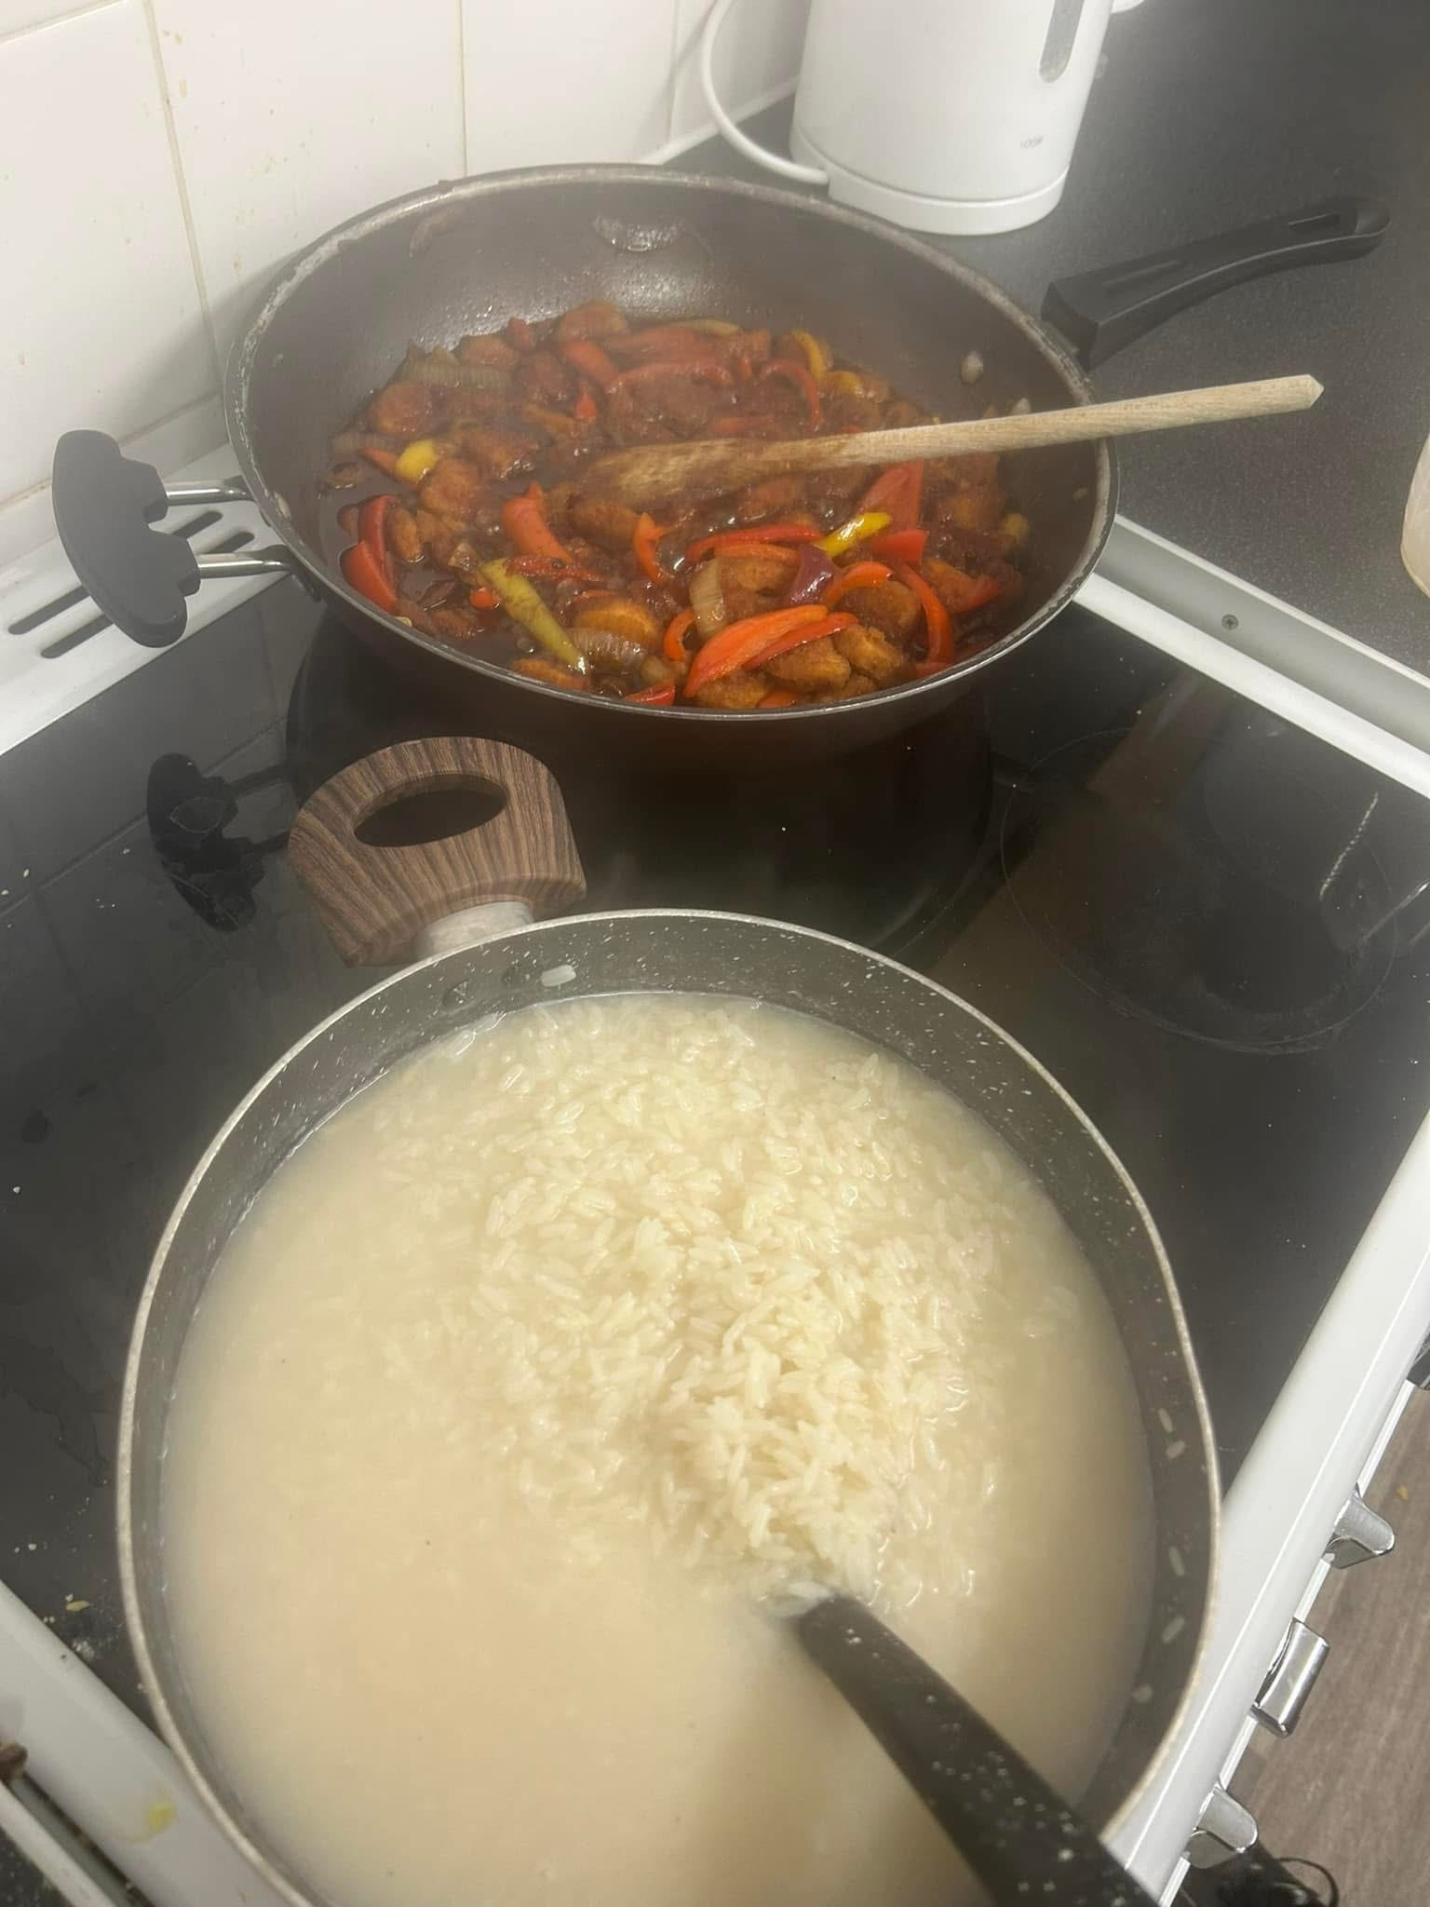
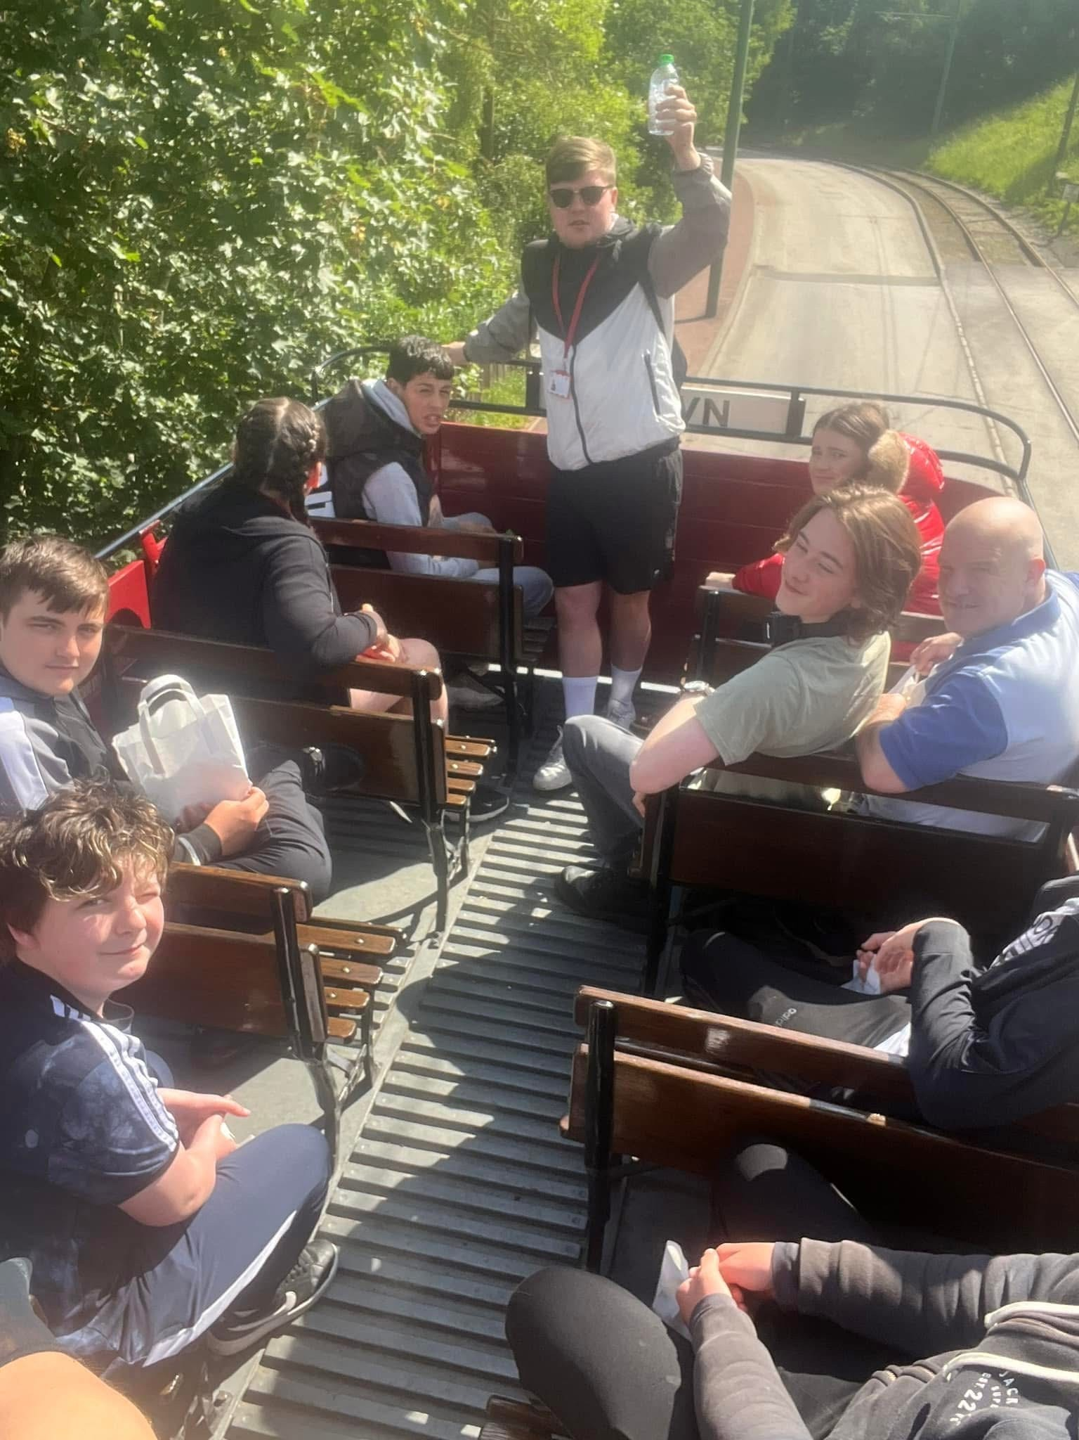
Resource it
Staff : Student Ratio
1:3 or 1:4
Provision
Food
Therapy
Support
Equipment
Rewards
#IQMFamily

Slide 11
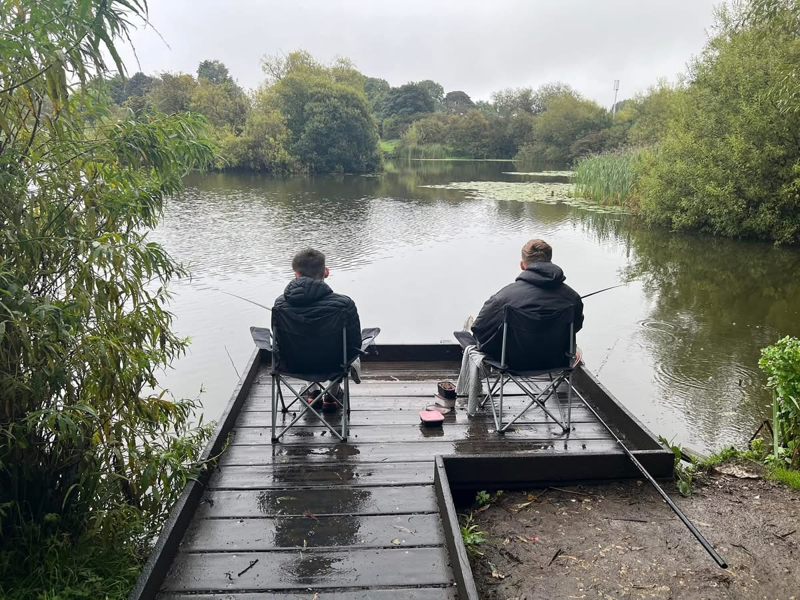
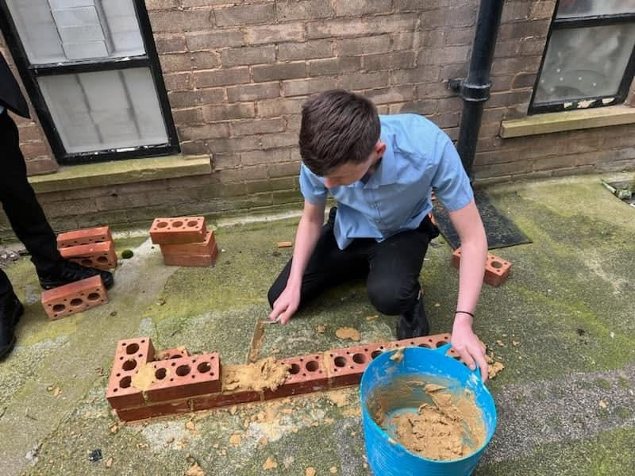
Curriculum
Make it Academic
English
Mathematics
Science
Options
Make it relevant
Vocational (Construction & Engineering)
(Hair & Beauty)
Life skills
Preparing for Adulthood
#IQMFamily

Slide 12
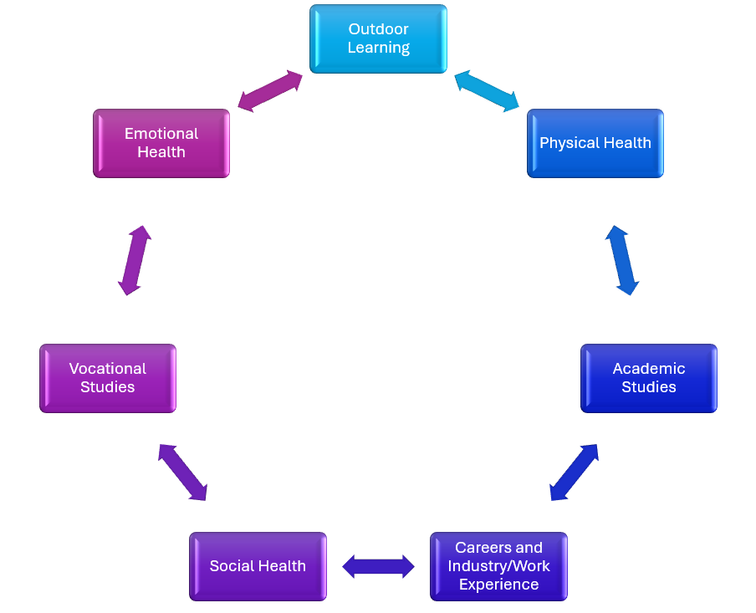
Curriculum - Development
#IQMFamily

Slide 13
Timetable
Full or Part Time
Realistic expectations
9 – 1
Breakfast and Lunch served as part of the day
Consequences planned
1 – 3
Parents onboard
Realism on attendance
Prosecutions?
Multi-Agency Support
#IQMFamily

Slide 14
Desired Outcomes – Our Success
GCSE Results
P8 (-1.96)
A8 18.52
Average Entries 4.9 GCSE’s
Destinations
FE College
Apprenticeships
Training
Attendance
#IQMFamily

Slide 15
#IQMFamily

Slide 16
Future Plans
Bigger Provision
Better offer
Developing employability
Entrepreneurial skill development
Offer to a wider cohort to be part of the solutions
#IQMFamily

Slide 17
Questions
#IQMFamily

