Slide 1
Creating a Positive
Behaviour Culture
Presented by Pete Hines OBE
Headteacher at Perryfields Primary PRU
#IQMFamily

Slide 2
Welcome
#IQMFamily

Slide 3
‘Culture eats strategy for breakfast’
At Perryfields it can be summed up by ‘the way things are done around here’
#IQMFamily

Slide 4
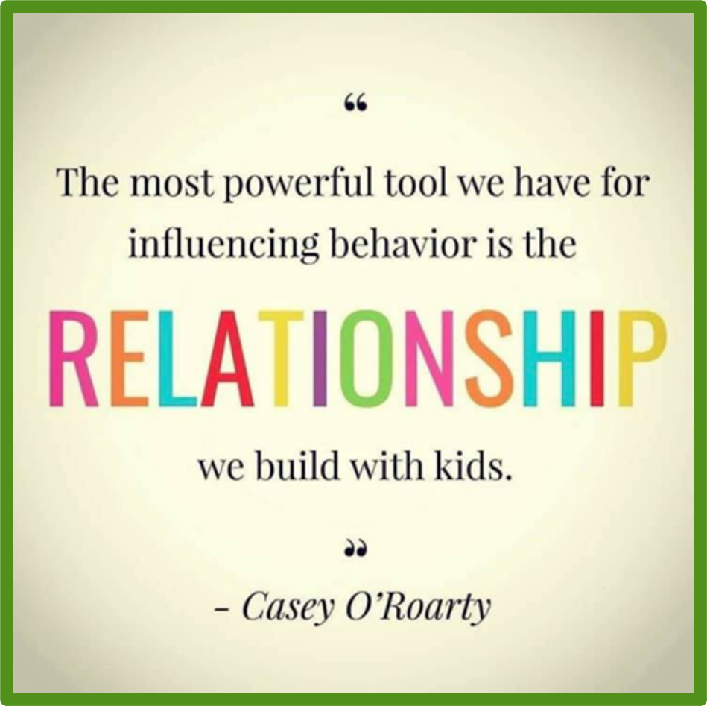
#IQMFamily

Slide 5
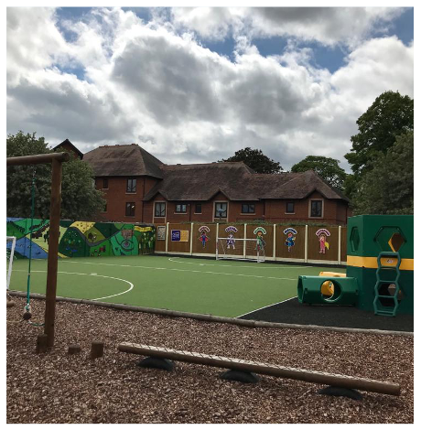
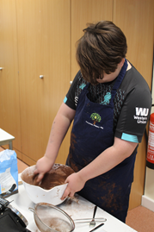
What underpins an effective and positive behaviour culture?
Quality First Teaching, engaging lessons pitched at the right level so to reach ALL pupils.
Positive relationships based on respect in an extremely nurturing and caring environment.
Don’t Pretend!
The best and first behaviour
support strategies
#IQMFamily

Slide 6
Importance...
“How much a difference really great teachers make.”
Dylan William
“Pupils learn best through the smiling eyes of the teacher.”
Prof Bart McGettrick (Dean of Liverpool Hope University)
As a leader my role is… “helping every teacher do a better job day in day out.”
Dylan William
“Schooling is a one shot deal for our Students.”
#IQMFamily

Slide 7
Create an atmosphere of pupils who seek recognition and are eager to please through constant praise and encouragement –create a culture where it’s worthwhile being good
#IQMFamily

Slide 8
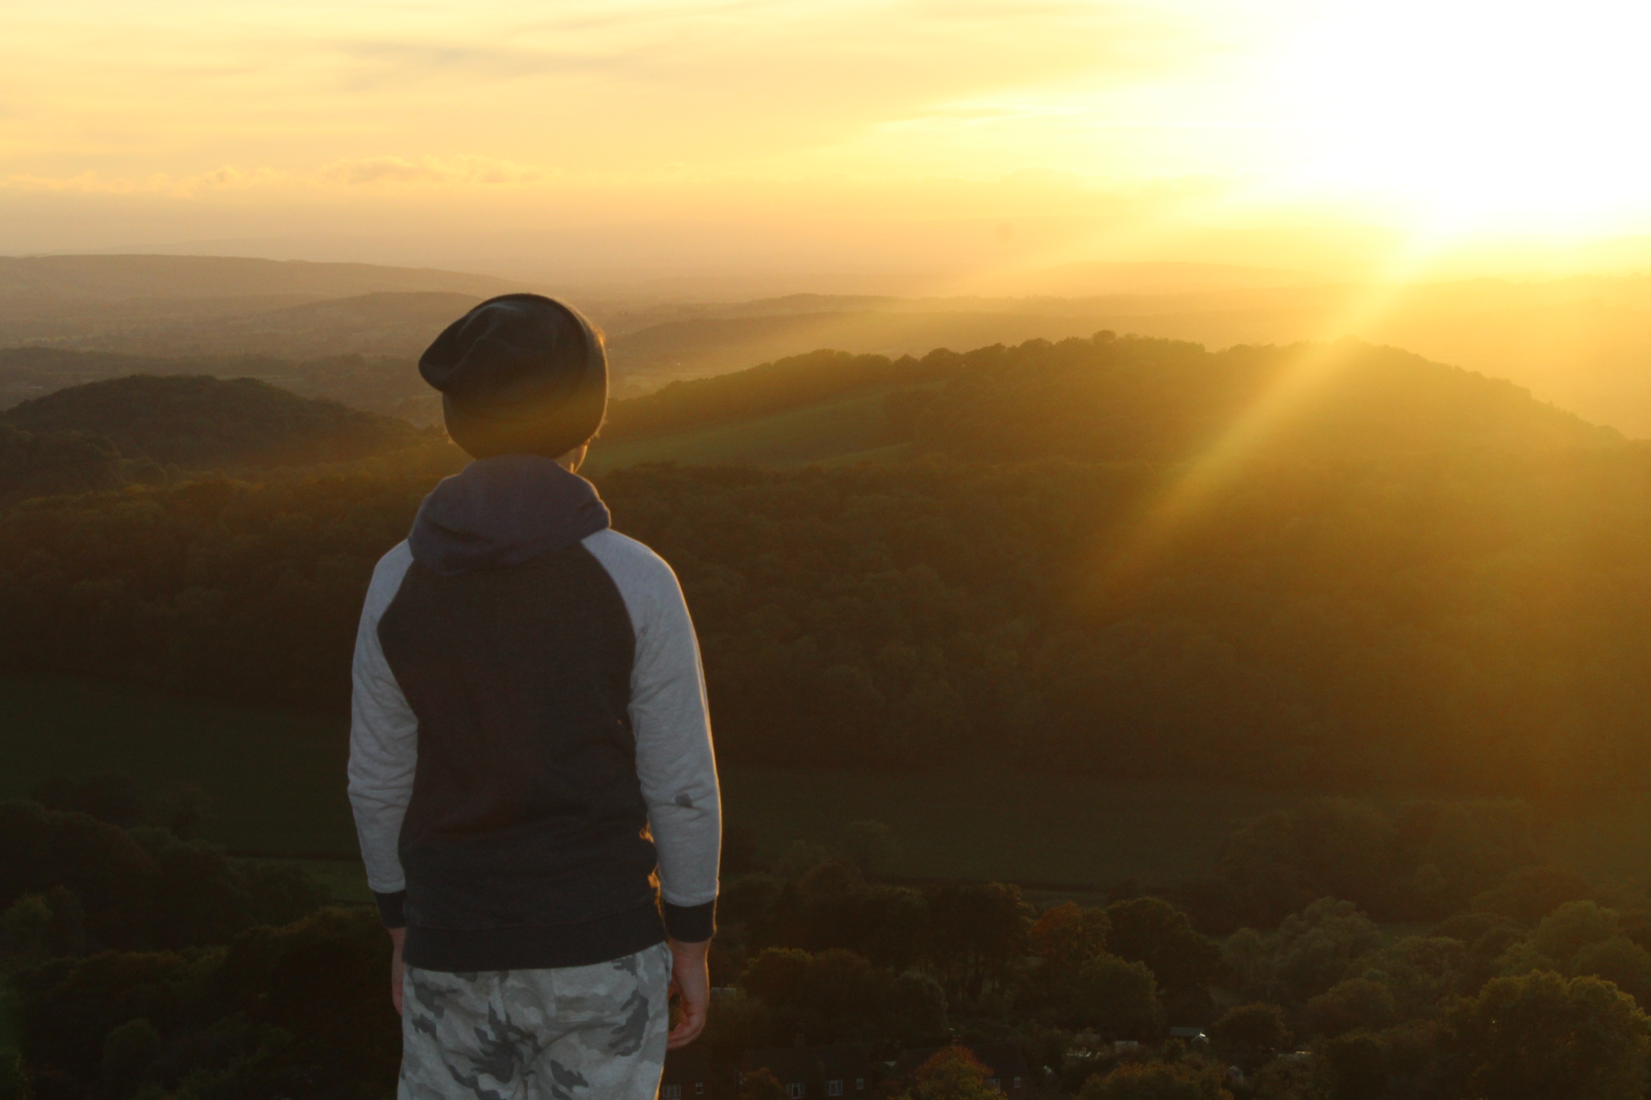
Thinking of a child as behaving
badly disposes you to think of punishment.
Thinking of a child as struggling to handle
something difficult encourages you to help
them through their distress.
#IQMFamily

Slide 9
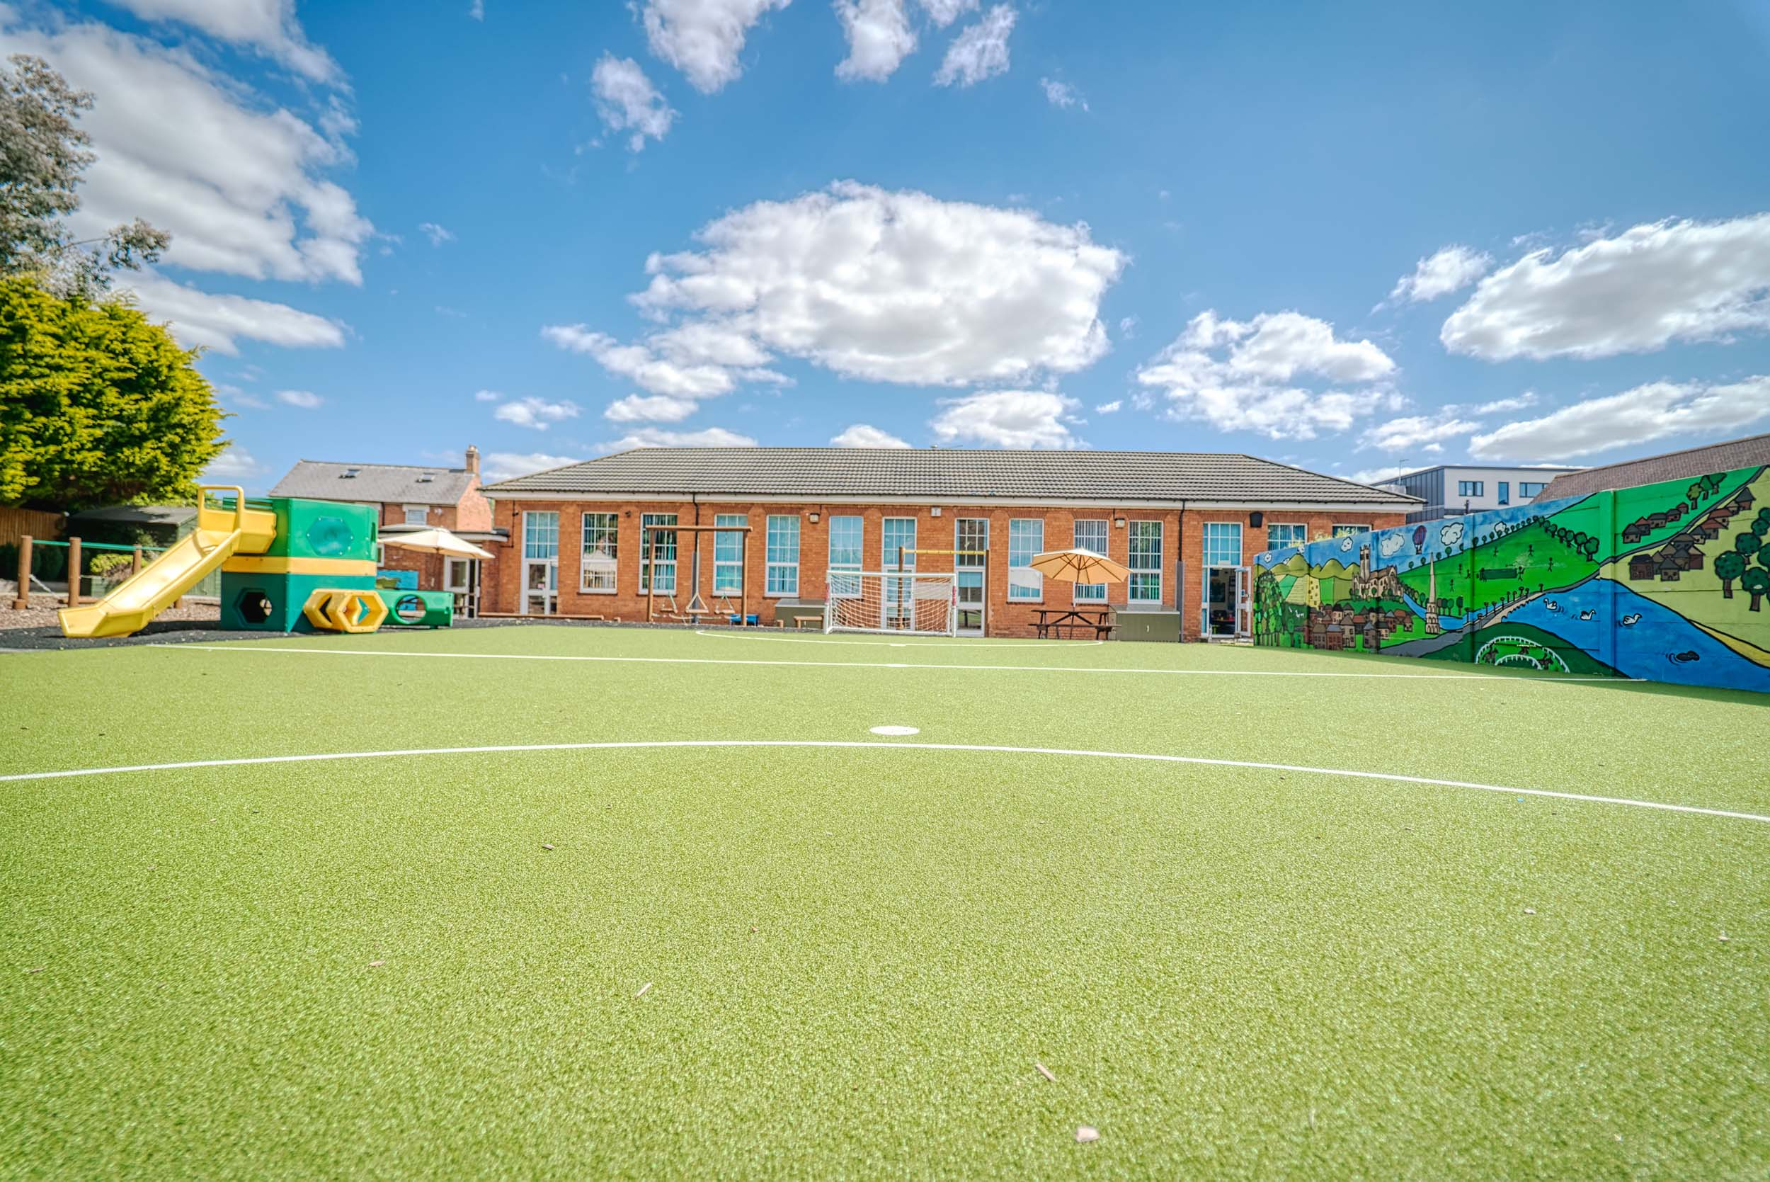
“You can’t teach children to behave better by making them feel worse.
When children feel better, they behave better.”
Pam Leo
Author of Connecting Parenting
#IQMFamily

Slide 10
#IQMFamily

Slide 11
It is vital to spend time thinking very clearly about the core values that are important to the school. At Perryfields we have established the following so we know what we are and what we want:
Hard work
Empathy, kind and caring
Humility
Adaptable
Teamwork
Reflective
Creativity
Resilient
Willingness to embrace purposeful change
#IQMFamily

Slide 12
Perryfields – Example
Interview Questions
Questions | Related Values
What motivated you to apply for this role? What do you know about Perryfields? What impressed you during your visit? | Hard Work
Thank you for allowing us to watch you teach. How do you feel it went? What would you do differently next time? | Reflective
If I walked into your classroom at Perryfields what would I see? | Hard Work, Adaptable, Willingness to Embrace Purposeful Change
Tell us what you feel are some of the key components of an engaging curriculum. | Creativity, Reflective
What areas of the curriculum do you consider as strengths and which do you feel you have areas for development? | Humility, reflective
What personal qualities do you have which would help you work effectively as part of a team? | Teamwork, Empathy, Kind, Caring, Adaptable
If you were to ask a colleague to describe you in 3 words which ones would they choose? | Reflective, Humility
Working with our pupils can be rewarding but equally hard work. How would you ensure that you are able to maintain a positive mental and physical health? | Resilience, Creativity, Adaptable, Reflective
#IQMFamily

Slide 13
#IQMFamily

Slide 14
‘Culture eats strategy for breakfast’
At Perryfields it can be summed up by ‘the way things are done around here’
#IQMFamily

Slide 15
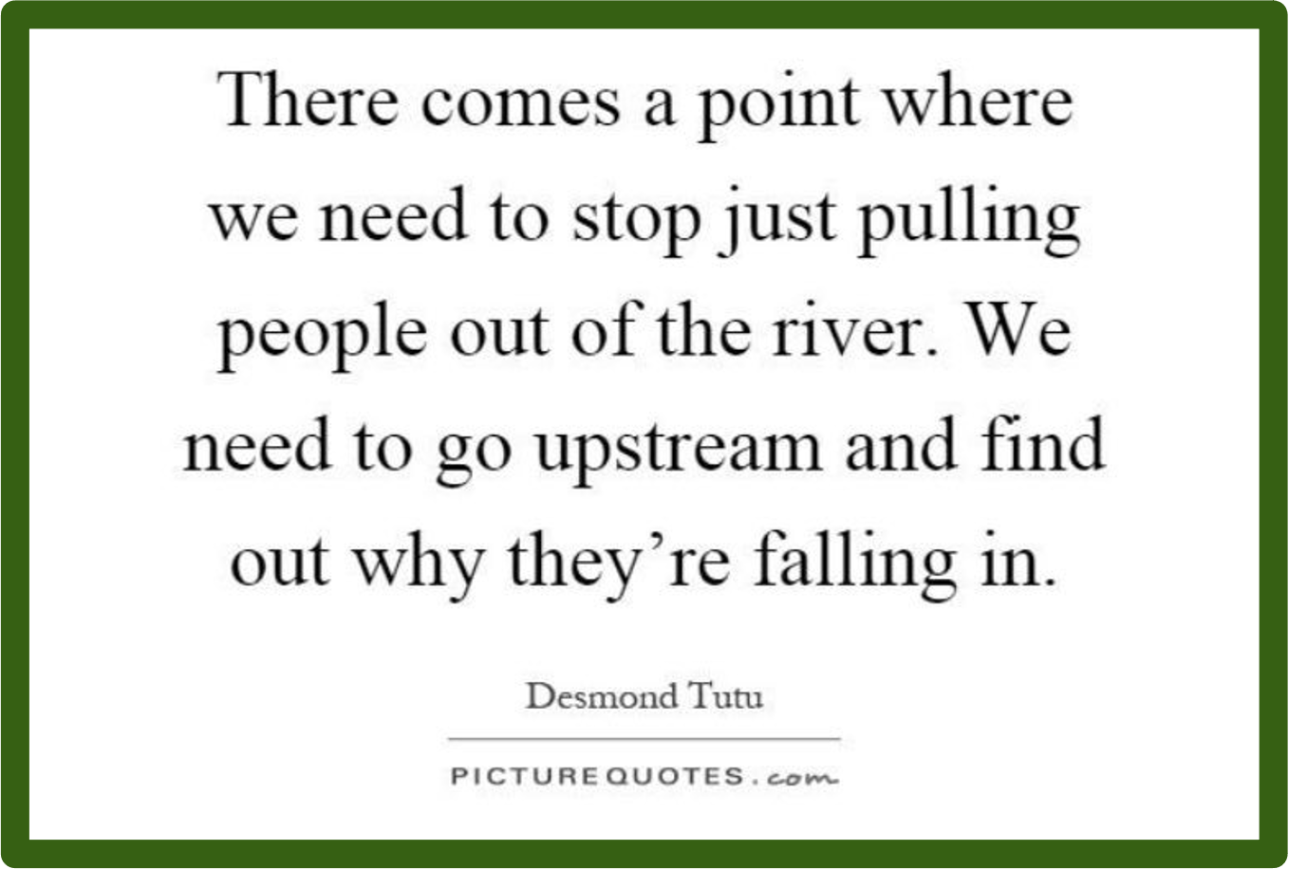
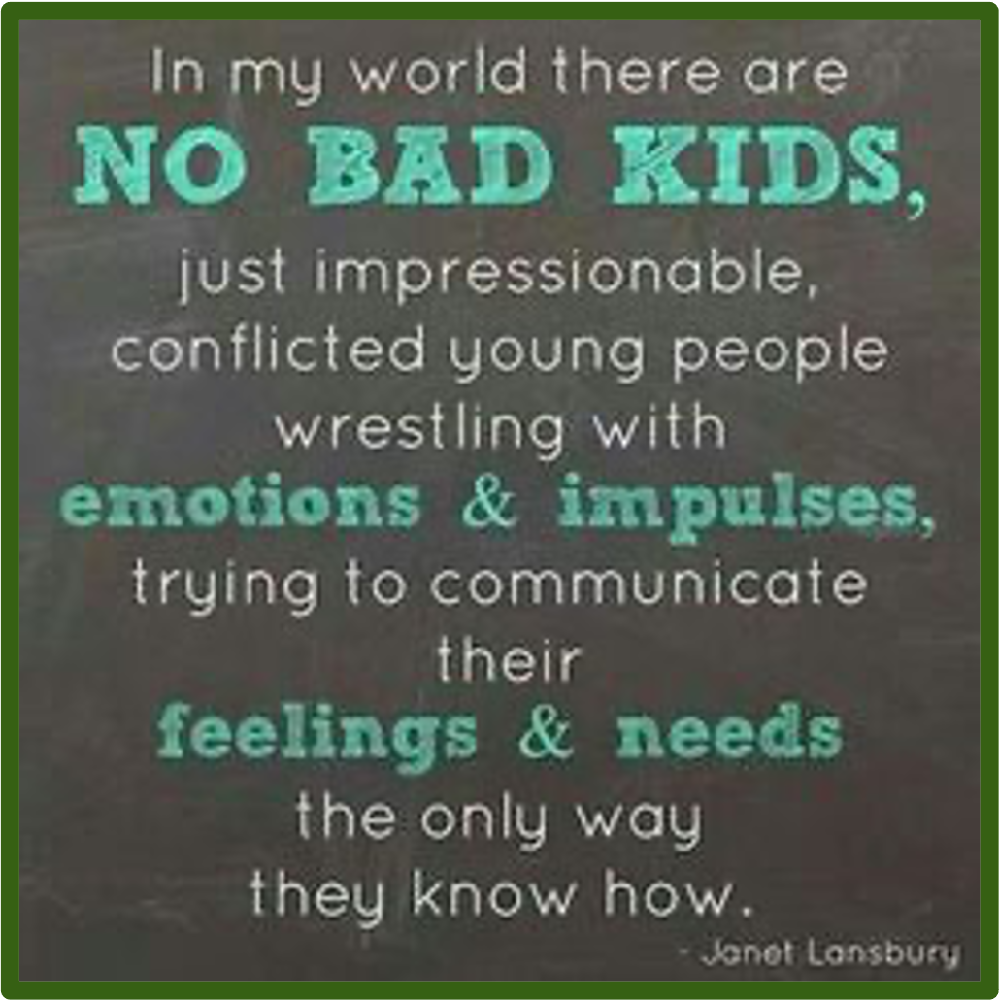
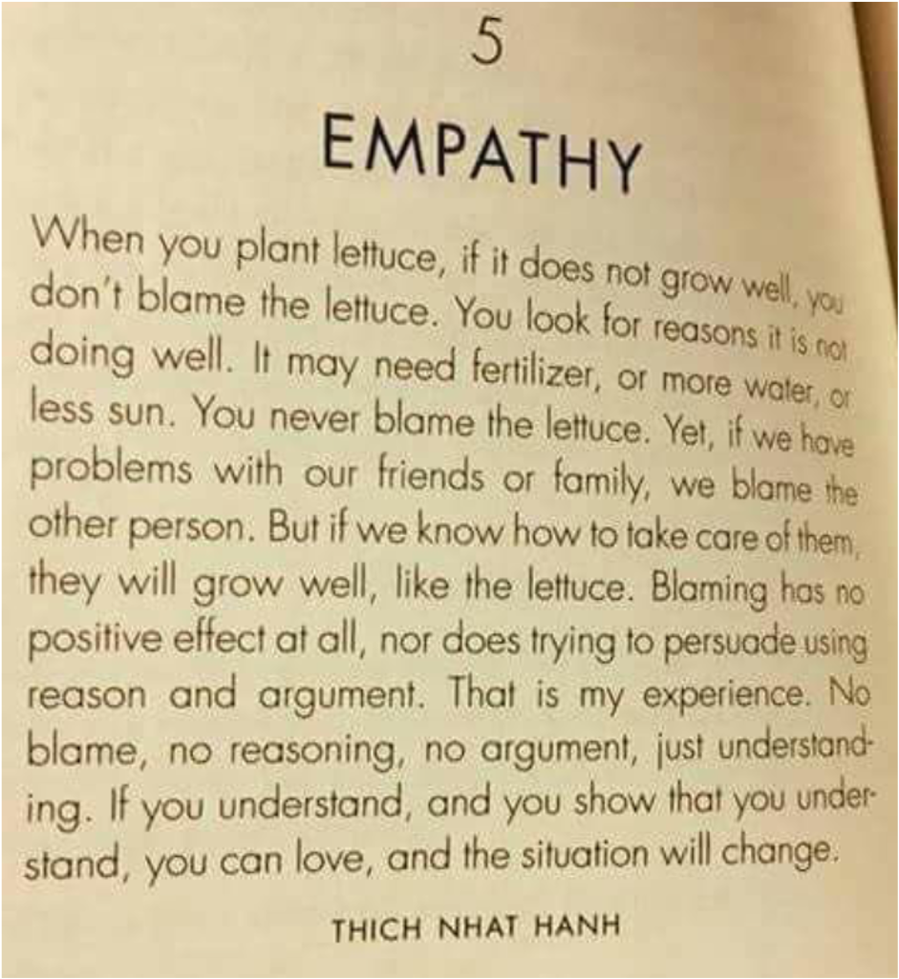
#IQMFamily

Slide 16
Quick Wins
Clarity of shared vision
Values based approach to appointing the right people
Be relentlessly positive!
#IQMFamily

Slide 17
Questions
#IQMFamily
#IQMFamily

