Slide 1
Inclusion Quality Mark
Fostering a love for learning in the Early Years
Five Acre Wood School
Demi Lockett, Assistant Headteacher
dlockett@five-acre.kent.sch.uk

Slide 2
School Context & Starting Points
Five Acre Wood School is an Outstanding district Special School, currently catering for pupils aged 4 – 19, with an Outreach Nursery Model
Approx. 850 pupils on roll, 135 Early Years pupils
6 learning approaches
Previously, EY was Reception-aged pupils, but now encompasses our Year 1 cohort for consolidation of foundational skills
EY curriculum heavily centred on 7 Areas of Learning and teaching to ages and stages

Slide 3
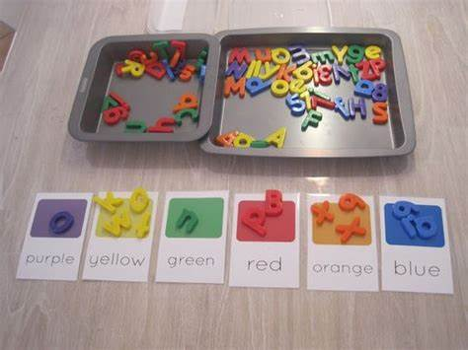
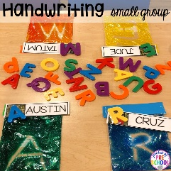
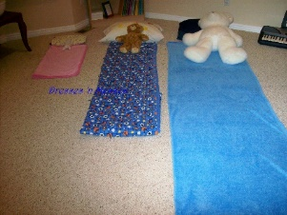
Starting Point Pre-Curriculum Review - Examples of Learning
Can the children use their fine motor skills to write their name? Can they do this independently or do they need to use the visual in front of them? Do they require HOH?
Can the children sort the letters into colour groups? Can they put them on the right card? Are the children able to comment on the letter they have picked up and its colour?
Can the children make different beds for the teddies? Do they try themselves? Can they use the vocab learnt throughout the week?
Notes:
Outcome driven and teacher-led – activities were closely linked to developmental strands in the Development matters framework, with teachers directly teaching skills to pupils
Closed resources – activities were heavily focused on plastic, closed resources that limit the pupils ability to develop their imagination, foster a sense of curiosity and enhance the sensory experiences of learning
Whilst pupils leaving the EY were often ready to engage in teacher-led activities, they struggled to think creatively and be deeply invested in the process of what they were learning or engaging with. Our thoughts were focussed on how we could make the learning most relatable to our pupils promote independent thinking

Slide 4
Intent
Our curriculum intent is to develop the following within our learners:
Foundational skills and a readiness for learning
Early communication skills
Resilience to learning
Confidence
Emotional regulation – mutual and self
We are looking to develop confident and curious learners. Those that question the ‘what if’ of learning opportunities and actively explore this.

Slide 5
Our Core Approaches to Learning
Hygge
A Scandinavian term that does not translate to English. It is a feeling, an atmosphere – a cosy, comfortable and warm space.
Open-ended learning
An approach focusing on the use of open-ended resources, loose parts and the natural world. It enables us to bring curiosity, awe and wonder into childhood experiences and creates the ‘thinkers and doers’ of the future. We seek to empower our practitioners and ignite passion and excitement from them to fuel our pupils' learning journeys.
Saplings
A bespoke learning provision in our Outdoor Learning Environment. Saplings is a pre-cursor to Forest School sessions that are led by our Outdoor Learning Team. Saplings allows students to build a connection with nature, have the freedom to explore in a way that they cannot within the confines of a classroom and encourages them to engage in risky play.

Slide 6
Implementation
Open-ended Learning
Discovering open-ended learning, following the lead of the child
Open-ended, natural resources
Characteristics of Effective Learning as main assessment framework
Identification of ‘core’ Development Matters areas in line with curriculum offer
Learning environments and arousal level
Embarking upon official accreditation journey
Notes:
We have been on a 4-5 year journey with our implementation of The Curiosity Approach and are now looking at getting our The Curiosity Approach accreditation.
We began to reflect on the learning opportunities on offer for our learning, realising how closed they were as learning experiences and reflecting upon the value of age-related activities for children with cognitive and developmental delays.
We introduced more open ended, natural resources to our provision and allowed the child to lead their learning. We promoted ‘the power of you’ within our staff which placed an emphasis on the importance of their interactions with our children and promoting a shared love for a learning experience
With The Curiosity Approach and open ended learning in mind, we decided to make the Characteristics of Effective Learning our main assessment framework, identifying 3 ‘core’ areas from the EYFS Statutory Framework that complimented our curriculum intent – Communication & Interaction’ Personal, Social and Emotional Development; Physical Development. This allowed us to demonstrate holistic pupil progress.
With open ended learning, loose parts and natural resources well established, and with team enthusiasm for further development, we explored hygge and the impact that the learning approach can have on pupils engagement to learning. We place consideration on the lighting, scent and sounds of the learning environment, seeking to create a sense of calm and allowing the learning activities to stand out within the room.

Slide 7
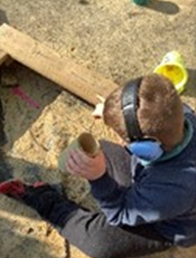
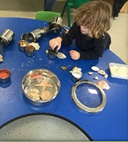
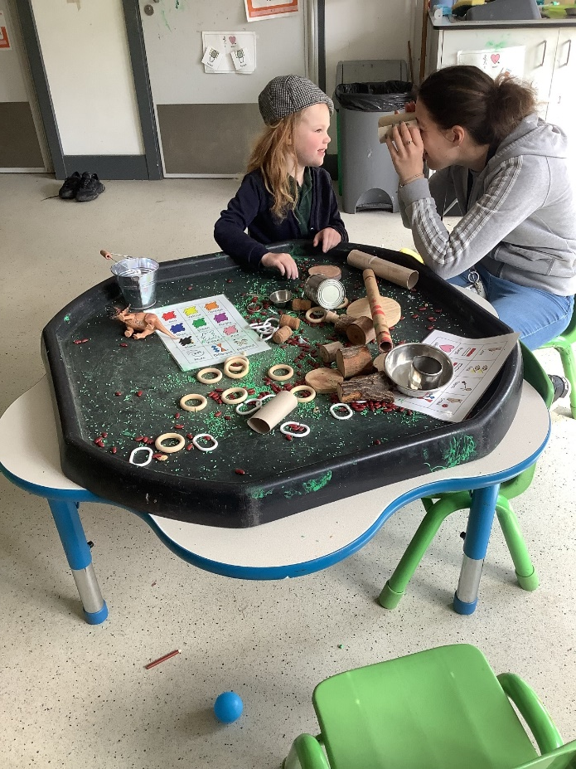
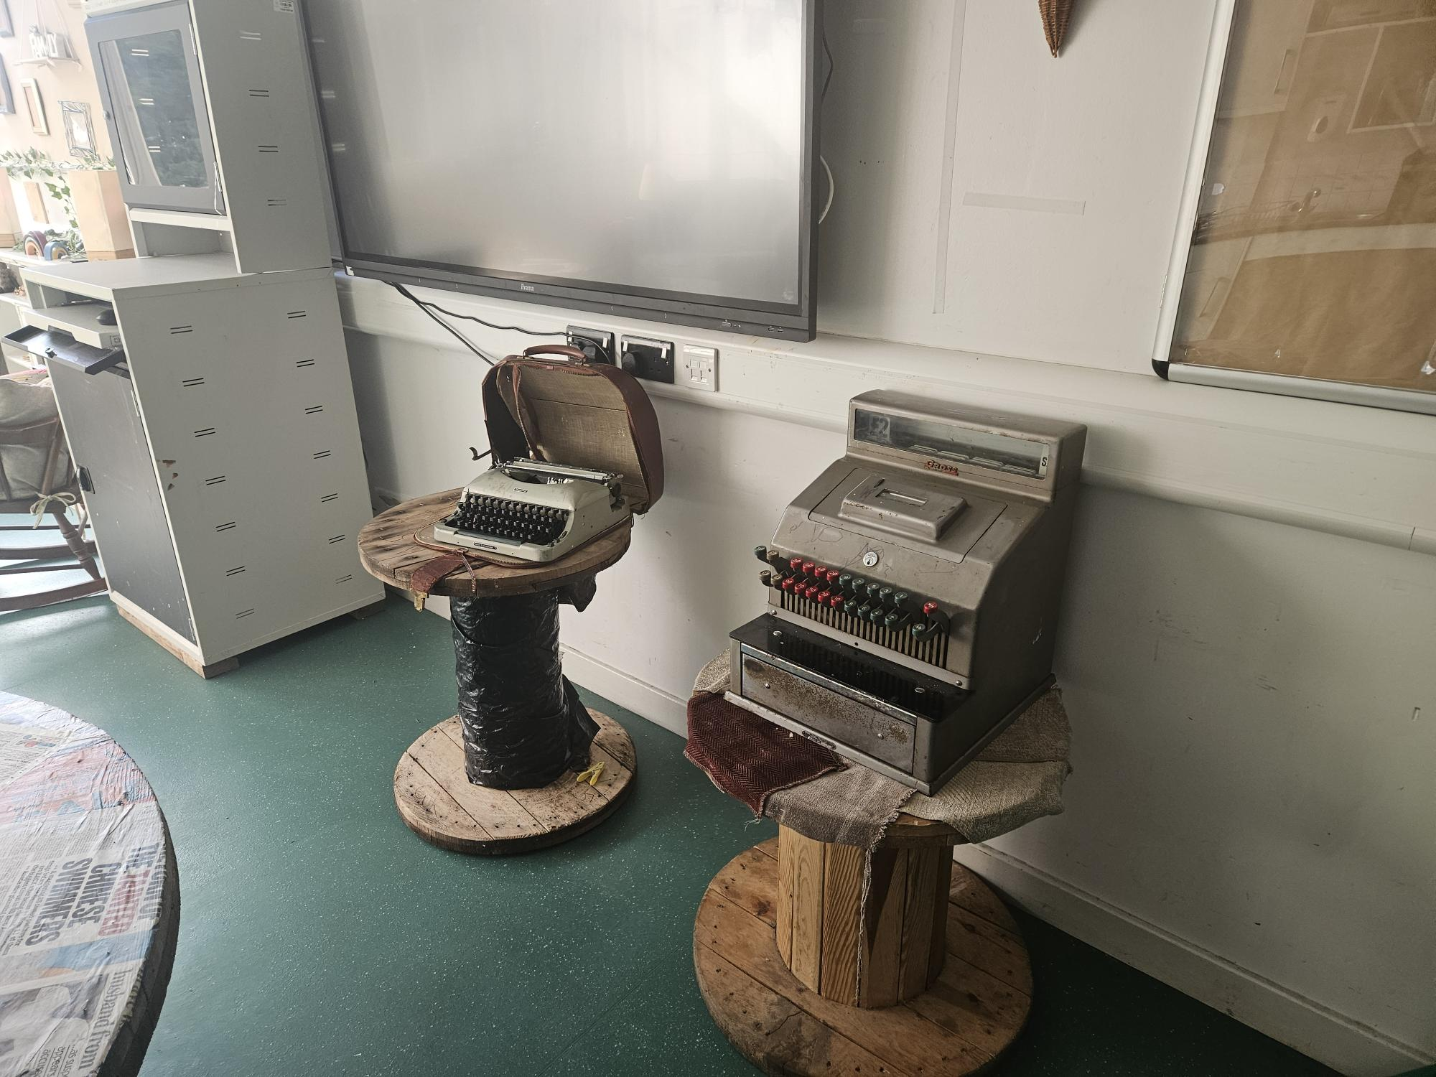
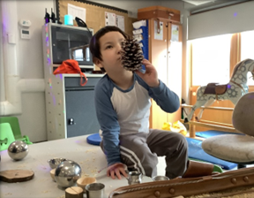

Slide 8
Implementation
Hygge
We allow Class Leads to evaluate the needs of their class group and the individual pupil. They consider how the below can be used to best support their pupils:
Music & Scent
Soft furnishings
Connectedness
‘Slow teaching’
Notes:
Music & scent – Music can contribute to better memory, building confidence and develops concentration skills. Many classes may use music within their lessons to contribute to a feeling of hygge and enhance focus. Others use it to aid students transitions at key points throughout the day, such as with the use of bespoke transitional songs
Soft furnishings – the use of soft furnishings to create cosy places to retreat, offering an alternate space when students are feeling emotionally dysregulated, or somewhere to relax after completing their work
Connectedness – Staff are ‘in-the-moment’ with their students. They take the time to get to know them as individuals and invest in their relationships. The same applies to staff-to-staff relationships. We aim to work collaboratively, wit the students at the centre of our focus.
Slow teaching – the desire to empower our staff to focus on the little things that are important to their students and to themselves. Our students sometimes need us to recognise when activities are not matching their current energy levels or rely on us to adapt this for them. This is where slow teaching and the culture of ‘trial and error’ is invaluable for our learners. Our children often function at a much faster pace than us. If we are hectic and busy in our presentation and our interactions, how can meaningful learning take place?

Slide 9
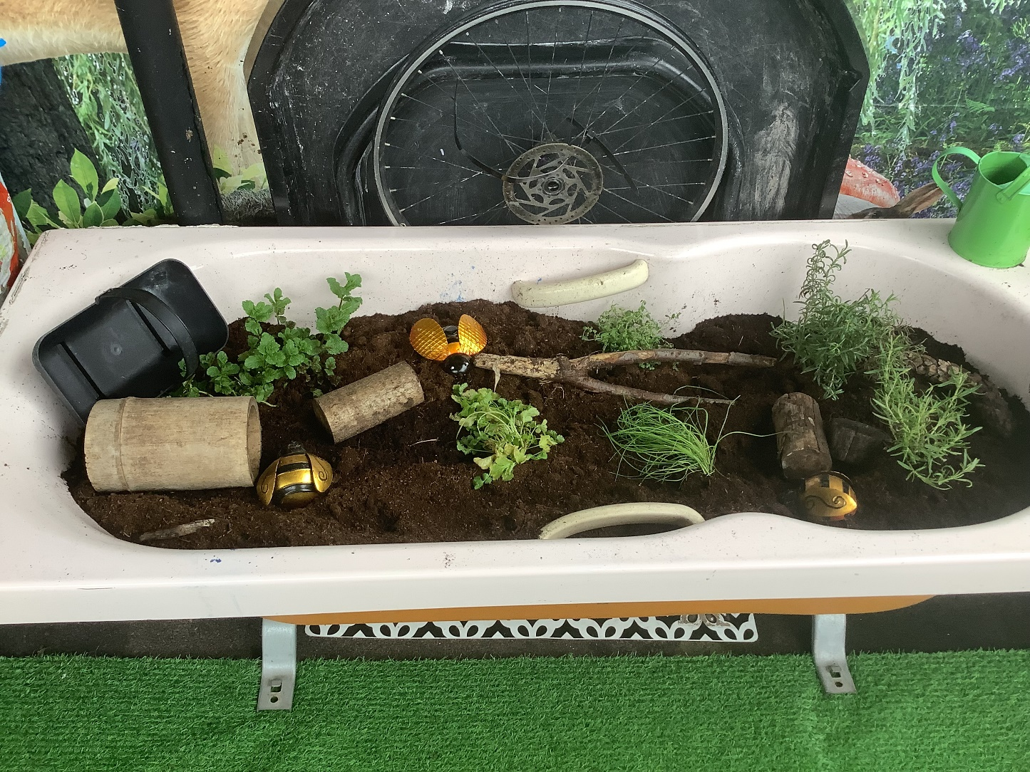
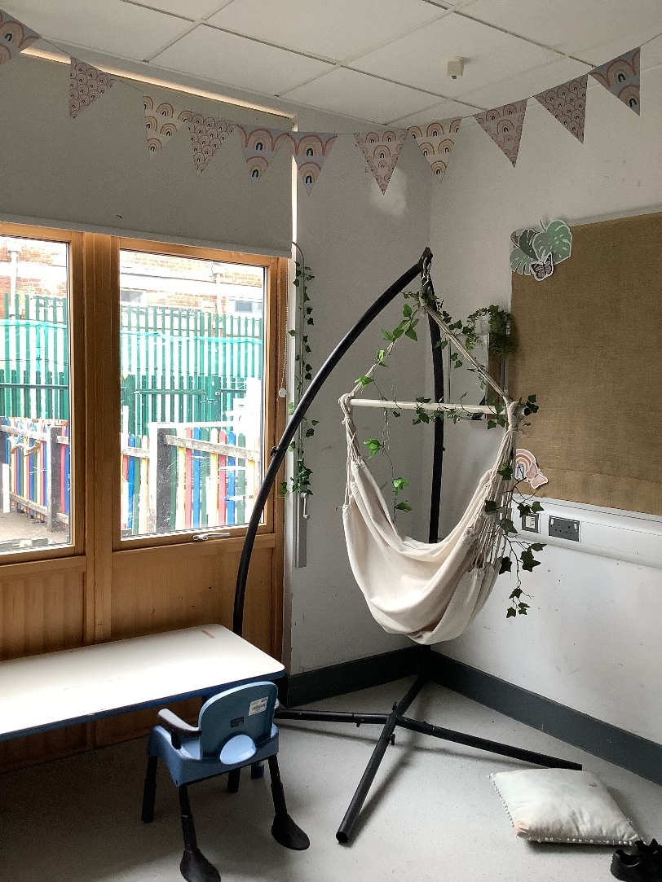
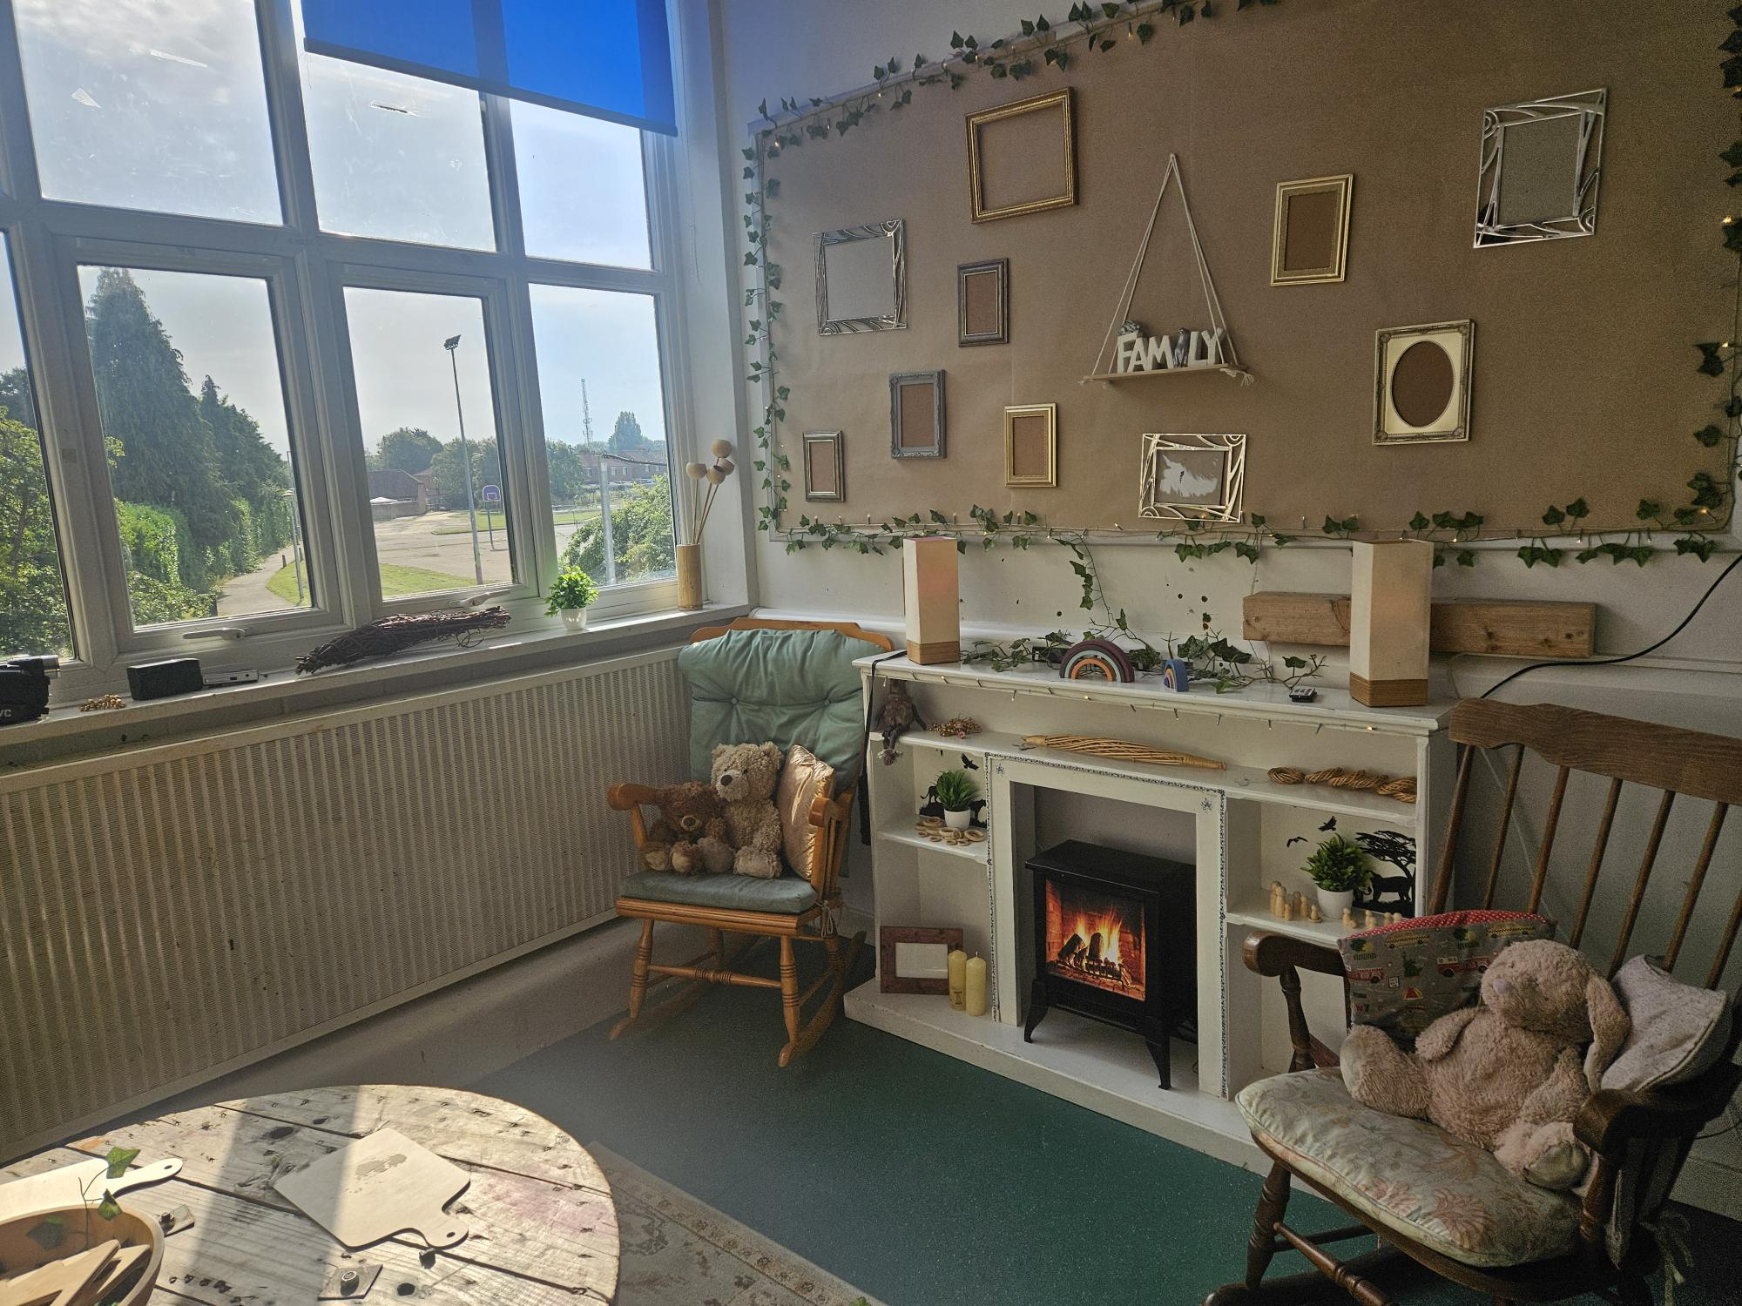
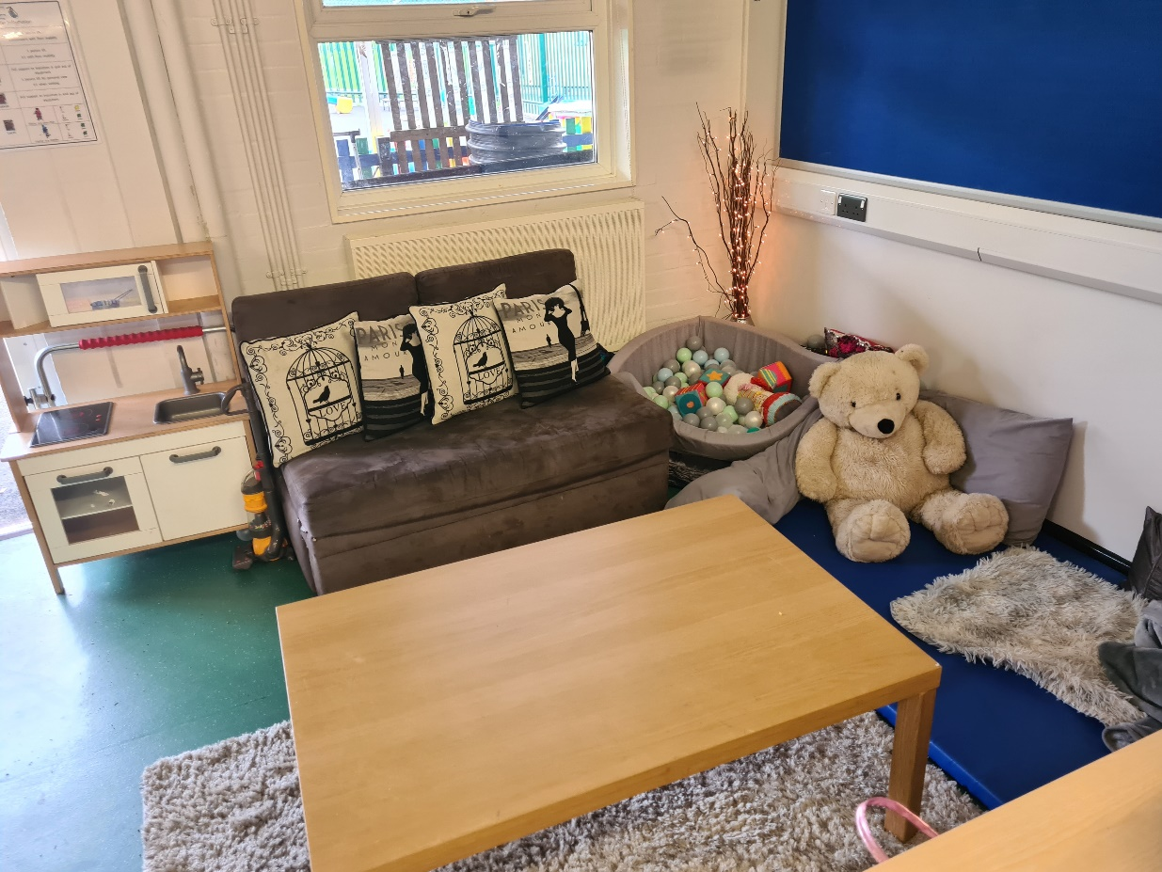

Slide 10
Implementation
Saplings
Risky play
In-the-moment
Weather Warriors
Continuous provision and extension planning
Notes:
Risky play – we allow students to take supported risks appropriate to the environment and their personal capabilities. We want students to develop a greater sense of their body within the world. We encourage our staff to consider: risks vs. hazards?
In the moment learning supported by a rich continuous provision and appropriate extension planning – the Early Years team worked collaboratively with our Outdoor Learning team to design a continuous provision for Saplings. This included a camp fire role play area, a small pond, mud kitchen and a ‘risky play’ area. It was also important to both parties that there were areas for nature to take control and the children are encouraged to explore this safely. We ask practitioners to consider the importance of extension activties that can be taken down to he saplings area so that the children can make the most of their time down there and explore their topics holistically across their school week.

Slide 11
Activity: Risk or Hazard?
Scenario A:
A class has walked to Saplings for a pumpkin patch role play activity. A previous class were using hammers and nails as an activity to enhance their motor skills. You notice that some nails are left on a wooden work bench near to the pumpkins where your pupils are working.
Scenario B:
Two pupils are curious about a tree that has just been cut down. They climb on to the tree stump and begin to take turns jumping down. They are hesitant at first. The floor is clear, but the log is tall.
Risk – a challenge or uncertainty that a child can recgonise in their environment and determine whether to engage with it or not
Hazard – is a danger in the environment that is beyond the child's understanding and can result in severe injury or endangerment
Scenario C:
You have a new rope swing installed at school. This draws the attention of a new student. They use their body to swing higher and higher with each motion.

Slide 12
Notes:
Bus ride story with wagon

Slide 13
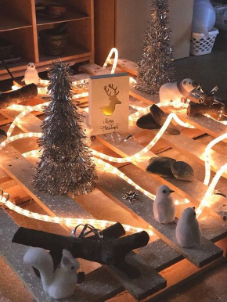
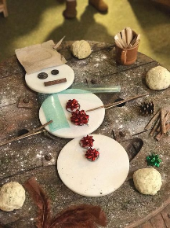
Examples of Learning – where are we now?
Resources: warming lights, snowy trees, loose parts (cogs, keys, wooden parts)
Which resources do students show an interest in? Do they respond to intensive interaction strategies? Are they curious about the different lighting from the activity? How do they choose to explore and is this new or typical for the student?
Resources: white cut outs for snowman body, loose parts (gift bows, string, ribbon, balls, buttons, cinnamon sticks etc.)
Do students look at the model from the adult and engage with what they have made? Are students able to think of their own ideas and select the resources that they want to use to create their snowman? How do they engage with the activity?

Slide 14
Impact
Practitioner passion – evident in staff voice: “The learning experiences and activities feel exciting, and I get to know the pupils more deeply.”
Sustained pupil progress
Pupils' engagement with learning
Higher wellbeing levels
Pupils are more regulated and have better focus for structured activities that take place in the classroom following Saplings sessions
Notes:
Practitioners at all levels bring their own ideas to the delivery of activities and follow the lead of the children. This leads to a higher investment in learning opportunities by both pupils and staff. Students are inquisitive learners and will explore the what if? of an activity.
Sustained pupil progress goes beyond what we offer in the Early Years as more of the school are recognizing the benefits of child-led learning and our Core Initiatives
Pupils demonstrate longer periods of engagement within activities. They are invested in their learning as the open ended nature of activities means that there is no ‘wrong’ to their play, allowing pupils to make progress within their EHCP goals.
Higher levels of wellbeing, engagement and deeper learning across a range of learners and need types

Slide 15
Obstacles & Learning points
Resourcing – this will not be an instant result. It takes time to look for objects that will ignite curiosity and excitement within your learners.
Staff investment – sometimes you need to show it for your staff team to understand the value of it. Why not try a staff meeting over a tea party? Or a hot chocolate around a campfire while you are planning your next steps?
'Enchanting Environments' or 'Enriching Environments'? It is not just about how the classroom looks. It can be tempting to get swept up in Instagram-perfect classrooms but ask yourself: What is the purpose of this? What benefit will it bring to my learners?

Slide 16
Key takeaways
Trust your children to guide their own learning!
Take risks and join them in their world
The Curiosity Approach have a great website to browse with blog posts to get you thinking
Books:
Hygge in the Early Years – Kimberley Smith
The A to Z of The Curiosity Approach

Slide 17
Questions

Slide 18
Thank you
Contact us to learn more
Email: admin@iqmaward.com
Phone: +44 287127 7857
www.iqmaward.com

