Slide 1
Inclusion Quality Mark
Wonderfully Wired!
South Green Junior School
Vicki Servantes – Assistant Headteacher/ SENDCo
Liz Benjeddi – Headteacher
admin@southgreen-jun.essex.sch.uk

Slide 2
School Context
We are a mainstream, two-form entry Junior School
240 pupils on roll
25% of our pupils have identified SEND
8% of pupils have an EHCP
22% of our pupils are in receipt of Pupil Premium top-up funding
88% of our pupils are White British
We have a high and growing number of pupils who have been diagnosed with Autism and/or ADHD

Slide 3
Rationale
Many of our neurodivergent pupils lack strategies to support their learning and emotional regulation.
They often have low self-esteem, as they do not yet recognise their unique talents and skills.
Many of the parents of neurodivergent pupils that staff speak to also face challenges, as they can struggle to help their child and would like support.

Slide 4
Intent
Increasing staff understanding of ADHD, so that they can effectively adapt their practice.
To ensure that the school environment is adapted to the learning of neurodiverse pupils.
Pupils learn and begin to use effective strategies to support their neurodiverse needs, to develop independence.
To increase parental understanding of neurodiversity so that they can support their child to complete tasks and projects more easily at home.

Slide 5
1) Actions - staff development
Educational Psychologist led ADHD training for teaching staff
ADHD Champion roles
ADHD training for LSAs
Behaviour scenarios used in staff meetings to support staff approaches to situations
Lesson observations for both teaching staff and LSAs to focus on staff practice for pupils with ADHD
LSA and teacher performance management reviews to have an ADHD focus

Slide 6
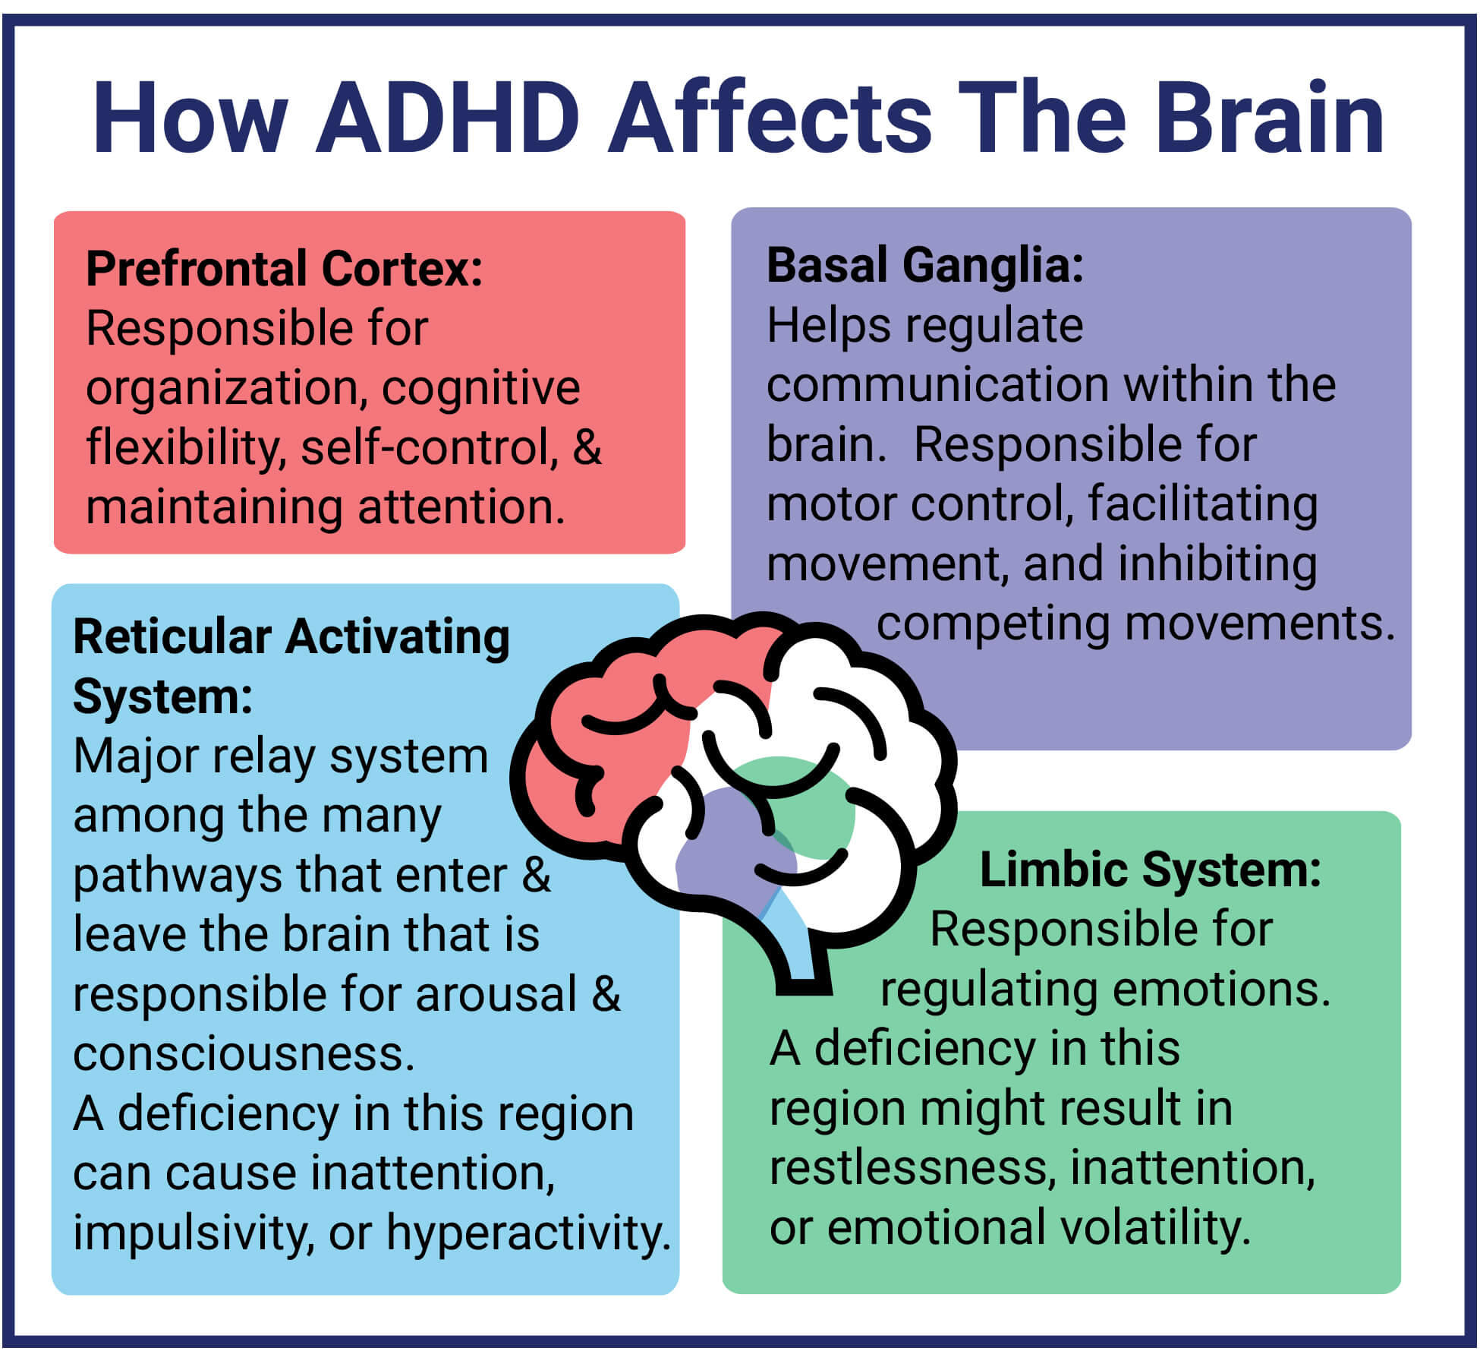
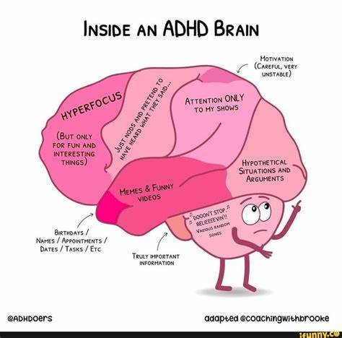
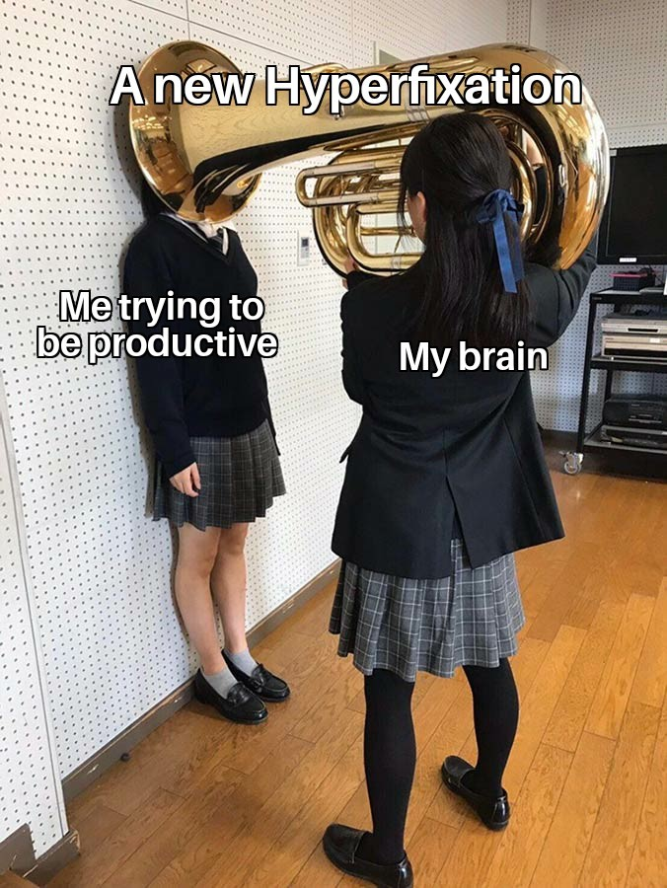
Staff development
Understanding ADHD
What is it?
How does it affect children?
What does this mean for my practice?
Diagram attributed to Verdugo Psychological Associates
Image attributed to ‘Researchild’ (Research Institute for Learning and Development)
Image attributed to adapted
@coaching with brooke
@ADHDoers

Slide 7
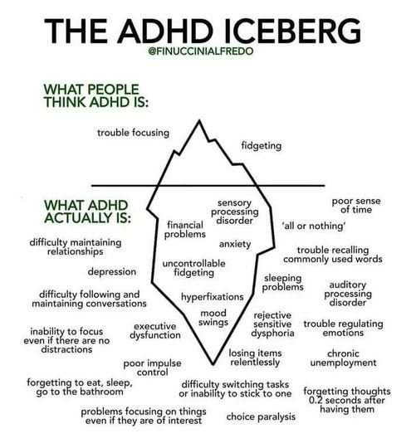
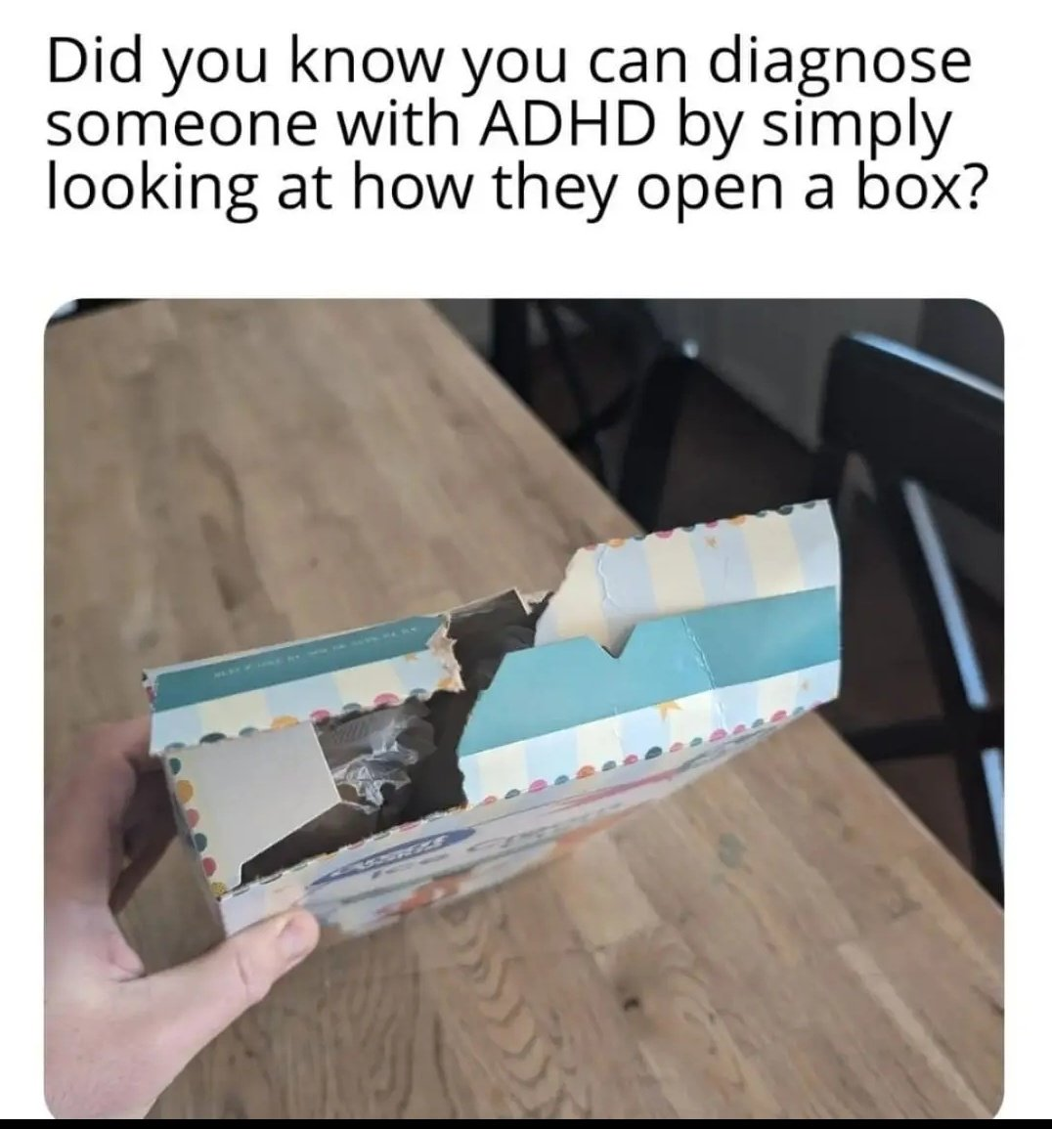
Staff development
Challenge stereotypes
Staff with lived experience
ADHD simulators - Youtube
Image attributed to ADHD Memes @ ADHD for Real

Slide 8
2) Actions - school environment
Review current classroom environments using knowledge gained from ADHD training
Consult pupils about classroom environment
Discuss changes to classroom environments in staff meeting and agree whole school changes
Adapt classroom environments from findings of pupil voice and staff voice
Review playground environment using knowledge gained from ADHD training and research

Slide 9
School environment
Every time my partner turns their page over, I can’t remember what I supposed to be doing…
If I can stand up in lessons, I can focus more on what the teacher is saying.
I don’t get in so much trouble if I can stand while I’m writing. I can move around instead of having to get out of my seat.
Pupil
voice

Slide 10
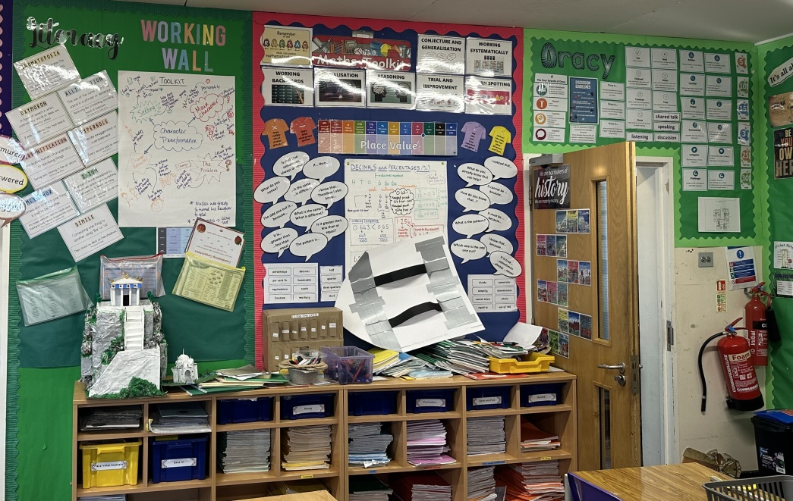
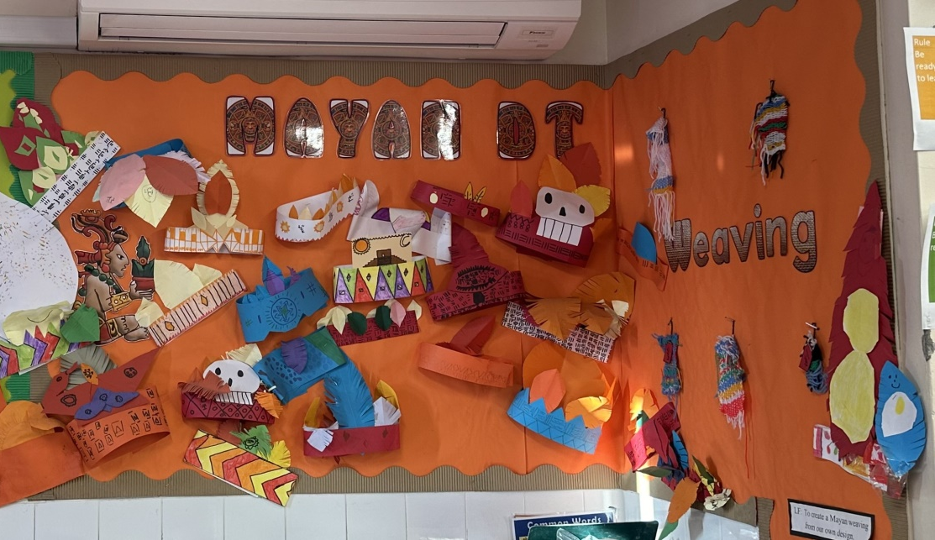
School environment
Before
After
Fewer distractions
‘Quieter’ visual environment
Easier to locate information

Slide 11
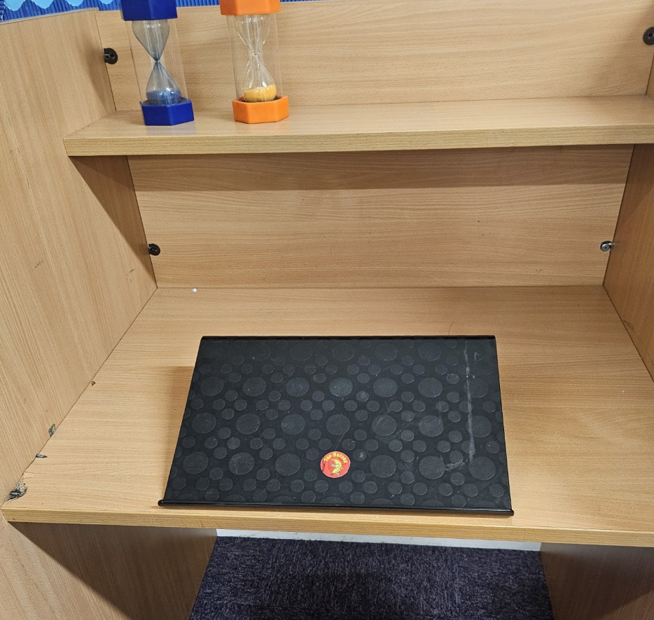
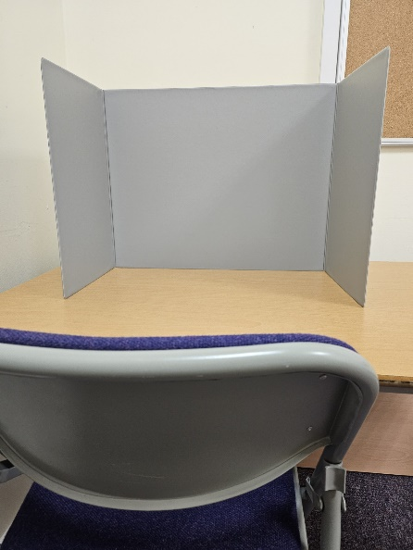
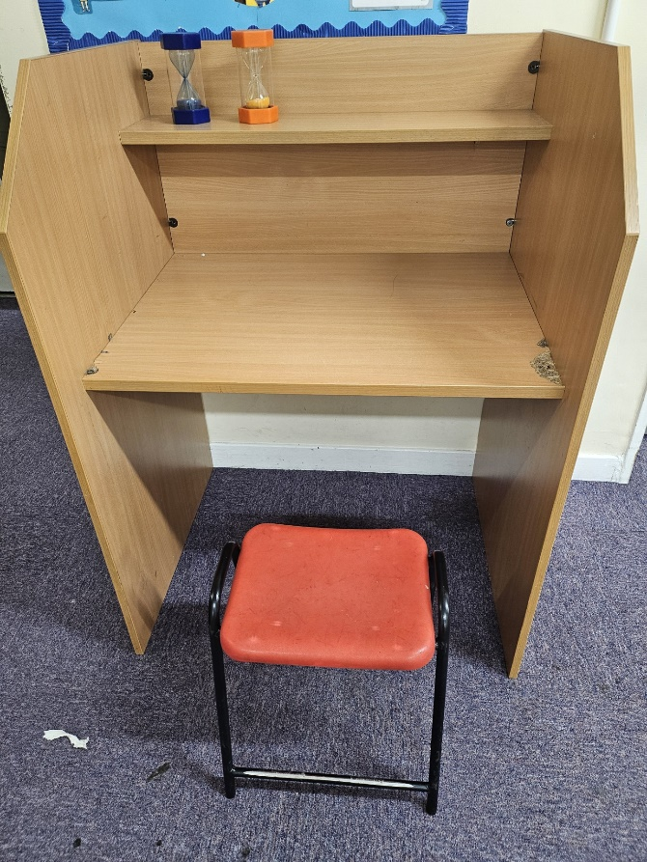
School environment
‘Sit stand’ desks
‘Concentration stations’
Portable or fixed. Mechanical versions more useful for primary classrooms.
Portable or fixed versions available
Wobble cushions.
Large or small, square or circular available.

Slide 12
3) Actions - pupil strategies
ADHD staff champion - emotional/regulation support
Pupil ADHD champions
ADHD support group
ADHD display
Interventions to teach strategies for learning and
emotional regulation
'Body doubling'

Slide 13
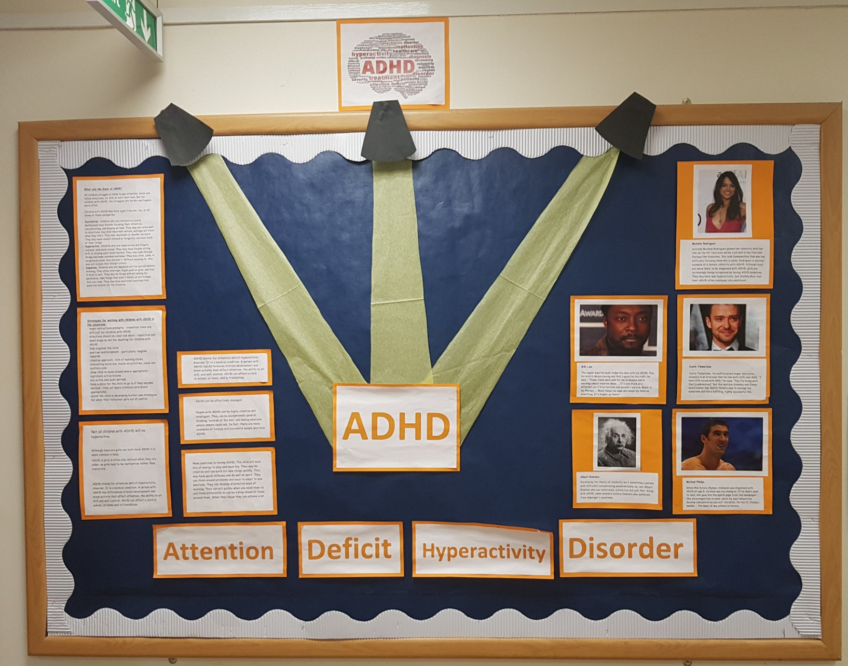
Pupil strategies
Intervention to support ADHD pupils with time management. E.g. starting a task, planning steps, positive self-talk & knowing how long a task will take.

Slide 14
Pupil strategies – case studies
My friends and my education are important to me. I am happiest and I feel good when I go to school, people say hello and I talk with my friends. When people annoy me sometimes this upsets me, but I've learnt that I can either walk away or tell my teacher. Pupil 1 Year 6
It is important to me that adults spot the signs when I'm upset and can support me. I know that adults in school understand, care and can support and reassure me.
Pupil 3 Year 5
In the past, I used to get upset and angry when teachers used to tell me ‘stuff’ and when they would tell me off, but I have now learnt to walk away or to speak to my class teacher about this. Pupil 2 Year 6

Slide 15
4) Actions - support for parents
Parent workshop with an ADHD focus
Parent workshop on emotional regulation
Support pages on the school website https://southgreenschool.org.uk/Our-School/Pupil-Premium/
Links for referrals and support groups on school website
https://southgreenschool.org.uk/SEND-parents-information/

Slide 16
Support for parents
Provided booklets and handouts at the session
Uploaded the presentation onto our school website
Uploaded booklets and handouts online
Links to helpful websites on school websites
Local signposting on school websites

Slide 17
Support for parents
https://www.ukadhd.com/
https://www.janssenwithme.co.uk/en-gb/living-with-adhd/home
https://www.adhdcare.co.uk/
http://addiss.co.uk/
https://www.nhs.uk/conditions/attention-deficit-hyperactivity-disorder-adhd/
https://www.minded.org.uk/
https://www.adhdfoundation.org.uk/
https://www.autismandadhd.org/

Slide 18
Impact
Understanding of staff has improved - more empathy & understanding of difficulties.
Increased positive talk - led to more acceptance/ tolerance.
Fewer incidents of heightened dysregulation (reduction in CPOMs/need for SLT support/verbal reports from staff) .
Increased independence - e.g. organisation, starting tasks.
Pupils have increased understanding of their unique neurodivergent profile.

Slide 19
Obstacles & Learning Points
Don’t assume all staff are ‘on board’ with the changes you want to make! Expect challenge.
Funding – especially for equipment & furniture.
Parent & pupil understanding.
Time!

Slide 20
Quick wins
Consider adapting classroom environments - e.g. neutral displays, decluttering.
Hold an ADHD assembly, put up an ADHD display.
If you have a training session for staff, you can adapt the same training for parents quite easily.
Use positive talk around ADHD.
Links for parents on your school website.

Slide 21
Quick wins
Famous people with ADHD:
Michael Phelps
Emma Watson
Will.i.am
Ant McPartlin (Ant & Dec)
Simone Biles
Lewis Hamilton
Sue Perkins
Richard Branson
Jessie J
Heston Blumenthal

Slide 22
Classroom toolkit
You will be sent a copy of our classroom toolkit to support pupils with ADHD in the classroom with our slides.

Slide 23
Questions

Slide 24
Thank you
Contact us to learn more
Email: admin@iqmaward.com
Phone: +44 287127 7857
www.iqmaward.com

