Slide 1
Inclusion Quality Mark
Parental Engagement- ‘Hard to Reach’ Parents
Camrose Primary School
Lara Wheeler – Deputy Headteacher
larawheeler@hotmail.co.uk

Slide 2
Aims and Intent
The focus of this workshop will be to explore different ways to engage parents and develop positive partnerships.
We will consider how to engage the 'hard to reach' parents.
Jigsaw Families.
Explore a variety of ways to develop early identification of SEND in the EYFS before they start school.
I will share successful initiatives we have used in school and the impact of these.
I will explain in detail our successful approaches such as our ‘Parents Educating Parents’ and our Ofsted approved EYFS initiatives.
There will be opportunities to share good practice.
What does hard to reach mean in your school?
‘Hard to Reach’, low engagement with school maybe
because of language barriers, previous negative
experiences with schools (their own school
experiences), parents/carers that do not attend
Parents evening/ meetings/ workshops, resist
efforts to interact with school, low self esteem.

Slide 3
The Importance of Good Parental Engagement
It is widely acknowledged that parents/carers are children’s first educators. Not only do parents/carers hold vital information about their child, but they also act as their advocate and a representative of their voice. Parents and carers become experts in interpreting and translating their child’s subtle body movements, facial expressions, and vocalisations to others. However, once a child enters an educational/care setting, this role and responsibility is shared with practitioners. It is essential to establish and maintain effective parentships with parents/carers to ensure the best possible outcomes for children.
send-network.co.uk
Parental engagement has a positive impact on average of 4 months’ additional progress. It is crucial to consider how to engage with all parents to avoid widening attainment gaps. EEF (2021)

Slide 4
Statutory Requirements
The importance of working in partnership with parents is reflected in the EYFS statutory framework.
‘The EYFS seeks to provide partnership working between practitioners and parents/ carers’
‘Keep parents/ carers up to date with child’s progress and development’.
The importance of developing Parent partnerships with parents and carers is also reiterated within the SEND Code of Practice (DfE and DoH 2015).
These documents outline the statutory requirements for working in partnership with parents and ,however, they only provide minimal guidance on how to translate this into practice.

Slide 5
Our school Context
2-form entry LA maintained Primary school in Northwest London
420 pupils on roll
19% Pupil Premium
45 pupils with SEND, 11 with EHCPs
87% EAL - mainly Romanian and Arabic
High mobility with many new starters & New to Country

Slide 6
SEND and the EYFS
Why was this a focus?
Pupils not attending 2- and 3-year development checks so SEND needs were not identified before starting nursery or school.
Pupils not attending nurseries, pre-schools and play groups.
Those that do, SEND are not always being identified.
Pupils starting school nursery and reception with increasing speech and language (S&L) development needs
Parents not knowing about support available through Children’s Centres and Early Help
Parents feeling isolated/ embarrassed
Parents have EAL barriers themselves
Traveller community – sometimes illiterate and unable to understand / fill in forms

Slide 7
How Have We Tackled This?
Liaised with local Children’s Centre to work collaboratively.
Our staff trained to carry out Development Checks with parents the term before pupils start school. (June)
Identifying SEND needs and referring to appropriate services (e.g. SALT referrals made, and process started before pupils start school in September).
Talk and Play (delivered by SLC practitioners).
Special Playtimes (delivered by SEND Champions) ASD/ SEND other can S&L.
Connecting parents to SEND services, applying for DLA/ blue badge etc.
Identifying parental workshop foci linked to areas of need i.e. toilet training, sleep training, healthy eating, oral hygiene, understanding challenging behaviour, regulating emotions, behaviour (ASD/ ADHD. SLC focus) food aversion (ASD).

Slide 8
How Have We Tackled This?
Home visits – talking about birth of child, family support and environment, concerns parents may have, immunisations, hearing/ eye tests. Seeing pupils in their home environment and how parents engage with their child.
School readiness workshops.
Visiting SEND pupils in their preschool settings to see them in an environment they are happy and secure in. Meeting with Key Workers.
SEND pupils 1:1 tour of classrooms/ meet with SENDCo.
Pupils coming off the SEND register by year one.
Staff ELKLAN trained.
Contact your Children’s Centres – they offer so much free support.

Slide 9
How to Engage the ‘Hard to Reach’ Parents
PEP Parents
‘Parents Educating Parents’ which has now been developed into ‘Parents Empowering Parents’.
Initially started off as Parent Ambassadors.
They meet weekly to discuss and plan workshops etc to meet the schools needs and/or to promote initiatives/agendas. They act as the voice of parents and carers and bring to our notice any parental concerns.

Slide 10
PEP - What do they do?
Gather parental voice / views
Forge a positive link between school and parents
Translate key documents, for example: enrolment forms translated into Romanian / Arabic, attendance notifications, Key policies and leaflets
Act as interpreters at meetings and parents' evenings
Support other parents in meetings with school staff (parents feel more confident approaching teachers with concerns when they have a PEP parent with them)
Support with home language assessments
Support with transition and induction of newly arrived children
Support pupils in class
Help them apply for school places/ fill in forms
SRE workshops
We no longer need to advertise to recruit new PEP parents, they come to us and ask to join the group!

Slide 11
Supporting New Parents Across the School
Welcome to Camrose (in 22 different languages) in school office Mantralingua.com
English for Speakers of Other languages (ESOL) run by local college.
Parenting Programme and Family Learning.
Parent Support Programme (mornings - 30 minutes) - time framed support for newly arrived families to show them how best to support their child at home with their learning with PEP parents.
Parent Induction Programme (morning - 30 minutes) - once a week -. All new families will be required to attend at least one session the week following their child's enrolment to share key procedures and expectations at Camrose.
Parent and child Google Classroom morning session for newly arrived families to ensure they gain the basic knowledge and 1-1 or small group support to access the online learning. Where possible home language support is provided.
Celebrate parent successes eg. PEP afternoon with the Head Teacher, ESOL/Community Village parents receive certificates (their children attend these too).
Parents going on to employment, giving references and seeking employment.

Slide 12
Parent voice
Questionnaires (translated in variety of languages)
PEP parents present on parents' evening
Workshop needs and wants informed by parents
Children Centre runs the workshops
SEND coffee mornings with SENDCo, SALT, SLT
Learning journey hour (EYFS)

Slide 13
Parent Comments
"I feel listened to and not judged"
"I have been supported with strategies to use with my ADHD child at home which has been a game changer"
"Never any judgement - just help"
"The workshops help me to support my child’s learning, and I know exactly what to do with them at home"
"The school has been my lifeline"
"Staff are always viable and approachable"
""Information shared is always personalised

Slide 14
Jigsaw Families
Jigsaw Families provides an informal, friendly and safe environment to explore the challenges of being a parent and offers strategies to help meet families' needs while building a richer engagement with the school or community.
We use Jigsaw – PSHE curriculum.
Supporting families to develop healthy, strong, loving relationships. Parents consider their attachment and parenting styles.
Weekly afternoon sessions for six weeks.
Explores parenting challenges as a group.
Each session focuses on a key theme such as communication, managing change, belonging, positive behaviour etc. The issues to be discussed are raised through original child-friendly stories and short video clips.
Jigsaw Families is inclusive, enabling all parents regardless of background to participate and fully benefit from the programme.

Slide 15
Jigsaw Families
Jigsaw Families provides an informal, friendly and safe environment to explore the challenges of being a parent and offers strategies to help meet families' needs while building a richer engagement with the school or community.
Parent/carer feedback
“I think the sessions were useful and it was nice to connect with other parents. It helped me understand that most families face the same struggles with parenting. My child enjoyed the weekly activities.” Year 1
“It was a great opportunity to share information and talk my heart out.” Year 1
“I really liked hearing the opinion of other parents. I will listen to my child more and let him express his opinion.” Year 3
“I think the sessions were beneficial and helped me understand my child and her thought process better. She spoke non-stop about the weekly crafting activities they have done with the other children”. Year 4
“It was a really good way of exchanging information about different things, parenting tips, techniques to help us, listening to other mums’ views.” Year 5
Families Programme - Jigsaw PSHE (jigsaweducationgroup.com)

Slide 16
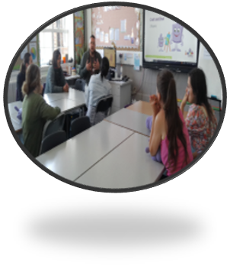
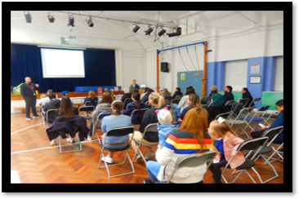
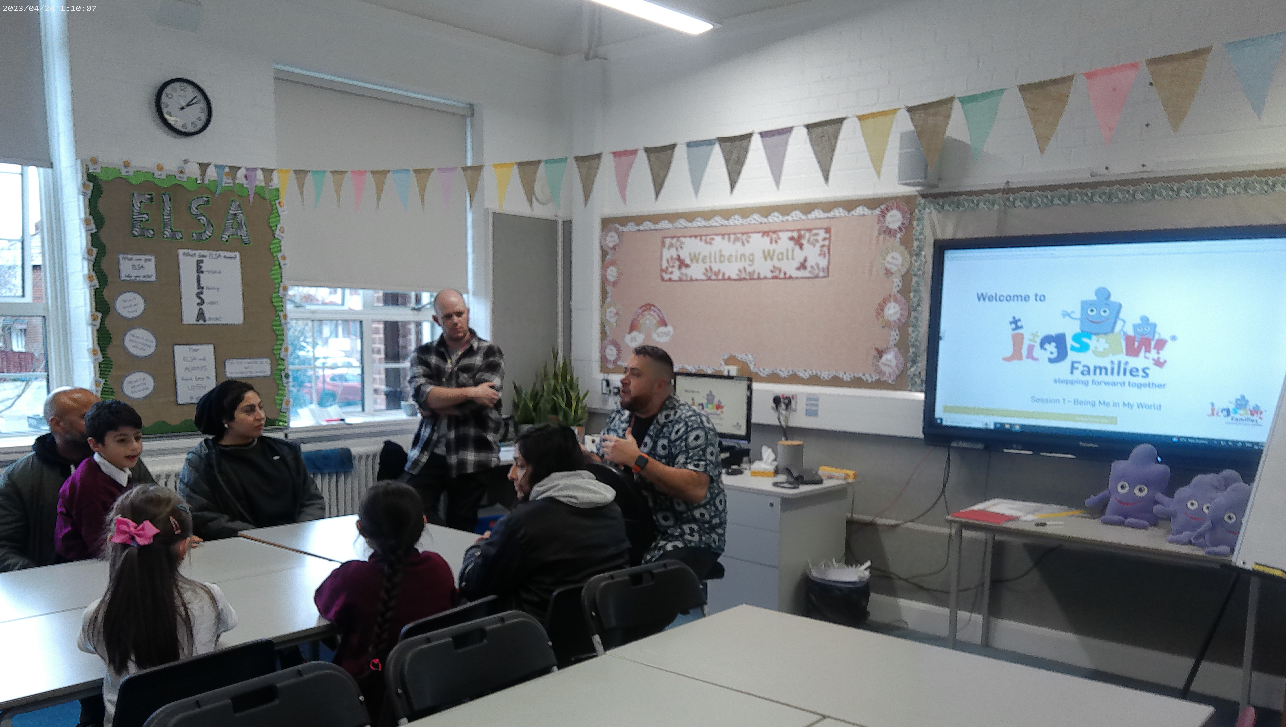
Jigsaw families and RSE workshops

Slide 17
Workshops
Observing phonics lessons – most parents were not taught phonics. Share strategies used in school. Encourage parents to share what works at home.
SEND coffee mornings for parents to network with other parents..
Parent and child Google Classroom after school club for targeted children ie, those not completing their homework regularly. They attend with their parent and are supported in home language by PEP
Parent noticeboard – PEP responsibility.
Jigsaw Families.
Children’s Centre workshops such as understanding challenging behaviour, regulating emotions, developing independence.
Tooth brushing support.
Reading initiatives.
Mother’s and Father’s day workshops – high attendance workshops. Parents love to do things with their children.
Christmas Crafts.

Slide 18
Workshops
Consider what support you can give to parents to ensure home learning is of high quality. For example, providing practical strategies with tips, support, and resources to assist learning at home may be more beneficial to pupil outcomes than simply gifting a book to pupils or asking parents to provide generic help to their children.
Consider what support you can give to parents to ensure home learning is of high quality. For example, providing practical strategies with tips, support, and resources to assist learning at home may be more beneficial to pupil outcomes than simply gifting a book to pupils or asking parents to provide generic help to their children.
EEF 2021

Slide 19
Questions?
Time to reflect… How can you implement ideas into your school?

Slide 20
Thank You
Contact us to learn more
Email: admin@iqmaward.com
Phone: +44 287127 7857
www.iqmaward.com

