Slide 1
Inclusion Quality Mark
From inclusion to equity:
using Universal Design for Learning (UDL) in work with Dual and Multiple Exceptional learners
Nisai Education Trust
Paul Keenleyside -
paul.keenleyside@nisai.com

Slide 2
Notes:
Working with DME

Slide 3
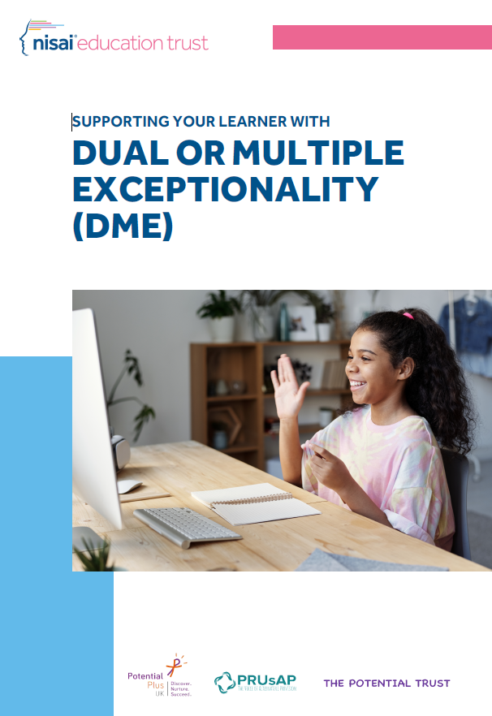
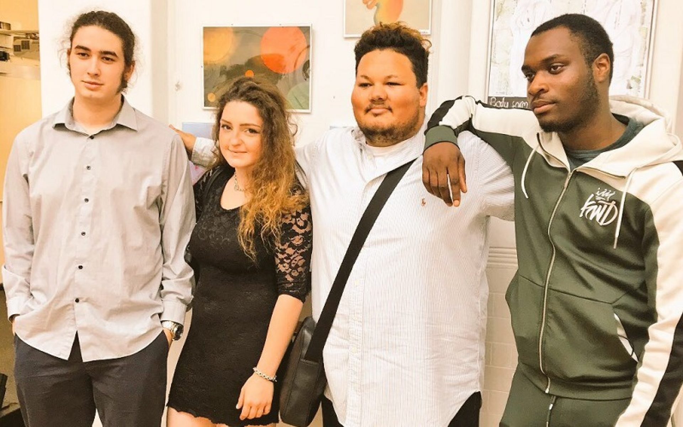
Notes:
Working with DME

Slide 4
Definition of DME
“double or dual and multiple exceptionality (2E and DME) are terms used to describe those who are intellectually very able (gifted) or who have a talent (a special gift in a performance or skill area) and in addition to this, have a special educational need (SEN).” (Montgomery, 2015).
It is estimated that 5-10% of children with high learning potential also have a special educational need.
It is estimated that 2-5% of children with an identified special educational need also have high learning potential.
The term dual or multiple exceptionality is used to cover high learning potential alongside:
Neurological disabilities, such as autism spectrum disorders, attention deficit disorders sensory processing disorder and dyspraxia
Learning difficulties such as dyslexia, dysgraphia and dyscalculia
Sensory and speech impairments
Our work with young people attending the Nisai Virtual Academy (NVA), those in Alternative Provision and those who are home educated due to anxiety and emotional issues, as well engagement with practitioners, led us to undertake action research with Potential Plus – developing guidelines for working with DME young people
Notes:
Working with DME

Slide 5
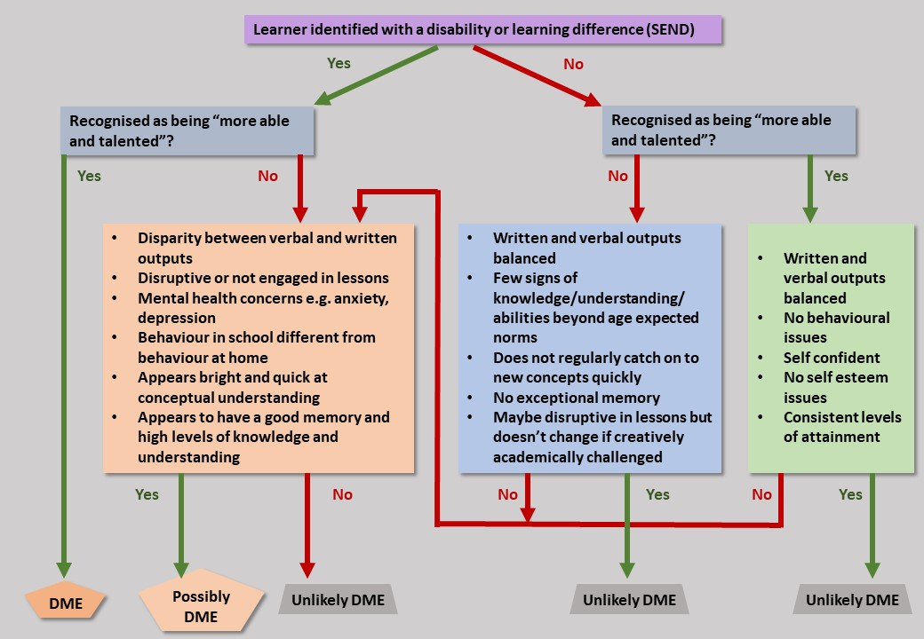
Notes:
Identification - The term dual or multiple exceptionality is used to cover high learning potential alongside:
Neurological disabilities, such as autism spectrum disorders, attention deficit disorders sensory processing disorder and dyspraxia
Learning difficulties such as dyslexia, dysgraphia and dyscalculia
Sensory and speech impairments

Slide 6
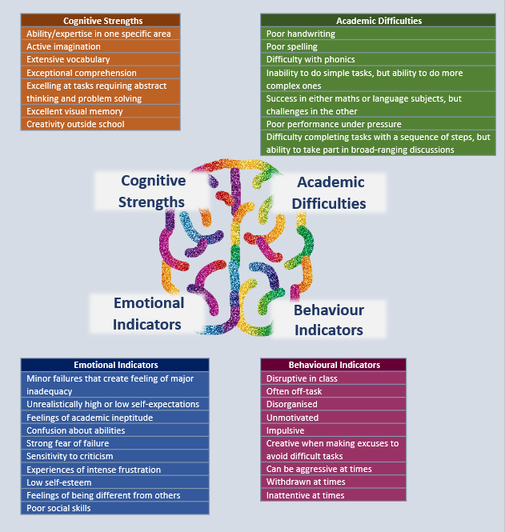
Identification of Learners with DME
What am I noticing about my learner?
Use this as a checklist to reflect on your learner’s characteristics and the intersectionality they experience
Why is my learner behaving like this? What else might be going on for them?
Notes:
Identification

Slide 7
Nurture relationships building trust
Provide challenge consummate with abilities
Embrace cognitive style
Balancing these three while supporting specific needs and difficulties will provide a foundation which can adapted as the learner develops and matures
Notes:
Working with DME

Slide 8
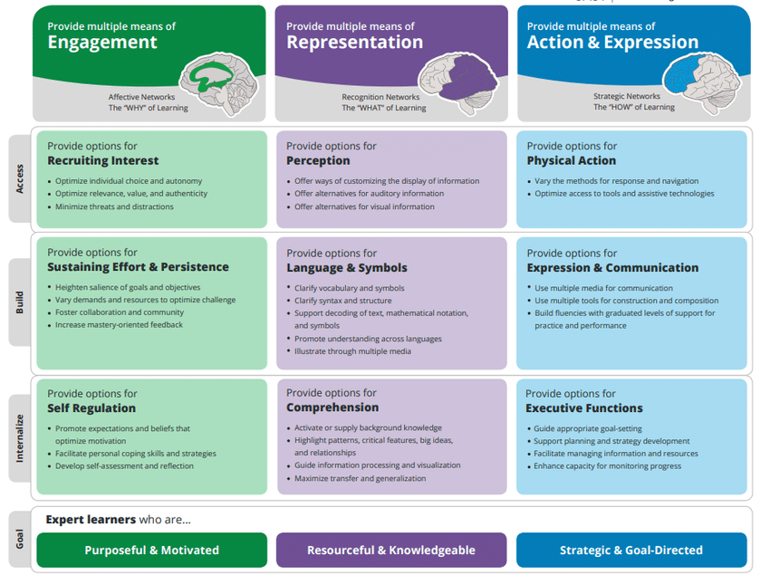
Notes:
Working with DME

Slide 11
UDL Guidelines v3.0 – September 2024
Emphasizes identity as part of variability, including the “who” along with the “why” (Multiple Means of Engagement), the “what” (Multiple Means of Representation), and the “how” (Multiple Means of Action and Expression)
Acknowledges individual, institutional, and systemic biases as barriers to learning without limits
Emphasizes the value of interdependence and collective learning
A shift from teacher-centered to learner-centered language

Slide 12
Notes:
Working with DME

Slide 13
Thank you
Contact us to learn more
Email: paul.keenleyside@nisai.com
Phone: +44 20 84248475
www.nisai.com/nisai-education-trust/

