Slide 1
Inclusion Quality Mark
Diversity is a Fact; Inclusion is a choice!
Chickenshed Theatre Company
JoJo Morrall, Head of Education Programmes and Projects
jojom@chickenshed.org.uk

Slide 2
Chickenshead Context
A Theatre company for absolutely everyone.
What we do: Performance, Education, Participation, Outreach, Youth Mentoring
750 Young Company Members
75 students enrolled on our FE Btec National in Performance Practice
90 students enrolled on our Degree
courses in Inclusive Performance
60-70% of our students have EHCPs
95% of our FE students progress to
our HE courses

Slide 3
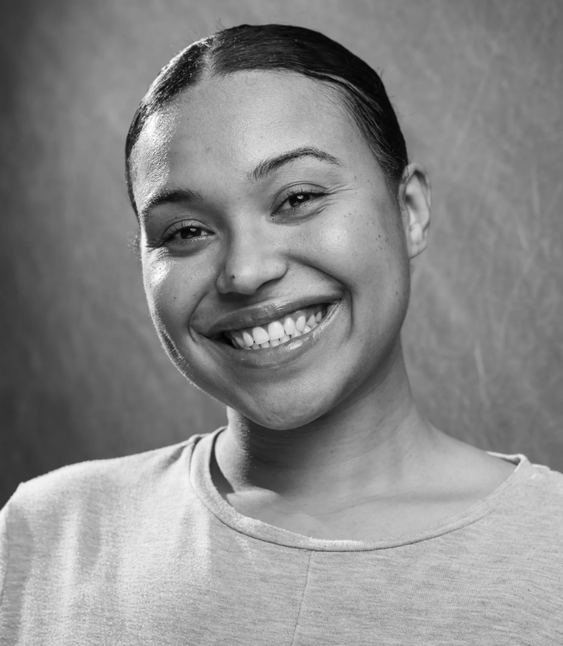
About Me
I have been a part of Chickenshed since I was 3
I have a PG (Cert) Higher Education Teaching and Learning
Currently Head of Education at Chickenshed Theatre Company

Slide 4
What is Inclusion?

Slide 5
What is Education?

Slide 6
Discussion
So, what is inclusive education?

Slide 7
Short Video

Slide 8
What are the barriers to Inclusive Education?
Pressures of legislation. Students are forced to fit into what legislation has identified as “intelligence”- instead of the sector moulding to fit the individual.
Too narrow a concept of Intelligence and Learning. Howard Gardener identified 7 (2 in discussion) types of intelligences ranging from Bodily-kinaesthetic to verbal-linguistic. Surely as society changes - more intelligences need to emerge? What is your intelligence? activity
Behaviours labelled as “bad behaviour” as opposed to being identified as an indication of trauma, a “cry for help” or a clash in cultural norms and/or values.
Singular teaching structures- whereby teachers are approximately 21:1+ in most educational settings.

Slide 9
Inclusive additions used at Chickenshed
Team Teaching
Cascade teacher training (both ways)
Mentors
Cascade mentor training (both ways)
“Trauma-informed place of education”- understanding and seeking explanations for difficult behaviours as opposed to overly sanctioning them. Creating an Inclusive safe environment to learn.
Students lead learning for themselves and their peers
Practical experiences - Practice as Research, Practical IS Academic

Slide 10
What can we do now to increase inclusion in our spaces?
Peer mentoring- Link older year groups with younger year groups for more than just reading. Allow mentoring for social, emotional and academic needs (always referring to a teacher).
Reach out to Universities and Colleges to widen your teaching support pool.
Connect with teachers of a different subject to share techniques (can Performing Arts and Maths/science have a joint session? Why not?!).
Can we allow inclusive additions (reasonable adjustments) for all? Can everyone access a fidget? Can students walk around the classroom if they can take responsibility to sit back down?
PARTNERSHIP, PARTNERSHIP, PARTNERSHIP!

Slide 11
Case Study

Slide 12
Key Takeaways
If you are striving for inclusion - you are an Inclusive Practitioner.
The smallest adjustments/moments could be everything to the individual.
Linking up as inclusive practitioner/educator will eventually force the system to change.

Slide 13
Inclusion is a
never-ending continuum
so…
small steps can make big differences!

Slide 14
Questions

Slide 15
Thank You
Contact us to learn more
Email: admin@iqmaward.com
Phone: +44 287127 7857
www.iqmaward.com

