Slide 1
Inclusion Quality Mark
Preventing Exclusion: Delivering High Impact School-Based Multi-Agency Early Intervention
St Wilfrid’s Academy
Dirk Pittard – Principal
dirk@iqmaward.com

Slide 2
Rationale
The acute needs and poor outcomes of children in Alternative Provision (AP) and with special educational needs and disabilities (SEND), means the appropriate, targeted support is essential. The complex underlying needs of the SEND and AP cohorts mean that they can be some of the most disengaged children and young people in the education system. These needs often manifest as challenging or disruptive behaviour, which can have a severe impact on their education and that of other pupils. The aim of the multi-agency approach is that with intervention, these needs and risks are reduced.

Slide 3
Target Outcomes of the Model
• Improved school attendance
• Reintegration into mainstream education
• Reduced NEET
• Improved social, emotional and mental health (SEMH) wellbeing
• Higher Academic Attainment
There is currently an independent evaluation funded by the Youth Endowment Fund that is assessing the impact of the model on these outcomes through the DfE APST Pilot programme.

Slide 4
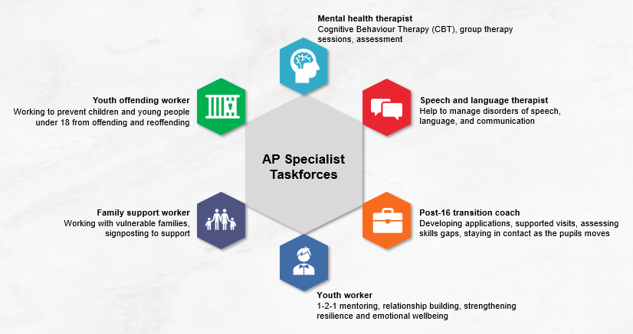
What could this look like?

Slide 5
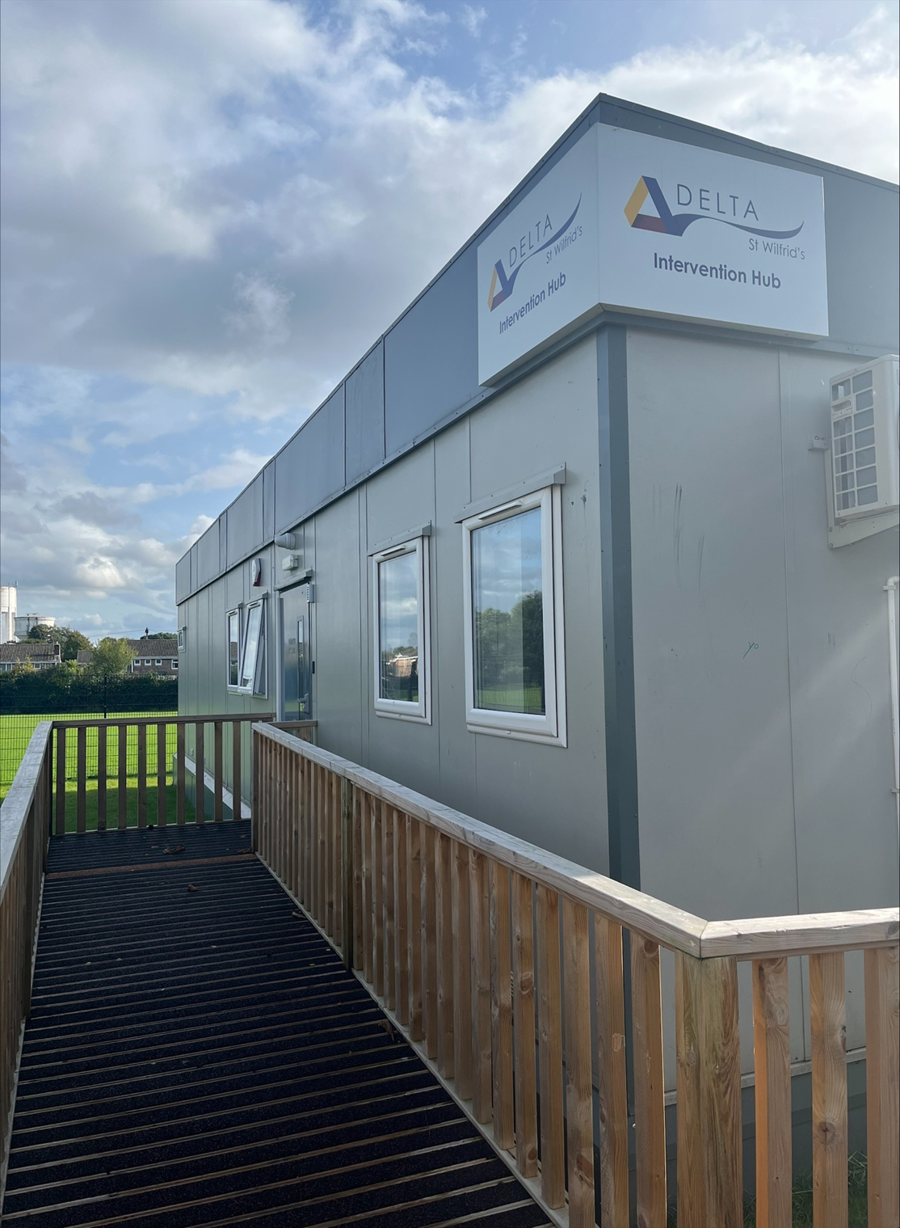
Let's hear from Danny and Liza
Mental Health Therapist
Post-16 Transition Careers Specialist
Family Support Worker
Early Help Co-Ordinator
Youth Justice Officer
Speech and Language Therapists
SENCO/Intervention Lead
Leadership Oversight

Slide 6
Impact
Multi–Agency Approach, based on school site but operating from a separate building sharing the car park. Hours of operation extended beyond the school day and allowing for evening interventions.
The APST are regularly in the building, supporting learners and building relationships. This has made it easier to engage with parents and carers in the home.
Early Help ‘RAG'-rate every student and can expedite referrals through the system, cutting down on red tape. Average time from referral to work starting is now 2 days (if not hours), down from 6 weeks plus!
Youth Justice Work has seen earlier intervention have a greater effect. The YJW has seen his caseload double, however most interventions are now pre-court rather than post-court.
Trauma-informed interventions start with the Counsellor / Mental Health Worker in our ‘Wellbeing Suite’ and are interwoven throughout the school meaning more time is spent getting to the root cause of negative behaviours.

Slide 7
Impact & Evidence
In November, the Youth Endowment Fund as part of their evidence in practice series, ran a session which focussed on the work and learning from the Department of Education’s Alternative Provision Specialist Taskforces (APSTs). This 2-year programme aims to keep pupils that are in alternative provision – including those who have been excluded from school – engaged in education, getting them back on track with their studies and preventing them from being criminally exploited.
The Youth Endowment “Virtual Learning Café Event: Alternative Provision: Keeping Children in Education & Safe from Violence”
https://youthendowmentfund.org.uk/events/alternative-provision-keeping-children-in-education-safe-from-violence/

Slide 8
Impact & Evidence
The St. Wilfrid’s APST has supported over 400 students from 41 different schools since November 2021.

Slide 9
Learning points
Don’t get hung up with the potential financial cost of a multi-agency approach. All of these professionals already exist within your Local Authority.
The question needs to be HOW or WHO needs to convince them to change their working practice.
Build on existing relationships:
SENCO Network
NHS School Nursing
CAMHS
Educational Psychologists
Look at local professional sports clubs for mentor programmes.

Slide 10
Key takeaways
If there is one in your area, consider approaching the existing APST Pilot School for support. There may be the possibility to refer students into the AP for Multi-Agency support only. The student stays dual registered.
The SEND and AP Improvement plan (March 2023) has raised the profile of Multi-Agency Support, and the work piloted by the APST has been evaluated and shown to have proven impact. With many Local Authorities now aware and open to building on the pilot, it may be the perfect time to approach local Early Help, Youth Justice and the NHS directly and offer to ‘host’ a hub in your school.

Slide 11
Questions

Slide 12
Thank You
Contact us to learn more
Email: admin@iqmaward.com
Phone: +44 287127 7857
www.iqmaward.com

