Slide 1
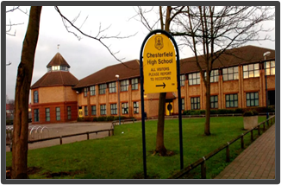
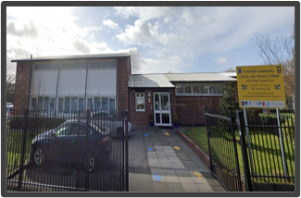
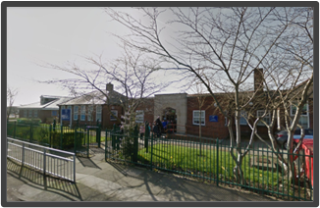
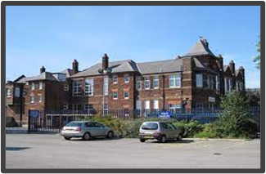
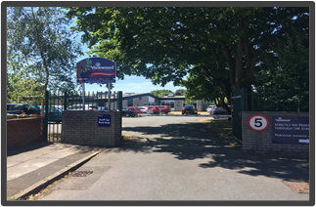
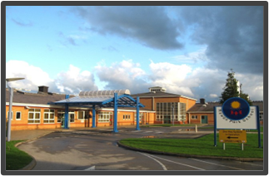
Inclusion Quality Mark
Inclusive Leadership
​
Mersey View Learning Trust
​
Kevin Sexton –
kevin.sexton@merseyview.com
Chesterfield High
Forefield Infants
Forefield Juniors
Waterloo Primary
Valewood Primary
Rowan Park

Slide 2
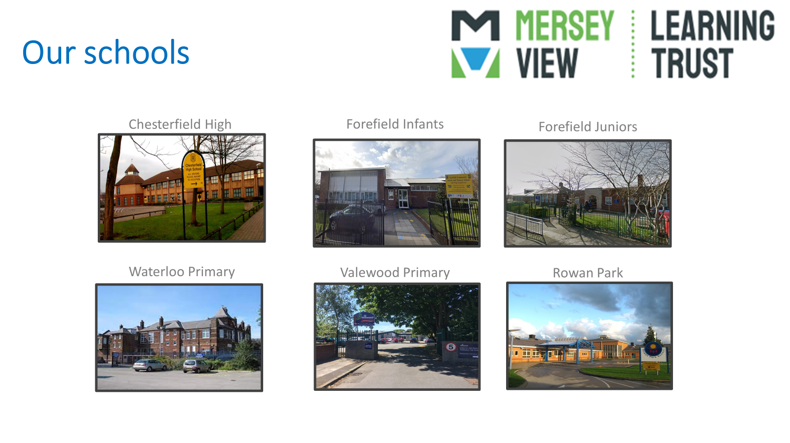
Our Schools

Slide 3
Our journey so far ...

Slide 4
School Improvement

Slide 5
How to Build a More Inclusive School Culture
Learn to speak inclusively
Focus on everyday micro-experiences
Teach leaders how to model inclusion
Build a culture of inclusion through recognition
Create feelings of belonging so employees want to stay

Slide 6
Self-Reflection
Visible Commitment
Humility
Awareness of Bias
Curiosity about others
Cultural Intelligence
Effective Collaboration
Create an Inclusive School Culture
Unify teams towards a common goal
Track company progress.
Values should be all-encompassing
To ensure company values are as inspiring as they are instructional,
School-wide culture
Building an Inclusive Team Culture
Team input diverse
Team culture
Inclusive hiring practices.
External specialist to both assess and build
Gather and review anonymous feedback
Work with HR staff and appropriate

Slide 7
Staff Charter

Slide 8
Staff Wellbeing
Using the IQM framework to support staff development and wellbeing.
1.12 Support for staff and pupil well-being are an integral part of the school ethos.
1.4 Staff are effective role models, understanding and fully engaging with Inclusion agenda promoting high standards. They take professional responsibility for individual needs of learners within their class.
1.5 Collegiate approaches to planning and review demonstrate value and respect for colleagues.
2.3 Staff well-being is addressed effectively.
2.6 Leaders ensure staff engage fully in focused professional development so that subject knowledge consistently improves over time.
2.7 There is effective induction for all new staff, including middle and senior management and staff are effectively deployed.

Slide 9
Pitfalls/obstacles/learning points
Governance – getting the right people
Dealing with LA SEND Departments
Skillset of Leaders - knowing SEND & Inclusion
State of buildings
Getting the right organisational structure
The MAT Brand vs Local school identity

Slide 10
Key takeaways or quick wins for colleagues
DON’T FORGET WHY YOU DID IT….
PUPILS
PARENTS
TEACHERS
ALL STAFF
COMMUNITY
Do not rush
Meet with potential partners – do you align?
Speak early and often to your Regional Office
Growth Plans
Create Trustees that will challenge
Learn about being a business

Slide 11
Questions

Slide 12
Thank You
Contact us to learn more
Email: admin@iqmaward.com
Phone: +44 287127 7857
www.iqmaward.com

