Slide 1
Inclusion Quality Mark
Reinventing Reading: KS3 and Beyond
​
Lord Derby Academy ​
​
Elizabeth Pope – Assistant Headteacher, KS4 Pastoral/Whole School Attendance Lead
elizabethpope@lordderbyacademy.co.uk
Claire Sergison – Assistant Headteacher, Professional Development / Designated Safeguarding Lead
clairesergison@lordderbyacademy.co.uk

Slide 2
Lord Derby Academy
Context
1100 on roll (18% on SEN register)
46 pupils with an EHCP (4%)
Primary need typically: ASD/SEMH/SLC
56% pupils in receipt of PP
97% White British

Slide 3
Work Experience
Learning
Pupil Wellbeing Group
Personalised Learning Environment
Literacy Support Programme
PLE
Inclusion Groups
Alternative
Provision
SEND Base
Re-Engage Attendance
Provision
Pupil Counsellors
Re-Engage Behaviour Mentoring
Online
Tutoring

Slide 4
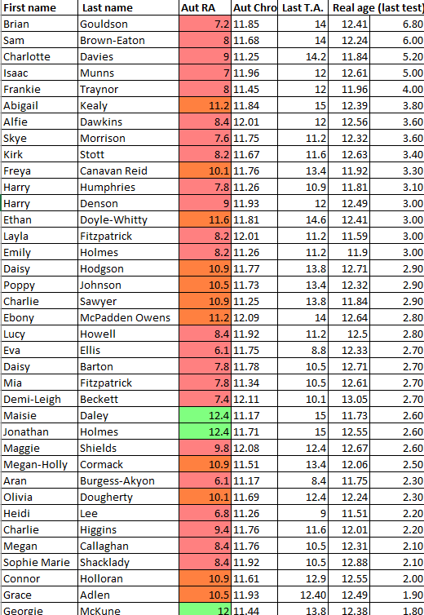
Starting point
January 2022
Notes:
New LM area. Return from COVID. Many questions asked of post-holder. Data didn’t tell us anything. Literacy coord – diff job now. Brave decisions. Experts at the helm

Slide 5
Leadership
Headteacher & Governor Support
Whole-school Culture
Credible Leaders
Notes:
HT: Reading must be prioritised. Financial. Curriculum time. CPD time.
Leaders: knowledgeable, informed credible

Slide 6
Intent … or so we thought
Priorities
To reduce the gap between chronological and reading age across Key Stage 3.
To make reading, oracy and vocabulary instruction an integral part of every lesson across the curriculum.
To support departments in developing disciplinary reading, writing and oracy.
Notes:
Ambitious from the start. Reality check. Huge amount of work to do if we were to affect real change. Timescales would have to change. Implementing new strategies etc.

Slide 7
Intent … the evolved version
Whole-School Strategy
Reciprocal reading
Direct vocabulary instruction
Curriculum development
Disciplinary reading
Intervention
Establishing an expert reading team
Effective screening & diagnostic tools
Bespoke, multi-tiered intervention
Reading for Pleasure
Form-time reading
Reading for pleasure & progress at subject level
Personal Development texts
Notes:
Writing and oracy shelved. Disciplinary literacy came later. Focus mainly on whole-school strategy – touch on intervention. Available to discuss reading for pleasure.

Slide 8
Implementation: training
Notes:
Whole school CPD – took over for much of the first year. Changes to CPD – big launch events must be followed up. Showcase events, QA, sharing good practice

Slide 9
Implementation: training
'Protect the vulnerable': Marcus Rashford's emotional letter to MPs
I encourage you to hear the childrens’ pleas and find your humanity. Please reconsider your decision to cancel the food voucher scheme over the summer holidays.
To all MPs in parliament,
On a week that would have opened Euro 2020, I wanted to reflect back to 27 May 2016, when I stood in the middle of the Stadium of Light in Sunderland having just broken the record for the youngest player to score in his first senior international match. I watched the crowds waving their flags and fist-pumping the Three Lions on their shirts and I was overwhelmed with pride not only for myself but for all of those who had helped me reach this moment and achieve my dream of playing for the England national team.
Understand: without the kindness and generosity of the community I had around me, there wouldn’t be the Marcus Rashford you see today: a 22-year old black man lucky enough to make a career playing a game I love.
My story to get here is all-too-familiar for families in England: my mum worked full-time, earning minimum wage to make sure we always had a good evening meal on the table. But it was not enough. The system was not built for families like mine to succeed, regardless of how hard my mum worked.
Notes:
Part of the first training session delivered by new literacy lead. Discussion task: identify barriers to comprehension

Slide 10
Implementation: training
Vocabulary Knowledge
Background Knowledge
Language Structures
Literacy Knowledge
Verbal Reasoning
Breadth, precision, links
Facts, concepts
Syntax, semantics
Print concepts, genres
Inference, metaphor
Notes:
Whole-school strategy

Slide 11
Implementation: training
Vocabulary Knowledge
Background Knowledge
Language Structures
Literacy Knowledge
Verbal Reasoning
Breadth, precision, links
Facts, concepts
Syntax, semantics
Print concepts, genres
Inference, metaphor
Notes:
In view of that. Have another look at the article with a particular focus on knowledge. FEEDBACK

Slide 12
Implementation: training
'Protect the vulnerable': Marcus Rashford's emotional letter to MPs
I encourage you to hear the childrens’ pleas and find your humanity. Please reconsider your decision to cancel the food voucher scheme over the summer holidays.
To all MPs in parliament,
On a week that would have opened Euro 2020, I wanted to reflect back to 27 May 2016, when I stood in the middle of the Stadium of Light in Sunderland having just broken the record for the youngest player to score in his first senior international match. I watched the crowds waving their flags and fist-pumping the Three Lions on their shirts and I was overwhelmed with pride not only for myself but for all of those who had helped me reach this moment and achieve my dream of playing for the England national team.
Understand: without the kindness and generosity of the community I had around me, there wouldn’t be the Marcus Rashford you see today: a 22-year-old black man lucky enough to make a career playing a game I love.
My story to get here is all-too-familiar for families in England: my mum worked full-time, earning minimum wage to make sure we always had a good evening meal on the table. But it was not enough. The system was not built for families like mine to succeed, regardless of how hard my mum worked.
Vocabulary Knowledge
Background Knowledge
Language Structures
Literacy Knowledge
Verbal Reasoning
Notes:
Discussion task: identify barriers to comprehension. Lots of overlap. Staff aware of the many barriers that might exist. Needed a strategy to support.

Slide 13
Implementation
Notes:
Simple takeaway from each new area of focus

Slide 14
Implementation
Supporting Comprehension in the Classroom
Direct Vocabulary Instruction
Curriculum Development
Reading Fluency
Supporting Reading at KS4
Disciplinary Literacy
Adaptive Teaching
Form-Time Reading
Whole School Phonics
Supporting Struggling Readers (TA Training)
Notes:
High quality, credible training from experts.
Circular training – showcase events / sharing good practice
Leaders’ investment

Slide 15
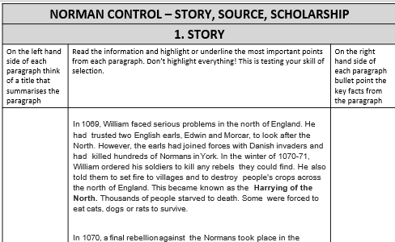
Impact
‘The Key Stage 3 Lead in Science has embraced the reading across the curriculum initiative, bringing reading to the forefront of the science curriculum. Reading ability is currently a barrier for some students in accessing the curriculum in science. There has been a cultural shift in science; staff never make assumptions about what language the students know. Whereas previously the learners had become accustomed to accepting there are words they do not know, they now ask for the meaning due to the safe. language-rich culture which has been created. Staff have enjoyed delivering the reading lessons and the impact to date is very positive. The Key Stage 3 Lead has shared the good practice in science at a whole staff briefing, widening the impact.’ IQM report (2024)
Notes:
Any questions so far?

Slide 16
Implementation
Whole-School Strategy
Reciprocal reading
Direct vocabulary instruction
Curriculum development
Disciplinary reading
Intervention
Establishing an expert reading team
Effective screening & diagnostic tools
Bespoke, multi-tiered intervention
Reading for Pleasure
Form-time reading
Reading for pleasure & progress at subject level
Personal Development texts

Slide 17
Screening & Diagnostic
Diagnostic assessment to ensure accurate understanding of precise barriers
Individual evaluation
Entry level phonics screening
WRAT testing
Rasinski’s Fluency Rubric
Multiple tools to identify struggling readers
Screening programme (reading age / standard score / CATS)
Key Stage 2 data (SATS, teacher assessments & feedback)
‘Leaders have strengthened their processes for identifying pupils who struggle with their reading knowledge.’ Ofsted report (2023)
Notes:
Diagnostic assessment tools – research / quantitative and empirical data. Right for your setting. Our journey has evolved. Pitfalls with Lexplore. Satisfied with Lexonick (come back to that)

Slide 18
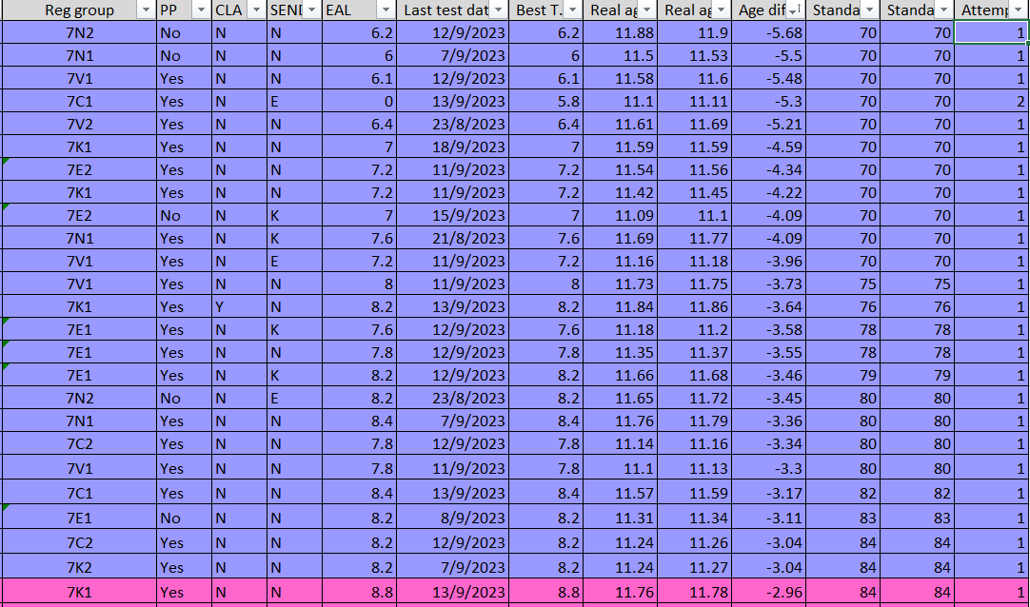
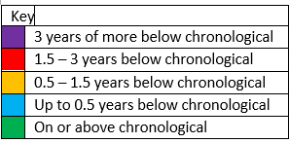
Identifying priority cohort
Intervention
Establishing an expert reading team
Effective screening & diagnostic tools
Bespoke, multi-tiered intervention
Notes:
Identifying priority cohort. School priorities etc. Moral imperative

Slide 19
Identifying a product
Suitable for older readers
Research led, fully resourced programme
High-quality training and quality assurance
Multi-tiered and flexible
Targeted
Notes:
Choose your programme wisely! Products aimed at older readers.

Slide 20
Implementation
Delivered by reading experts
SLT support
Highly organised and well-communicated
Delivered with fidelity
Ongoing evaluation
Notes:
Choose your programme wisely! Products aimed at older readers!

Slide 21
Impact: evaluating success
Last year, the average gains for those pupils based on their exit tests suggested they had made 51 months progress in terms of reading age and 15 points progress on standard score.
Whilst this data reveals rapid success in a short period of time, this data should be treated with some caution. The WRAT exit test does not assess unfamiliar vocabulary or comprehension in the same way reading age screening does and these two scores did not always correlate .
The data did prove that the intervention was delivered with fidelity and the decoding gaps had been filled, however this did not appear to immediately support pupils in their comprehension.
The team decided that an additional layer of intervention was required that incorporated the application of reading skills at whole text level and increasing exposure to a variety of texts.
Notes:
Don’t be afraid to make changes

Slide 22
Impact: evaluating success
Average gains of 2 years in 10 weeks suggest that the whole text reading and fluency practice following a phonics programme is effective in improving reading.

Slide 23
Impact: evaluating success
September 2023 to July 2024
 | -7%
 | -2.2%
 | -2.2%
 | +1.2%
 | +11.6%

Slide 24
Key takeaway
Headteacher & Governor Support
Whole-school Culture
Credible Leaders
Notes:
You cannot do it on your own.

Slide 25
Questions
Notes:
You cannot do it on your own.

Slide 26
Thank you
Contact us to learn more
Email: admin@iqmaward.com
Phone: +44 287127 7857
www.iqmaward.com

