Slide 1
Inclusion Quality Mark
Worthwhile Wellbeing
Emily Carr – IQM Executive Lead for School Improvement
Emily@iqmaward.com
@MrsEmilyCarr
Emily Carr

Slide 2
Welcome!
Mother
Primary teacher
Senior leader in PRUs
Governor
Consultant
IQM
Headteacher of a Pupil Referral Unit (PRU):
IQM Flagship School
SMSC gold standard school
Gold standard Mental health
Notes:
Explain who I am and my experience
Refer to Bishopton and how some of what I share today will be about the strategies I had in place for staff

Slide 3
Aims
To understand the rationale behind improving staff wellbeing and mental health support in schools;
To have a culture of wellbeing support for staff, and know what good support looks like.
So that…
you can identify what staff wellbeing support can look like and successfully apply supportive strategies across your setting.
Notes:
This workshop is about supporting you to truly reflect on your current wellbeing offer for staff in the current climate. I will encourage you to look at how you can create, and embed, a meaningful culture of staff wellbeing and mental health.

Slide 4
Burnout
“Burnout is a syndrome conceptualised as resulting from chronic workplace stress that has not been successfully managed. It is characterized by three dimensions:
Feelings of energy depletion or exhaustion;
Increased mental distance from one’s job, or feelings of negativism or cynicism related to one’s job; and
Reduced professional efficacy.
Burnout refers specifically to phenomena in the occupational context and should not be applied to describe experiences in other areas of life” (World Health Organization in Waters, 2021:4).

Slide 5
Burnout: Maslach’s 6 factors
Work overload.
Lack of control.
Lack of reward.
Lack of community: “People thrive in community and function best when they share praise, comfort, happiness, and humor with people they like and respect. In addition to emotional exchange and instrumental assistance, this kind of social support reaffirms a person’s membership in a group with shared values” (Maslach et al. 2001: 415).
Lack of fairness.
Conflict of values.

Slide 6
Staff Wellbeing Case Studies
www.teachwelltoolkit.com

Slide 7
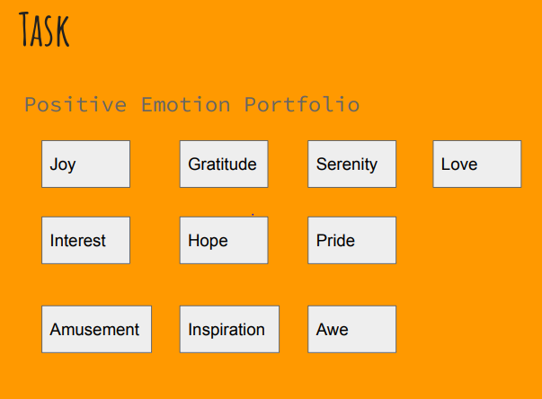
Positive Emotion Portfolio
What is it in your life that supports your emotions?
https://www.robertsoncooper.com/good-day-at-work-challenge-positive-emotion/
Notes:
Explain the task and give colleagues a few minutes to complete
Think about these emotions - when do you feel them in your life? Is anyone willing to share? When do you feel them at work?

Slide 8
Intent
To improve staff wellbeing
To encourage staff to develop their talents, skills, abilities and knowledge and in doing so, become fully engaged in whole school life
To support and develop effective teaching and learning
To maintain a positive learning community and school ethos
To promote a culture of fairness and equity for all
To contribute to a positive behaviour culture
To promote best practice
To improve productivity and staff engagement
To support and promote the school values and a culture of recognition
Notes:
These are the points as to why we did what we did

Slide 9
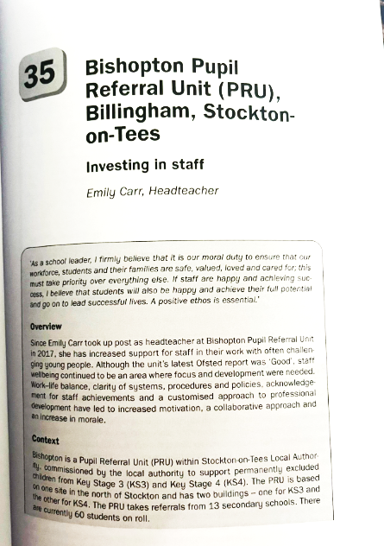
Strategy
A clear long-term vision - developing staff is a key feature
Culture is key!
Leadership - drive from the top
Notes:
One of our 4 key strands
Tom Bennett work on
Relationships - connections - really care - genuine

Slide 10
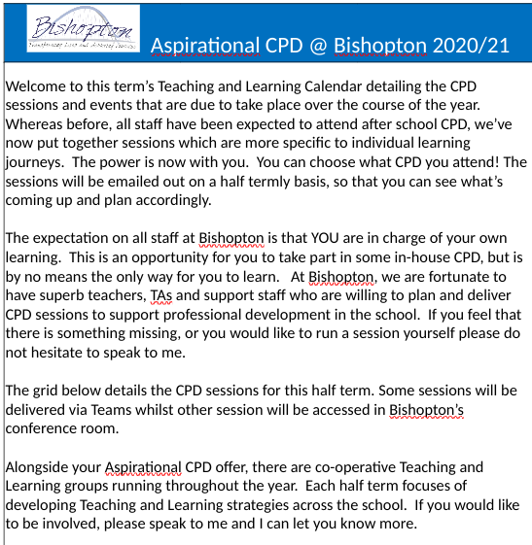
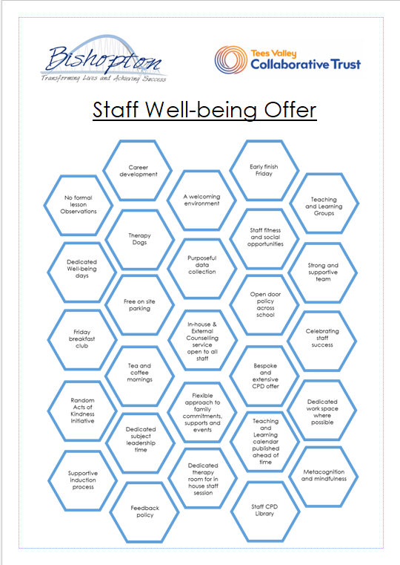
Strategy
Staff voice - focus groups
Policies - clear systems
and procedures
Opportunities for staff
growth and development
CPD reward stamps
Value of time and
expertise
Notes:
CPD offer - progression, development, bespoke
Bishopton PRU’s CPD programme consisted of four distinct leadership pathways: Aspirational Support Staff (those who are in a non-teaching role in the school looking to progress); Aspirational Middle Leaders (those looking to move into middle leadership); Aspirational Senior Leaders (those looking to move into senior leadership); Aspirational Future Leaders (those currently in senior leadership looking for further development). Staff could collect award stamps.
CPD stamp reward card
CPD and time - not having meetings for meetings sake, CPD being bespoke to staff and mapped alongside PM and appraisal etc

Slide 11
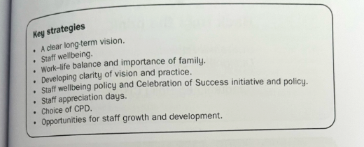
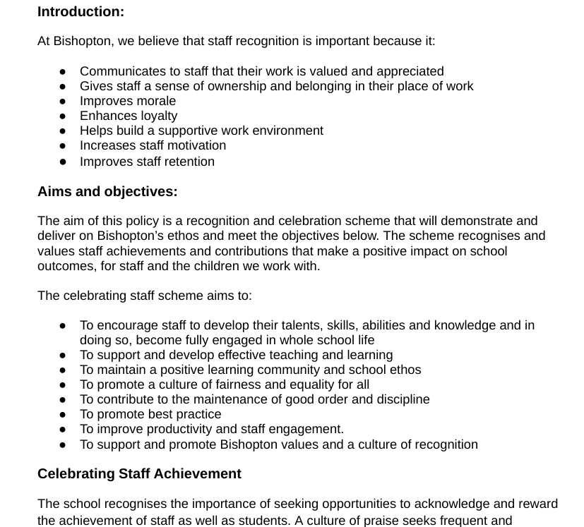
Strategy
Initiatives: Celebrating staff success; Random acts of kindness
Time!
Professional trust!
Support for staff - formal supervision
You know your staff - what will
motivate them and show them you
appreciate them?
Notes:
Initiatives which feature in the case study - Celebrating staff Success (policy), Random Acts of Kindness, celebrating staff birthdays, celebrating staff achievements eg qualifying or passing a course etc
Northern Guild offer
PM
Regular 1:1 meetings
HR Occ Health
Looking at ways we could support with giving staff time e.g. PPA at home, meetings that could be emails, would be! Parents progress meetings on an afternoon rather than an evening

Slide 12
Impact

Slide 13
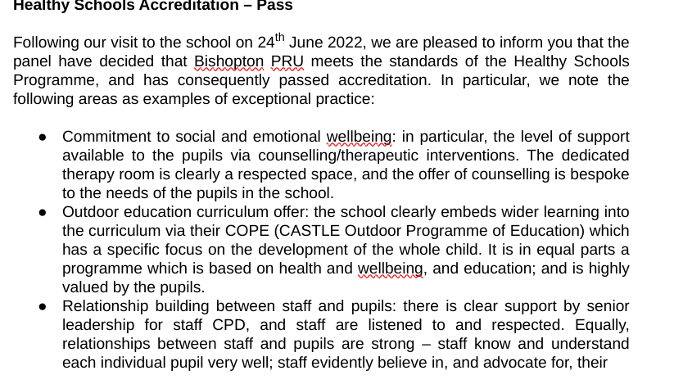
Impact

Slide 14
Impact
Notes:
Success (and impact) can be measured in many ways:
Staff survey feedback
Improved pupil behaviour due to happier and healthier staff
Improved staff attendance and retention
External validation
More productive staff

Slide 15
Obstacles
You cannot please everyone!
HR
Union
Notes:
Live by the sword die by the sword
The Nolan principles
Looking yourself in the mirror
Not abusing power and a position of leadership and trust

Slide 16
Key takeaways
Culture is everything! A clear whole school vision is key
Leadership - this has got to come from the top! (Trust, Governors, SLT, Mental Health Lead)
Staff buy-in
You need a clear strategy and policy
You can offer your staff counselling at no cost to your school through organisations such as The Northern Guild
Time is precious
Protect your staff and their time
Be brave!
Notes:
Culture eats strategy for breakfast!

Slide 17
What can you do now?
What makes your setting right for your community?
Create a culture and a vision for wellbeing
Speak with your staff - collate their views
Create a clear wellbeing pathway of implementation
Speak to the Northern Guild or your local university about how you can use trainees in your setting
Invest in a person to run the offer, not just an add on to another busy role
Create a dedicated staff safe space
Notes:
Think: What do you do currently? What could you do differently?

Slide 18
Questions
Do you have any questions?
Please keep in touch - you can email me or connect with me on X or LinkedIn

Slide 19
Thank you
Contact us to learn more
Email: admin@iqmaward.com
Phone: +44 287127 7857
www.iqmaward.com

