Slide 1
Inclusion Quality Mark
High standards within an inclusive culture
St Peter’s CE Primary School
Matt Lane – Assistant Headteacher
Yvonne Price – Assistant Headteacher
office@st-peters-farnworth.bolton.sch.uk

Slide 2
Context
Who are we?
Two-form entry school (427 pupils) in Farnworth, Bolton.
Approximately 40% on our Pupil Premium register, 14% have an identified SEND, Over 95% live in the bottom most deprived 30% postcode in the country.
'Outstanding' in our most recent OFSTED (Sept 2021).

Slide 3
Rationale
School improvement plan target - High Quality teaching and learning- striving for excellence through high expectations and precision.
We had noticed behaviour and standards from children were not of the expected standard following COVID.
In-class expectations not always consistent or high-quality across the different year groups and changes were needed to meet our school improvement plan.
Time of transition – change of headship, leadership structure and several experienced staff leaving / retiring.

Slide 4
Implementation
We implemented a strategy to break the school improvement target into manageable steps:
‘Fortnightly Focus – The St Peter’s Way. Having the highest of expectations’

Slide 5
Implementation
Following discussions with staff, we agreed this would consists of 5 focus areas:
Behaving for effective learning
Presenting our work
Moving around school
Enjoying our break time
Caring for our school
Each focus area has five focus targets which we believe sets the minimum standard of quality that we expect.
We focus on each target for 2 weeks on rotation.

Slide 6
Implementation
Developing the brand and raising the profile:
First, it is launched in whole school assembly at the start of the week and shared with staff and children
Displayed in class and around school on posters
Display board in the staff room
Videos made by our pupils

Slide 7
Implementation
Developing the brand and raising the profile:
Reminders and reviews in staff briefings / Key stage meetings
Twitter
Encourage ‘buy-in’ from ALL staff
Drop ins
Book scrutiny

Slide 8
Implementation

Slide 9
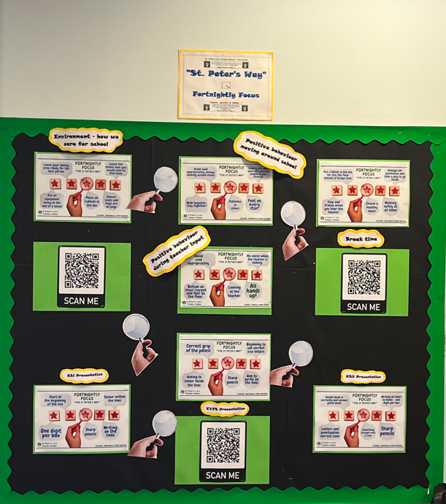

Slide 10
Impact
School SIP Feedback (Mark Mullin)
"This is a superb initiative. It gives clarity to staff and children and makes it clear of the expectations which make the organisation outstanding."
Jenny Scott (Headteacher)
"The fortnightly focus has given us the clarity to ensure that the highest of expectations, for both staff and children, run throughout key areas of our organisation."

Slide 11
Impact
Class Teacher (Mrs Cowell)
"This has really encouraged the children to constantly think about and be aware of the high expectations we have at St Peter’s in terms of presentation and behaviour. The children have responded very well and can explain what is expected for each focus."
Teaching Assistant (Melissa Smith)
"The Fortnightly Focus was an opportunity for me to make some suggestions on areas that could be improved during our break times. Having watched the children outside, it was pleasing that my voice was heard and suggestions I had were implemented and led to improved playground behaviour."

Slide 12
Impact
A calm start to the Year this September.
Children have transitioned into new classes extremely well as the expectations are consistent across year groups.
Children and staff have confidence in knowing exactly what is expected of them or what to work towards, regardless of teacher, age or ability.
Staff are now recognising and setting their own targets in terms of class behaviour and presentation

Slide 13
Impact
Children can talk about what is expected of them in a variety of situations.
Over time, this will embed further so the same standards and expectations thread throughout school.
Positive feedback from staff around impact around school.
Monitoring has shown improvement in book presentation.

Slide 14
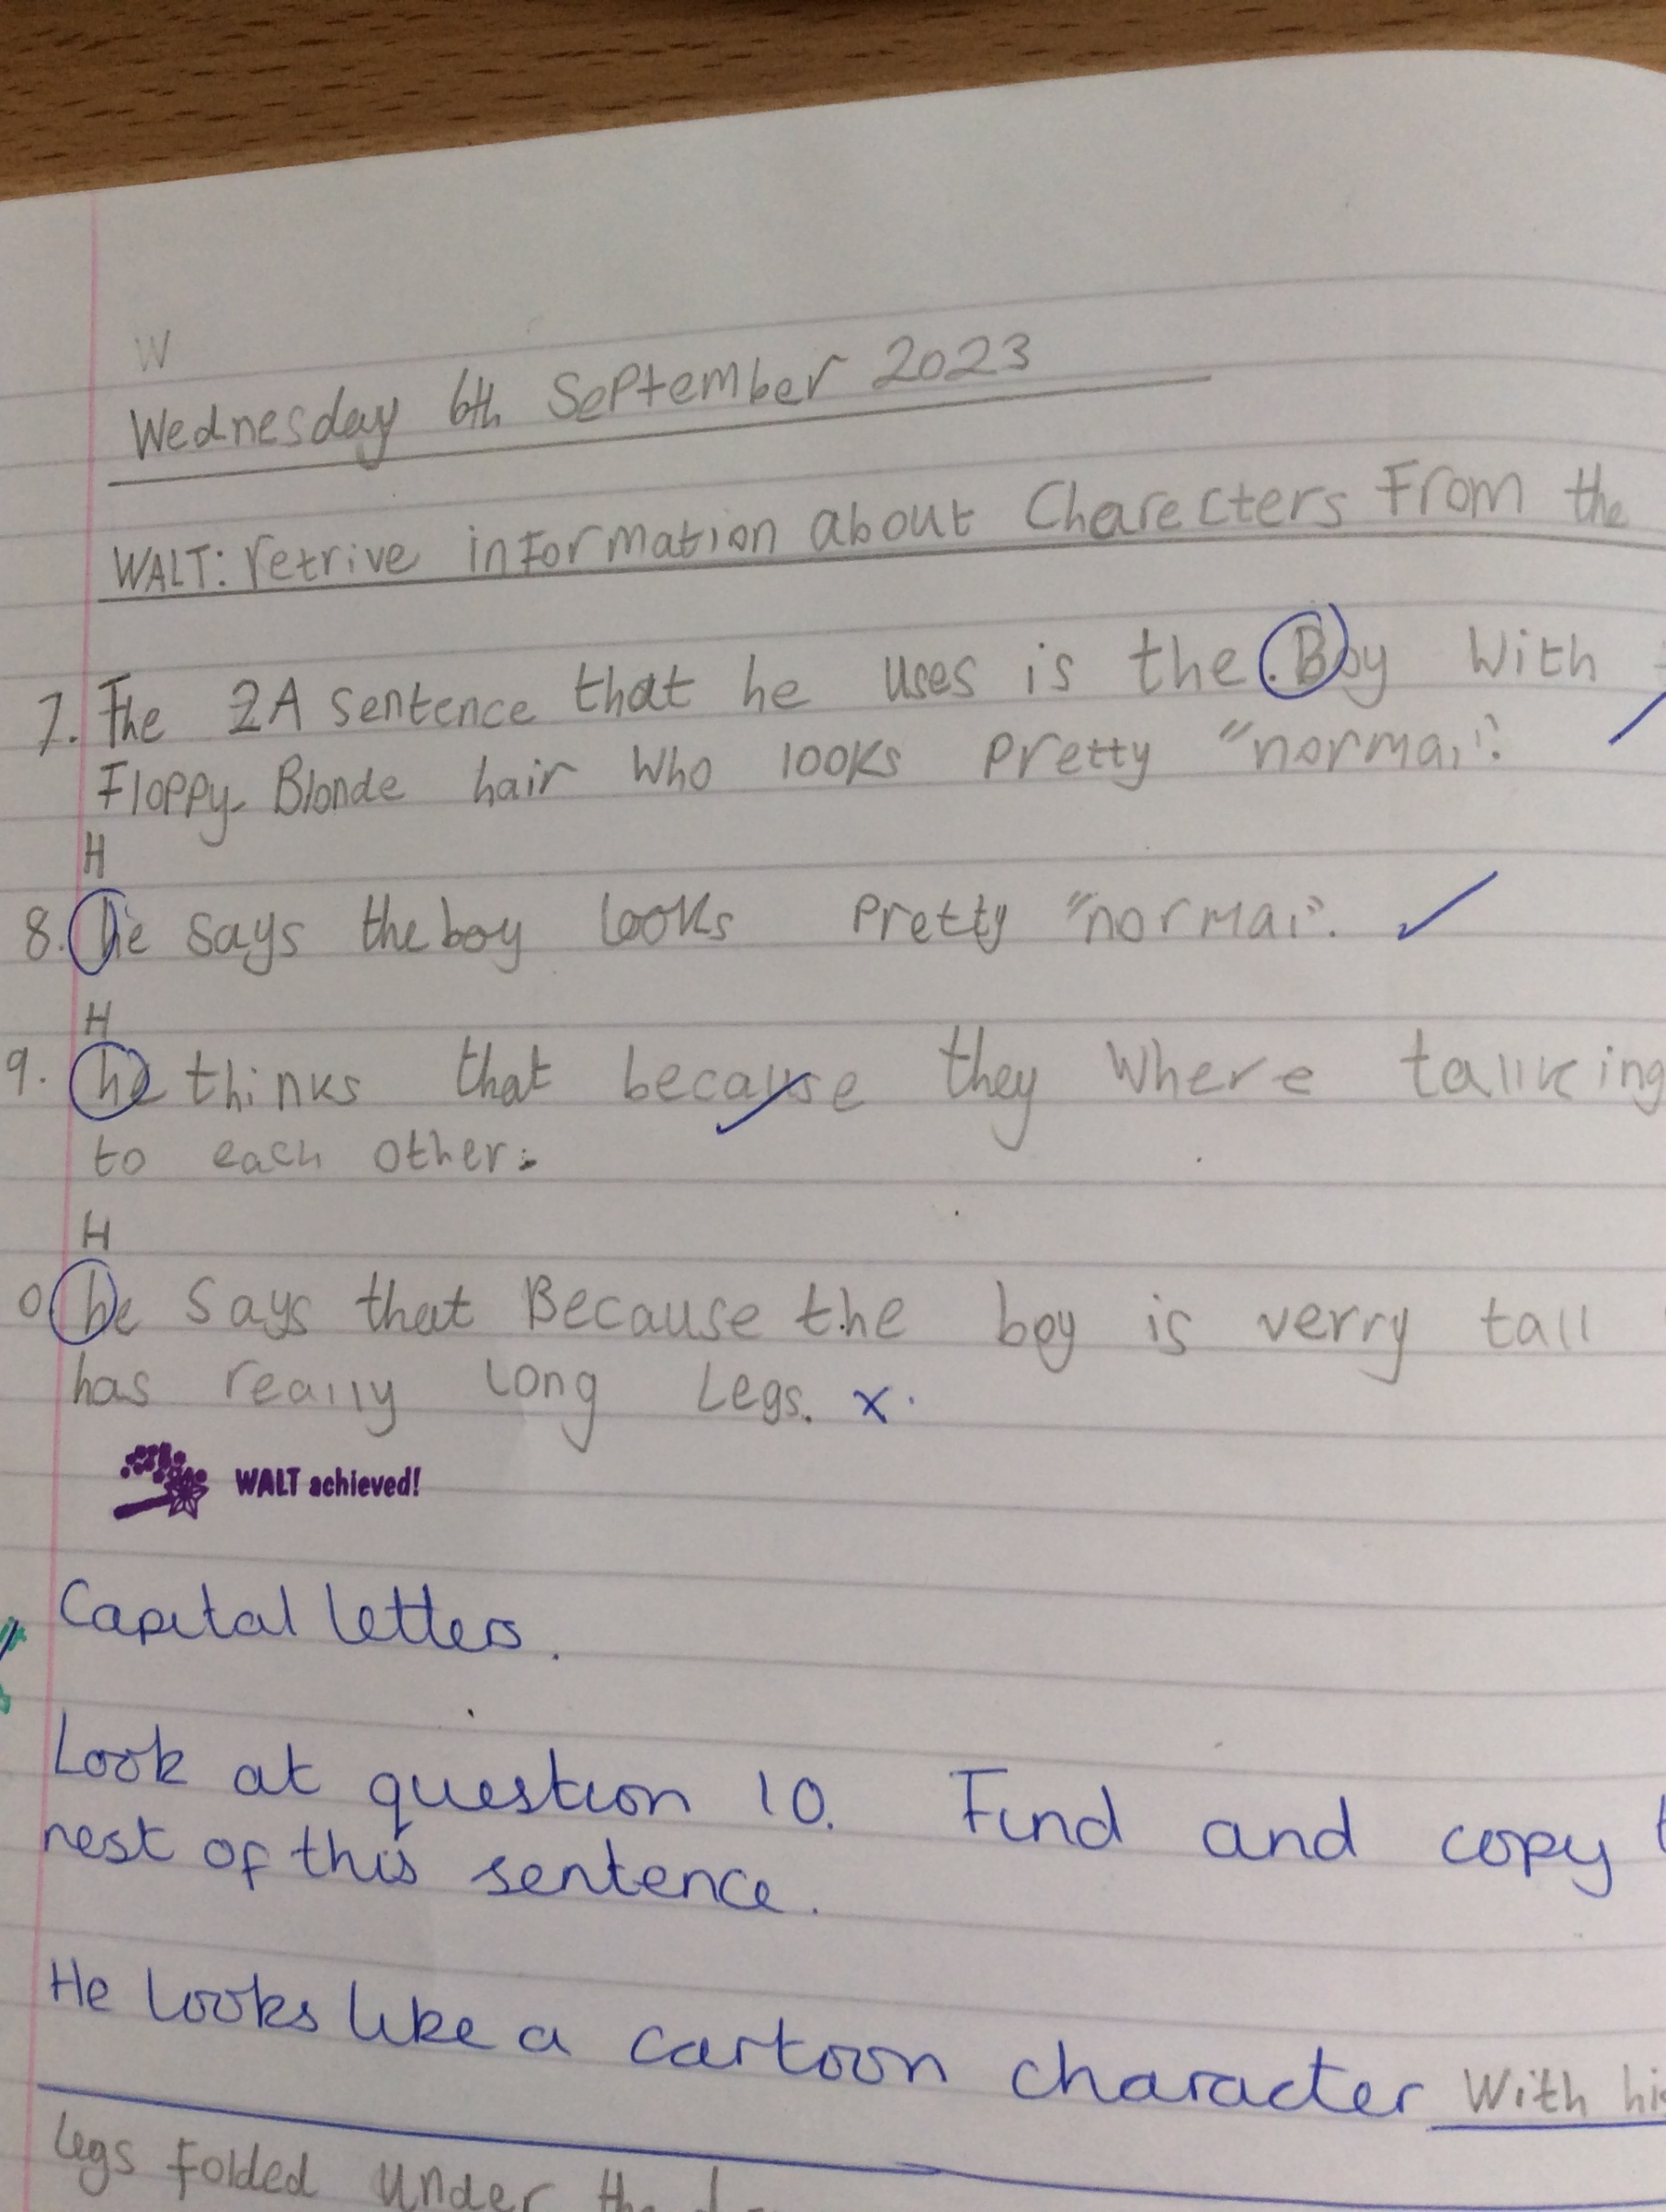
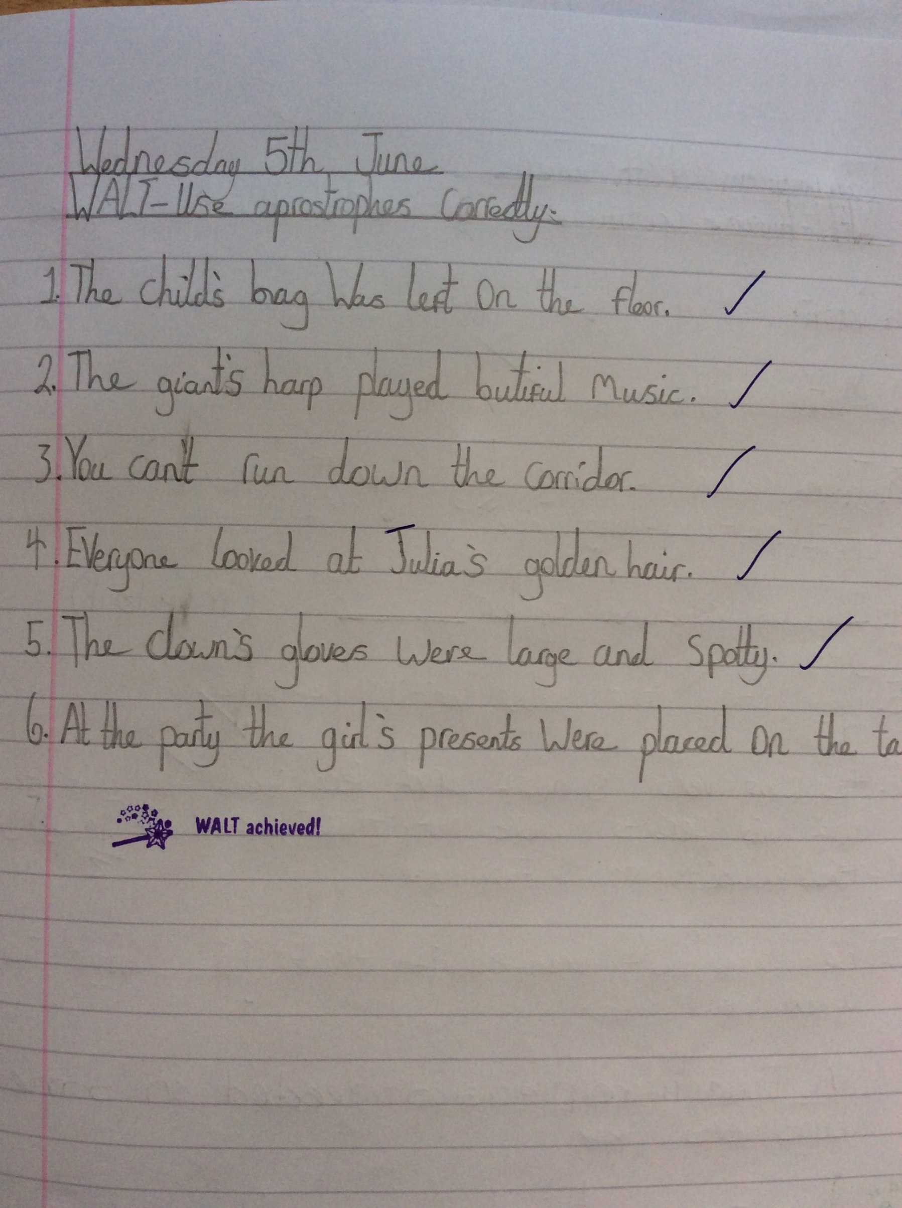

Slide 15
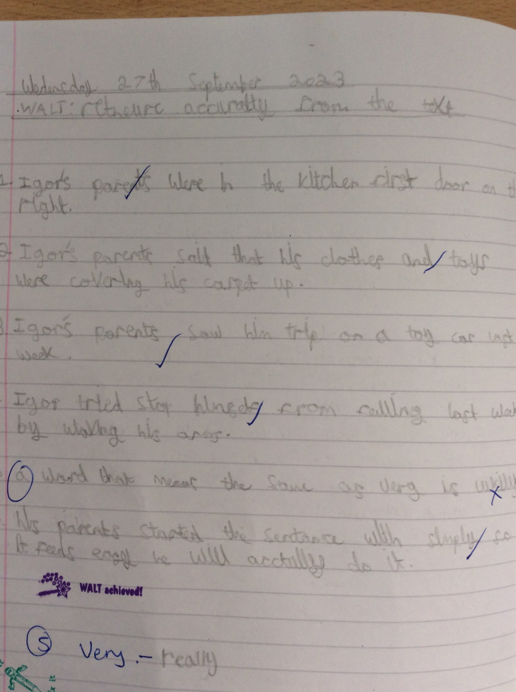
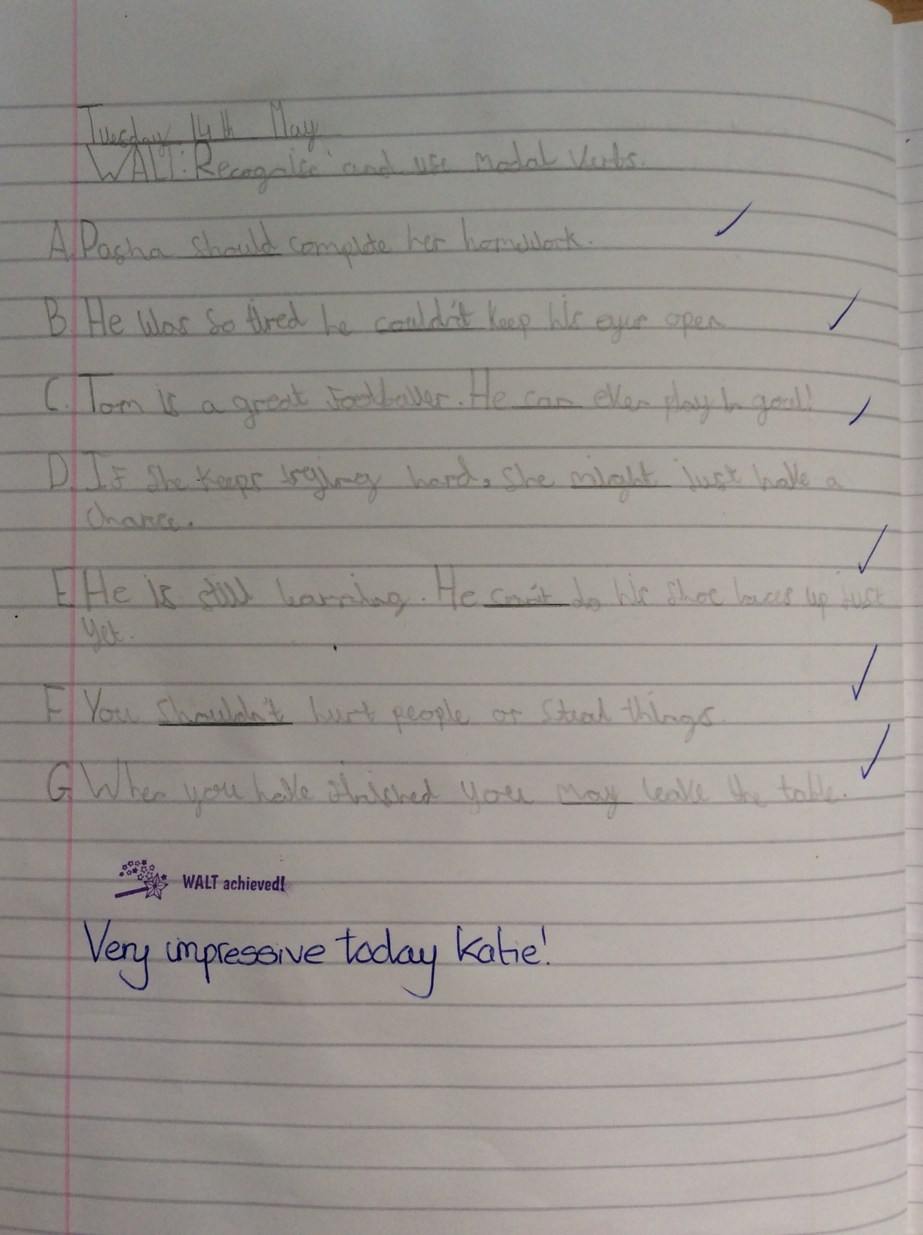

Slide 16
Learning Points
Simplicity - implementing ‘another’ initiative
Encouraging staff to ‘buy in’ and make it high prolife
Choosing wording of targets carefully - for some children it is a journey and a target to work towards

Slide 17
Learning Points
Knowing when to stop
Repeating 3 times per year to embed
10 weeks allocated to targets per term. This gives ½ weeks of flexibility to adapt to the needs of the school or targets that need extra work.

Slide 18
Key takeaways
1. Identify non-negotiables / basic standards you would like to be of a consistent high quality throughout school
2. Break down into 5 simple and clear targets (adapted if necessary and with careful wording)
3. Branding – make it high profile for both staff and children
4. Predict the obstacles – listen to staff to encourage that buy-in

Slide 19
Questions

Slide 20
Your turn….
1. Identify non-negotiables you would like to be consistent throughout school
2. Break down into 5 simple and clear targets
3. Branding – make it high profile for both staff and children
4. Predict the obstacles – listen to staff

Slide 21
Thank you
Contact us to learn more
Email: admin@iqmaward.com
Phone: +44 287127 7857
www.iqmaward.com

