Slide 1
Inclusion Quality Mark
Supporting EAL learners and families
Woodhouse Primary Academy
Oliver Wilson – Headteacher
Tayce Mason – Assistant Headteacher Inclusion, SENDCo
tmason@whp.greenheartlearning.org

Slide 2
Context
We are a larger than average primary school in the south of Birmingham. ​
We have a diverse population with 44% of children being Pupil Premium. ​
There are currently 48 first languages identified, this includes variants and dialects.​
We have a higher than average % of children with SEN, particularly those with an EHCP.

Slide 3
Rationale
To further develop the provision available for EAL children.
To develop support and work collaboratively with parents.

Slide 4
Implementation
EAL Provision - Universal Level
New starters in reception and nursery are assessed using the Wellcomm Assessment Framework. This looks at both expressive and receptive language. ​
Children that are identified as needing additional support have targeted interventions, however immersion in the learning environment plays a large part in developing the children's language at the EYFS stage, so staff are provided with targets that can be addressed daily through everyday play and learning activities within class.

Slide 5
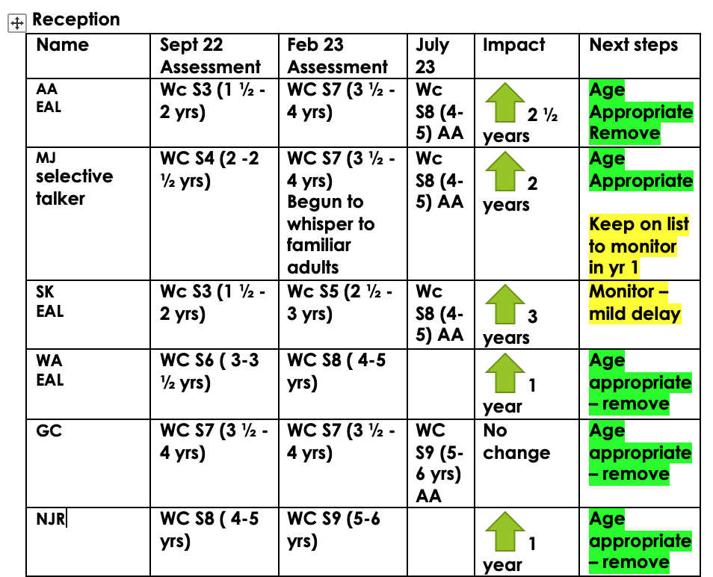
Impact Report

Slide 6
EAL Support in KS1 and KS2
All children identified as having EAL are assessed and monitored using the EAL Proficiency Codes A to E:
A-New to English/Beginning
B-Early acquisition/Emerging
C-Developing competence/Expanding
D-Competent/Diversifying
E-Fluent.
(The Bell Foundation)
Class teachers use the descriptors for each level to identify best fit for each child.
Children working at A or B code are supported through additional interventions focusing on developing spoken and written language. Children remain in class for maths.
Children working at C are supported in class, in a group appropriate to their needs and understanding.

Slide 7
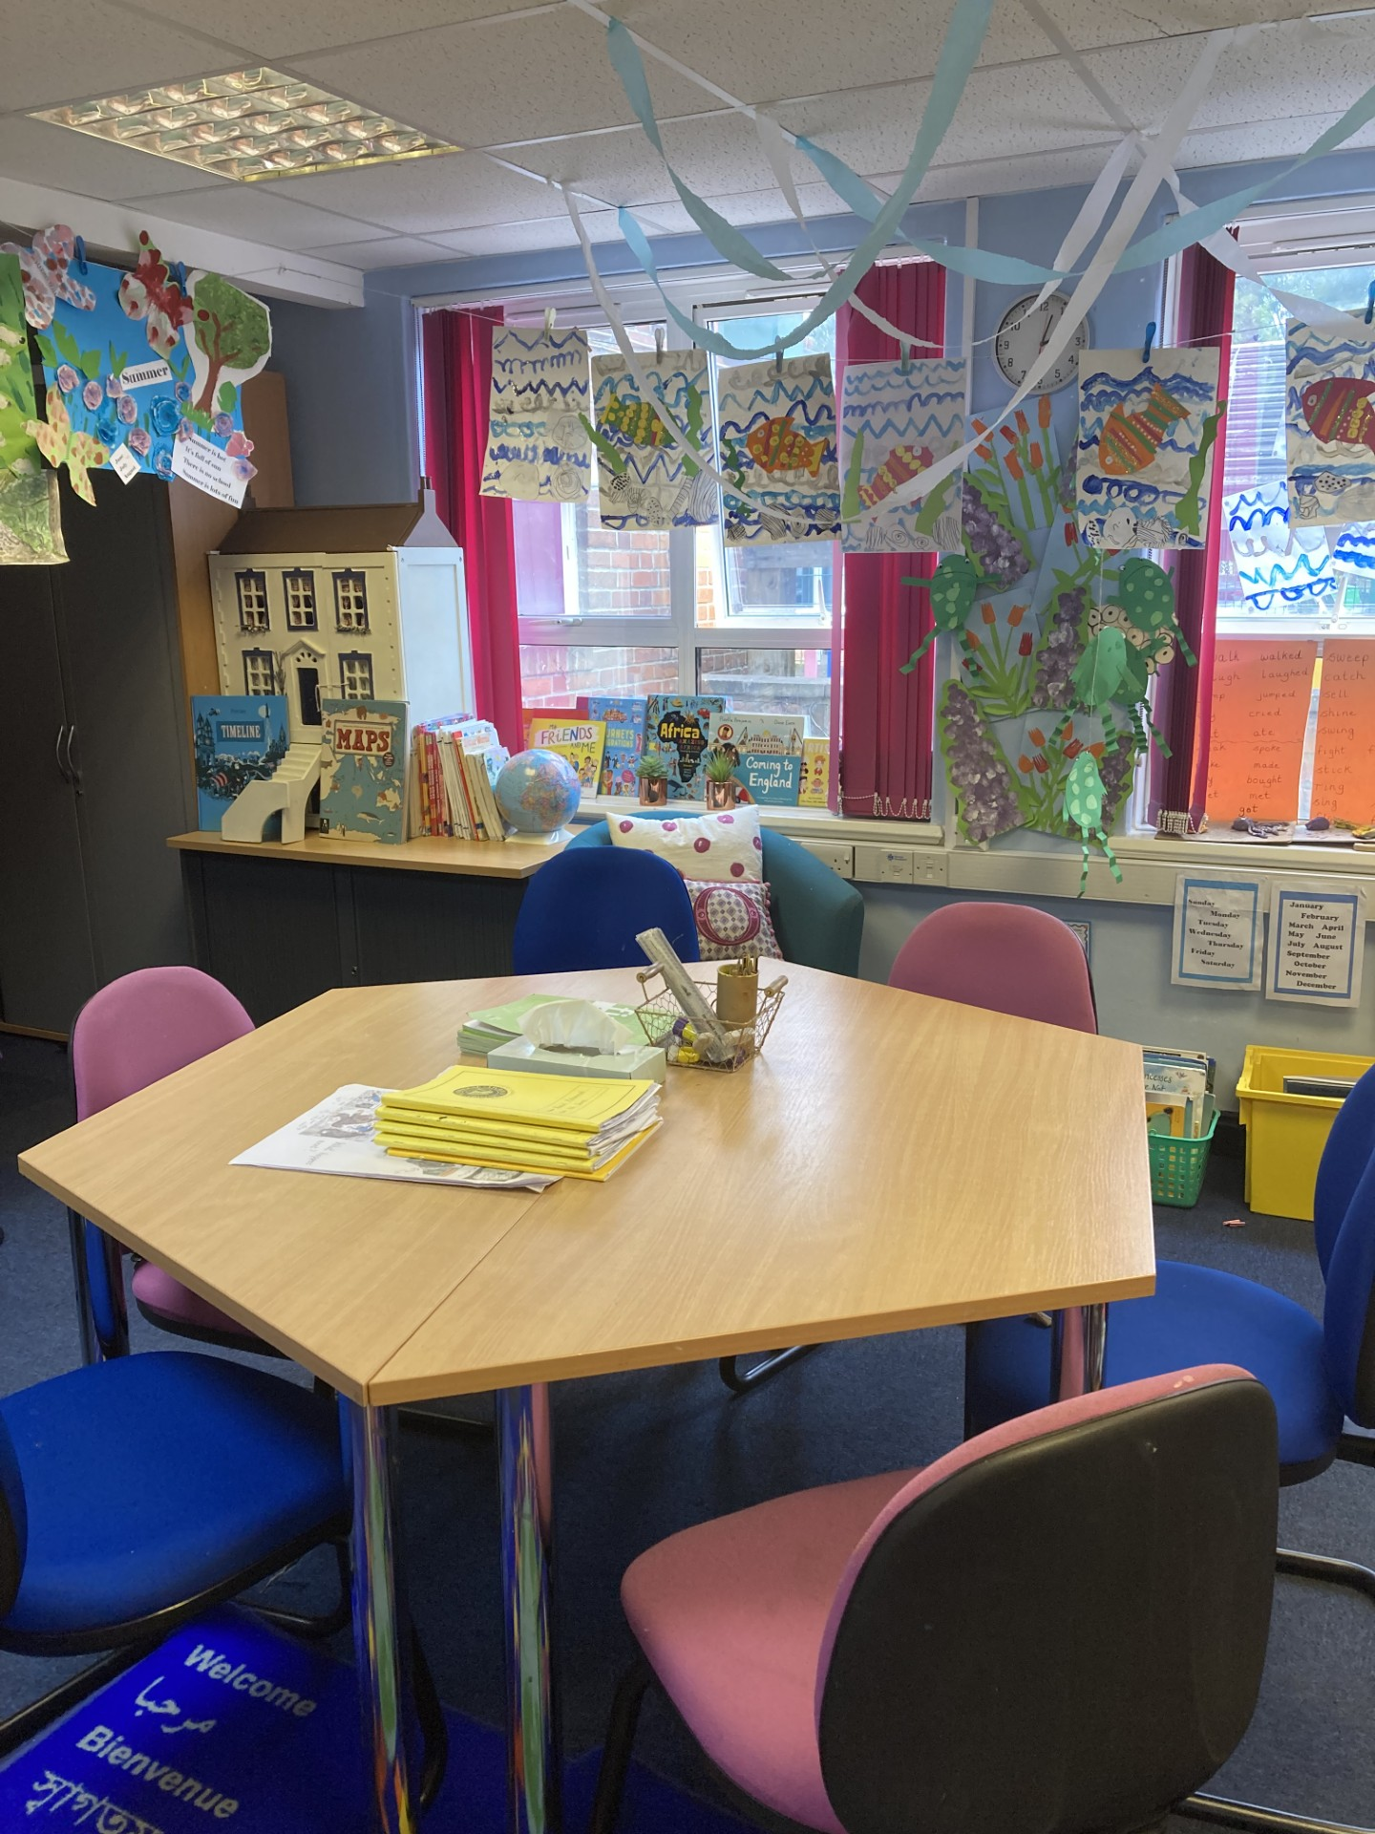
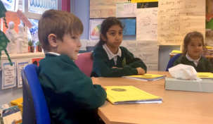
Small Group Support
Small group support is provided by a teacher that has knowledge and experience of working with children with English as an additional language.
Children are baselined using the British
Picture Vocabulary Scale prior to starting an intervention. ​
The EAL teacher links learning within the small groups to the topics being covered in class.

Slide 8
New to English
Some children are new to English, these children receive additional support including:
A buddy for the first week, where possible another child that speaks the same language;
Small group support;
Race to English activities in class;
Flashcards with home language and symbols;
Opportunities to explore English culture;
Create a sense of belonging – long-term strategy.
Some children may require this support for over 12 months before they are confident in class, particularly in writing.
Children should not be seated with SEN children in English as they need opportunities to develop language, which the SEN group may not offer.

Slide 9
Bohdan’s Story

Slide 10
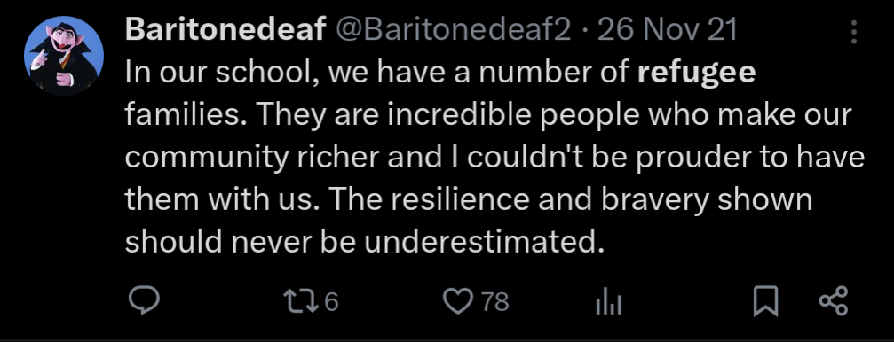
Teachers pr
Wider Impact
Oliver Wilson, head of Woodhouse primary school […], says: “The biggest thing is the warm welcome.” Wilson’s school has enrolled children who have fled Syria, Afghanistan, Iraq, Iran and the Congo. Before the children start, he invites the family to come into school to meet him and his team. An interpreter will be there to help, often a member of a family already at the school. Wilson is always mindful the new family may have had “a horrific journey” and “witnessed terrible things”. A small thing like making sure to smile can help, he says. […] The school has an expert English as an additional language [EAL] teacher, something many schools now lack because of funding cuts in the past 10 years […] Wilson says: “You can’t just put them in a class in a totally new system and language and expect them to flourish. We give them time, adult conversation and the opportunity to develop confidence.” […] But he says what matters most is that they find school a safe and welcoming place.
https://www.theguardian.com/education/2022/apr/27/they-can-really-fly-how-to-teach-a-refugee-child

Slide 11
Impact
Name | Age | Reading Age 2023 | Reading Age 2024 | Score 100 - average
GC | 6y 11m | 5y 3m | 5y 9m | 83
DK | 7y 2m | 5y 4m | 5y 9m | 80
XN | 7y 5m | 5y 2m | 5y 9m | 80
DS | 6y 11m | 4y 11m | 5y 5m | 81
RA | 8y 0m | 5y 0m | 6y 3m | 90
BH | 9y 1m | 7y 3m | 8y 11m | 125
YK | 9y 1m | 7y 0m | 8y 3m | 110
RA | 11y1m | 5y 0m | 7y 3m | 101

Slide 12
Support for families
We also offer our parents and carers support through:
Option of having an interpreter to translate meetings, translation of paperwork, emails etc.
Phonics workshops
Family Support Worker
Coffee Mornings
Parent volunteer in school
Workshops and training opportunities
References

Slide 13
Valentina's Story
"I am from Moldova, and I was a teacher and psychologist in a community
centre for special needs children. I finished my master's degree in
Psychology and pedagogy in 2006. In October 2015, I came to London,
and because I didn't speak English, I worked in a shop as a cashier.
In 2018, we moved to Birmingham, and I decided to attend the university Health and Social Care course. And this is my last university year; I am working on the dissertation. I cannot say that it was a straightforward adaptation because it was a new country and new people, but I am happy to be here and be helpful to the people."
Student placement
Parent volunteer – arranging activities for other parents, preparing resources, attending trips, reading with children, photocopying
Supported workshops in school - contacted outside agencies to arrange training for other parents (Ashiana Community Project)
School provided a reference for supply agency
Now working as a supply TA, including in our school

Slide 14
Pitfalls
Time constraints
Cost
Space
The community's view could be a potential obstacle
Learning Point
Parents and carers have lots to offer; language need not be a barrier!

Slide 15
Key takeaways
EAL children need to sit with peers in English that are going to help them to extend and develop vocabulary and language skills.
Additional input for New to English children, need not be excessive but can reap benefits further on in their educational journey.
Co-production with parents/carers can be beneficial to both parties.
Creating a culture within the school and community.
Systematic approach.

Slide 16
Questions

Slide 17
Thank You
Contact us to learn more
Email: admin@iqmaward.com
Phone: +44 287127 7857
www.iqmaward.com

