Slide 2
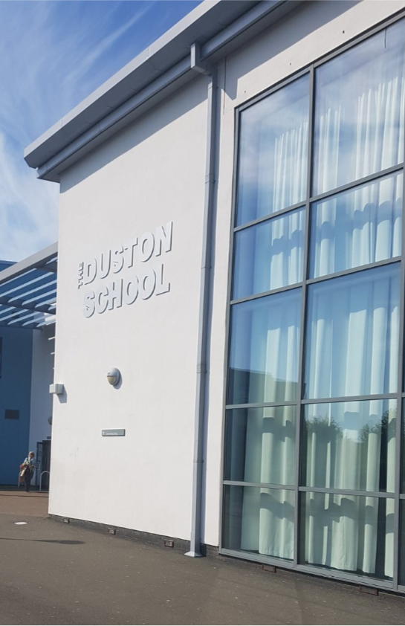
Ofsted Good School
Heavily Over-subscribed
27th Most Improved School Nationally
Nationally Acclaimed
ACE School of Character
CCF Troop
IIP Gold School
IQM Flagship School
Positive Impact Centre
Behaviour Hub Lead School Designation
GEC School
ResearchED Northampton
Exemplary Leaders School
PKC School
Inspiring Leaders Network
DI Hub Case Study School
Aspiration - Resilience - Respect

Slide 3
Behaviour Hub – Common Issues
Safeguarding
Mental Health
Attendance
Behaviour
Funding
External services
Aspiration - Resilience - Respect

Slide 4
The Duston School Five Year Plan
Year 1: 2019-2020 | Year 2: 2020 - 2021 | Year 3: 2021 - 2022 | Year 4: 2022-2023 | Year 5: 2023-2024
Doing the same but better Embed curriculum - Workbooks in Year 10 Embed culture Maximise outcomes Develop a coaching culture (40 staff) Curriculum review Full spending review Drive Teach Like A Champion (TLAC) - Lemov and Rosenshine principles Line-ups Year 7/8/9 Launch show me your best Year 7/8/9 Commence Direct Instruction Full training for all staff in the use of visualisers Build an in-house Positive Impact Centre (PIC) Prepare the school for a positive Ofsted Host the inaugural ResearcheED Northampton Appoint an internal bid writer Undertake a full review of Governance | Doing the same but better Part 2 Embed curriculum – workbooks in Year 11 Line-ups Year 7-10 Show me your best Years 7-10 Drive TLAC (Lemov) and Rosenshine Develop the coaching culture further to 60 -80 staff and gain Gold accreditation Fully embed Direct Instruction Embed the PIC provision Full curriculum review Full spending review Gold IIP review Secure a positive Ofsted Apply to become a SCITT salaried trainee provider Utilise the expertise of our in-house SLEs + NLE to support other schools. Principal to become an NLE Host ResearchED Northampton Work with Tom Bennett to become a Behaviour Support Hub and offer external support and training Apply to become a regional Research Hub Develop key Business Links Undertake a full review of Governance | Striving For Excellence Embed curriculum – workbooks in Year 7 Line-ups Year 7-11 Show me your best Years 7-11 Whole-school coaching approach fully embedded Refine the full TDS approach Full curriculum review Full spending review Decouple the Primary and Secondary Phases Planning permission/permission to build a free school Host ResearchED Northampton Undertake a full review of Governance | Expansion Embed curriculum – workbooks in Year 8 Full curriculum review Full spending review Attract Primary Cluster schools into the TDET MAT Free School plans in place Host ResearchED Northampton Undertake a full review of Governance | Embedding A MAT Embed curriculum – workbooks in Year 9 Full curriculum review Full spending review Full MAT in Place Free School opens Host ResearchED Northampton Undertake a full review of Governance

Slide 5
SIP 2023 – 2024: Driving The Enacted Curriculum
Wellbeing
Embed SEN approaches
Further Embedding TDS Culture
Enhancing the enacted curriculum
Maximising outcomes for all
Welcome to
The Duston School
Principal:
Mr Sam Strickland
Dream - Believe - Achieve

Slide 6
You permit what you promote
You promote what you permit
Aspiration - Resilience - Respect

Slide 7
Dream - Believe - Achieve

Slide 8
TDS ETHOS
Supportive Environment
All work together
Mutual Respect
Respect for the School and the Community
No shouting
Focus on preparing students for the adult world
A ‘can do’ culture
Inclusive
Welcome to
The Duston School
Principal:
Mr Sam Strickland
Aspiration - Resilience - Respect

Slide 9
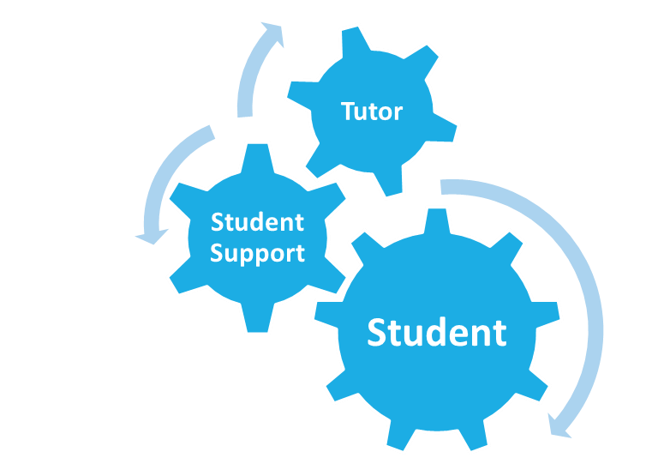
SUPPORTING THE ETHOS
Tutors
ADOY/ DOY
Assistant Principal
Vice Principal
Student/ Family Welfare Team
Positive Impact Centre (PIC)
SENDCo
Knowledge itself is power

Slide 10
THE ROLE OF THE TUTOR
Tutors are pivotal to the student’s success.
They act as an advocate on behalf of the student.
Adopt a positive attitude and develop a positive relationship.
Tutor meets daily with their tutor group.
Parent and carers can directly contact the tutor.
Weekly assemblies.
Aspiration - Resilience - Respect

Slide 11
TUTOR TIME AND ASSEMBLIES
Tutor time will follow 5 key activities per week:
1: Literacy: BIG Reads before you leave Duston
2: PSHE
3: Year group assemblies
4: Character Session, including PSHE
5: Academic Reads
6: Careers
7: Unifrog Platform (P16)
8: Current Affairs (P16)
Welcome to
The Duston School
Principal:
Mr Sam Strickland
Dream - Believe - Achieve

Slide 12
Explicit swearing at a member of staff
Fighting
Bullying
Persistent oppositional defiance
Persistent truancy
Refusal to attend detention
Smoking on school site
Consuming or bringing in alcohol
Bringing illegal substances to school (and distributing)
Bringing a weapon to school
Assaulting a member of staff
Knowledge itself is power

Slide 13
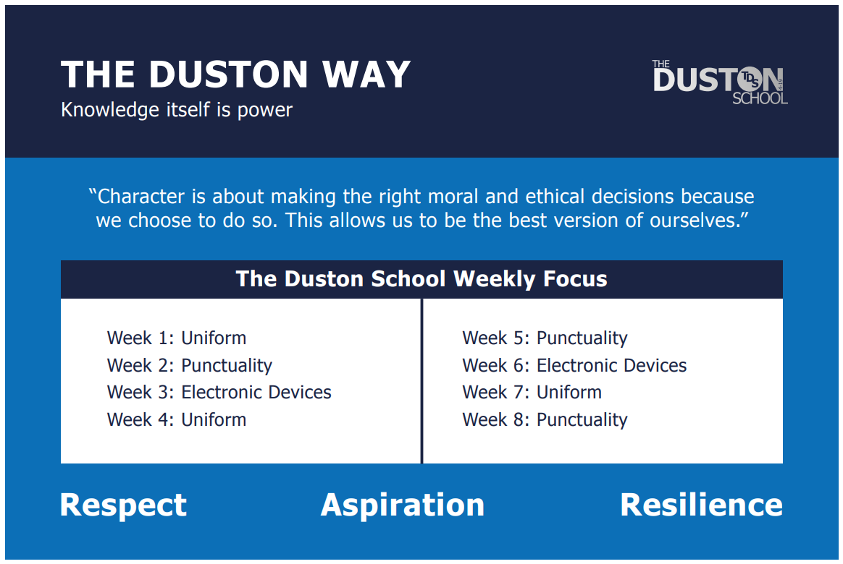

Slide 15
STUDENT CARE STAGES
Stage 1 Tutor
Stage 2 ADOY/DOY
Stage 3 AP
Stage 4 VP
Stage 5 Principal
Welcome to
The Duston School
Principal:
Mr Sam Strickland
Running alongside this is graduated support for children with SEND (where applicable)
Knowledge itself is power

Slide 16
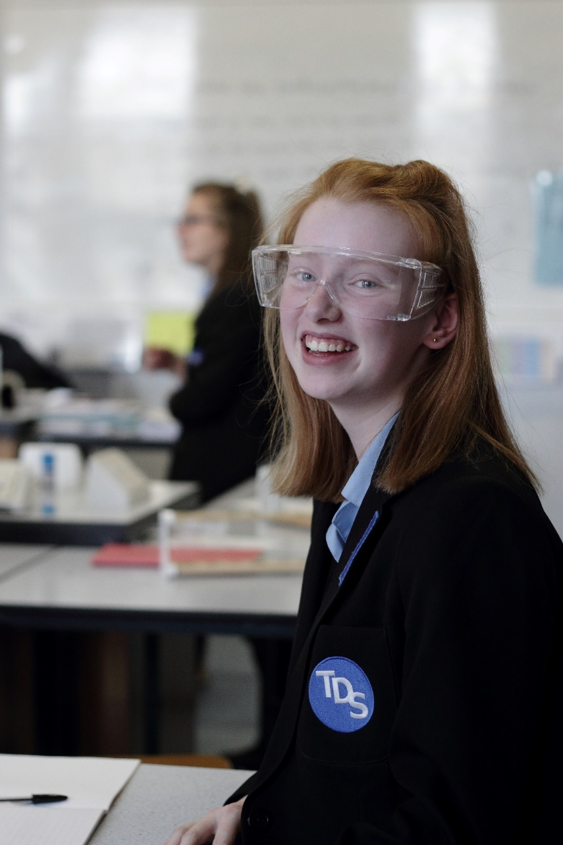
HOUSE AND REWARD SYSTEM
Welcome to
The Duston School
Principal:
Mr Sam Strickland
Dream - Believe - Achieve

Slide 17
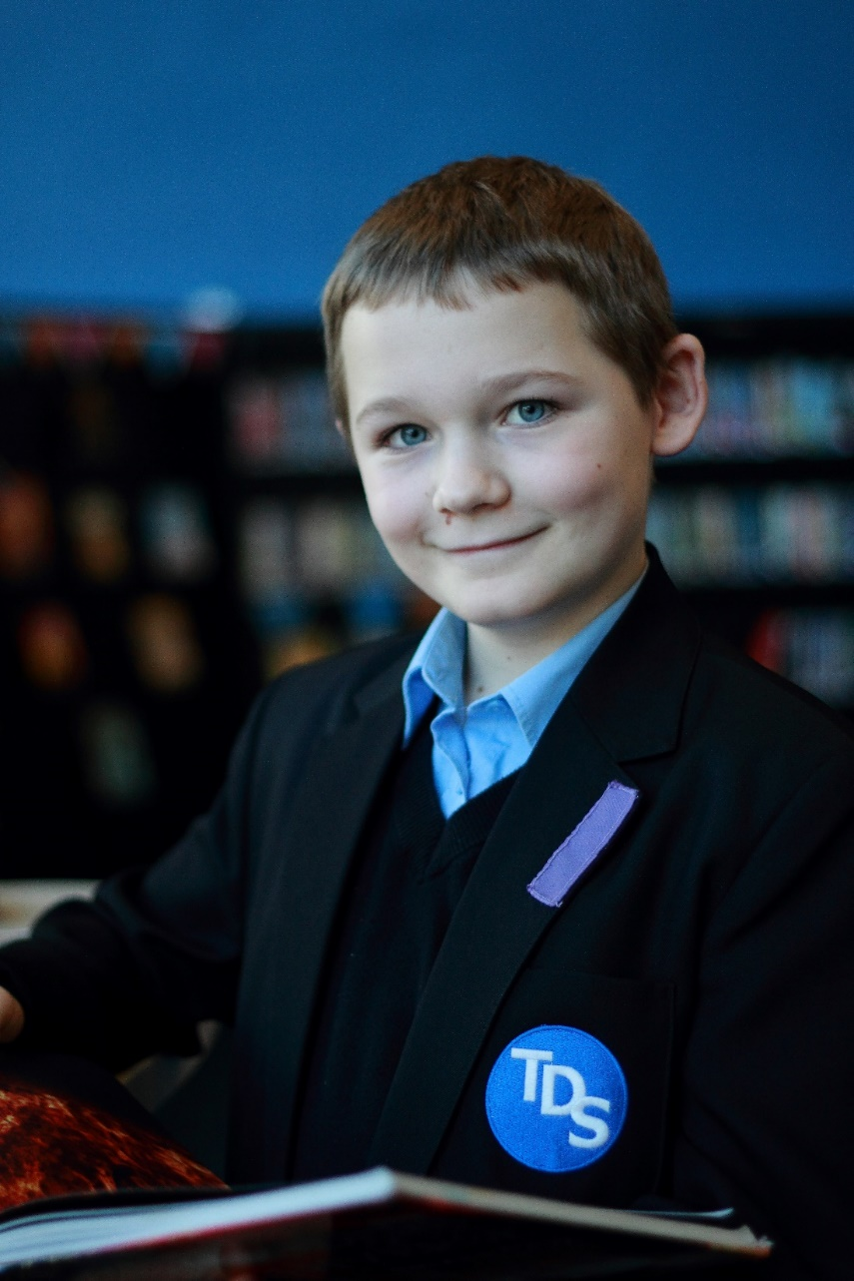
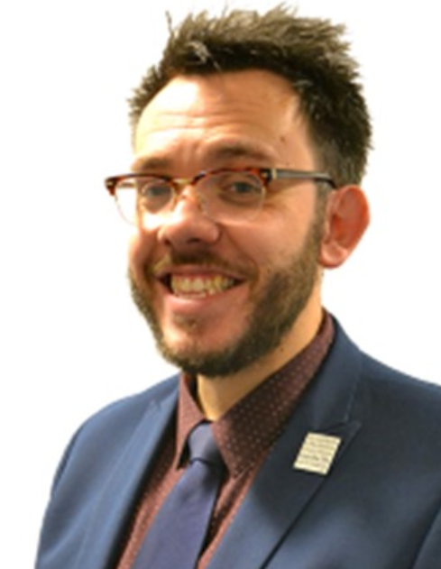
THE HOUSE SYSTEM AT TDS
Willow | Oak | Maple | Chestnut
Head of House is Mr Bidwell | Head of House is Mr Clarke | Head of House is Miss Temple-Fry | Head of House is Mrs Gioia
Welcome to
The Duston School
Principal:
Mr Sam Strickland
Aspiration - Resilience - Respect

Slide 18
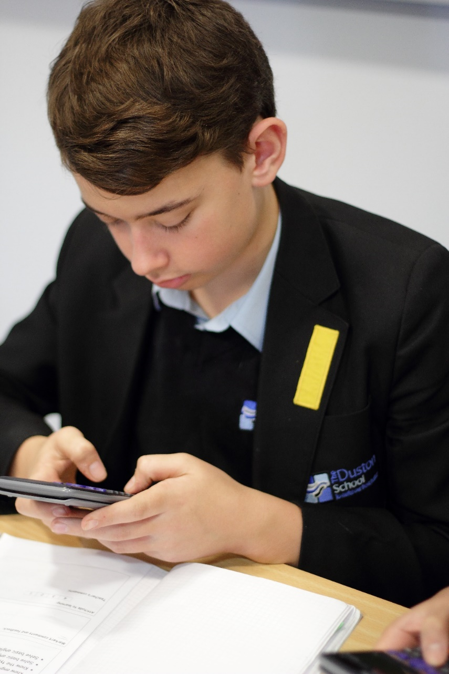
HOUSE NAMES AND MOTTOS
Chestnut
“Determination today leads to success tomorrow”
Maple
“Don’t wait for opportunity; create it”
Willow
“Winners don’t quit, quitters don’t win”
Oak
“Through devotion unto fulfilment”
Welcome to
The Duston School
Principal:
Mr Sam Strickland
Knowledge itself is power

Slide 19
Positive Impact Centre (PIC)
Welcome to
The Duston School
Principal:
Mr Sam Strickland
The implementation of the ‘positive impact centre’, which provides personalised support for individuals and small groups of pupils, has helped a significant number of pupils to overcome their barriers to learning.
Ofsted, October 2018
Knowledge itself is power

Slide 20
Alternative Provision
(12 Week Full Time programme)
Phased return through PIC following exclusion/period of absence
PIC Interventions
(Short term focus groups)
School counselling
(1-1 targeted support)
Nicola O’Brien - PIC Manager
Hannah Tee Deputy - PIC Manager
Georgia Perry - Assistant Principal
‘Ipsa scientia potestas est – Knowledge itself is power’

Slide 21
PIC Intervention Menu
Exploring emotions | Social skills 1-1
Connect and reflect 1-1 | Social skills group work
Protective behaviours 1-1 | Emotional coaching
Anxiety | Self-esteem
Conflict resolution/mindfulness | Social stories
1-1 mentoring | Nurture activity tutor and character culture
Personal character development (12 weeks) | SAIL(Self-Assurance in Life and Learning)
Mental, Emotional and Physical Strengthening (MEPS) | Motivation
Peer mentoring (run by sixth formers) | Anger management
All interventions are offered for 1 hour per week, once a week.
‘Ipsa scientia potestas est – Knowledge itself is power’

Slide 22
Reminder of the referral process
PIC Manager allocates intervention.
Year team informed of support and letter sent home. Highlighting type of intervention, start and end date .
The year team will call home and discuss the extra support PIC offers with parent/carer.
If you feel intervention may be required for a student in your tutor group/class please discuss with the year team.
All referrals submitted are discussed within the PIC weekly department meeting
(Wednesday 3-4pm)
If all in agreement the year team will complete and submit a PIC Intervention referral.
(O-drive- PIC- referral forms)
If a student fits into many different categories PIC will carry out further assessments to establish the best pathways of support for the student.
Intervention starts for set period
End of programme evaluation produced, shared and a copy sent home.
‘Ipsa scientia potestas est – Knowledge itself is power’

Slide 23
‘Ipsa scientia potestas est – Knowledge itself is power’

Slide 24
Further Information regarding PIC Intervention
Intervention allocated; the below process will begin;
Start of the Intervention
SDQ entry point (Strengths & difficulties questionnaire)
Self-Evaluation Audit
Start the intervention (6 weeks, 1 session a week)
End of the intervention
SDQ exit point
End of course evaluation produced by intervention lead. This is sent home via email to parent/carer, form tutor and year team.
All information regarding student support is shared on the staff drive and Edukey.
‘Ipsa scientia potestas est – Knowledge itself is power’

Slide 25
Positive Impact Centre (PIC)
Alternate Provision:
To further enhance our PIC (Positive Impact Centre) provision for vulnerable & SEN students.
The provision of suitable full-time education to those who would not otherwise receive it:
Behavioural issues – those at risk of permanent exclusion.
Non-attenders – school refusers, health issues, including mental health.
To reduce fixed term and permanent exclusions.
To increase attendance and reduce persistent absenteeism.
Welcome to
The Duston School
Principal:
Mr Sam Strickland
Knowledge itself is power

Slide 26
Supporting literacy
To ensure that all students have the literacy skills needed to access the curriculum, three levels of support are offered depending on need:
Direct Instruction lessons – timetabled lessons at key stage 3 for those students assessed on entry to require more intensive instruction.
Literacy small group support – weekly sessions for students focusing on reading skills and handwriting. Designed for those students whose reading age is below their chronological age to help them close this gap or those identified by their teachers as needing support.
After school literacy club – extra curricular sessions that students book onto in the library where teachers are available to support literacy needs in a more bespoke way.
Welcome to
The Duston School
Principal:
Mr Sam Strickland
Knowledge itself is power

Slide 27
Special Educational Needs and Disabilities
The curriculum is ambitious and accessible for all learners
Teachers value and anticipate diversity, creating learning environments that reflect this.
Every teacher is a teacher of SEND
Teachers know their pupils and endeavour to implement strategies to overcome barriers to learning and motivate pupils
CPD Termly SEND faculty agenda item
CPD Pupil focus meetings
CPD SEND briefings / Middle leader SEND training
QA EHCP pupil pursuits
Two Parental SEND review dates per year group
Staff / pupil / parent surveys
Aspiration - Resilience - Respect

Slide 28
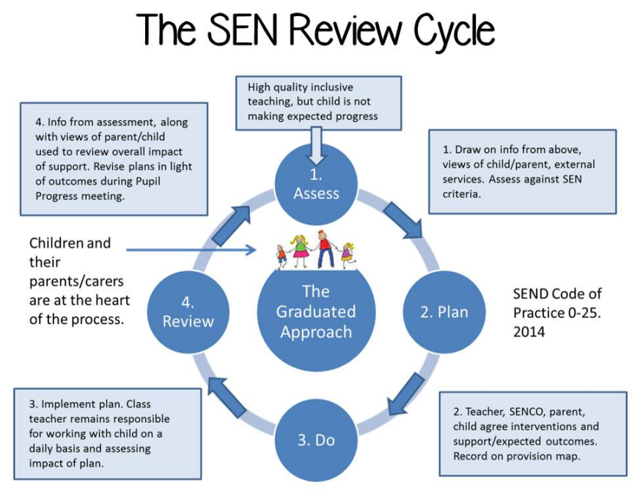
The SEND Review Cycle
SEND department may consider further investigation / evidence or to involve external support
Curriculum design
High quality first inclusive teaching, but child is not making expected progress
Staff training
Assess, Plan, Do, Review
Info from assessment, observations with child/parent views used to review overall impact of support. APDR continues
Draw on information, lesson observations, views of the child/parent.
‘Intervention’ does not always mean extra tuition / classes, it is ‘something else’ in place at classroom level to support the pupil
It needs to be personalised, pupil centred and remove their barriers to accessing the lesson
If exam access arrangements are to be considered teachers must provide SEND department with evidence and this should be provided for as usual way of working
Implement plan, class teacher remains responsible for working with child and assessing the impact of the plan
Teacher, SENDCO, parent, child, HOF agree interventions and support/expected outcomes
Aspiration - Resilience - Respect

Slide 29
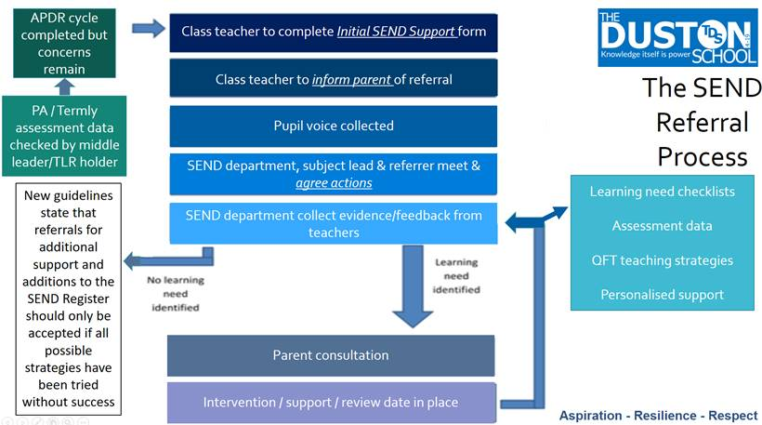

Slide 30
Questions
#IQMFamily
IQM National Inclusion Conference

