Slide 2
DfE APST Taskforce Pilot
In July 2021, St. Wilfrid's Academy was invited to take part in an exciting pilot by Vicky Ford MP (Parliamentary Under-Secretary of State for Children and Families) to provide intensive multi-agency support to vulnerable children and young people in Alternative Provision (AP) most at risk of disengaging with education, being criminally exploited by gangs and becoming involved in county lines and knife crime.
The programme was fully funded and will pilot the impact of co-locating a variety of specialist workforces in St. Wilfrid's on a full-time basis. The specialists were drawn from across health, education, social care, youth services and youth justice and designed to deliver targeted, wraparound support to pupils in AP to reduce truancy, not in education, employment, and training (NEET) rates, the risk of involvement in serious violence and improve mental health and wellbeing.
The best AP schools in the country are already operating in this way, working in strong partnership
with local schools and local authorities, and the DfE want to make sure this good practice is delivered
across the country. It is also clear that the vast majority of pupils in AP have special educational needs
and disabilities (SEND), particularly social, emotional, and mental health (SEMH), and that AP is
increasingly operating as part of the SEND system.
IQM National Inclusion Conference

Slide 3
DfE APST Taskforce Pilot
Mental health therapist
Cognitive Behaviour Therapy (CBT), group therapy sessions, assessment
Youth offending worker
Working to prevent children and young people under 18 from offending and reoffending
Speech and language therapist
Help to manage disorders of speech, language, and communication
AP Specialist Taskforces
Family support worker
Working with vulnerable families, signposting to support
Post-16 transition coach
Developing applications, supported visits, assessing skills gaps, staying in contact as the pupils moves
Youth worker
1-2-1 mentoring, relationship building, strengthening resilience and emotional wellbeing
IQM National Inclusion Conference

Slide 4
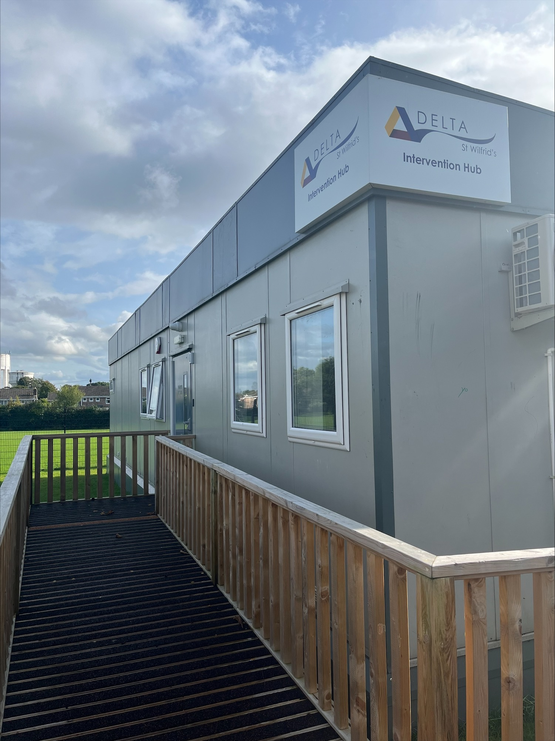
DfE APST Taskforce
Pilot Team
Mental Health Therapist – Lizzie Smith
Post 16 Transition Careers Specialist – Lorna Barton / Sophie Short
Family Support Worker – Sharon Newrick / Alleah Harris
Early Help Co-Ordinator – Liza Justice
Youth Justice Officer – Danny Hannam
Speech and Language Therapists – External agency as needed
SENCO/Intervention Lead – Simone Revell, Associate Vice Principal
Leadership Oversight – Dirk Pittard, Principal
IQM National Inclusion Conference

Slide 5
Let's Hear from Danny and Liza…
https://youtu.be/dSx73O7xQzM
IQM National Inclusion Conference

Slide 6
Impact: Additional Capacity
Multi–Agency Approach, based on school site but operating from a separate building sharing the car park. Hours of operation extended beyond the school day and allowing for evening interventions.
The APST are regularly in the building, supporting learners and building relationships. This has made it easier to engage with parents and carers in the home.
Early Help ‘RAG’ rate every student and are able to expedite referrals through the system, cutting down on red tape. Average time from referral to work starting is now 2 days (if not hours) down from 6 weeks plus!
Youth Justice Work has seen earlier intervention have a greater effect. The YJW has seen his caseload double, however the majority of interventions are now pre-court rather then post-court.
Trauma informed interventions start with the Counsellor/ Mental Health Worker in our ‘Wellbeing Suite’ and interwove throughout the school meaning more time is spent getting to the root cause of negative behaviours.
IQM National Inclusion Conference

Slide 7
Impact: KS3 Short Term Placements
November 2021– November 2022 (12 Months)
28
15
1
8
3
1
INCLUSION PANEL
ASSESSMENT PLACES
30
29
1
35
32
3
Day 6
Direct Commission
Mainstream
SWA
KS3 PRU
KS4 PRU
Other AP
93 Students referred to SWA during the past 12 months
for Assessment and APST Intervention.
76 Reintegrated into mainstream education (82%) and
did not require additional AP in 22/23.
100% of students found a setting appropriate for
their needs.
Mainstream
KS4 PRU
Mainstream
KS4 SWA
IQM National Inclusion Conference

Slide 8
Quick Wins
If there is one in your area, consider approaching the existing APST Pilot School for support. There may be the possibility to refer students into the AP for Multi-Agency support only. The student stays dual registered.
Alternative Provision Settings benefitting from AP Specialist Taskforces
Bradford AP Academy Centre, Bradford
Haringey Learning Partnership, Haringey
Manchester Secondary PRU, Manchester
Orchardside School, Enfield
Saffron Valley Collegiate, Croydon
Sandwell Community School, Sandwell
Snowdon Village (Bristol Future’s Academy), Bristol
Southwark Inclusive Learning Service (SILS), Southwark
Stephen Longfellow Academy, Leeds
Tunmarsh School, Newham
Unity Academy, Nottingham
St Wilfrid’s Academy, Doncaster
Park Campus Academy, Lambeth
Brent River College, Brent
City of Birmingham School, Birmingham
Ealing Alternative Provision (EAP), Ealing
Everton Free School, Liverpool
Leicester Partnership School, Leicester
London East AP, Tower Hamlets
Sheffield Inclusion Centre, Sheffield
The Clifton Centre, Salford
New Regents College, Hackney
The SEND and AP Improvement plan (March 2023) has raised the profile of Multi-Agency Support and the work piloted by the APST has been evaluated and shown to have proven impact. With many Local Authorities now aware and open to building on the pilot, it may be the perfect time to approach local Early Help, Youth Justice and the NHS directly and offer to ‘host’ a hub in your school.
IQM National Inclusion Conference

Slide 9
Questions
#IQMFamily
IQM National Inclusion Conference

