Slide 2
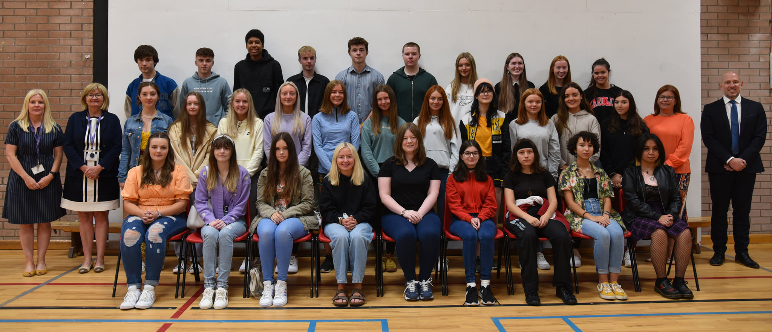
30 top achieving GCSE students All involved in extracurricular activities Removed barriers for participation Each department must offer something Must be inclusive activities Essential in areas of socioeconomic deprivation Use community expertise for coaching Apply for funding when available | Improved school-home relationships Important in developing soft (especially social) skills Creates a sense of belonging to the college Improves peer relationships Evidence of higher academic achievement Increased numbers into Post 16 More positive school experiences Improved mental health and wellbeing
IQM National Inclusion Conference

