Slide 1
Innovative Learning
and Intervention Approaches for Pupils with Additional Needs
Presented by Peggy Murphy and
Karen Robinson-Jones
from Five Acre Wood School
th
IQM National Inclusion Conference, 27
November 2023
#IQMFamily

Slide 2
Context
2 – 19 PSCN District Special School
(plus a 15 f/t equivalent nursery and 19+ College)
Teaching School (LEAF)
Foundation School,
Member of KSENT Co-Operative Trust,
Hold the SLA for STLS
1 of 12 similarly designated in Kent
Teaching School (LEAF),
Foundation School,
Member Of KSENT,
SLA holder for STLS
Rapid increase in population:
Sept 2008 – 119
Sept 2015 – 269
Sept 2017 – 330
Sept 2022 – 700+
Sept 2023 - 840
Approximately 460 staff
Cohort sizes
ASD – 48%, PMLD – 5%, MLD – 10%, SLD – 15%, PD – 5%,
SLCN – 17%
FSM – 32%, PP – 38%,
EAL – 6%
IQM National Inclusion Conference

Slide 3
One Wood, Many Trees
Loose Site (52 classes)
Early Years (including Nursery), Sensory;
Practical, Structured, Formal
521 Pupils, @350 Staff
Snodland Site (15 classes)
Secondary (Formal, Practical and Structured)
Functional (Sixth Form)
200 Pupils, @85staff
Grow 19
Post 19 provision
33 Students, 10 Staff
Palace Wood Site (2 classes)
Satellite provision for 2 x Formal Primary classes
34 Pupils, 9 Staff
Oxford Road (4 classes)
Satellite provision for 4 x Functional classes
60 Students, 8 Staff
IQM National Inclusion Conference

Slide 4
Our Purpose
“
To achieve new possibles, whilst preparing pupils for their life journey
”
IQM National Inclusion Conference

Slide 5
Trademark Behaviours
‘Pupils First’
Pupil’s remain at the heart of our decision making, to ensure that they have the best possible outcomes.
#PupilsFirst
‘Every Moment Matters’
Our pupil’s time in full-time education is limited and we are duty bound not to waste it.
#EveryMomentMatters
‘Together Stronger’
We all play a small but vital role in both the Five Acre Wood and the wider community. When we work together we are at our best.
#TogetherStronger
IQM National Inclusion Conference

Slide 6
Equality vs Equity
IQM National Inclusion Conference

Slide 7
Learning Approaches – Our Core Offer
A Brief Description
Early Years or Early Learning | For pupils of a nursery, reception and year 1 age. It plays a diagnostic role in establishing which learning approach / curriculum pupils follow next.
Sensory | For pupils at key fundamental and foundation levels of development (who are working within the Engagement Model), who typically have a description of profound and multiple learning difficulties.
Practical | For pupils who are working consistently, and over time, below or very near the start of their national curriculum, who benefit from a practical approach to their learning. Pupils may typically (but not always) have a diagnosis of severe learning difficulties.
Structured | For pupils who are working consistently, and over time, below or very near the start of their national curriculum, who benefit from structured learning environments. Pupils may typically (but not always) have a diagnosis of Autism.
Formal | Primary For pupils who are working below age-appropriate expectations but are able to access parts of the National Curriculum.
 | Secondary For pupils who are working below age-appropriate expectations but are able to access parts of the National Curriculum. From Year 8 to Year 11 pupils access an adapted secondary model.
Functional | For our students aged 16 – 19 years old (Sixth form) with moderate, severe and complex learning difficulties. (NB those with profound and multiple learning difficulties remain in the Sensory Learning Approach).
IQM National Inclusion Conference

Slide 8
Learning Approaches – Our Core Offer
Our Philosophy….
Curricula & Assessment
….are encountered via our well established ‘learning approach’ classes
Meeting Potential
….by setting up environments that best meet pupil’s needs
Equity
….is about meeting individual needs, not treating everybody in the same way
(Mittler, 2000)
The Big Picture
Each learning approach is overseen by a strategic SLT team, a learning approach lead, a specialist team of curriculum leaders, a detailed development plan and SEF, ‘non-negotiables’
The Benefits….
Specificity
Class groups equipped and organised to meet specific needs / preferred learning approach
Environments
Appropriate and suitably interactive environments
Provision
Appropriate provision of bespoke resources within learning approaches
Key Skills
Greater opportunities to build key skills
Staff Teams
Appropriate staff teams, with relevant training and experience, allocated
’
IQM National Inclusion Conference

Slide 9
Early Years
Developing foundation learning skills, to include curiosity, exploration, attention, engagement and collaboration.
The curriculum plays a diagnostic role in establishing which learning approach / curriculum pupils embark upon next.
Some of the approaches include….
1
Saplings
Stepping stone to our forest school
A place where pupils engage with risks and learn how to do so safely. It is about adapting the level of our support to the individual child so that they can learn their own boundaries independently
Child-led learning and the freedom to engage without expectations
2
The Curiosity Approach
Igniting a child’s natural curiosity to explore the world around them
Children make their own choices and solve things for themselves
Enchanting environments
Authentic resources and loose parts
3
Hygge
Home away from home environment
Sense of stillness and calm through enabling environments
Slow teaching – taking time to appreciate ‘the moment’
Cosy contentment
Also used to promote wellness for adults
IQM National Inclusion Conference

Slide 10
Sensory
Pupils access a curriculum that enables them to develop a sense of security in the school environment. The Sensory curriculum allows pupils to access a range of learning experiences, both practical and sensory. Focus is placed upon enabling pupils to establish positive, interactive relationships with others, to proactively explore the world around them, to gain environmental control skills, and to achieve the highest level of personal mobility and independence.
Individualised Learning
All learning is highly individualised with a main focus on communication skills
Pupils undertake many physical programs from OT specialists within their lessons. Some students have MOVE targets (an activity-based framework that enables disabled young people to gain independent sitting, standing, walking and transferring skills)
Pupils may have input from hearing, visual and multi-sensory impairment specialists
Pupils’ wellbeing and inclusion is at the heart of all activities and events which run in the approach
Curriculum
Pupils work on developing their skills in 5 key areas:
My Body
My Communication
My Thinking
My Independence
Me and My Community.
This means that their days are filled with learning opportunities that give them a chance to develop really useful skills which make a difference to their quality of life.
Communication
Pupils use a variety of high and low tech devices to communicate across the day
Exploring & Investigating
Pupils have opportunities to explore their senses
Focus is placed upon enabling pupils to establish positive, interactive relationships with others, to proactively explore the world around them, to gain environmental control skills, and to achieve the highest level of personal mobility and independence
IQM National Inclusion Conference

Slide 11
Practical
The Practical Learning Approach is a hands-on approach where learning is delivered through practical and real-world experiences that allow pupils to explore, understand and make links to the environment they live in. The aim is to pupils with the tools they need to access work and other social activities beyond Five Acre Wood School. All learning is supported by visuals and aids to encourage students' independence in all aspects of their learning.
Curriculum
A two-year rolling curriculum that is topic based. Topics include:
Celebrations
All About Me
The Outdoor World
My Community
Transport
Topics are taught through many different approaches e.g. outdoor learning, colourful semantics and small group work
Pupils cover these topics in varying detail depending on their ability and will have new skills taught to them as part of the spiral approach where learning happens gradually with skills being repeated and consolidated
Community Learning
Pupils have many opportunities to explore the wider community
KS1 classes go on road safety trips around the school site and have Christmas and Summer outings
KS2 classes visit local shops and amenities
KS3/4 classes visit the cinema, shop on a weekly basis and go to the café
On these trips pupils have the opportunity to work on valuable life skills such as road safety, looking after money, paying, ordering and navigating
Events
Coffee mornings
Afternoon tea
Stay and play
Collaborative PE sessions
Collaborative cooking sessions
Sensory/ practical reading
Fortnightly assemblies
Student council
IQM National Inclusion Conference

Slide 12
Structured
Learning is related to pupils’ own experiences. Some may learn through structured play, others will learn more effectively through functional activities and a topic-based approach. The curriculum content echoes the ground covered by the Early Years, since this framework is not confined to those below the age 5, but rather, extends right across the school where pupils are functioning at the pre key-stage level. However, the learning approaches reflect the age and learning style of the pupils concerned, becoming more functional and life skills based as they move up through the school
Principles
The Structured Learning Approach:
Follows the TEACCH approach to learning which provides pupils with predictable routines which alleviates their anxieties
Lays an emphasis on supporting pupils with their communication skills, social skills and skills relating to their emotional regulation (SCERTS)
Each pupil is treated as an individual and learning is tailored to their specific needs
TEACCH
Classrooms are designed to include the following structure:
1:1 work – to allow pupils to learn new skills and specific targets with an adult
Independent workstation – building confidence, independence and self belief
Group Work – designed to support pupils social and communication skills i.e. turn taking games, activities which allow for opportunities to communicate with one another
Leisure – allows pupils to self-regulate and take a break from work. It is a good opportunity to develop communication and decision making skills through choosing boards as well as continuing work on social skills and friendships
SCERTS
Social Communication – PECS, Sentence Strips, Colourful Semantics, turn taking boards, communication boards, choosing boards
Emotional Regulation – emotion zones, emotion key rings, choosing boards, social stories
Transactional Supports – the role of the adult and the quality of resources they provide e.g. stripped back language, schedules, signing
IQM National Inclusion Conference

Slide 13
Formal Primary
The National Curriculum is modified according to pupil’s developmental level and needs.
Specialist areas are covered both within a topic-based approach and in discrete lessons
Formal learning is linked to practical activities and consolidated and applied in practical sessions.
Pupils within the Satellite Provision classes have opportunities for inclusion, where appropriate, with their mainstream peers.
Aims
To use pupil need and interest as a starting point to establish a topic based approach that is meaningful and engaging, and acts as a rolling programme of learning
To address priority needs for a range of pupils, typically those with moderate learning difficulties
To focus on Social, Emotional and Wellbeing needs in order to facilitate readiness for learning
Approaches To Learning
Our ‘growing and learning’ cycle is at the heart of this curriculum, and enables us to build ‘learning capacity’ and ‘lifelong skills’
Evidence of understanding
Knowledge
Harvest
Contextualisation (through a range of learning styles)
Personal exploration
Areas Of
Learning
PSED
(Citizenship, PSHE, RE)
Communication, Language And Literacy
(English)
Numeracy, Thinking Skills, Problem Solving
(Maths)
Opportunities for enquiry
Creative Development
(Art and Design, Music, Design And Technology)
Knowledge And Understanding Of The World (History, Geography, Science)
Physical Development
(PE)
‘+’
Mobility and travel competence
Independence skills
Tactile development
Understanding of their own individual or medical needs
1:1 reading and / or Speech and language therapy input
Emotional regulation and readiness for learning
EHCP outcomes, Zones Of Regulation strategies and, where appropriate, SCERTS are embedded throughout, along with ‘Computing’, ‘Makaton’ and ‘Key Skills.’ Learning areas are ‘timetabled’ in line with individual pupil need. Pupils experience a ‘rolling’ combination of ‘discrete’ and ‘theme’ based learning
IQM National Inclusion Conference

Slide 14
Formal Secondary
The National Curriculum is modified according to pupil’s developmental level and needs.
Specialist areas are covered both within National Curriculum subjects and in discrete lessons
Formal learning is linked to practical activities and consolidated and applied in practical sessions. Older pupils will pursue accreditation pathways in Key Stage 4 (ranging from Entry Level to Level 2); they follow the appropriate syllabus in each qualification.
Aims
To addresses priority needs for pupils with moderate learning difficulties, such as ‘Key Skills’, expressive and receptive language difficulties and “narrowing the attainment gap” in Maths and English
To use pupil need and interest as a starting point to establish a topic based approach that is meaningful and engaging, and acts as a rolling programme of learning
Qualifications & Assessment
City and Guilds functional skills qualifications in maths and English. (Students are assessed in March and their predicted levels range between Entry levels 1 to 3 and Level 1 in these subjects this year)
A small number of students take GCSE maths. Last year 3 year 11 students passed GCSE maths.
Areas Of
Learning
PSED
(Citizenship, Careers, PSHE, RE and Preparation for adulthood)
Communication, Language And Literacy
(English and Drama)
Numeracy, Thinking Skills, Problem Solving
(Maths)
Preparation For Adulthood
Students in Years 8-11 take part in preparation for adulthood lessons every week.
They work on a carousel, with students rotating every 10 weeks between cooking, the allotment, and the OLE
Year 11 complete BTEC Cooking Level 1 as part of their PFA lessons
Students experience careers sessions, that involve visiting Holmesdale school for a careers fair and access specific careers computer programs to gain advice on future workplace options
As part of their careers lessons, KS4 have dedicated lessons provided by CXK (the careers service)
Creative Development
(Art and Design, Music, Design And Technology)
Knowledge And Understanding Of The World (History, Geography, Science, IT)
Physical Development
(PE)
EHCP outcomes, Zones Of Regulation strategies and, where appropriate, SCERTS are embedded throughout, along with ‘Computing’, ‘Makaton’ and ‘Key Skills.’ Learning areas are ‘timetabled’ in line with individual pupil need. Pupils experience a rolling combination of discrete and theme based learning in Year 7 and Willow classes and then a more traditional secondary model for year 8 -11 students, where by they experience a range of different subjects taught by subject specialists.
IQM National Inclusion Conference

Slide 15
Functional
Activities in the Functional Learning Approach reflect the age and changing needs of our students and their future pathways, with view to enabling them to leave school at 19 years of age being as independent as possible.
Student focus on a broad range of subjects including the core subjects of English, Maths, ICT, Personal and Social Development; key skills areas, Employability / work-related learning and Vocational pathways. This includes accreditation.
Aims
To develop and nurture independence, confidence and self-esteem by : building on and generalising skills; developing new skills, knowledge and understanding; enabling students to make choices and decisions; developing personal organisation skills; recognising and respecting students hopes, dreams and aspirations; building successful relationships with others; working towards and gaining recognised qualifications; being involved in planning for adulthood, having a voice and developing self-advocacy skills; being encouraged to consider personal safety; planning individualised pathways and targets to support a student’s interests, work options and individual needs; having fun and enjoyment through the activities they participate in
Approaches To Learning
Mixed ability pathway with a link to a local college
Timetables are tailored to meet the needs of the individuals within them; lessons (e.g. functional skills) are therefore taught according to ability
Personalised learning is at the heart of the curriculum
Areas Of
Learning
Skills For Life And Learning
Personal & Social Development
Vocational Studies
Options
Sport, Physical Activity & Leisure
Functional Skills (English, Maths), Personal Finance, Living Skills, Home Cooking Skills
Citizenship, Health & Well - Being, Online Safety, Enrichment, Travel Awareness Training, Sex and Relationship Education, Art and Design, ASDAN PSD accreditation entry 1-3
Employability, Construction, Land Based Sport, Art and IT; Work Experience, Work Placements, Community Links, Careers Education
AQA Unit Award Scheme; Duke of Edinburgh Award both Bronze and Silver, Volunteering, Dance, Gardening,
Fundamental Movement and Core Skills, Swimming, Sport and Active Leisure, Intra and Inter School Competitions, Kent School games
Annual residential, where student’s work on their life skills such as preparing their own meals, cleaning their own rooms, making leisure choices and being responsible for their own personal care
Accreditation
The type of accreditation and level depends on individual learning pathways
Functional skills – City and Guilds English & Maths – Entry 1, 2, 3 and Levels 1 and 2
ASDAN Personal Progress Diploma - Entry Level 1
Food Technology - AQA unit awards; BTEC Home Cooking Skills at Level 1 or/and 2
Personal & Social Development - Students work towards achieving an ASDAN PSD Award (6 credits) or a Certificate (13 credits) at Entry Level 1
AQA Awards in Personal and Social Development and Life Skills – pre-entry level
Vocational studies – ASDAN Employability Award or Certificate entry Level 2 to Level1
BTEC – Level 1 intro Sport, Level 1 intro ICT Level 1 Art and Design and Land Based Studies
Options - AQA Unit Award scheme
Duke Of Edinburgh – Bronze or Silver level
IQM National Inclusion Conference

Slide 16
Non-Core Offer
Nurture Nests
The Den
The Copse
The Brambles
Focused short term nurture interventions delivered with pupils who display social, emotional and behavioural difficulties or experience trauma by trusted familiar adults, away from the core class in a less formal setting
A specialist provision that uses the principles of Applied Behaviour Analysis (ABA) and Verbal Behaviour (VB) to provide enhanced support to targeted pupils
The class benefits from: the highest staff : pupil ratio, allowing maximum opportunities for 1:1 and small group teaching; enhanced support from our multi-disciplinary team
Discrete adapted provision for targeted cohorts of pupils who consistently find relationships with peers and adult instruction difficult to manage.
Through dedicated support, growth and understanding, the provisions enable the pupils to not only access education but empower them with the tools and support to thrive and reach their potential
Voc Squad – Yr 9-11 Development of core work skills and self esteem through daily practical vocational sessions and team projects to enable secondary pupils who find classroom engagement difficult, success through co-operation and a route to college.
Routes 16 – KS5
Development of skills and attributes valued by employers, through on the job learning, training and work experience, in order to increase confidence, knowledge and the ability to gain paid employment.
....as well as individual provision, where needed
IQM National Inclusion Conference

Slide 17
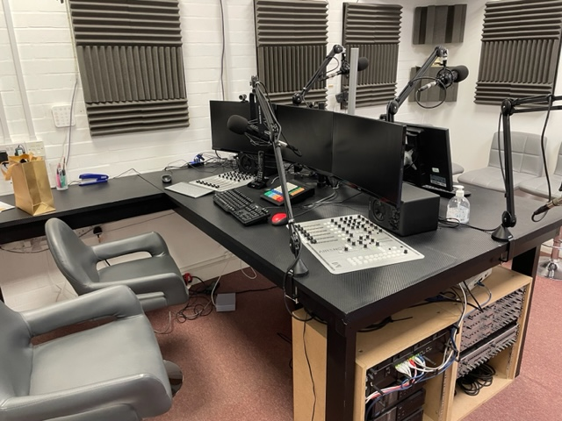
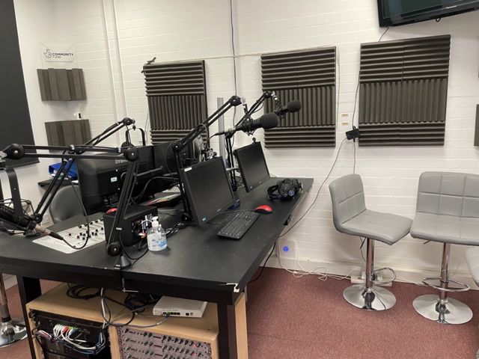
Innovation
We embrace novel and creative approaches, methods, and practices to improve the educational experience and outcomes for our pupils, as well as better meet their evolving needs
Music
Annual Music Festivals & Gigs
To offer our pupils the chance to access live and spectacular 'out of this world' events that they may otherwise never experience
Music Singles
We have released a number of successful iTunes charts music singles – ‘Don’t Give Up’ (Number 1, 2018), ‘Hall Of Fame’ (Number 9, 2021), ‘Beautiful’ (Number 13, 2023)
Record Company
We have set up our own record company – ‘FAW Records’ and distribute our music singles across 120 media platforms and 240 countries worldwide
Radio Station
We have recently acquired a radio station – and will be shortly re-launching it as ‘Maidstone Radio FAW All’
IQM National Inclusion Conference

Slide 18
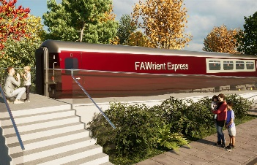
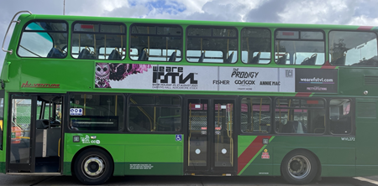
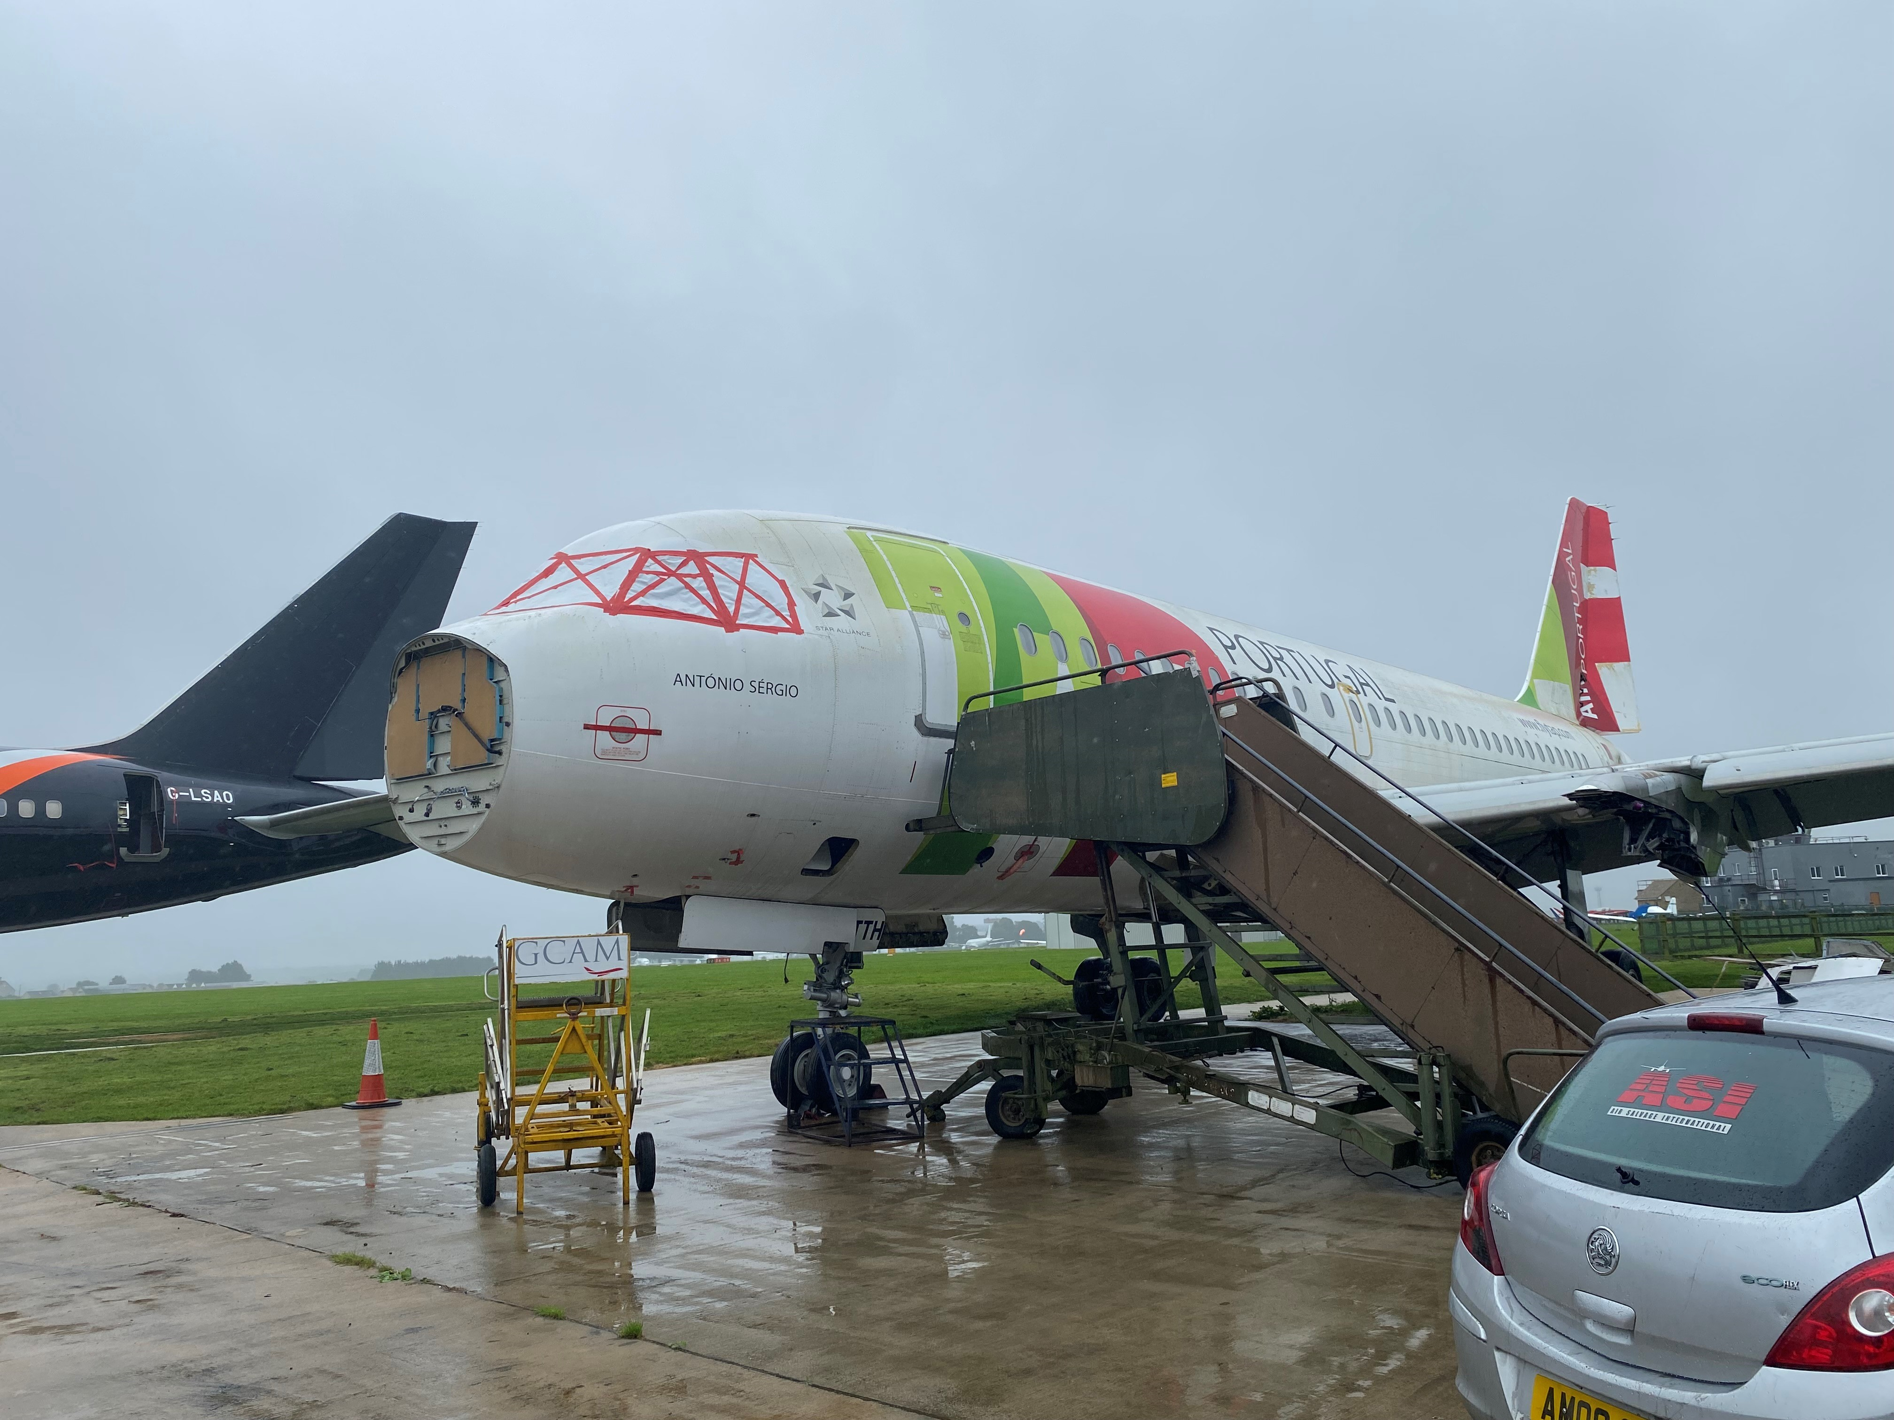
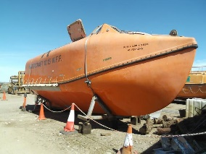
Innovation
We embrace novel and creative approaches, methods, and practices to improve the educational experience and outcomes for our pupils, as well as better meet their evolving needs
Learning Environments
The FAWrient Express
Our pioneering hospitality training academy, where our pupils will acquire ‘industry ready’ tools, know-how and experiences, to help improve their chances of finding employment and the key life skills they need to thrive
FAWnderland
Our new double decker bus, which is being transformed into a specialist soft play space
Apple Tree Yard
A unique and immersive learning experience which includes a farm, nursery and outdoor learning environment
Coming soon….
The 7FAW7
Our new library, housed in the cockpit and fuselage of an aeroplane!
Peggy’s Farm Shop
A ‘working’ shop, where our pupils will learn valuable retail skills, whilst selling our own products and produce
FAWtilus
A dedicated counselling space for pupils and staff
The FAWtory
A factory where pupils will learn production line skills – e.g. fruit packing, paper making
IQM National Inclusion Conference

Slide 19
Innovation
We embrace novel and creative approaches, methods, and practices to improve the educational experience and outcomes for our pupils, as well as better meet their evolving needs
Training & Development
Performance Psychology
All staff benefit from world class ‘performance psychology’ support and training, from our friends at Mindflick
World Class Consultants
We are supported by a range of global thought leaders such as Emily Rubin, James Kerr, Doctor Ceri Evans
Training & Conferences
We regularly stage our own training events, conferences and ‘summits’
Multi-Disciplinary Team
We have established a multi-disciplinary team to support our staff and pupils
Challenges
Previous Challenges….
…include cycling from London To Paris, Conquering the Welsh 3000s and running the Saxon Shore Relay
This Year – The National FAW Peaks Challenge
A team of staff, family members and representatives from partner organisations will be summiting Snowdon, Scafell Pike, Ben Nevis Slieve Donard, during Easter ‘24
And We’re Planning….
A World Record attempt….
IQM National Inclusion Conference

Slide 20
Quick Wins (or Key Takeaways)
See everyone as an individual – including staff
Focus on innovation, calculated risks and ‘absurd ideas’
Develop strong partnerships
IQM National Inclusion Conference

Slide 21
Questions
#IQMFamily
IQM National Inclusion Conference

