Slide 2
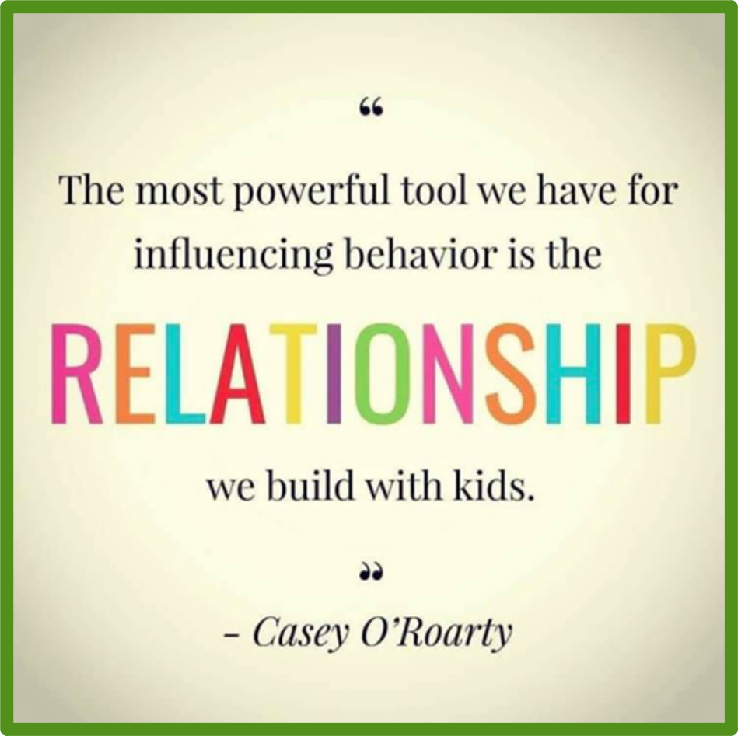
IQM National Inclusion Conference

Slide 3
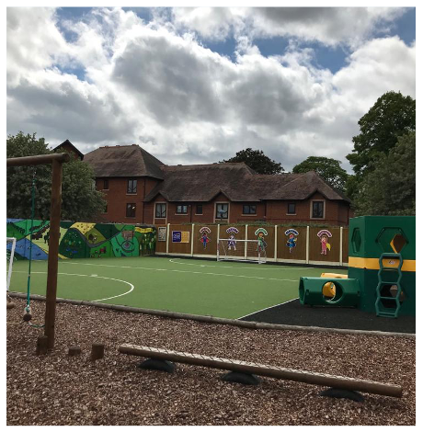
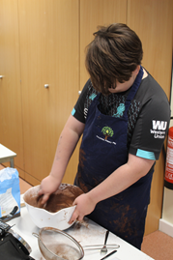
What underpins an effective and positive behaviour culture?
Quality First Teaching, engaging lessons pitched at the right level so to reach ALL pupils.
Positive relationships based on respect in an extremely nurturing and caring environment.
Don’t Pretend!
The best and first behaviour support strategies
Notes:
QFT – engaging and high quality lessons that triangulate with the assessment and attainment of the pupils. Differentiated to meet the needs of all pupils within your leaning environment.
Relationships – As we said earlier every interaction is a relationship. The relationship is key the hardest to reach children don’t know how to make a relationship – we need to forge that relationship for them – it is for us to make a relationship with the child.
Don’t pretend – above all don’t pretend to like the children – they know! I was having a conversation when I first came to Perryfields with a very experienced member of the outreach team and I made a comment about if you can’t find something that you like about a child pretend at which the outreach practitioner said to me NO! Find something, find that one small thing that you like about that child; their smile, the colour of their eyes, the style of their hair….. And use it. Build on it and that small thing will grow as the relationship grows.

Slide 4
Importance…
“How much a difference really great teachers make.”
Dylan William / Paul Black.
“Pupils learn best through the smiling eyes of the teacher.”
Prof Bart McGettrick (Dean of Liverpool Hope University)
As a leader my role is… “helping every teacher do a better job day in day out.”
Dylan William
“Schooling is a one-shot deal for our students.”
Notes:
PH
Worthwhile being good.

Slide 5
Create an atmosphere of pupils who seek recognition and are eager to please through constant praise and encouragement – create a culture where it’s worthwhile being good
IQM National Inclusion Conference

Slide 6
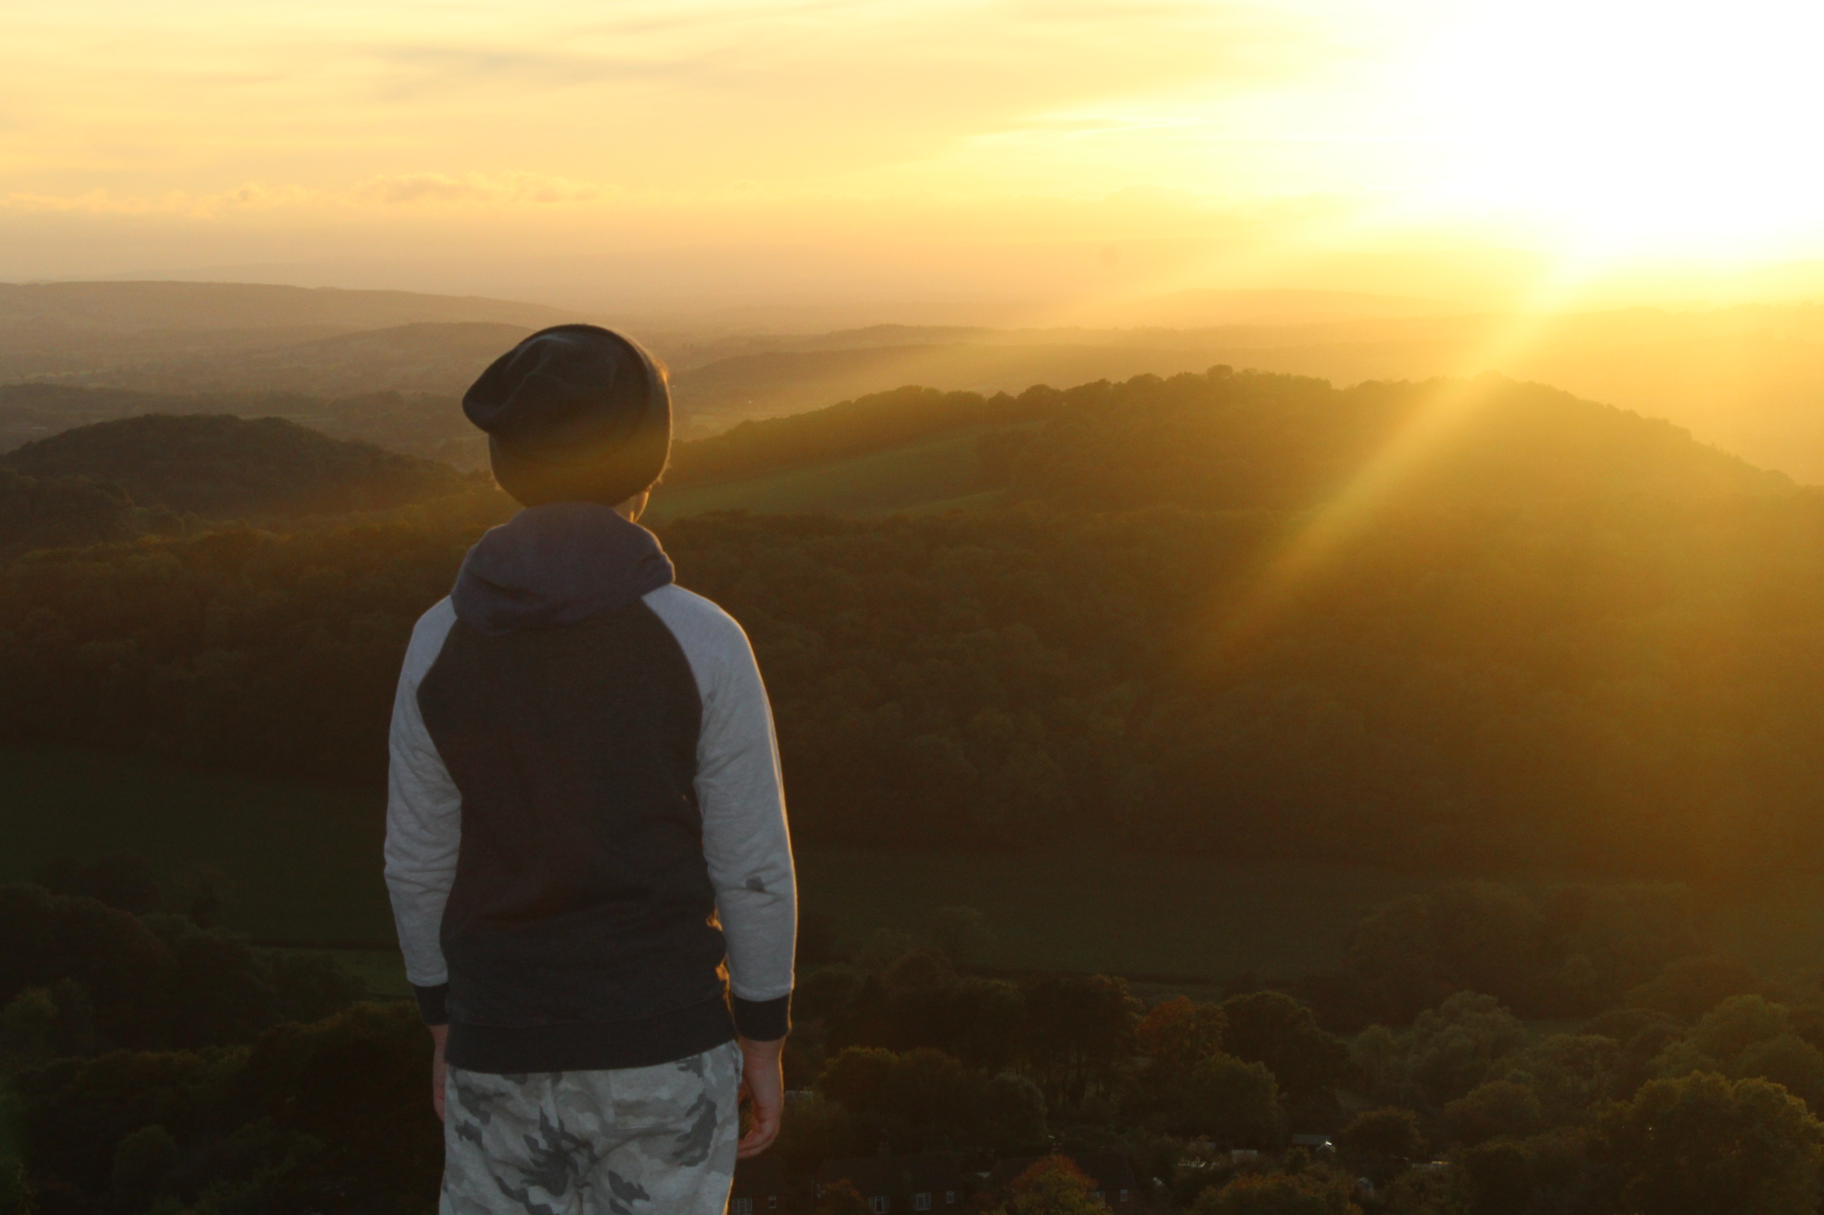
Thinking of a child as behaving
badly disposes you to think of punishment.
Thinking of a child as struggling to handle
something difficult encourages you to help
them through their distress.

Slide 7
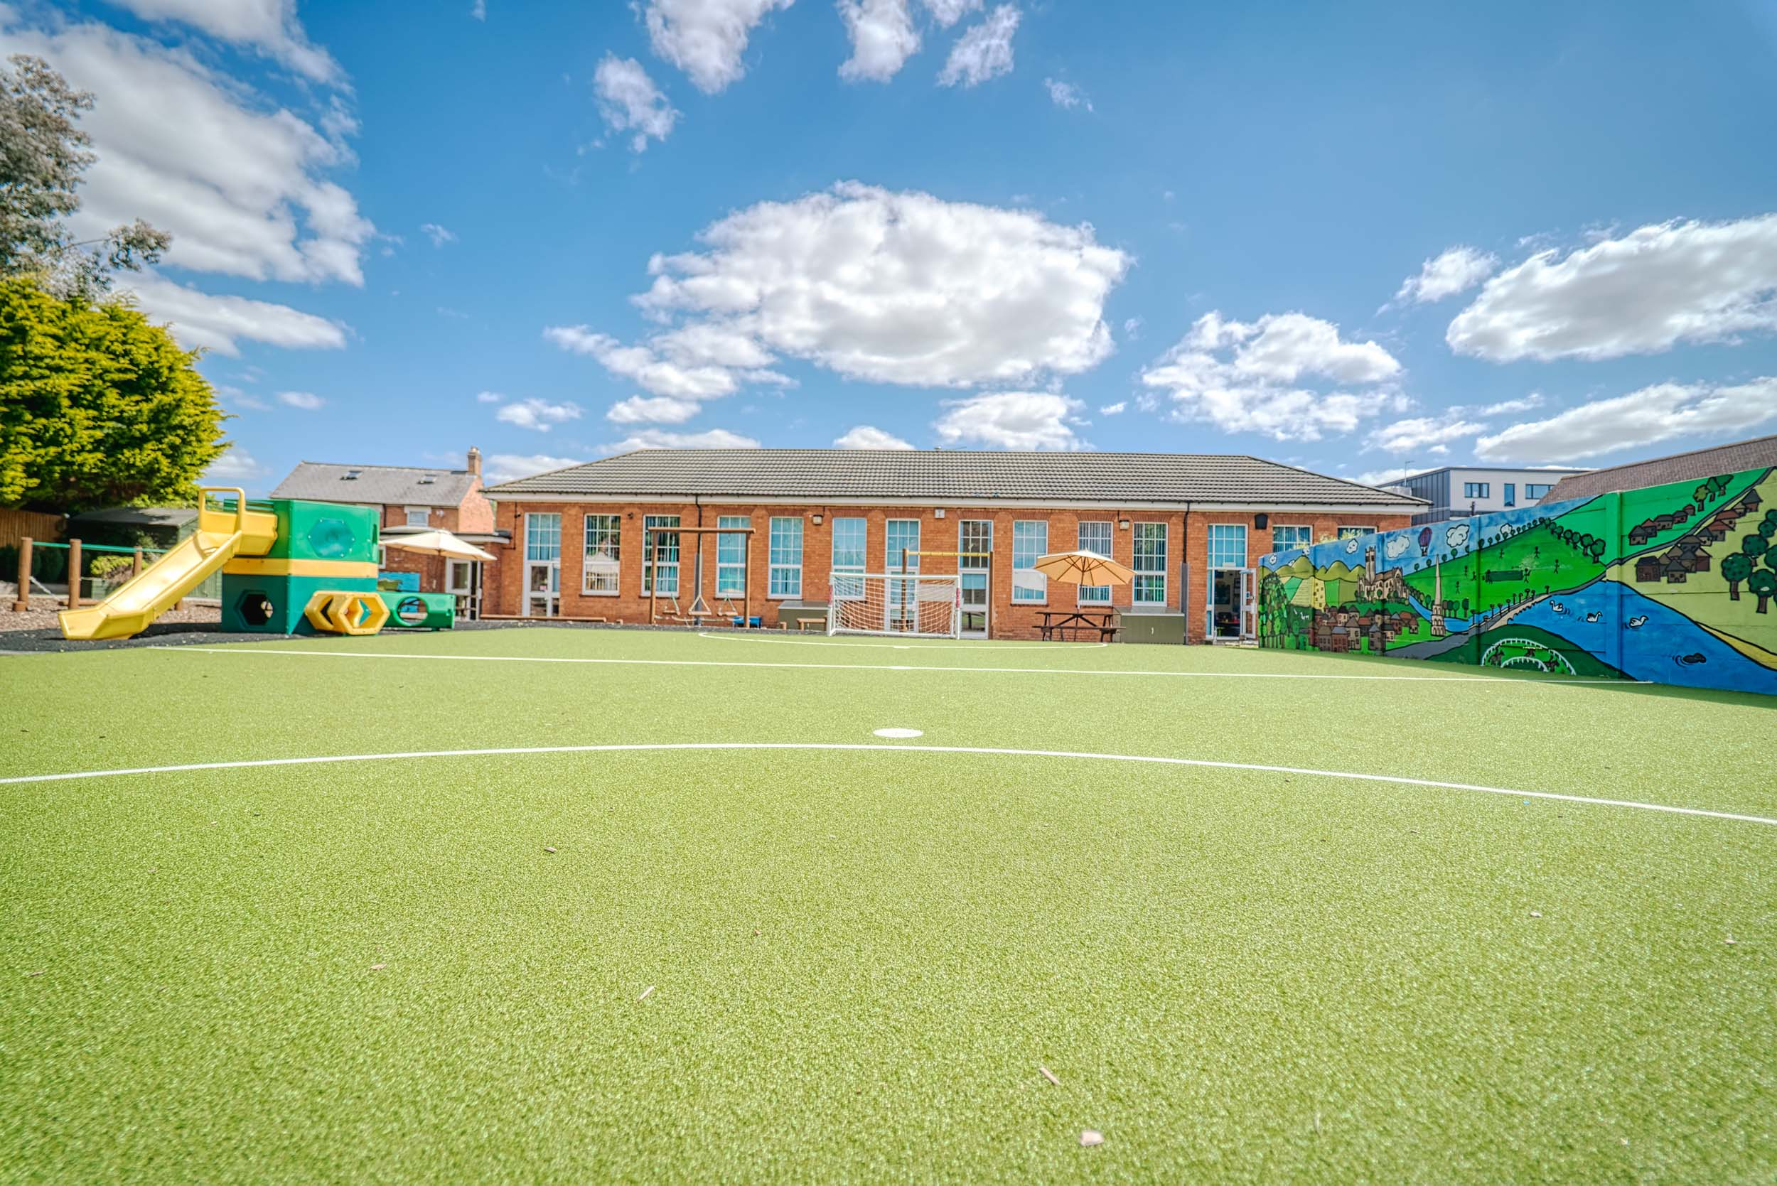
“You can’t teach children to behave better by making them feel worse.
When children feel better, they behave better.”
Pam Leo
Author of Connecting Parenting

Slide 8
.
.
IQM National Inclusion Conference

Slide 9
It is vital to spend time thinking very clearly about the core values that are important to the school. At Perryfields we have established the following, so we know what we are and what we want:
Hard work
Empathy, kind and caring
Humility
Adaptable
Teamwork
Reflective
Creativity
Resilient
Willingness to embrace purposeful change
IQM National Inclusion Conference
IQM National Inclusion Conference

Slide 10
Perryfields – Example Interview Questions
Questions | Related Values
What motivated you to apply for this role? What do you know about Perryfields? What impressed you during your visit? | Hard Work
Thank you for allowing us to watch you teach. How do you feel it went? What would you do differently next time? | Reflective
If I walked into your classroom at Perryfields what would I see? | Hard Work, Adaptable, Willingness to Embrace Purposeful Change
Tell us what you feel are some of the key components of an engaging curriculum. | Creativity, Reflective
What areas of the curriculum do you consider as strengths and which do you feel you have areas for development? | Humility, reflective
What personal qualities do you have which would help you work effectively as part of a team? | Teamwork, Empathy, Kind, Caring, Adaptable
If you were to ask a colleague to describe you in 3 words which ones would they choose? | Reflective, Humility
Working with our pupils can be rewarding but equally hard work. How would you ensure that you are able to maintain a positive mental and physical health? | Resilience, Creativity, Adaptable, Reflective
IQM National Inclusion Conference

Slide 11
IQM National Inclusion Conference

Slide 12
‘Culture eats strategy for breakfast’
At Perryfields it can be summed up by ‘the way things are done around here’

Slide 13
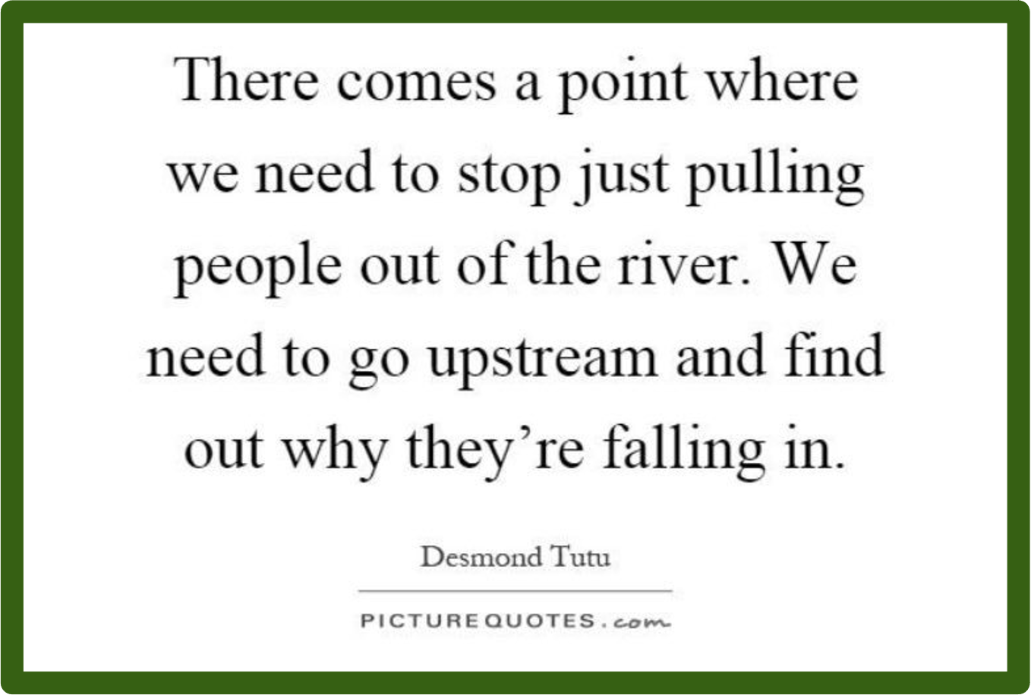
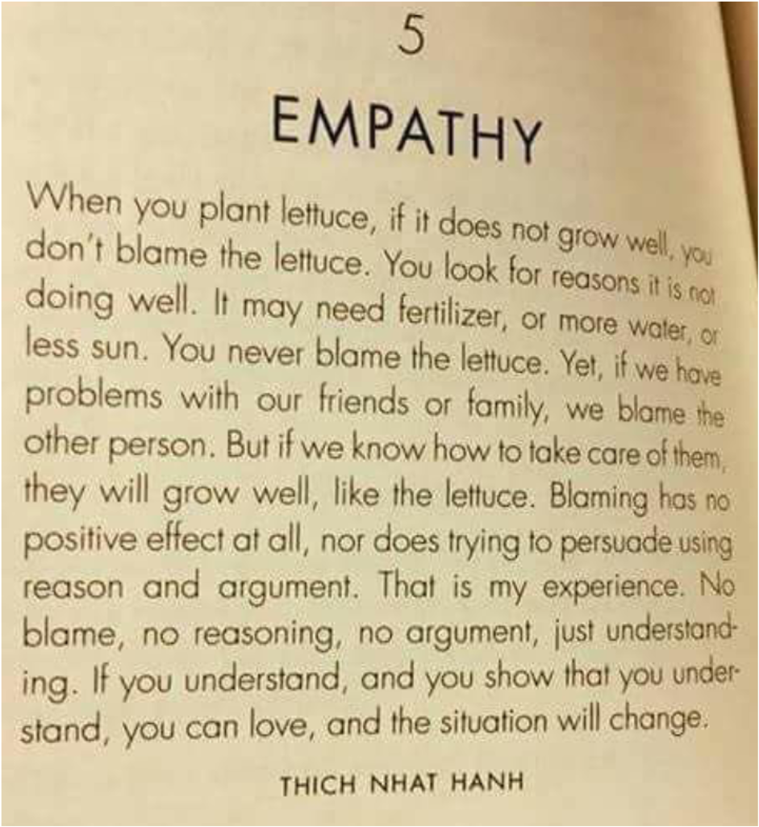

Slide 14
Quick Wins
Clarity of shared vision
Values based approach to appointing the right people
Be relentlessly positive!
IQM National Inclusion Conference

Slide 15
Questions
#IQMFamily
IQM National Inclusion Conference

