Slide 1
Enabling Environments with a Focus on The Outdoors and Forest School Provision
Presented by David Delaney and Georgia Geering
from Christ the King Primary School
th
IQM National Inclusion Conference, 27
November 2023
#IQMFamily

Slide 2
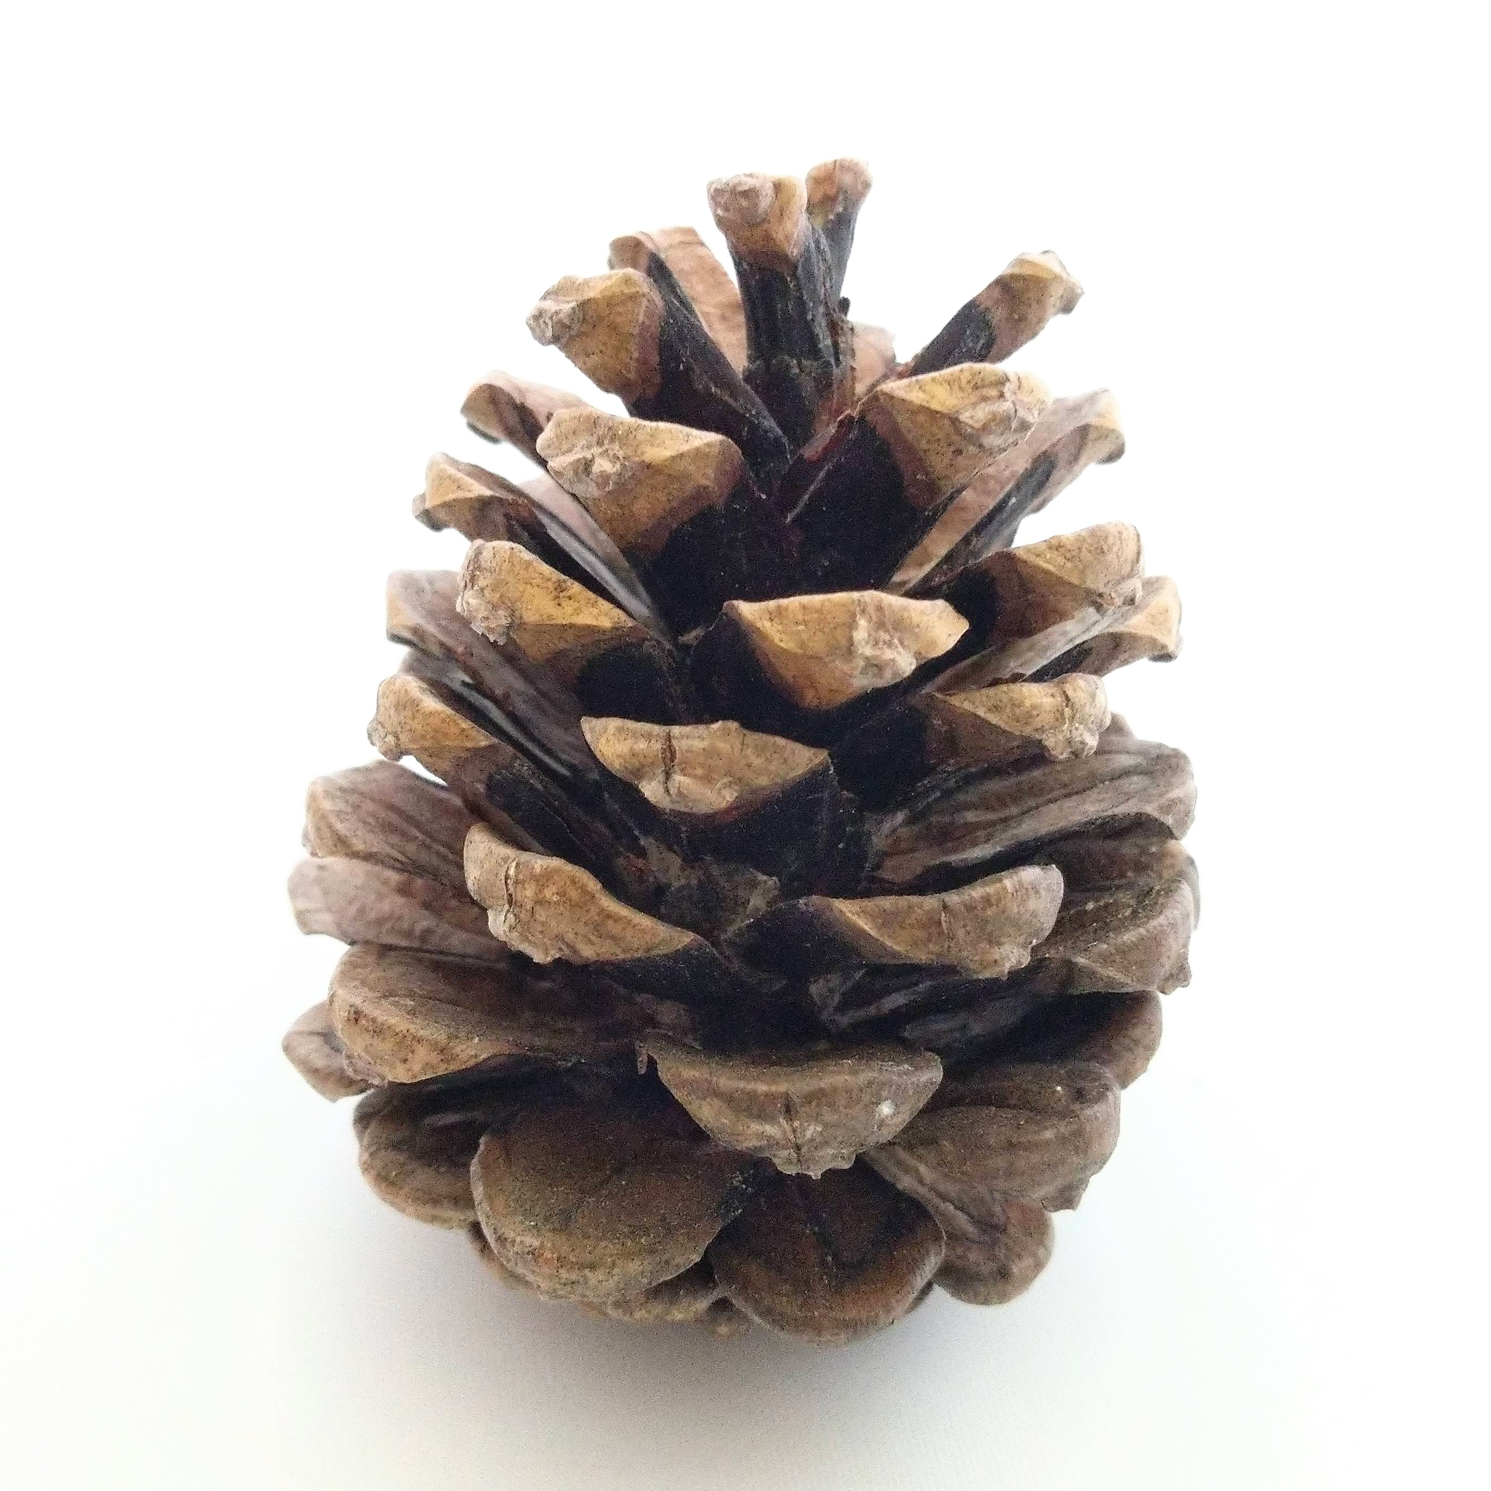
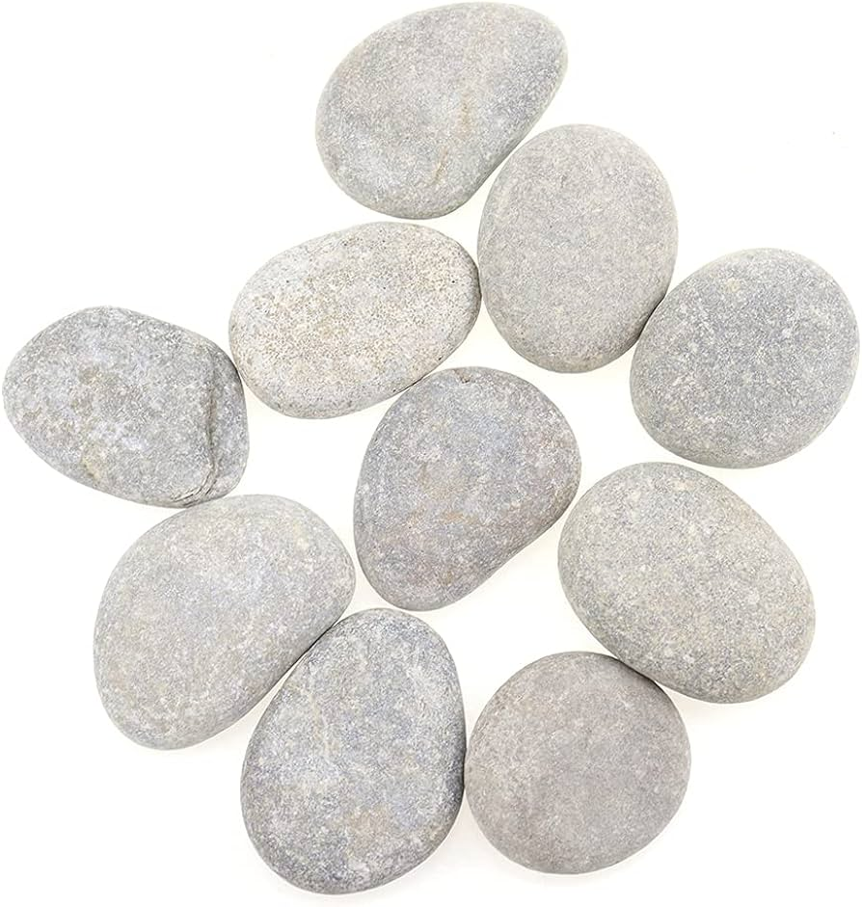
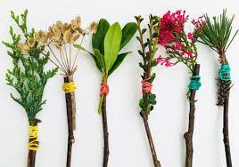
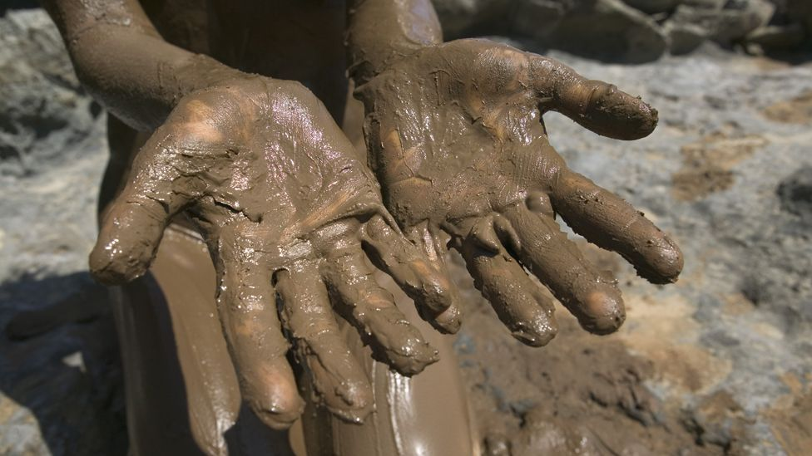
Reflection
IQM National Inclusion Conference
Notes:
2 minutes to choose an item from selection on table. Encourage P4C style discussion in pairs/tables. As a group, make the link between physical objects/environment and emotions. We can draw feelings and opinions from static objects - chn and staff do this with their school environment too.
We spend large amounts of time in the classroom/wider school environment. This time can impact SEMH when the experience is pos/neg.
https://commonslibrary.parliament.uk/research-briefings/sn07148/

Slide 3
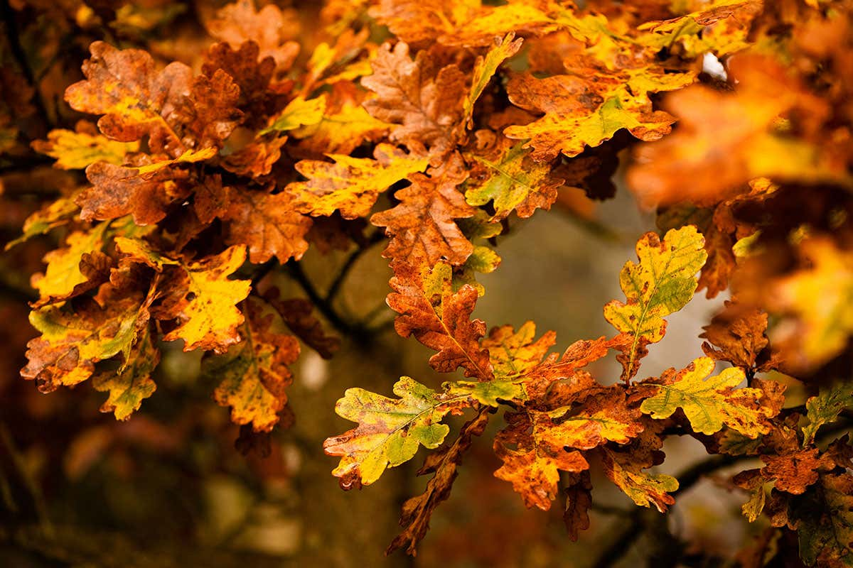
Reflection
IQM National Inclusion Conference
Notes:
2 minutes to choose an item from selection on table. Encourage P4C style discussion in pairs/tables. As a group, make the link between physical objects/environment and emotions. We can draw feelings and opinions from static objects - chn and staff do this with their school environment too.
We spend large amounts of time in the classroom/wider school environment. This time can impact SEMH when the experience is pos/neg.
https://commonslibrary.parliament.uk/research-briefings/sn07148/

Slide 4
Reflection
Children in LA maintained schools should spend at least 1,235 hours per academic year in their school building. How do we design these spaces to ensure the support of good mental health and wellbeing? How do we make this space inclusive and supportive of all learners when pupils’ needs are so varied?
IQM National Inclusion Conference
Notes:
2 minutes to choose an item from selection on table. Encourage P4C style discussion in pairs/tables. As a group, make the link between physical objects/environment and emotions. We can draw feelings and opinions from static objects - chn and staff do this with their school environment too.
We spend large amounts of time in the classroom/wider school environment. This time can impact SEMH when the experience is pos/neg.
https://commonslibrary.parliament.uk/research-briefings/sn07148/

Slide 5
School Context
Currently we have 412 children on roll, we grew over time from an intake of 45 to an intake of 60 across school.
IQM National Inclusion Conference

Slide 6
Enabling Environments
IQM National Inclusion Conference
Notes:
Examples of ways we incorporate indoor/outdoor environments for specific groups of children and all children. When is it appropriate to provide extra support? How does this impact SEMH?

Slide 7
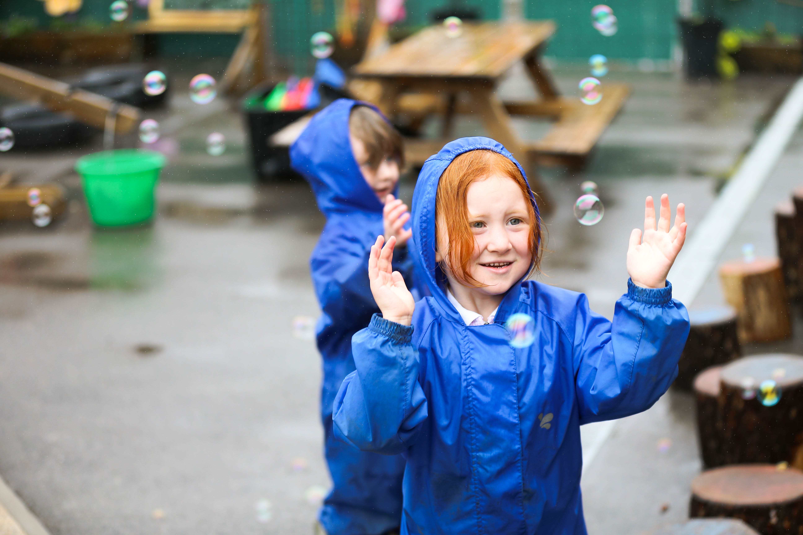
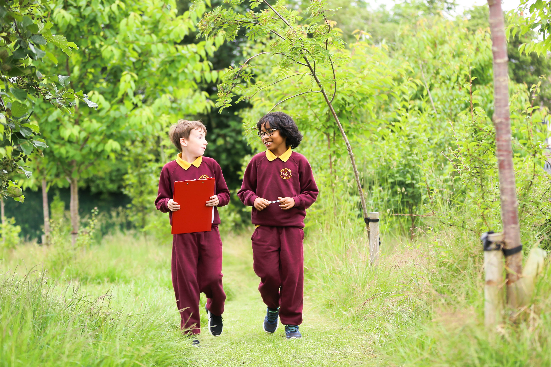
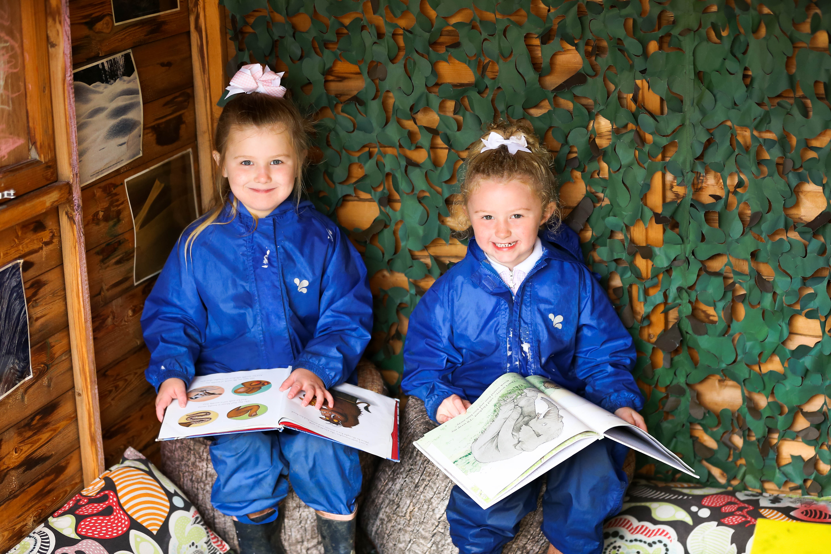
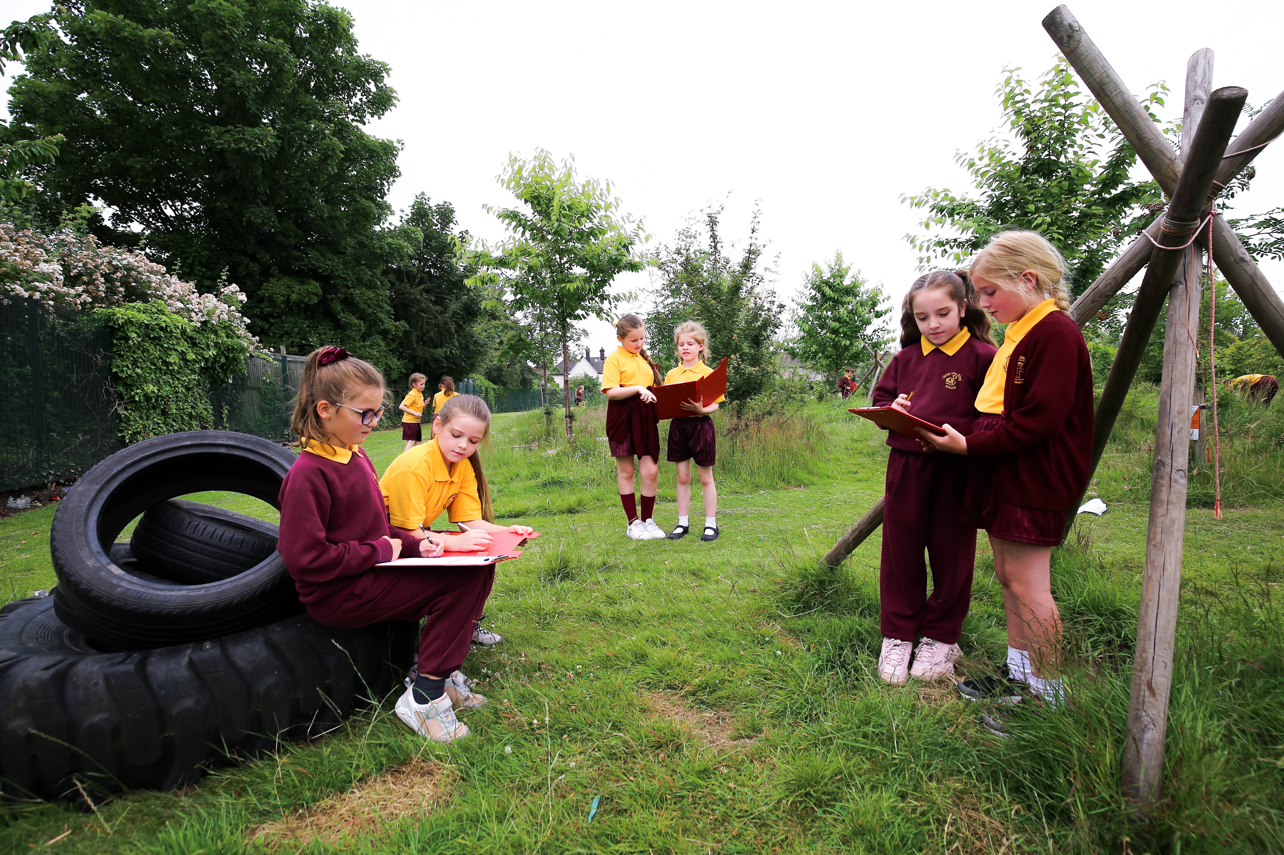
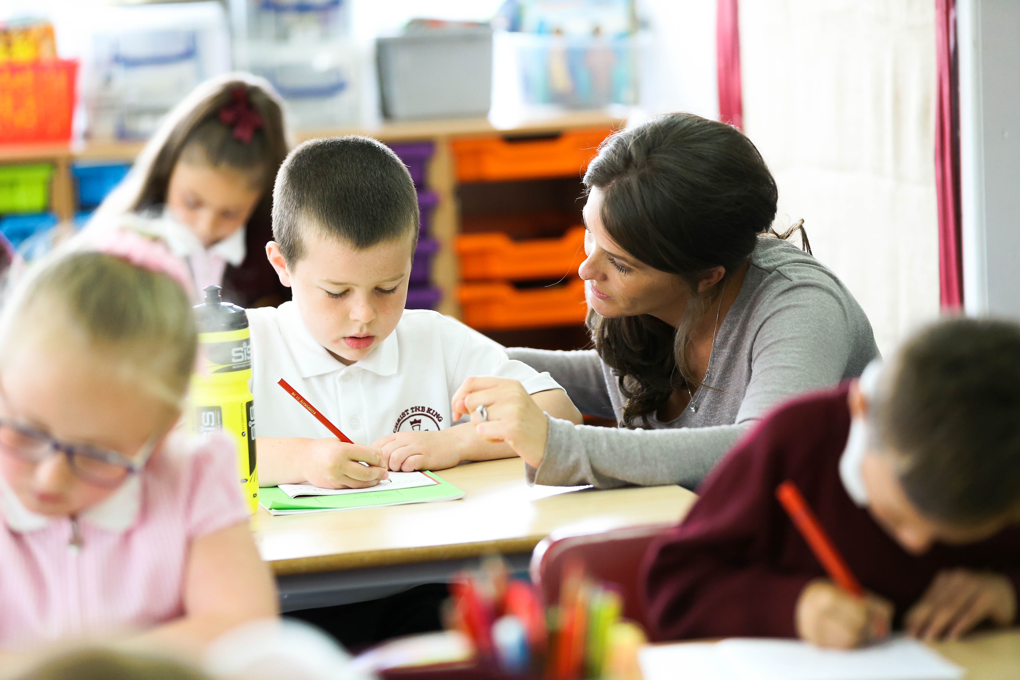
Enabling Environments
IQM National Inclusion Conference
Notes:
Examples of ways we incorporate indoor/outdoor environments for specific groups of children and all children. When is it appropriate to provide extra support? How does this impact SEMH?

Slide 8
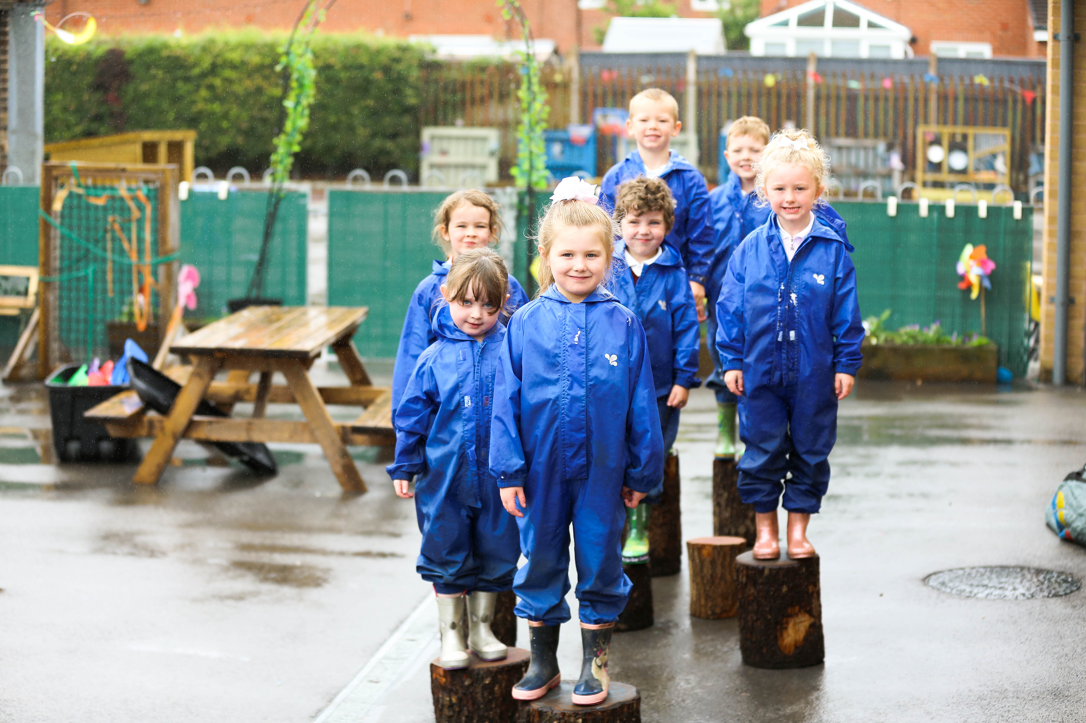
Enabling Environments
Nature Nurture Group
Who? - Children identified by class teachers/IEPs with SEMH needs who would benefit from more time outside
When? - weekly, small groups LKS2/LKS2
Where? - outside environments in need of TLC!
Why? - mindfulness of gardening, opportunities to take responsibility for the school environment
How? - gardening, site maintenance
IQM National Inclusion Conference
Notes:
Examples of ways we incorporate indoor/outdoor environments for specific groups of children and all children. When is it appropriate to provide extra support? How does this impact SEMH?

Slide 9
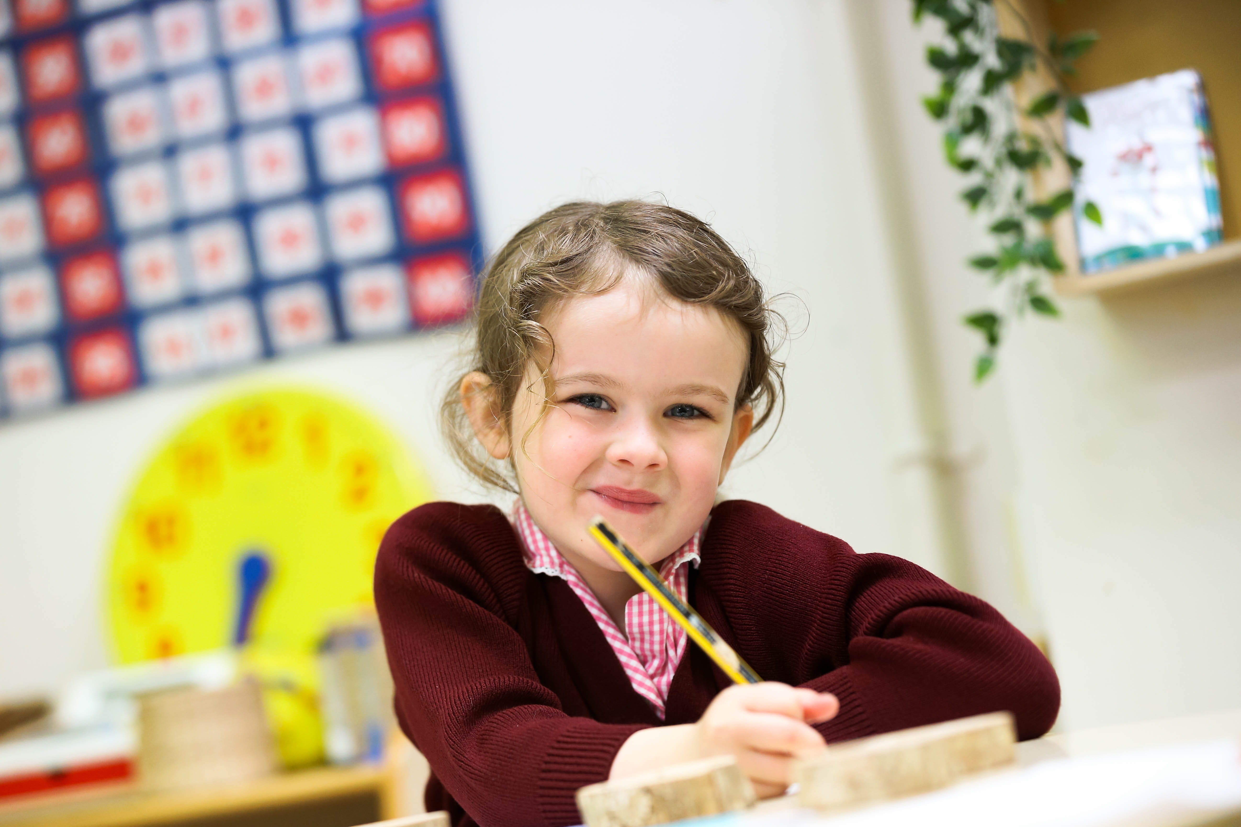
Enabling Environments
Classrooms
Amphitheatre
Who? - All children, EYFS - Y6
When? - teacher directed during lesson time, daily at break times
Where? - playground
Why? - performance, development of speech and language skills, listening skills
How? - reading, drama, performance poetry
IQM National Inclusion Conference

Slide 10
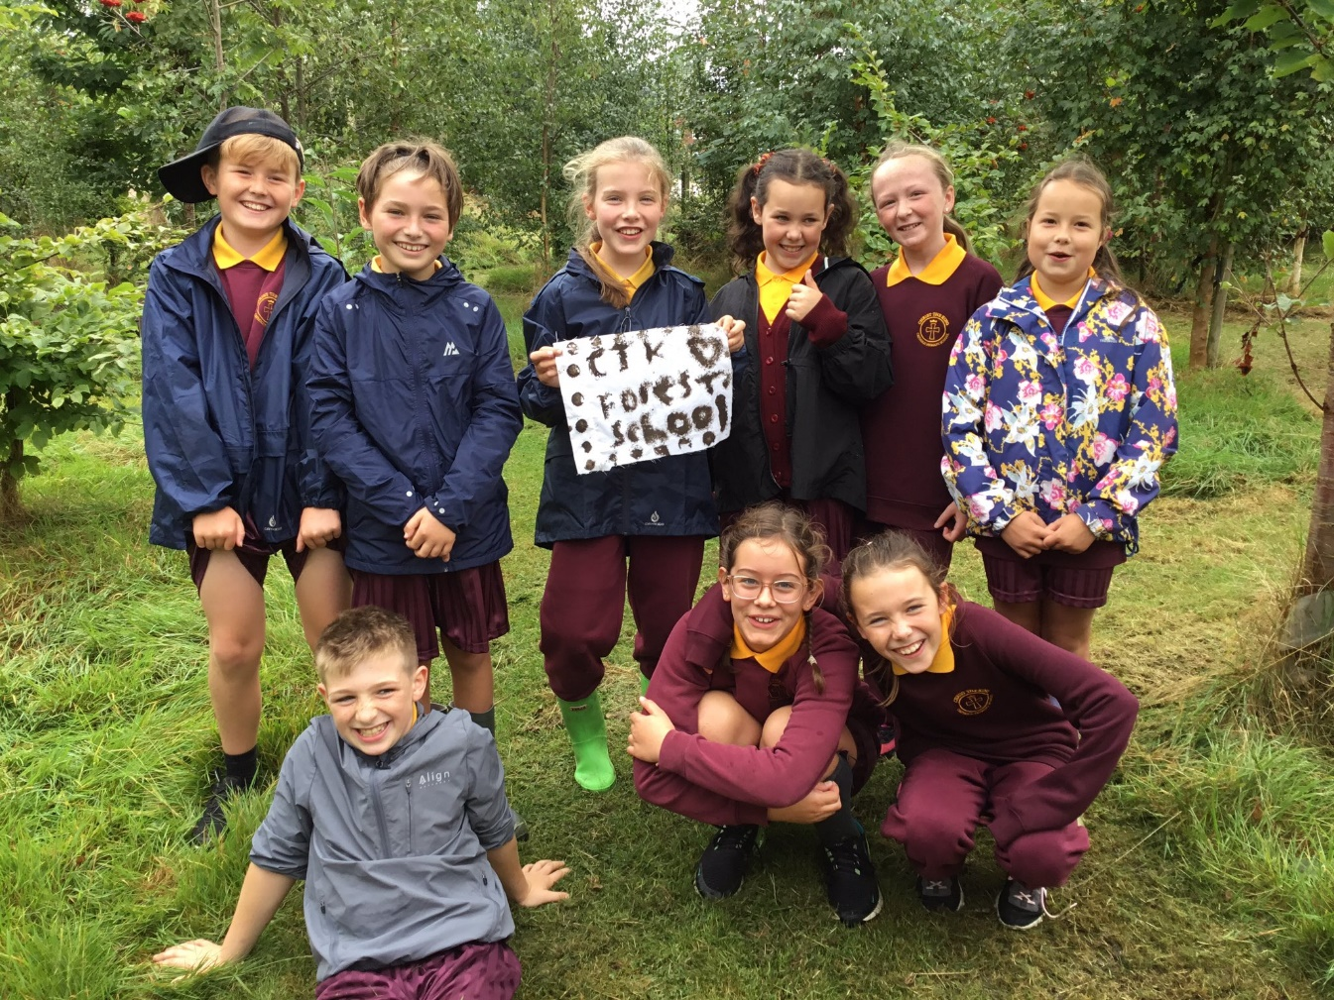
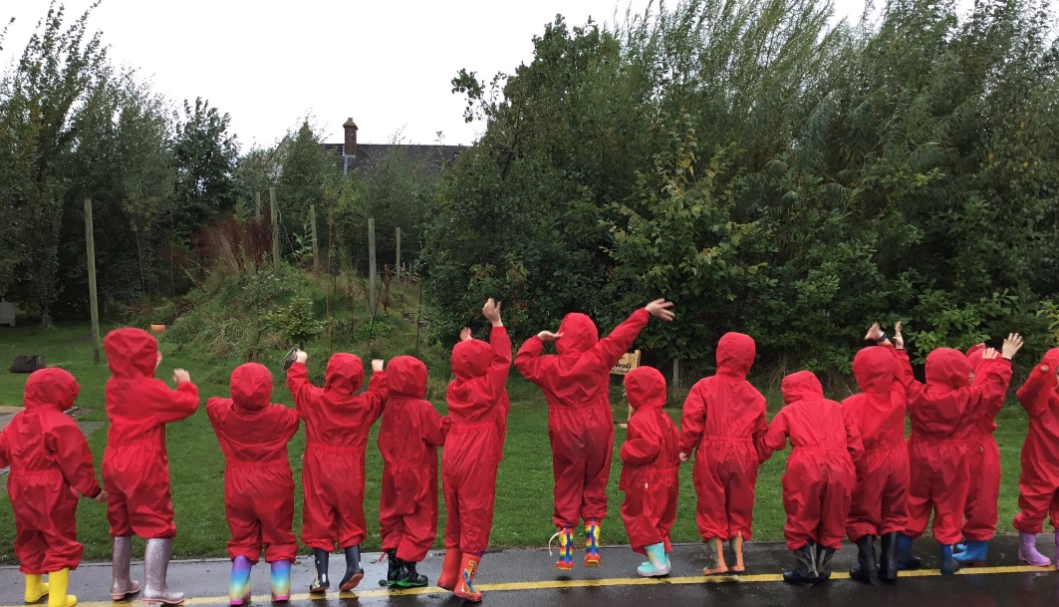
Forest School
Why Forest School?
Forest School aims to promote the holistic development of all involved, fostering resilient, confident, independent and creative learners.
Forest School offers learners the opportunity to take supported risks appropriate to the environment and to themselves.
Forest School Association (FSA)
IQM National Inclusion Conference
Notes:
Explain why this is important to our school context specifically - especially after lockdowns. Children are very busy and have limited time to decompress and relax. Sensory overload. Increasing MH concerns.

Slide 11
Reflection
IQM National Inclusion Conference
Notes:
2 minutes to choose an item from selection on table. Encourage P4C style discussion in pairs/tables. As a group, make the link between physical objects/environment and emotions. We can draw feelings and opinions from static objects - chn and staff do this with their school environment too.
We spend large amounts of time in the classroom/wider school environment. This time can impact SEMH when the experience is pos/neg.
https://commonslibrary.parliament.uk/research-briefings/sn07148/

Slide 12
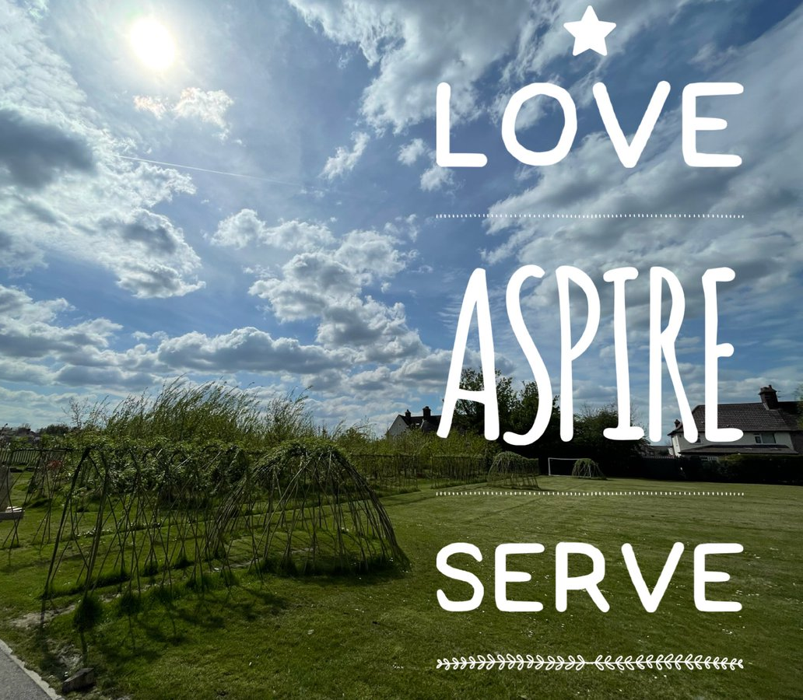
Forest School
‘Forest School’ at our school
A provision for all children
Reception – Year 6
Wellbeing & Mental Health Universal Offer
Part of our PPA cover
Children access every other week in small groups of 15
IQM National Inclusion Conference
Notes:
Explain why this is important to our school context specifically - especially after lockdowns. Children are very busy and have limited time to decompress and relax. Sensory overload. Increasing MH concerns.

Slide 13
 | Autumn | Spring | Summer
EYFS | Exploring Autumn Colours Using the environment around us to explore and identify changes in the seasons. | Changes in Spring Exploring changes in Spring with a focus on wildlife in our Forest School environment. | Celebrating Summer Observing the changes in how we use Forest School during the warmer months.
Y1 | Appreciating Autumn through Art Using the natural colour palette of Autumn to create art and crafts to reflect the environment. | Nature in our Local Environment Paying close attention to the minibeasts and other creatures who live in our Forest School. | Den Building Beginning to use sheets, tarpaulin and pegs to build simple shelters, appropriate for the warmer weather.
Y2 | Autumnal Crafts with Natural Resources Using the leaves, fruit and seeds of Autumn to create art and crafts to reflect the environment. | Supporting Nature Learning how to help the birds, insects and other creatures who live in our Forest School. | Den Building with Natural Resources Gathering sticks, leaves and other natural resources to build shady shelters in warm weather.
Y3 | Identifying Flora and Fauna Identification of common plants and animals in our Forest School environment. | Crafting With Tools - Woodwork Skills Applying fine motor and personal risk assessment skills to use woodworking tools safely. | Beginners Knots for Den Building Learning to tie beginning knots applicable to den building, including a basic clove hitch.
Y4 | Local Wildlife Conservation Using knowledge of common plants and animals in our Forest School environment to support growth. | Crafting With Tools - Whittling Skills Applying fine motor and personal risk assessment skills to use knives and peelers safely. | Applying Knots to Den Building Further development of knot skills and developing the ability to apply this in practice.
Y5 | Developing Den Skills Building on prior knowledge of knots and social skills to build dens successfully in groups. | Wildlife Watch - Identification Developing independent knowledge of common garden birds, insects and mammals. | Group Campfire Skills Applying personal safety and fine motor skills to begin to build a successful group campfire.
Y6 | Building Shelters for Protection Applying prior learning to build safe, waterproof shelters independently in groups. | Wildlife Watch - Conservation and Preservation Using independent knowledge of common garden birds, insects and mammals to support them. | Developing Campfire Skills Further development of campfire skills, including using fire strikers independently to create and maintain small fires.
IQM National Inclusion Conference
Notes:
Ensuring a development of skills, develops a feeling of achievement and progress for children. This is especially important for those children who struggle to thrive in “academic” subjects but are able to achieve in more hands-on tasks.

Slide 14
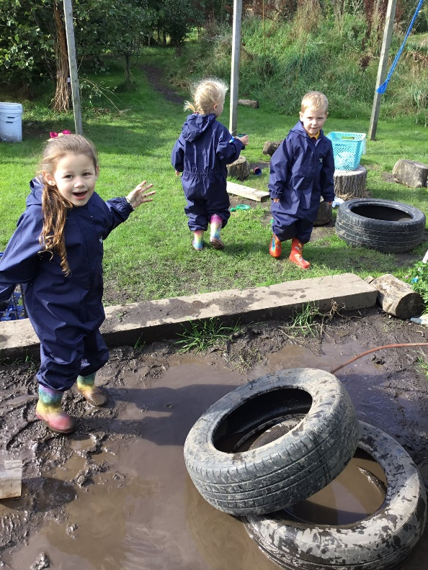
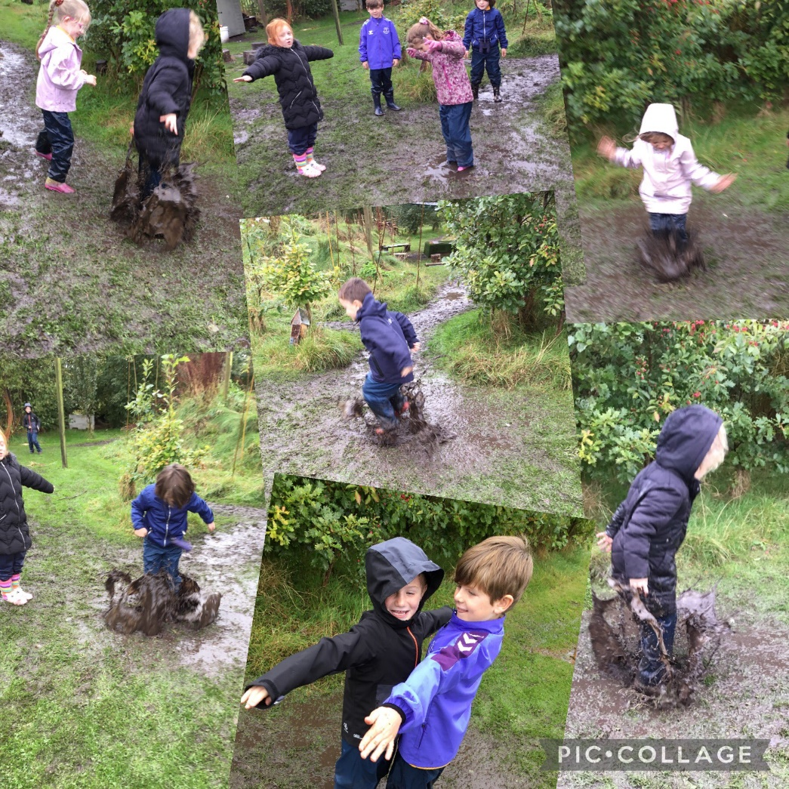
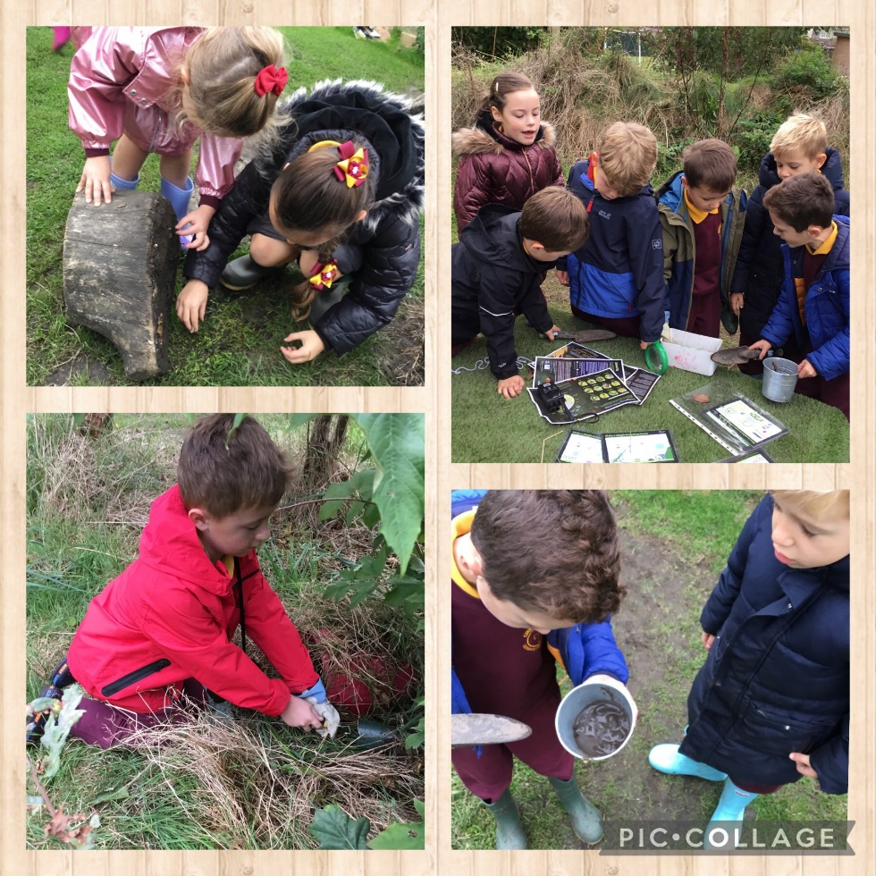
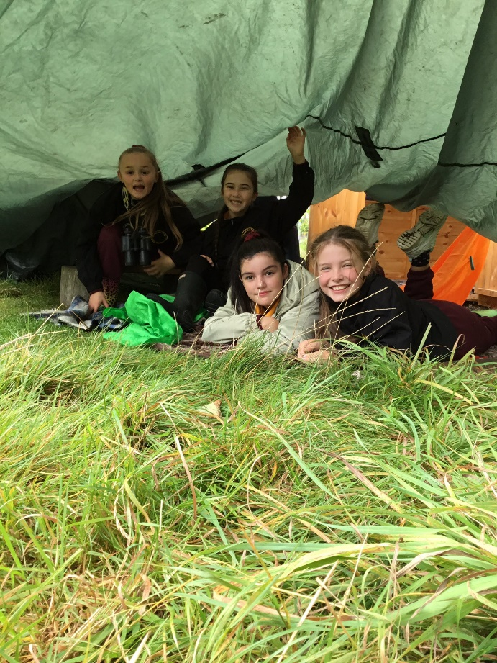
In Practice
EYFS | Focus on: Developing social skills Nurturing safe independence Encouraging exploration and child-led learning Play
KS1 | Focus on: Continuing to develop social skills Fine and gross motor skill development Further understanding of safe independence Awareness of world around them Play
LKS2 | Focus on: Freedom to choose – independent social development Cultural capital – beginning to develop vocabulary and understanding of wildlife Trust and independence Play
UKS2 | Focus on: Freedom to choose – independent social development Cultural capital – exploring opportunities not always available outside of school e.g. building campfires Trust and independence with tools Play
IQM National Inclusion Conference
Notes:
Links to EYFS continuous provision for all children - this is why every age group has opportunities to play.

Slide 15
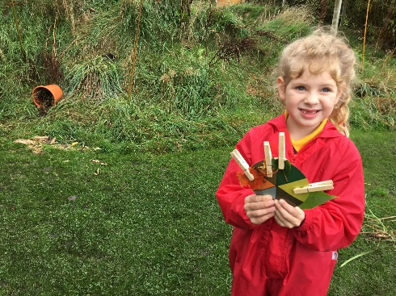
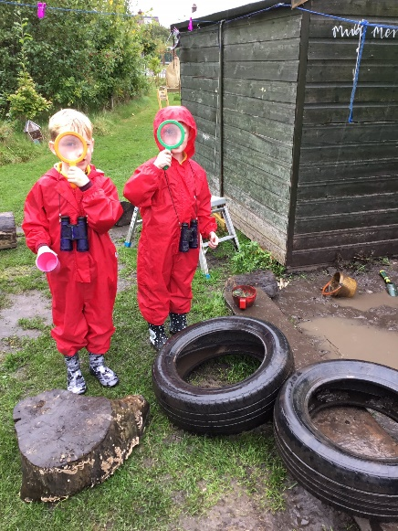
Impact
Improved mental health and wellbeing – children are aware of the importance of being outdoors and how this can positively impact wellbeing. Taking a mindful moment to be thankful for the space and time we have in Forest School.
Improved social skills – children of all ages are given a structured opportunity to engage in free play, often with classmates they would not regularly interact with.
Development of confidence – Forest School skills can often be different to traditional classroom ‘reading and writing’ skills. Typically ‘lower’ attaining pupils can flourish and some ‘higher’ attaining pupils experience challenge in a different context
IQM National Inclusion Conference

Slide 16
Impact - children’s testimonial
IQM National Inclusion Conference

Slide 17
Quick Wins
In small teams conduct an audit of the environment – we started with a 'stop, start, continue method'. Walking from the front door around the whole school
De clutter – Spring clean
Consistency of displays and environments – we use Hessian (creates clear routines and expectations for children, minimises fear of change in new classrooms)?
Empty Classroom Days
Using the outdoor spaces “as a learning resource” - how can children of all ages access continuous provision style learning?
IQM National Inclusion Conference

Slide 18
Questions
#IQMFamily
IQM National Inclusion Conference

