Slide 1
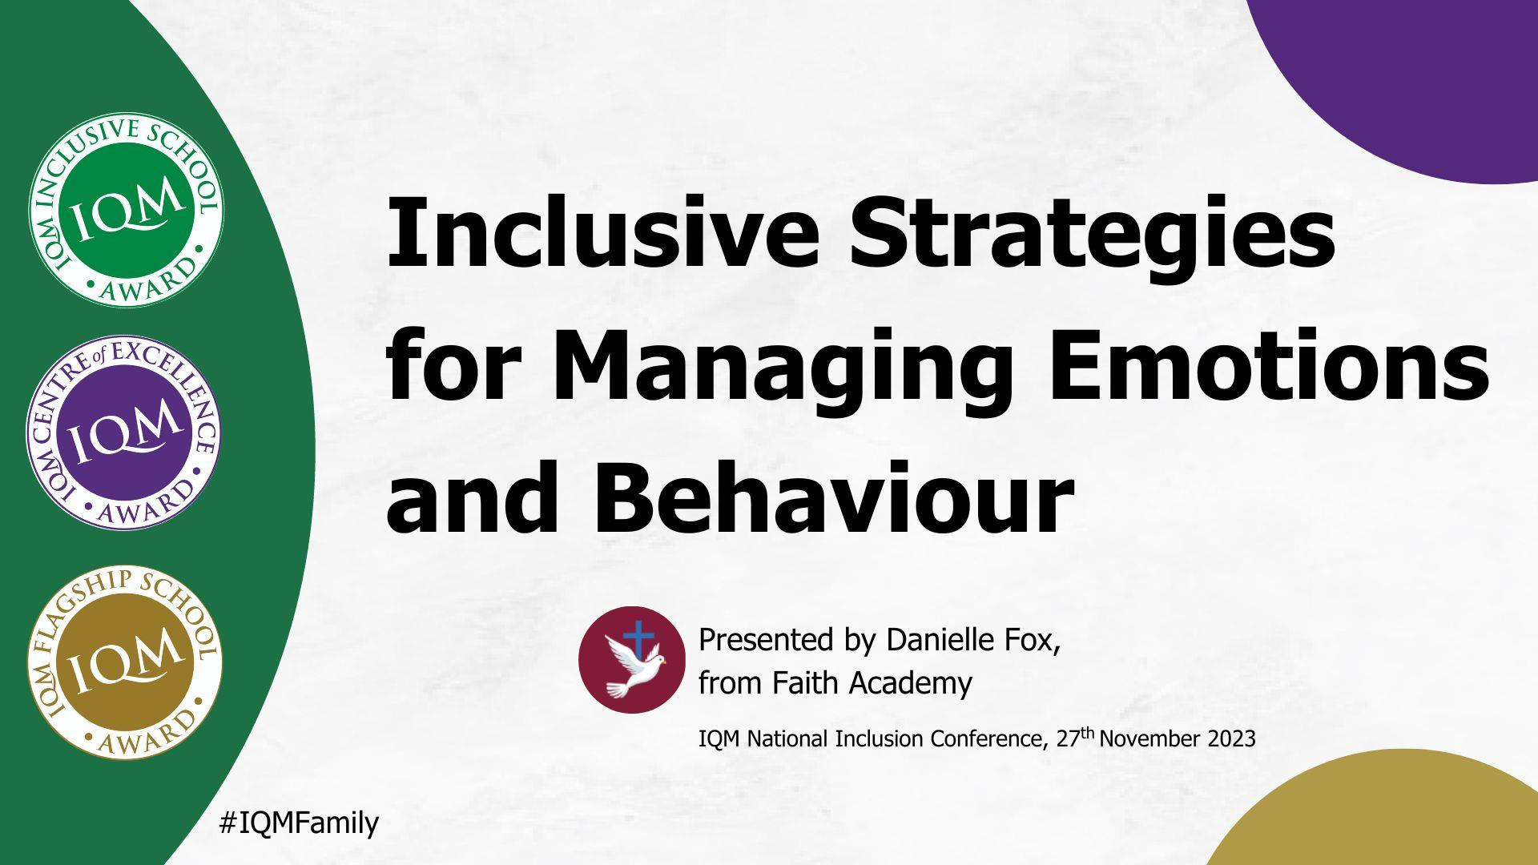

Slide 2




Ice Breaker
Think of an adjective that starts with the letter of your first name and describes one of the qualities
you least like about yourself.
Why do you think this is a negative quality?
IQM National Inclusion Conference

Slide 3

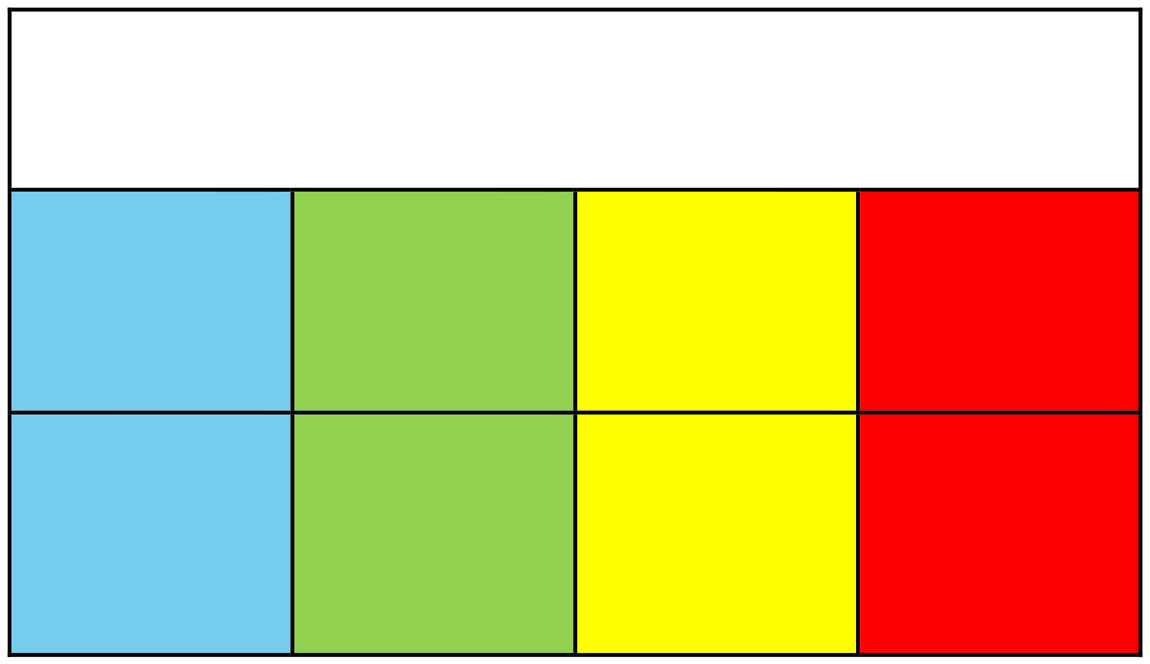

















How did that make you feel?
Morning Check in
Moving slow
Steady beat
Speeding up
Very fast
Sad Upset Lonely Unhappy
Bored Tired
Happy Calm Focused OK Ready to learn
Worried Annoyed Anxious Excited Frustrated Silly
Mad Angry
Yelling Hitting
Loss of control
IQM National Inclusion Conference

Slide 4



Faith Primary Academy is a one-form entry mainstream school located in Everton, which is one of the most deprived areas of Liverpool. On roll we currently have 41% SEND , 51% PP and 42% EAL.
We are passionate that all behaviour is a method of communication, and this is a view held by all of our school community. It is our duty to identify potential triggers for our children and create an environment where they feel safe and secure and are able to regulate and talk about their emotions alongside developing resolution skills.
Our school behaviour system is based around The Zones of Regulation and Restorative Conversations, we believe that
if you “get it right for the one, you get it right for the many”

Slide 5
Faith Primary Academy
Area | 2017 -2018 | 2022-2023
Exclusions | Fixed Term 14 Permanent 5 | Fixed Term 0 Permanent 0
Attendance | 93% | 96.2%
Data | 65% | 80%

Slide 6

Why is emotional
regulation important?
IQM National Inclusion Conference

Slide 7
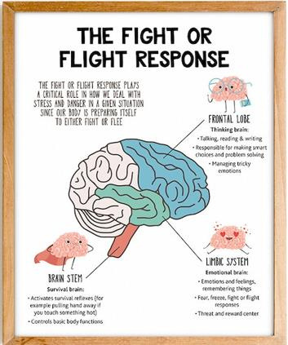
The role of the Prefrontal cortex (PFC)
Prefrontal cortex (PFC). It is responsible for thinking, thought analysis, and regulating behaviour. This includes mediating conflicting thoughts, making choices between right and wrong, and predicting the probable outcomes of actions or events. This vital region of the brain regulates short-term and long-term decision-making. In addition, the PFC helps to focus thoughts, enabling people to pay attention, learn, and concentrate on goals.
IQM National Inclusion Conference

Slide 8
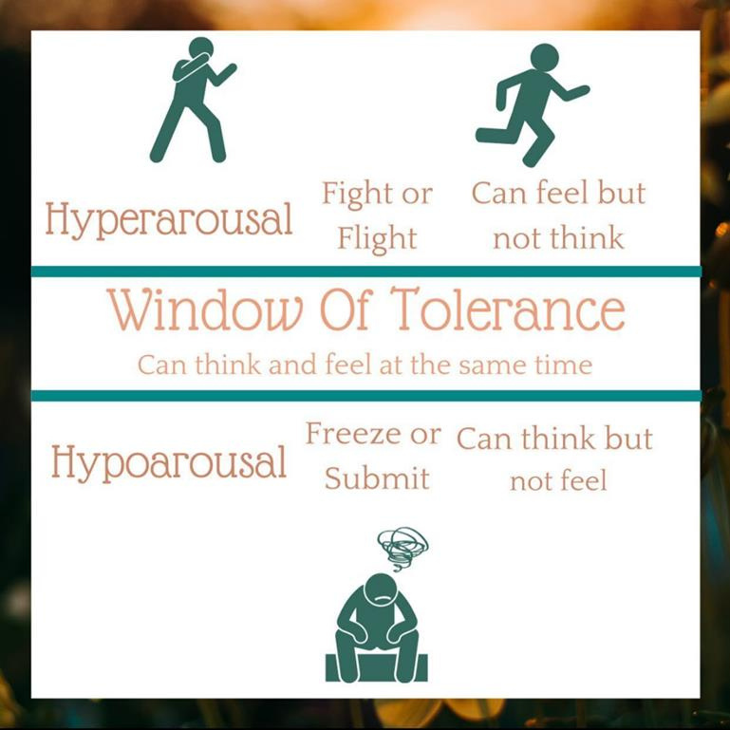
Window of Tolerance
During ‘fight or flight’ blood drains from the prefrontal cortex, so there is no rational thought. This makes it virtually impossible to learn new things, focus on small tasks, or engage with other people as the lower parts of the brain are
focused on survival and escape. When in a state of high arousal, it is impossible to have successful relationships with other people or to learn new things.
.
IQM National Inclusion Conference

Slide 9

Emotional Regulation and Behaviour - Our Journey
.
Date | Task | Evaluation / Barriers
Spring 2018 | Stand alone lessons Zones of Regulation , Training for Teachers, | Allowed Teachers a good starting point to explain emotional regulation. Difficult especially for boys to identify and discuss feelings.
Summer 2018 | Each class to have a Zones of Regulation display , Training for TAs | TAs gained more of an understanding so could model language to children.
Autumn 2018 | Behaviour policy linked to Zones , Letters sent home explaining Zones , Tool boxes in classrooms | Children would “play” with the tools rather than using them to regulate. “Rules” put in place and time to explore. This is no longer an issue
Spring 2019 | Curriculum links to Zones of Regulation | Worked well not only timewise but also helped children link the skills and therefore embed them. Also helped some children discuss the Zones when it didn’t relate to them personally.
Summer 2019 | Whole School Training Restorative conversations | Resolving conflict was an issue, so we carried out whole school training so that everyone could support children – we have a high staff turnover so this was not as impactful as we hoped .
Autumn 2019 | Introduction of “Reflection time” (not scaffolded) as a consequence for negative behaviour , Zones of Regulation training whole school | Staff found this difficult to accept and did not feel as if the child was being “punished”
Spring 2021 | Updated behaviour policy – Zones of Regulation, Restorative conversations , introduction of personlised toolboxes | Children who required it had their own “tools”, Restorative conversations began to take place but all staff were completing their own versions of the conversations, which lacked consistency and quality
Summer 2021 | Whole school training emotional wellbeing, importance of sleep, window of tolerance | Allowed all school staff to understand that behaviour is a method of communication and be aware of all of the outside factors that could be contributing to the child not being in the “Green Zone”
Autumn 2021 | Consistent displays throughout the school and in school hall, Introduction of PASS Data | PASS data allowed us to identify children who needed additional support. Identical displays ensured that message was consistent which helped children feel safe. Dinner staff could refer to display in school hall
Spring 2022 | Introduction of Regulation Responders – Play time, P4C Curriculum links to Zones | Sports coach trained up Y5&6 Regulation Responders to support their peers when they are not in the “green zone” – Staff meeting dedicated to linking Zones to curriculum
Summer 2022 | Updated behaviour policy – De-escalation focus , Zones of Regulation, Restorative conversations (same script by every adult) “Reflection time” now mediated by an adult to ensure resolve | Training bought in by Restorative Practice organising to ensure quality and consistency, Inset day set aside. Teacher kick back saying that they don’t have time to complete the restorative conversations.
Autumn 2022 | Introduction of morning check ins, Regulation Responders , School motto “Ready, Respectful, Safe” | Morning check ins biggest impact by far. Every child checks in of a morning, anyone not in the Green Zone is checked on by a member of safeguarding team (usually sports coach).
Spring 2023 | Assemblies for children to explain Zones of Regulation and restorative conversations to parents, work packs sent home, peer mediation training | Restorative Practice bought in to train children up in resolving low level conflict. Children delivered the message as we struggle with parental engagement.
Autumn 2023 | School Motto, “Compassion, Inclusion, Respect” – Focus on Transition times – Dinnertime Greeting , Line checkers, Zones check in analysis
.
IQM National Inclusion Conference
Notes:
. Its important to acknowledge that the overall of our behaviour system was not an overnight success. It has been 5 years of hard work, dedication, change and adaptations . We firmly believe that the behaviour within our school is outstanding. We are not militant and our children have considerable and complex needs so of course we do still have issues with behaviour. However, the systems that we use are consistent and impactful which has a knock on effect to other areas of school life.

Slide 10
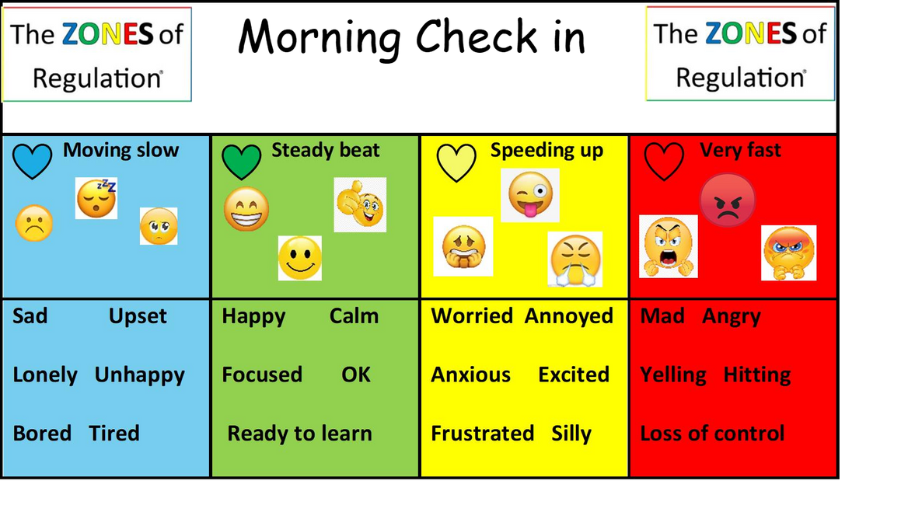
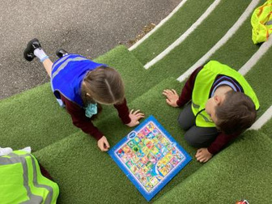
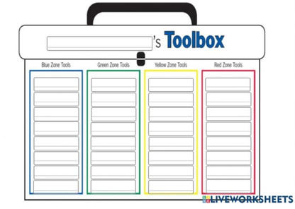
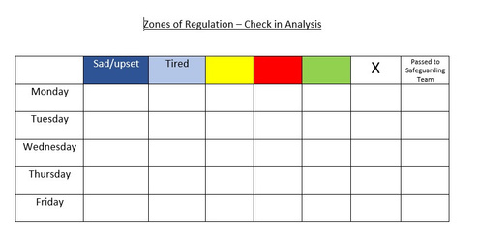
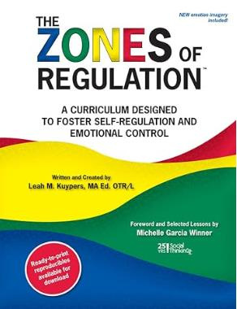

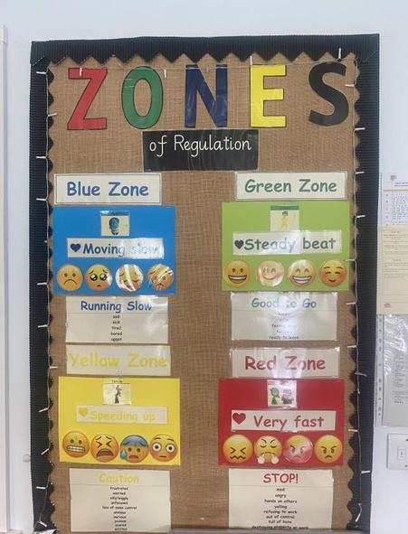
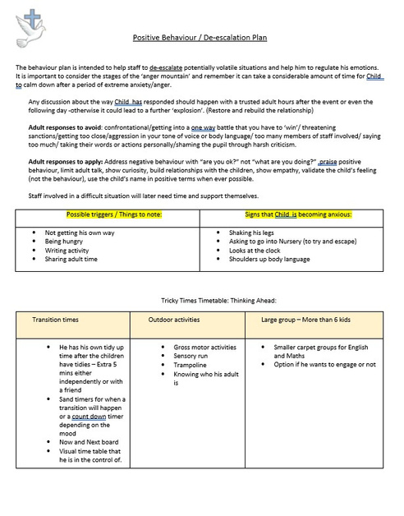
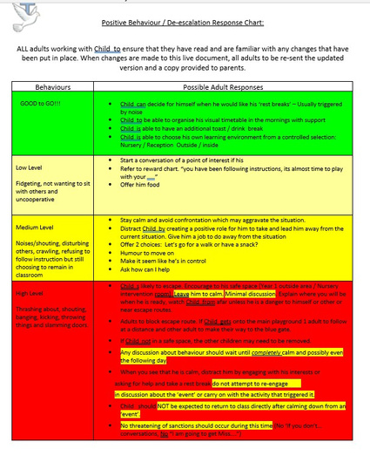
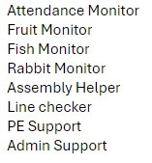
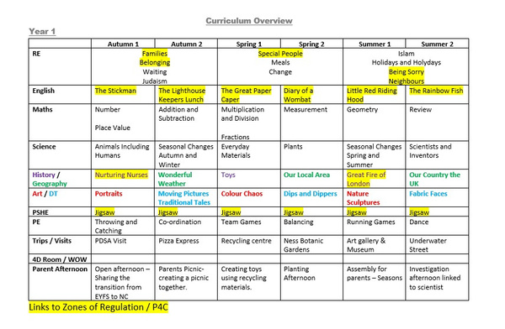
Emotional Regulation and Behaviour Today
Morning check in
Peer Mediators
Personalised Toolbox
Check in analysis
Interventions
Worry monster
Displays
De-escalation plans
Transition / Jobs
Curriculum
IQM National Inclusion Conference

Slide 11
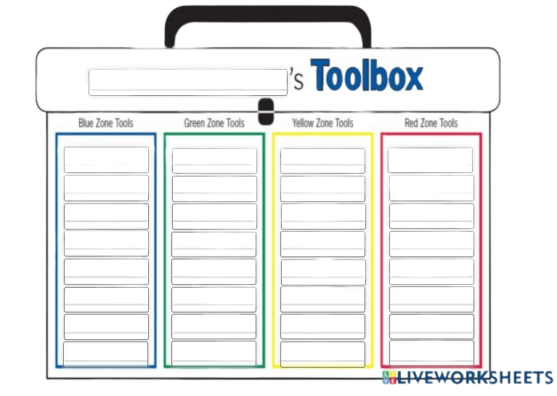
Quick Task
– No prep needed
IQM National Inclusion Conference

Slide 12
Quick Wins
•Morning Check-ins - Allows for early intervention
• Distraction (Jobs) - Sense of pride, positive reason to leave class ​
• De-escalation Plans - Ensures consistency of approaches used by adults ​
• Planned transitions tasks - Removes stress of transition (sensory overload, unknown) ​
• Flexible playtimes - Lessons come to a natural end, fewer children on the yard​
• PASS (Pupils Attitudes towards Self and School) Data - Highlights children who are
struggling so that appropriate support can be put in place
• Soft starts - Reduces anxiety
• P.A.C.E. (playfulness, acceptance, curiosity, empathy)- De-escalates a situation

Slide 13

Questions
#IQMFamily
IQM National Inclusion Conference

