Slide 2
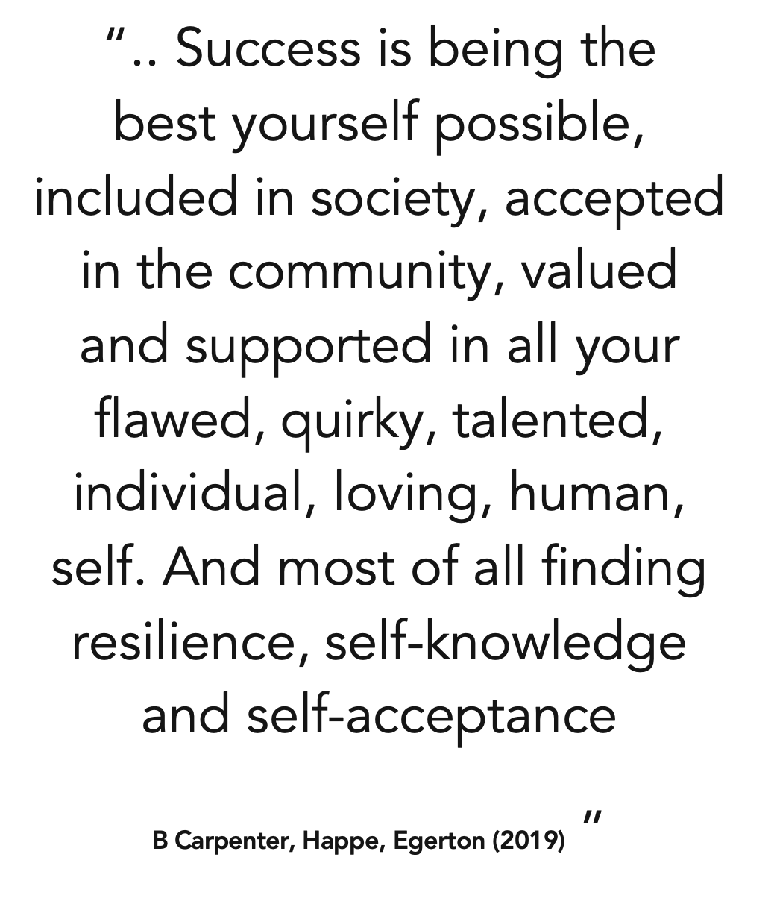
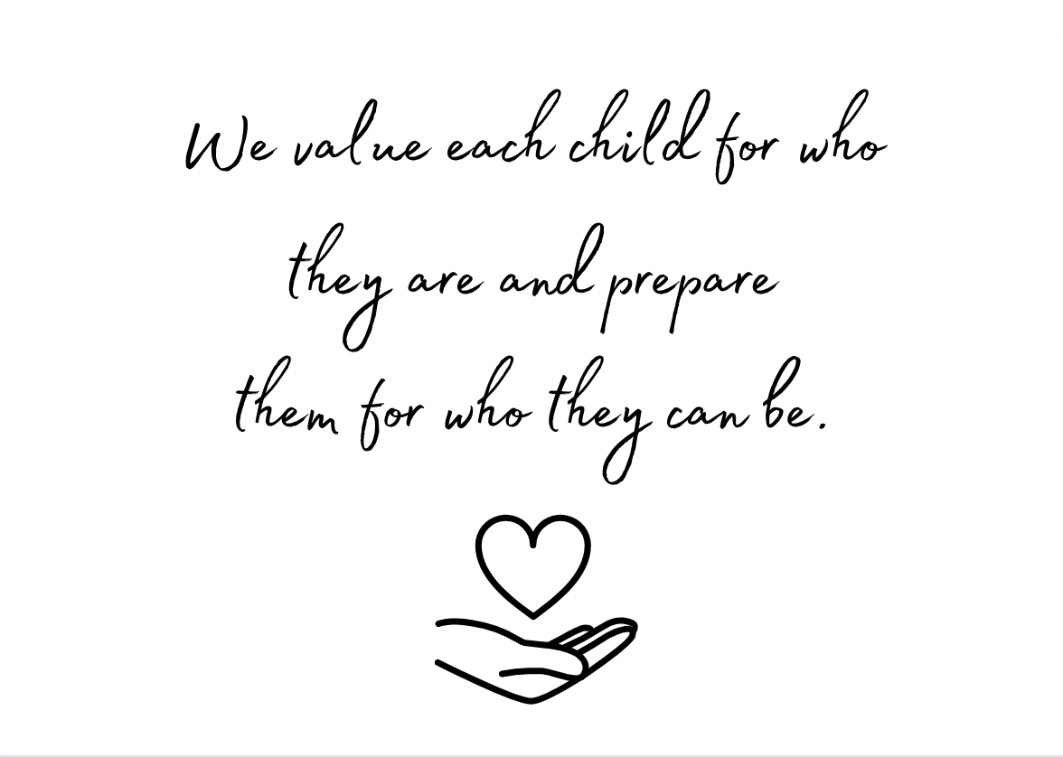
IQM National Inclusion Conference

Slide 3
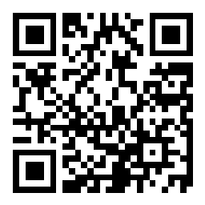
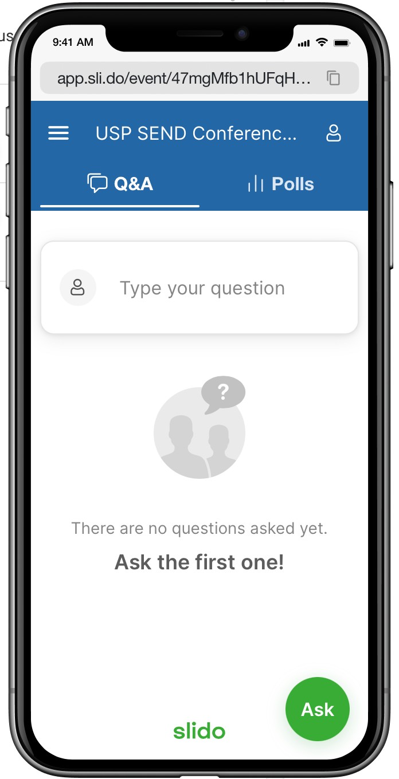
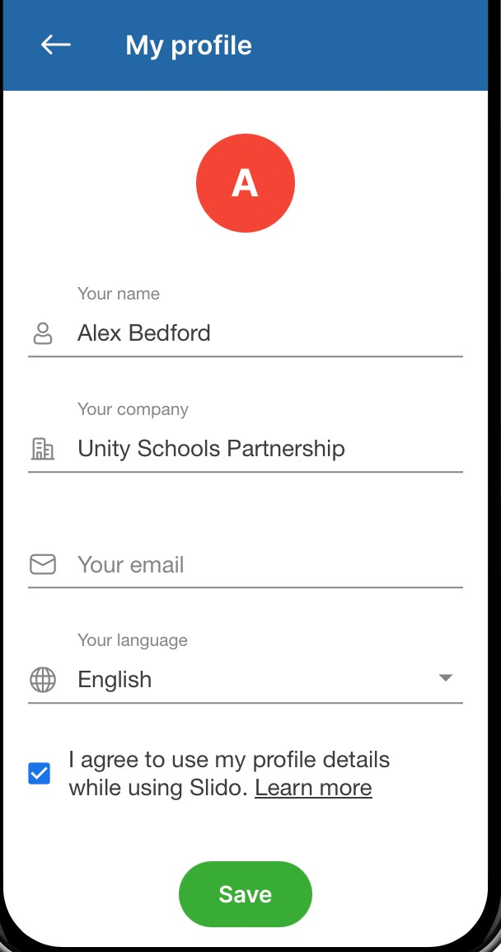
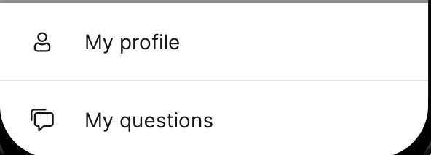
Use Slido
Join by scanning this QR code on your phone or device
Say hello to everyone
Use it to ask, respond to provocations and questions
Click on this icon
|
Choose My profile
IQM National Inclusion Conference
Press Save

Slide 4
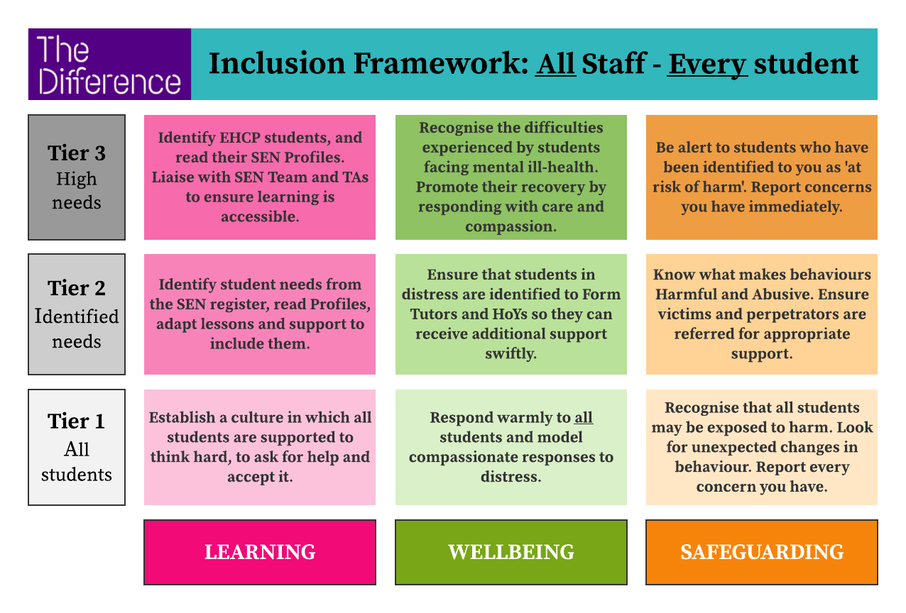
Key principles
All children want to and need to be included
All children have Learning, Wellbeing and Safeguarding needs
All staff have a role to play in supporting these needs
IQM National Inclusion Conference

Slide 5
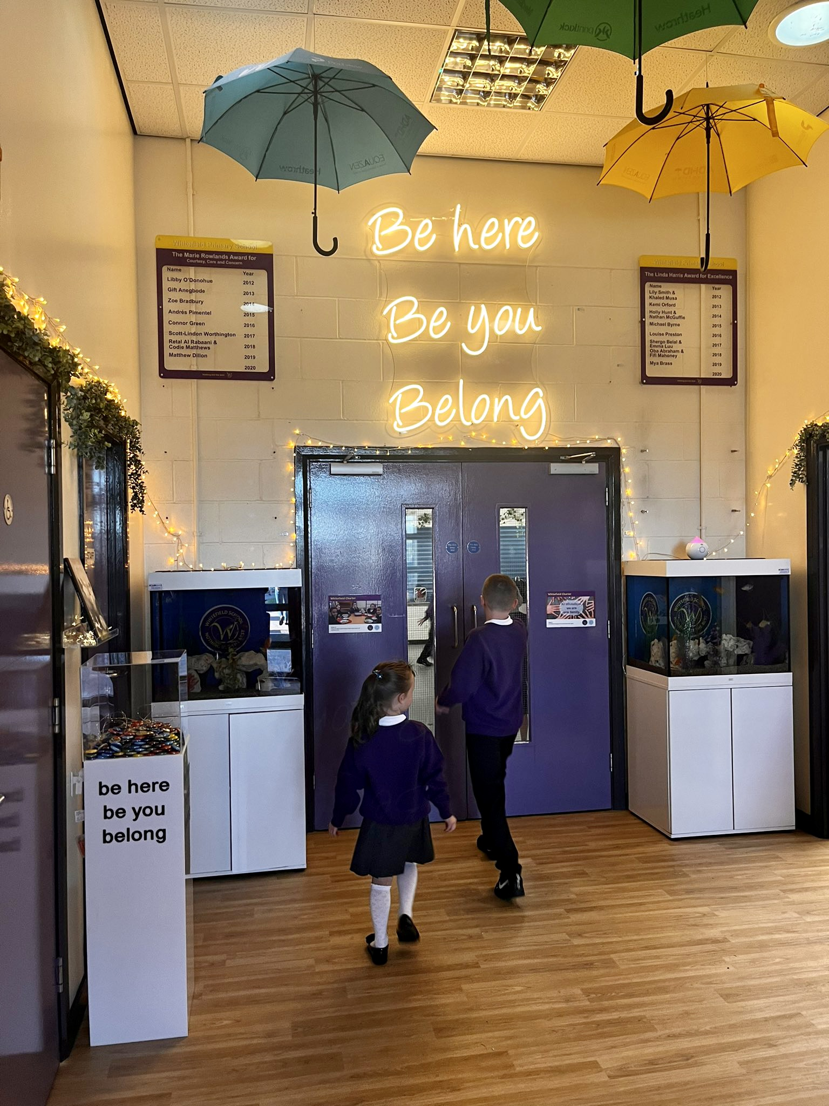
Be here
Be You
Belong
IQM National Inclusion Conference

Slide 6
Why is Emotional Literacy important?
'Self-regulation involves interplay between pupil commitment, control and confidence. It addresses the way in which [learners] monitor, direct and regulate actions towards a learning goal.
It implies autonomy, self-control, self-direction and self-discipline’
[Boyle & Charles 2013. Formative assessment for Teaching & Learning]
IQM National Inclusion Conference

Slide 7
Self Regulation to support learning
Self-regulated learning can be broken into three essential components:
cognition – the mental process involved in knowing, understanding, and learning
metacognition – often defined as ​‘learning to learn’; and
motivation – willingness to engage our metacognitive and cognitive skills.
EEF TOOLKIT (7 months progress)
IQM National Inclusion Conference

Slide 8
Self Regulation to support learning
Physical - sarah
Recognise links
Toolkit
IQM National Inclusion Conference

Slide 9
How? - Strengths-based Approach
Central to this debate (what inclusive education looks like) should be the rights of the child as a learner.
How do we design learning environments and learning activities that will ensure that each child is an active participant in the learning process and not a bystander, a peripheral participant, watching the activity of others?
How can we support families, teachers and professionals to include those learners in all aspects of the curriculum to achieve this goal?
Barry Carpenter, Enabling Access
IQM National Inclusion Conference

Slide 10
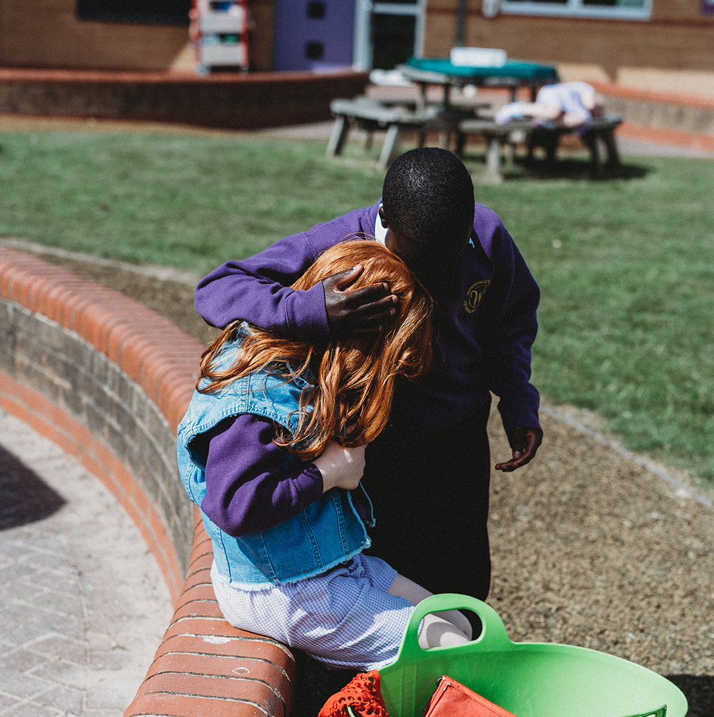
Trauma Informed
Staff at Whitefield Primary School have developed strategy and practice which is grounded in the understanding that trauma can impact an individual’s neurological, biological, psychological, emotional and social development, and this understanding is not limited to the students but to the entire population of the school, including staff and families.
The key questions asked by staff are related to what each individual needs and what has happened to them, rather than what is wrong with them.
“I am not defined by my scars, but by the incredible ability to heal”
Lemm Sissay

Slide 11
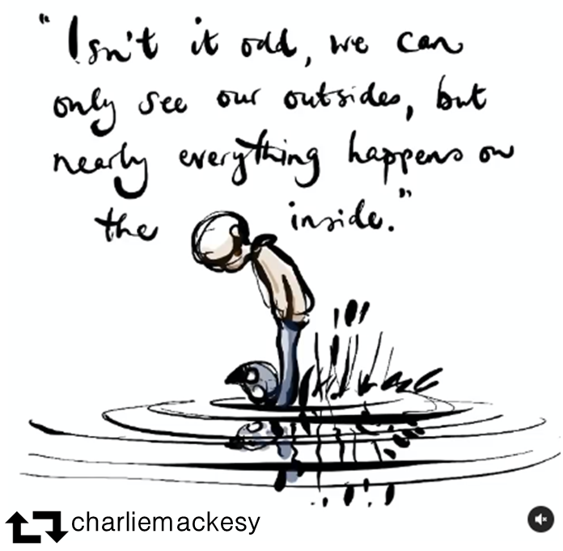
IQM National Inclusion Conference

Slide 12
What do we focus on?
Culture of Belonging
Environment
Routines
Consistency
Explicit curriculum and Vocabulary
Play
Language of thinking
Behaviour
Families
IQM National Inclusion Conference

Slide 13
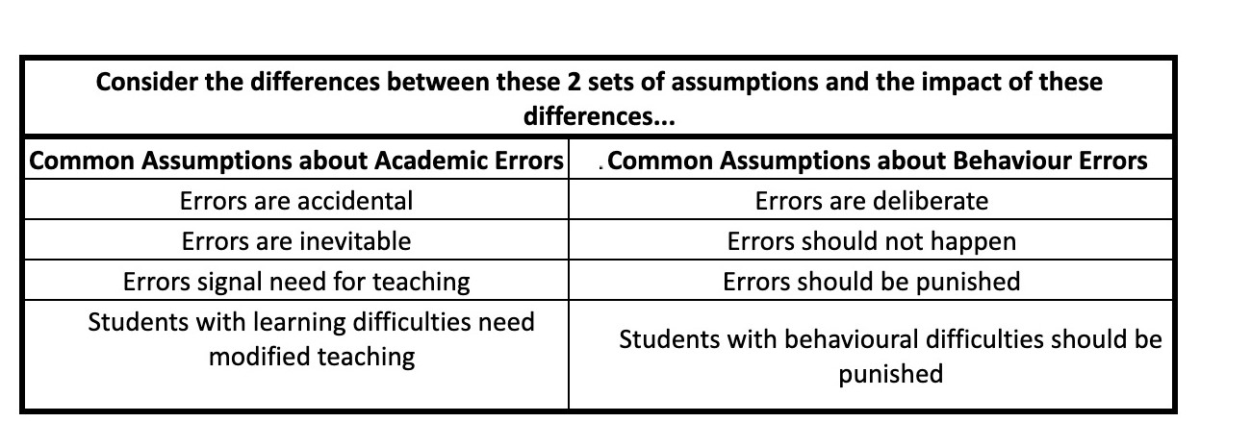
Behaviour
IQM National Inclusion Conference

Slide 14
Environment
How do you use your environment?
Have you got calm, quiet spaces?
How do adults support at times of dysregulation?
What is there and why?
IQM National Inclusion Conference
Notes:
Children use the space here to match emotion stones to the zones of regulation cards.
They often use this space to talk with peers and practitioners about how they are feeling and what they might try to bring themselves back to the green zone.
Children explore our sensory den and enjoy the different smells. sounds, sights and textures.

Slide 15
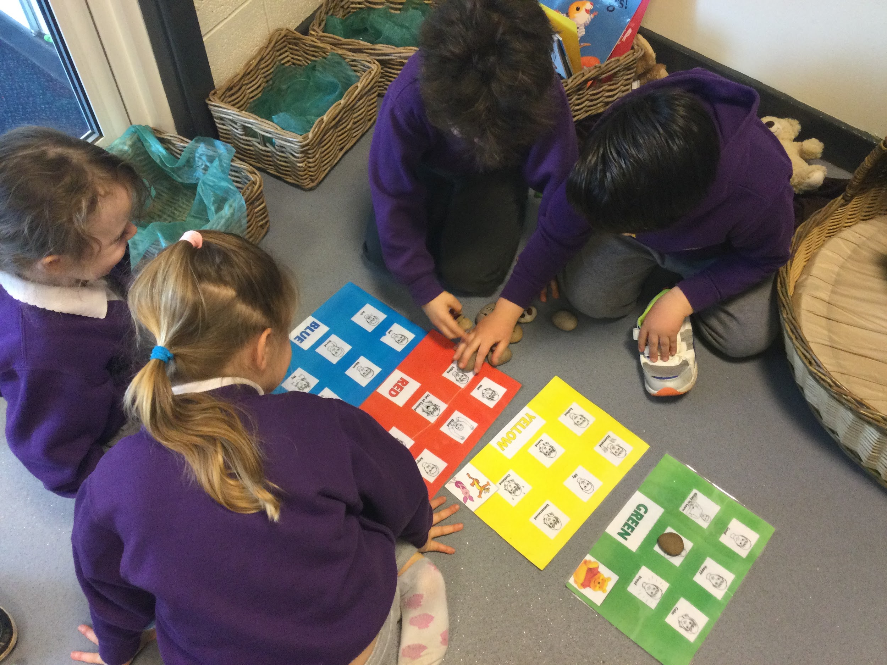
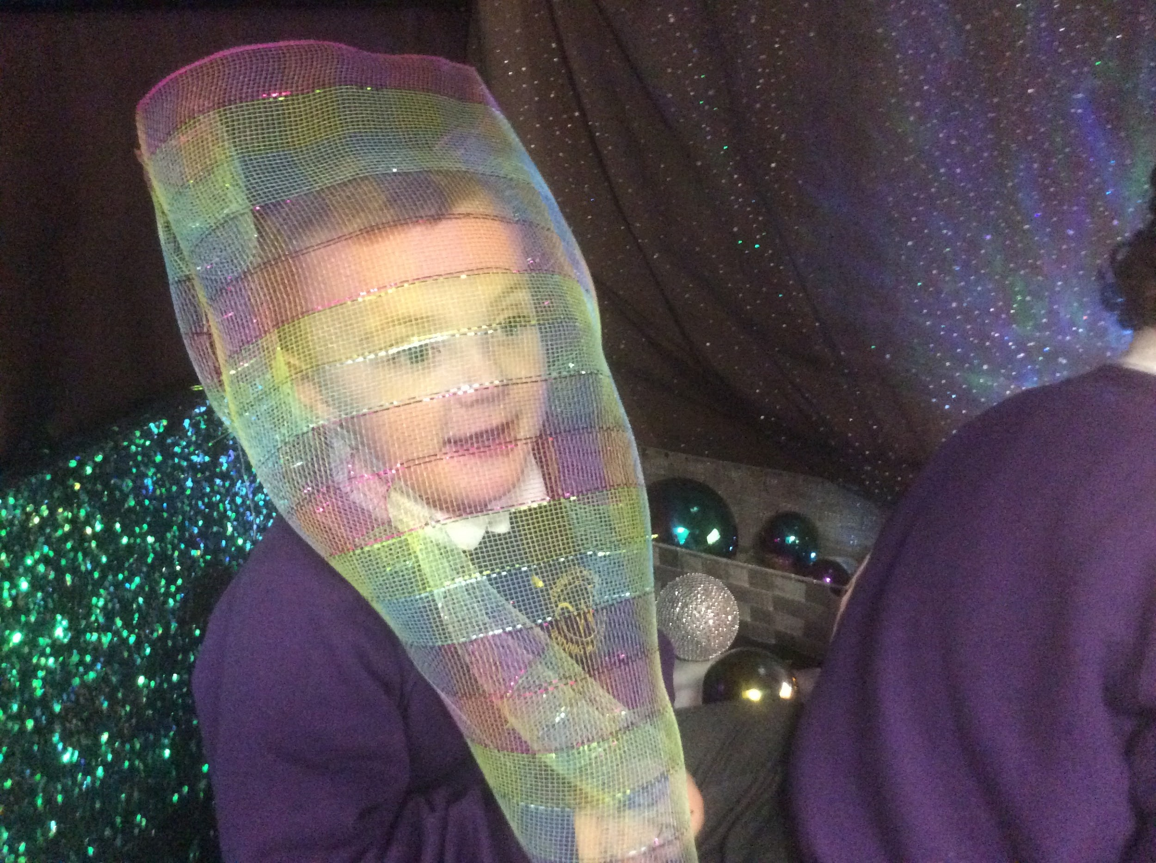
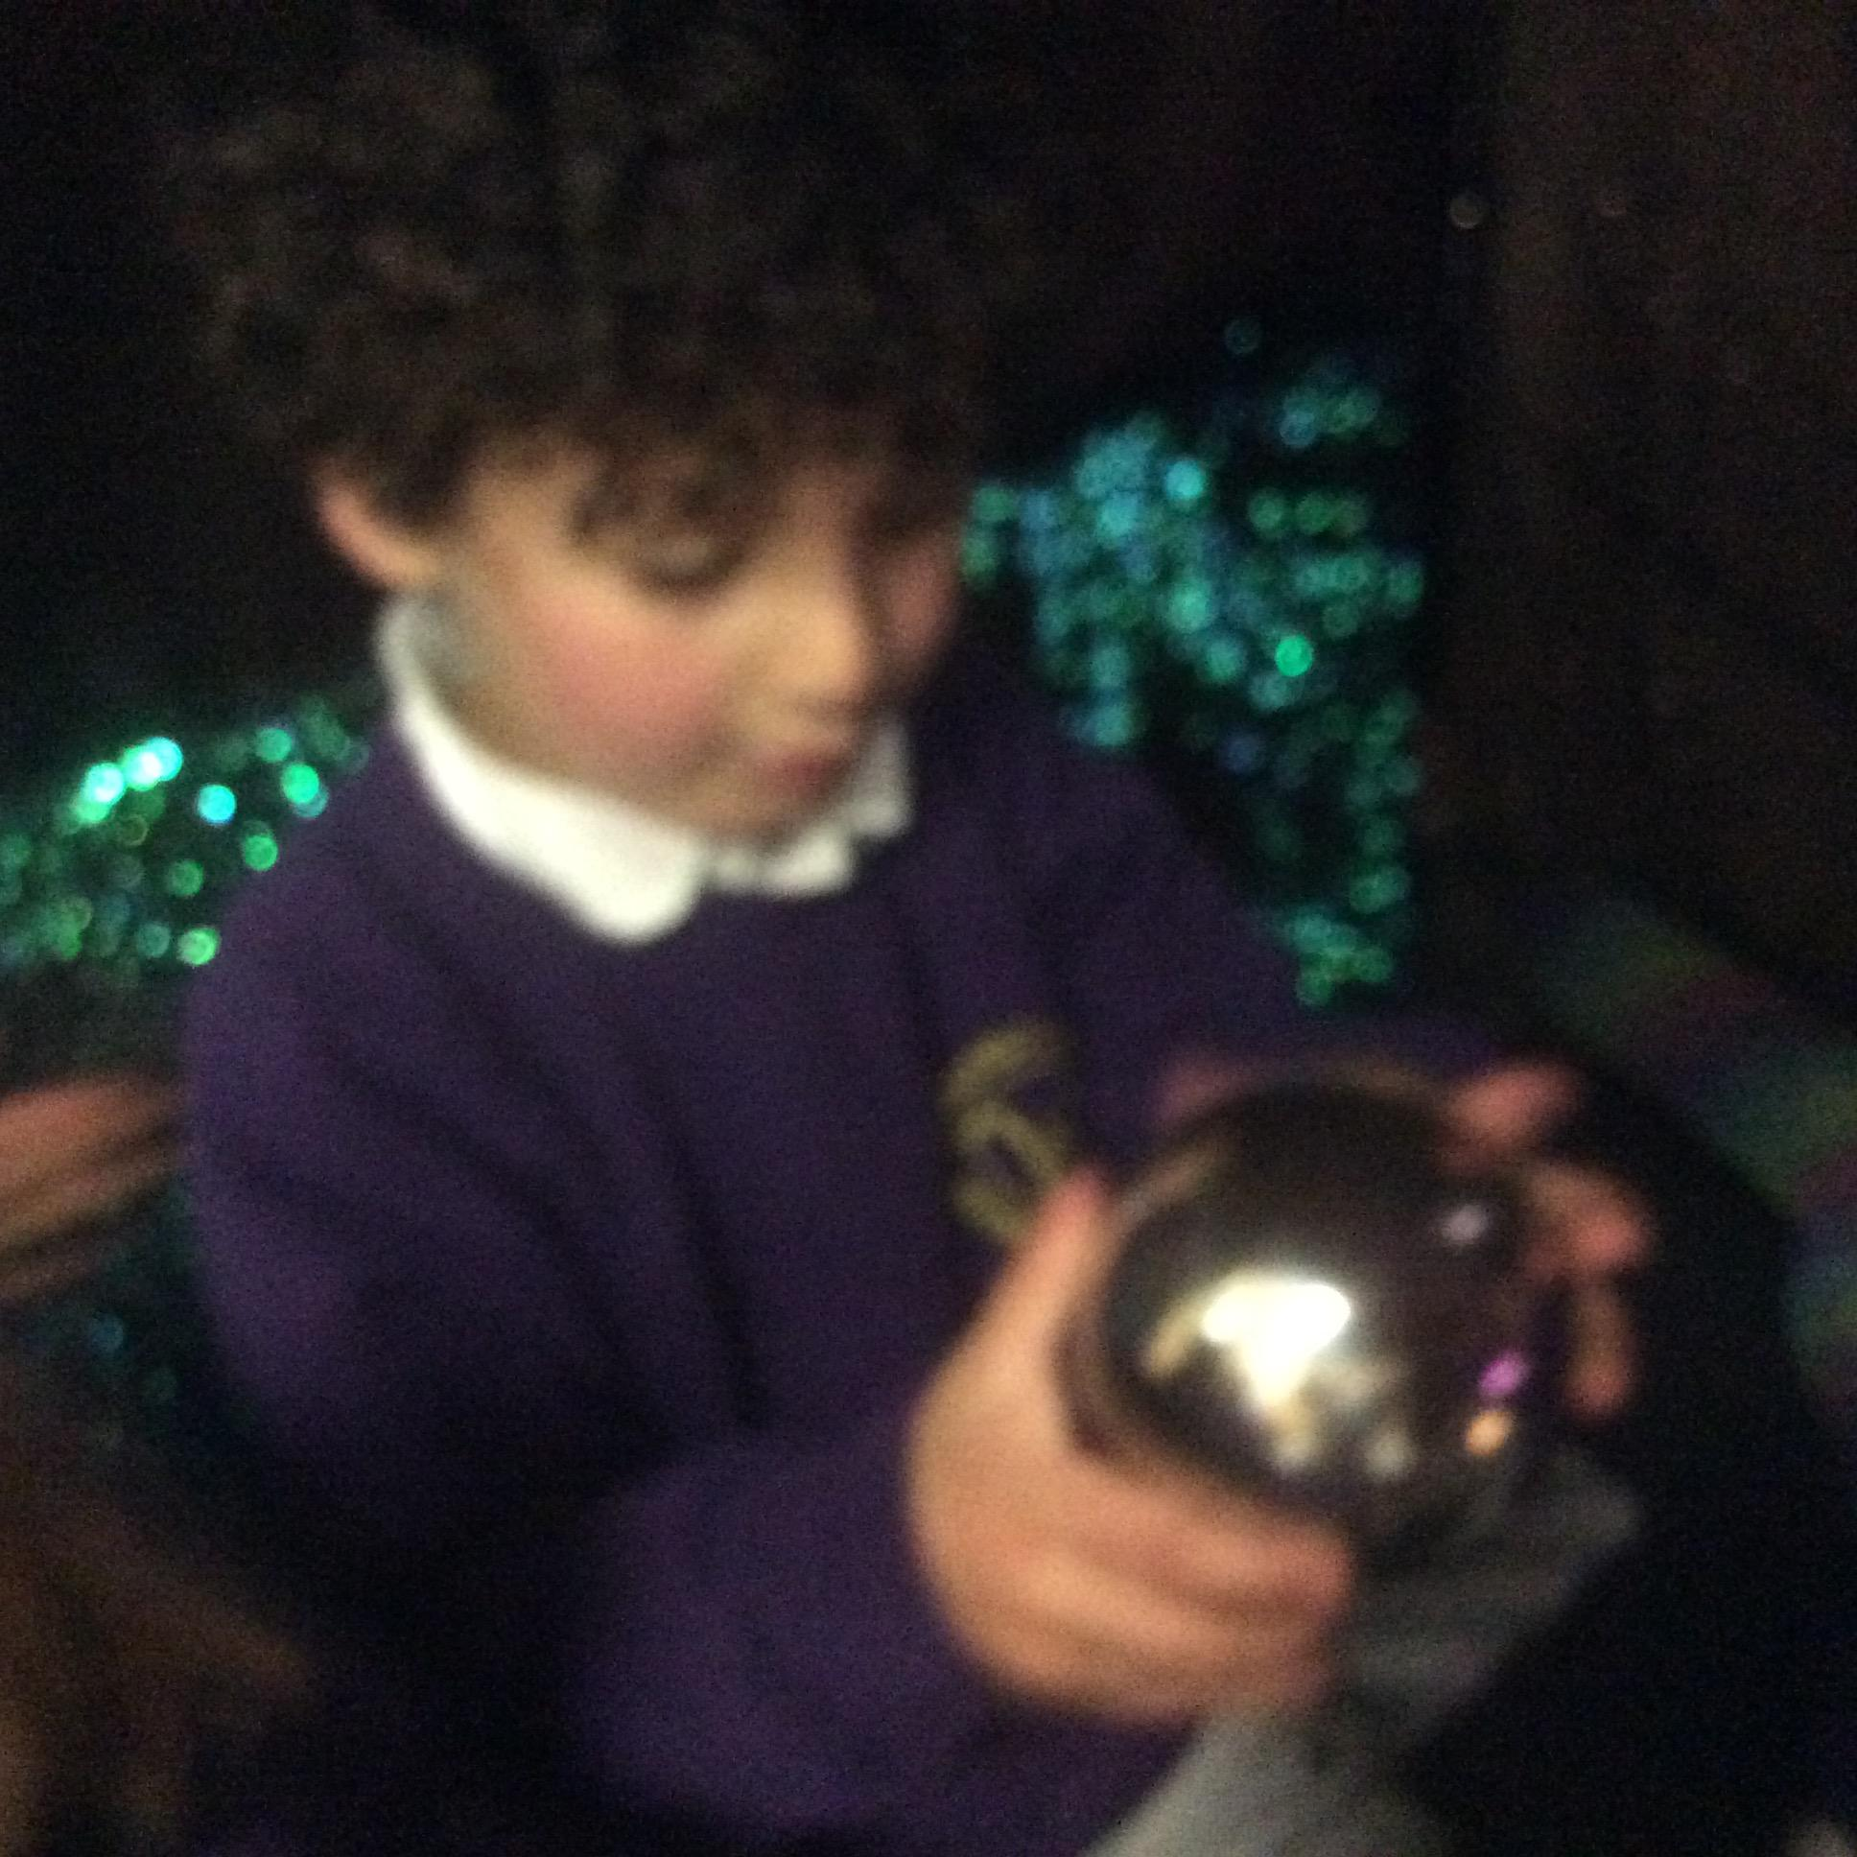
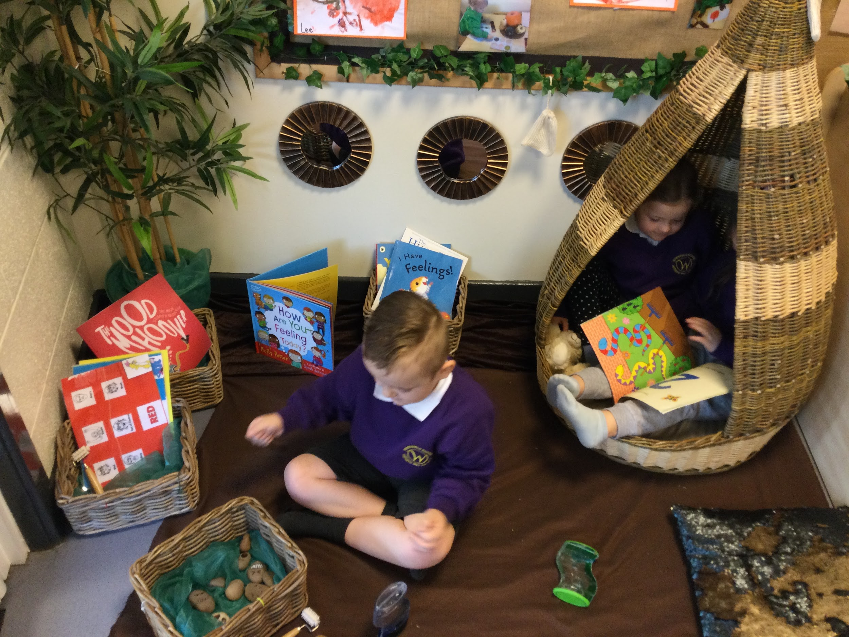
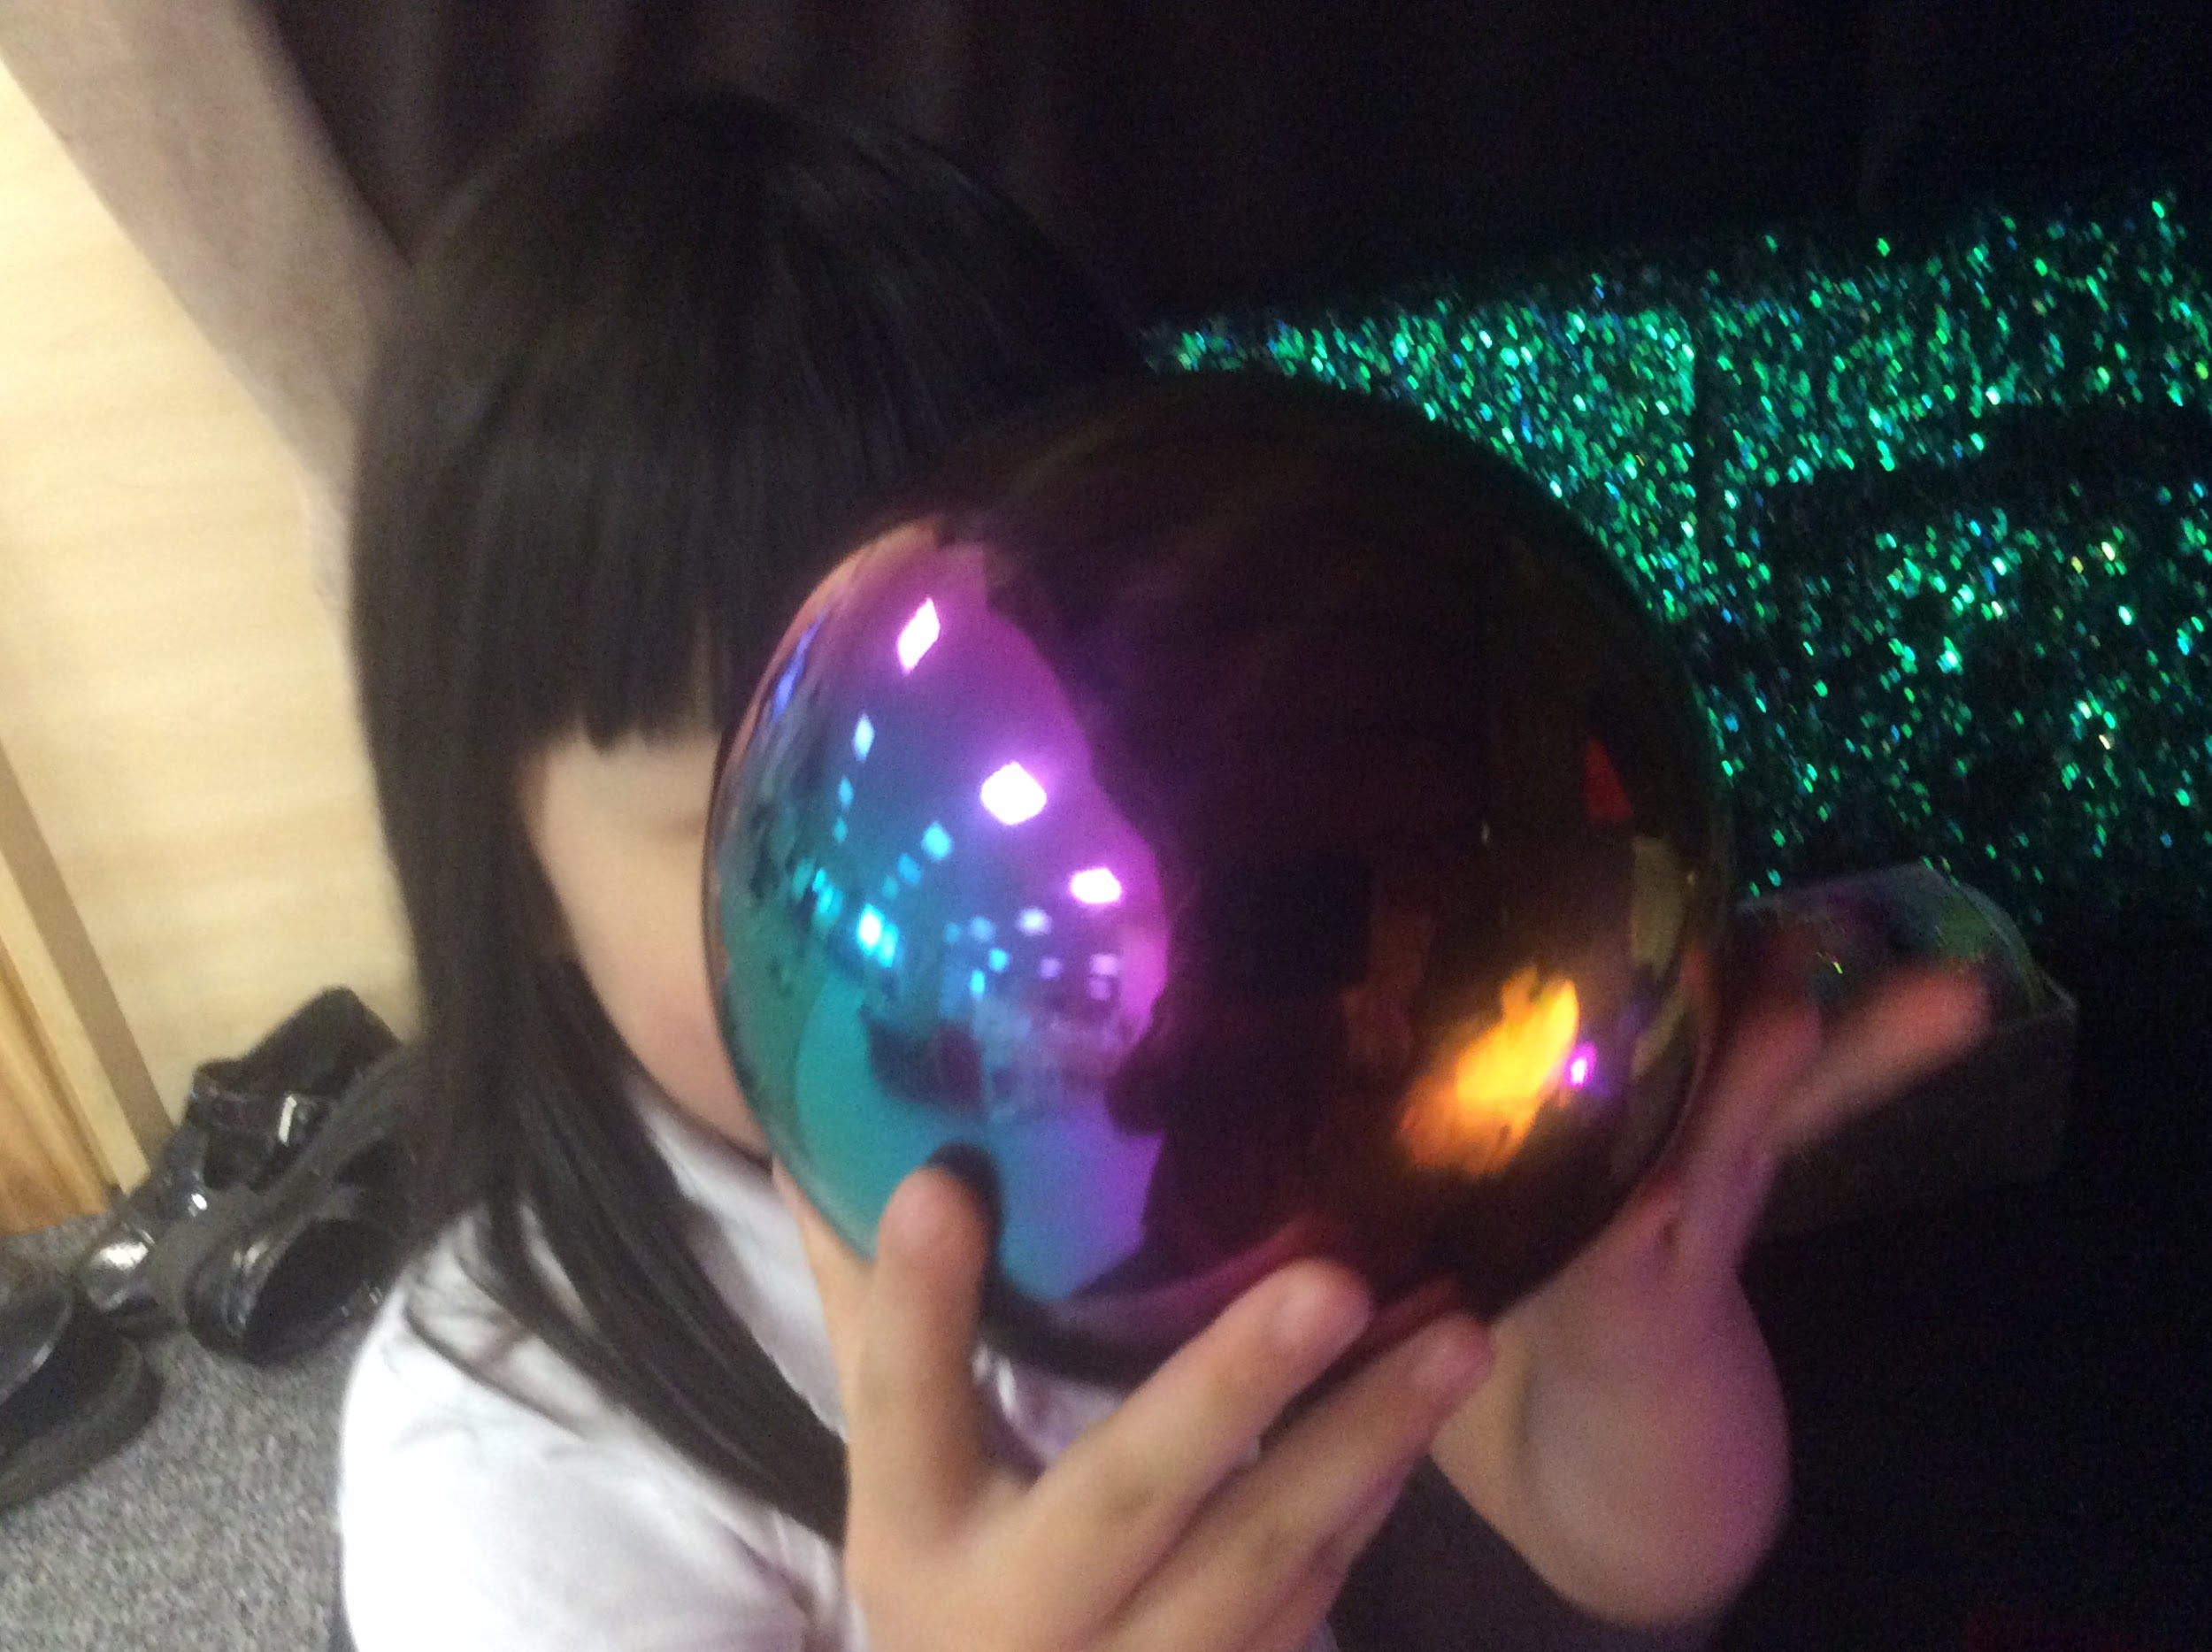
How do you use
EYFS Environment
IQM National Inclusion Conference
Notes:
How do you use your environment? Have you calm, quiet spaces? How do adults support at times of dysregulation?
They often use this space to talk with peers and practitioners about how they are feeling and what they might try to bring themselves back to the green zone.
Children explore our sensory den and enjoy the different smells. sounds, sights and textures.

Slide 16
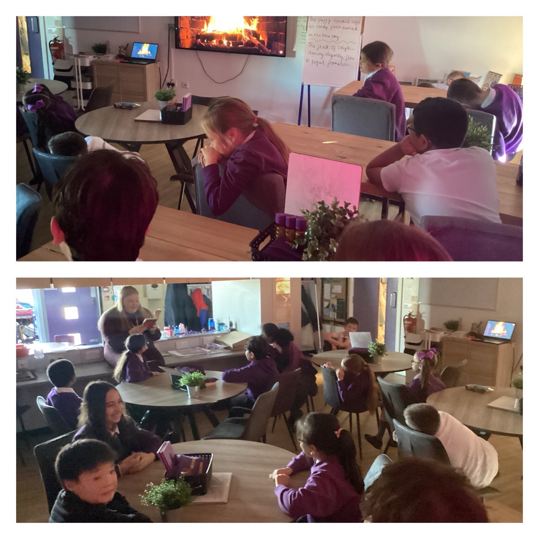
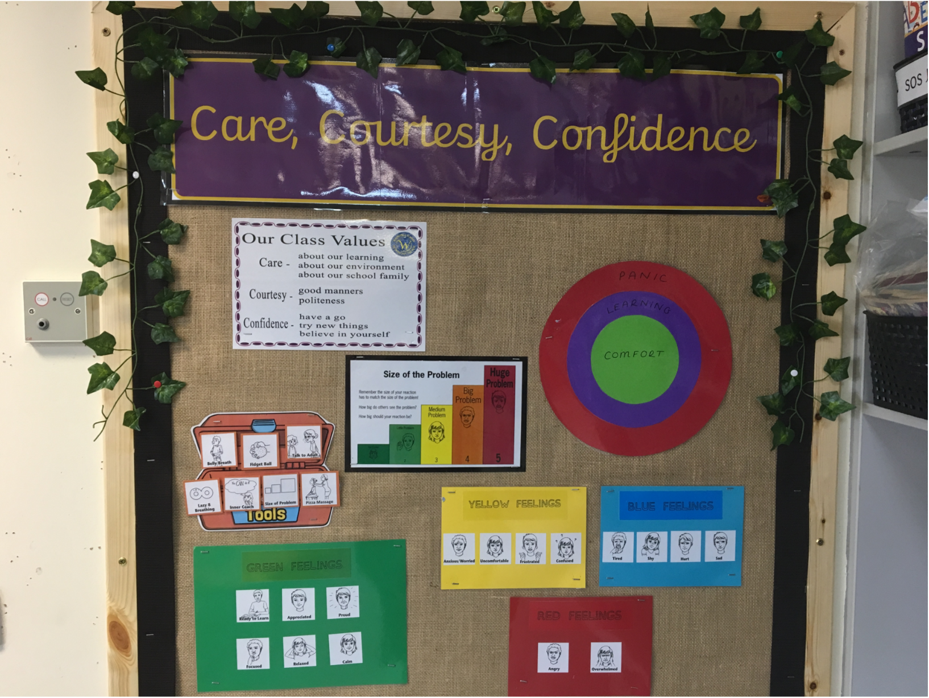
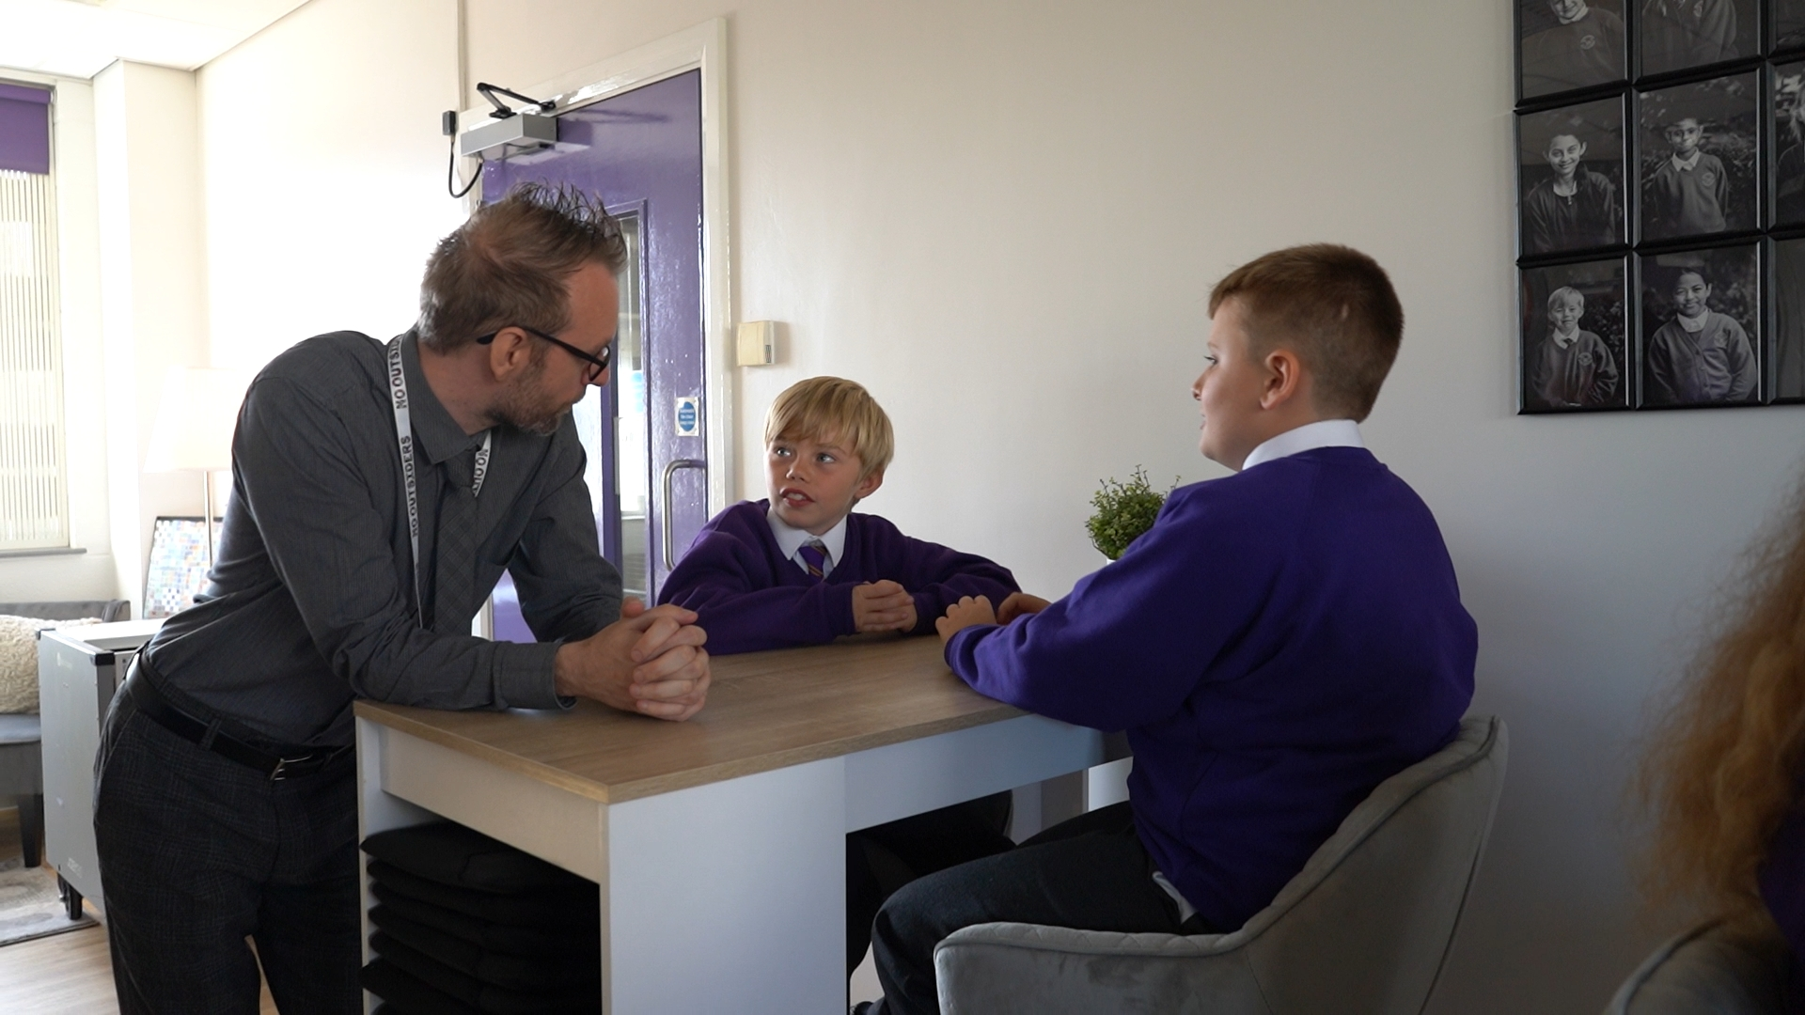
UKS2 Environment - explicit
IQM National Inclusion Conference
Notes:
Children use the space here to match emotion stones to the zones of regulation cards.
They often use this space to talk with peers and practitioners about how they are feeling and what they might try to bring themselves back to the green zone.
Children explore our sensory den and enjoy the different smells. sounds, sights and textures.

Slide 17
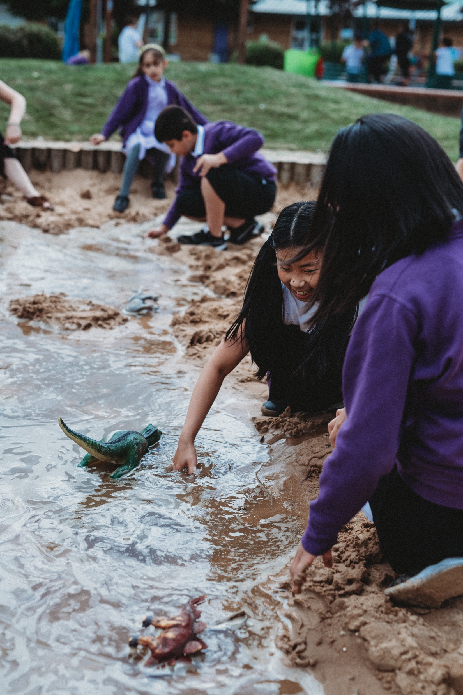
Play
How did it feel when?
Modelling and scaffolding
Size of the problem
Toolkit in action
IQM National Inclusion Conference
Notes:
Children use the space here to match emotion stones to the zones of regulation cards.
They often use this space to talk with peers and practitioners about how they are feeling and what they might try to bring themselves back to the green zone.
Children explore our sensory den and enjoy the different smells. sounds, sights and textures.

Slide 18
Emotional Literacy
In school children benefit from:
direct teaching to engage them with social and emotional learning.
exploration of the social world and how they can navigate to regulate within it.
a deep understanding of emotions and how they can use ‘The Zones of Regulation’ to identify these and access tools to support them in regulating them.
IQM National Inclusion Conference

Slide 19
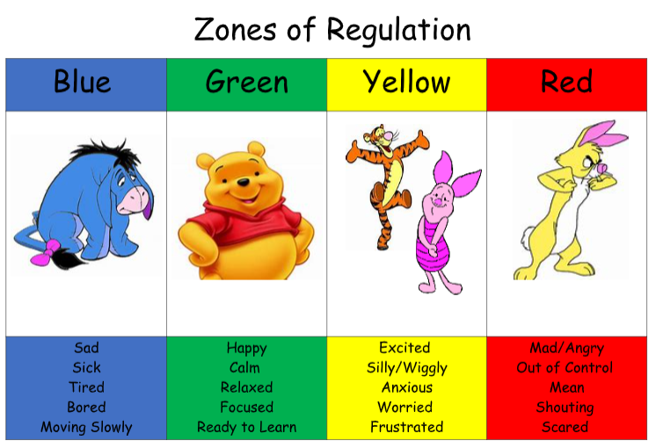
Supporting Young Children to Understand the Zones
IQM National Inclusion Conference

Slide 20
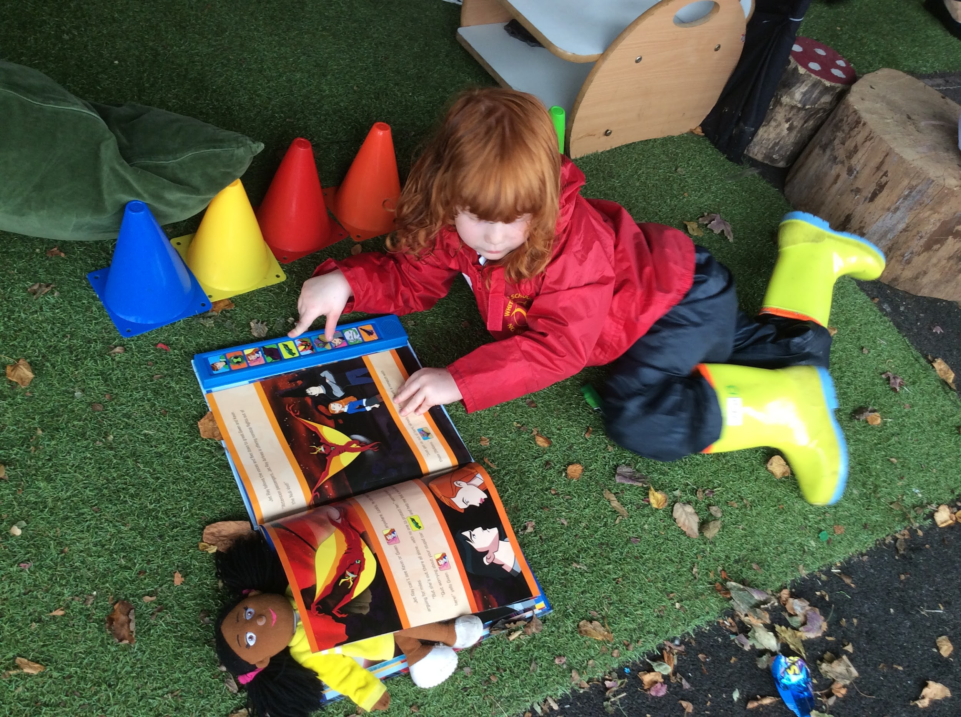
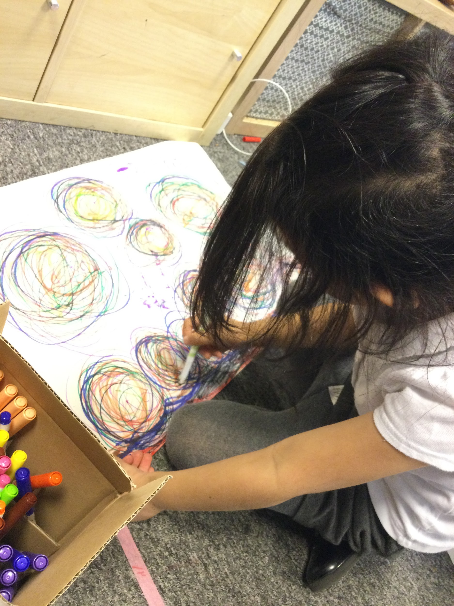
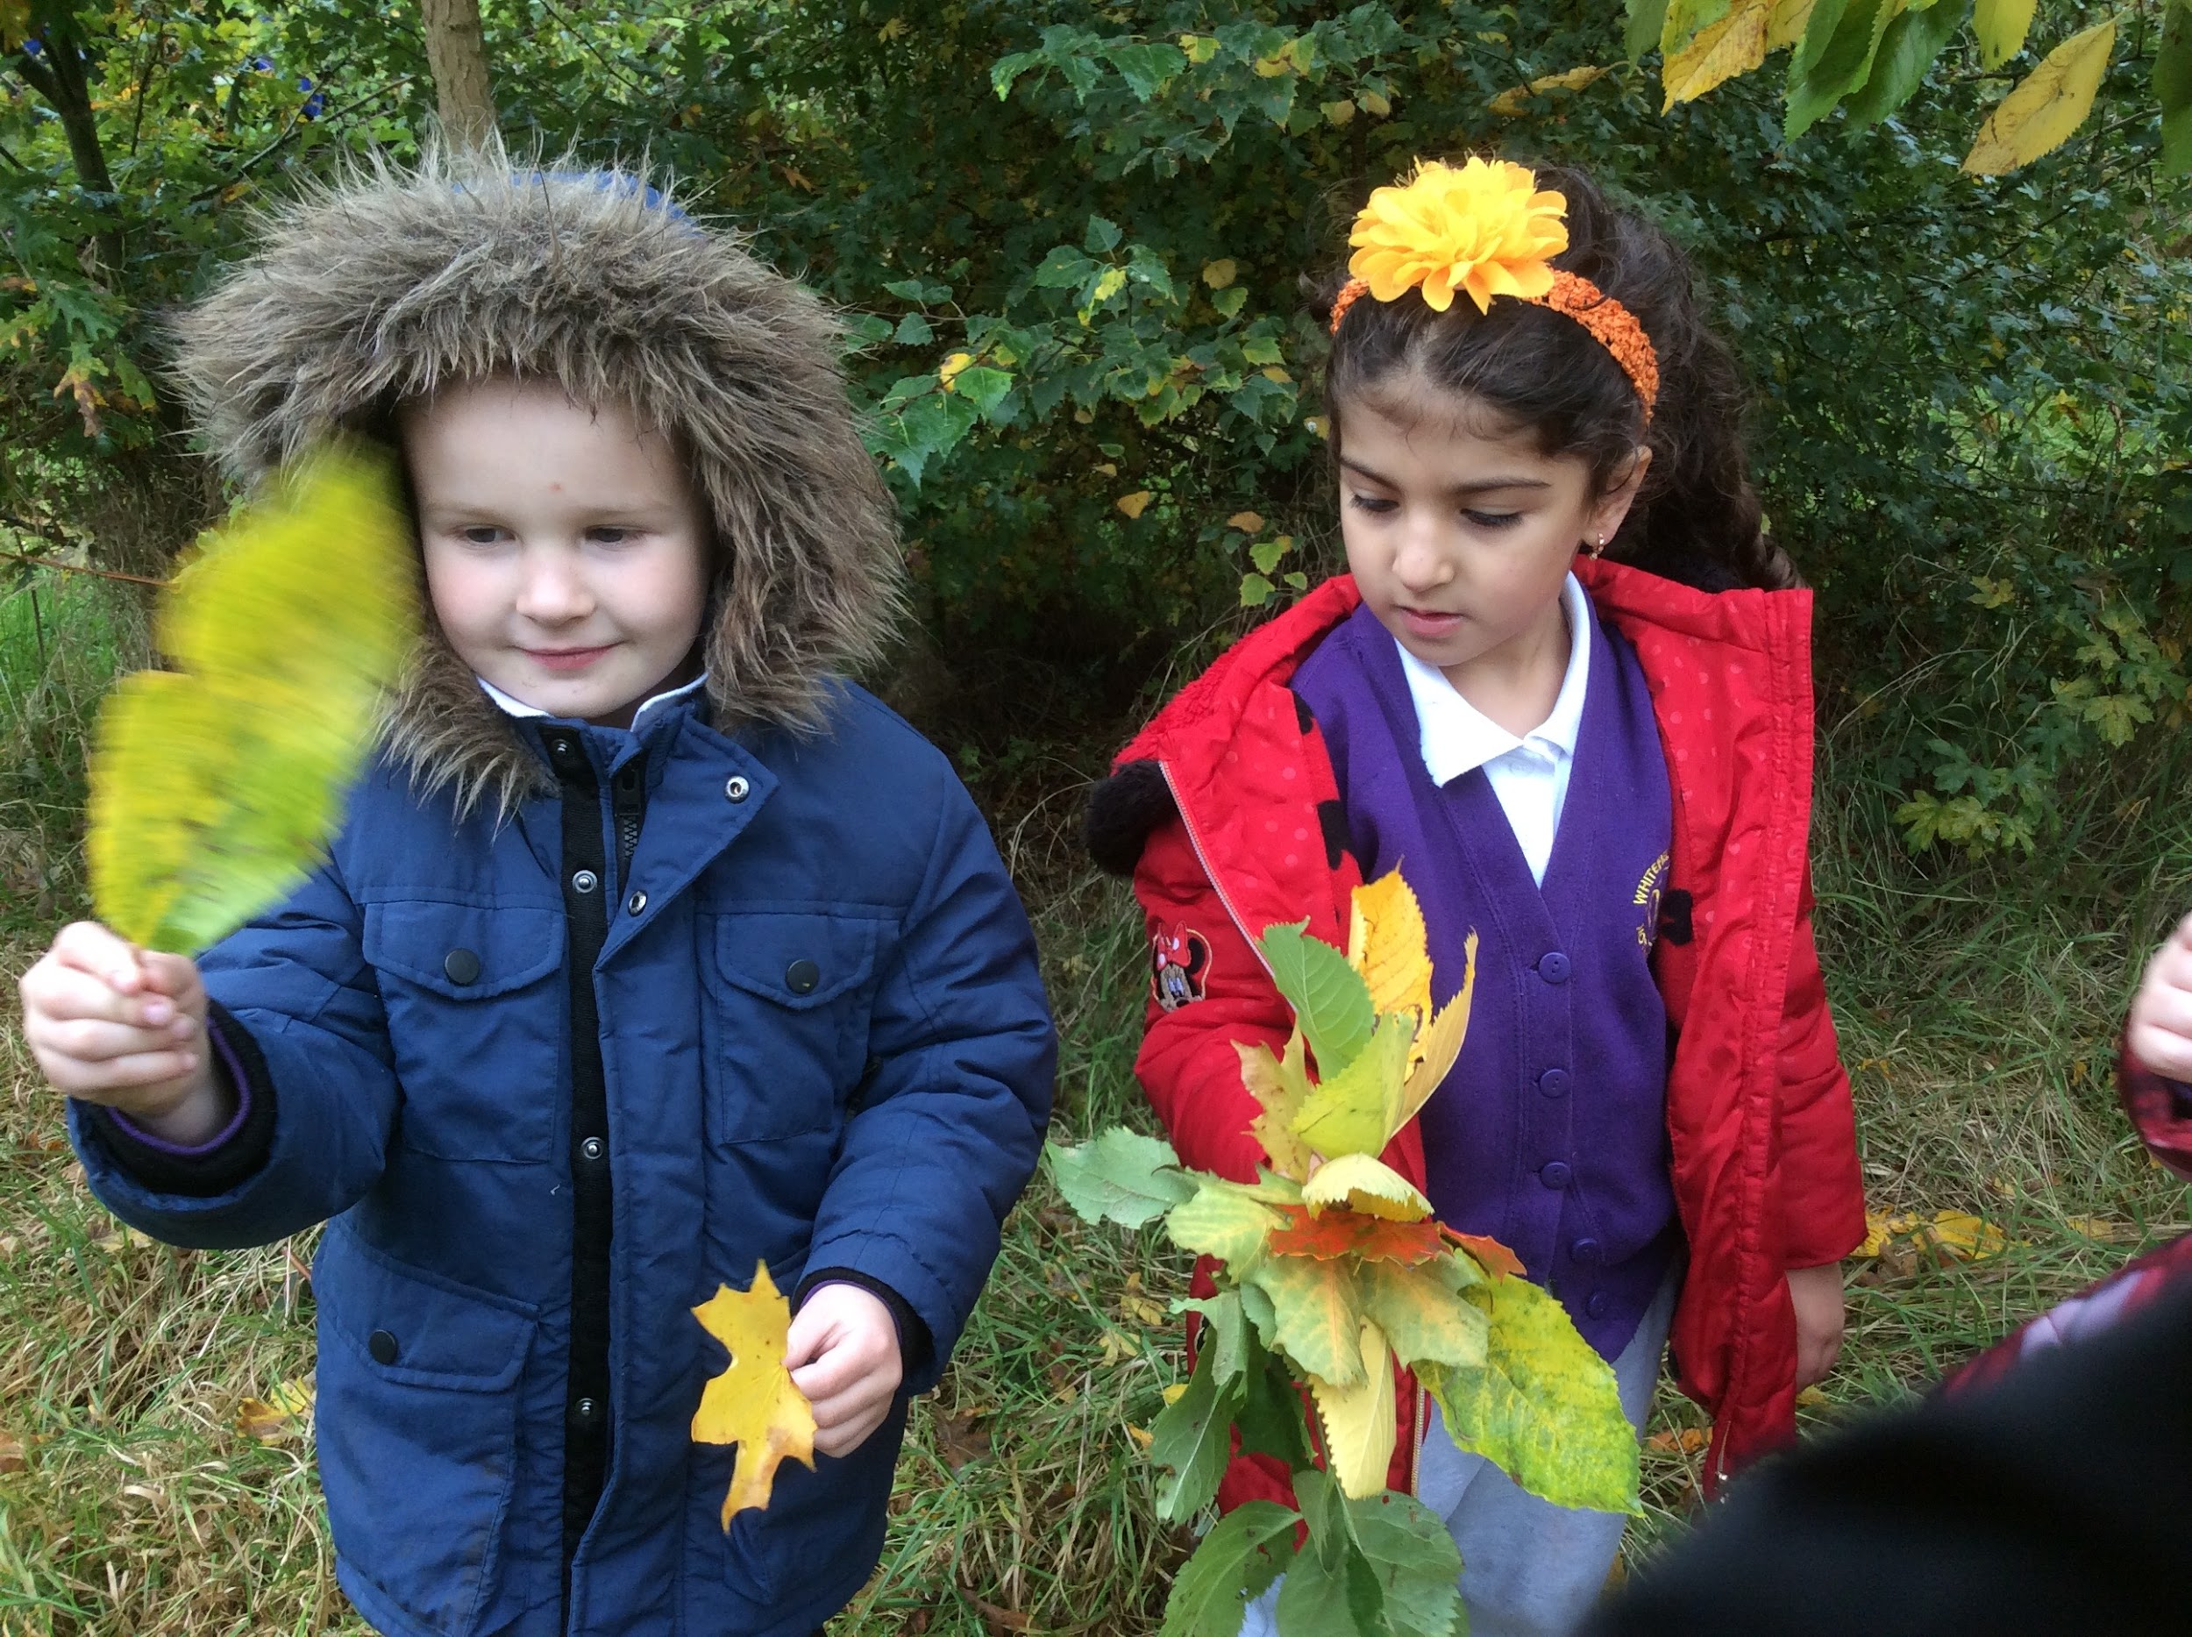
Our Tool Box
We encourage children to think of the strategies that they use to support them when they are in a zone as their 'tools.'
Some of these strategies may include:
Doing something they specifically enjoy
Spending time outdoors in our urban forest or finding a quiet space to retreat to.
Drawing whilst listening to relaxing music.
Participating in a physical activity they enjoy.
Using one of their favourite breathing techniques.
Chatting to a trusted adult or friend.
IQM National Inclusion Conference

Slide 21
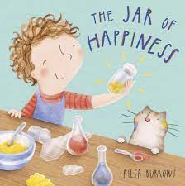
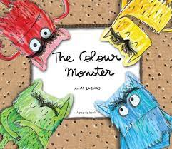
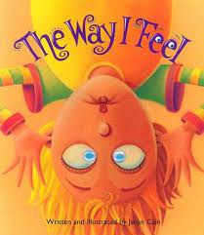
Books we have Found Useful to Explore Feelings and Emotions.
IQM National Inclusion Conference

Slide 22
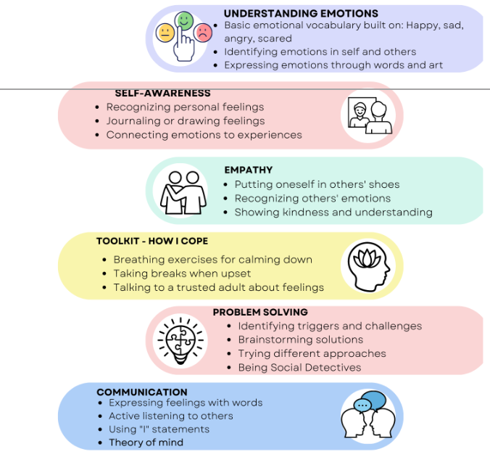
IQM National Inclusion Conference

Slide 23
Early Years
Parents find it difficult to manage their own emotions which in turn makes it difficult to support their child when managing theirs.
High numbers of our children and their families present with trauma responses.
Shared language and approaches to be used between school and home for our children and families in order to maximise impact.
Training developed and materials available for other settings
IQM National Inclusion Conference

Slide 24
How can I help my child manage big feelings?
Exploring how understanding
self-regulation can help me feel confident to support my child
at home

Slide 25
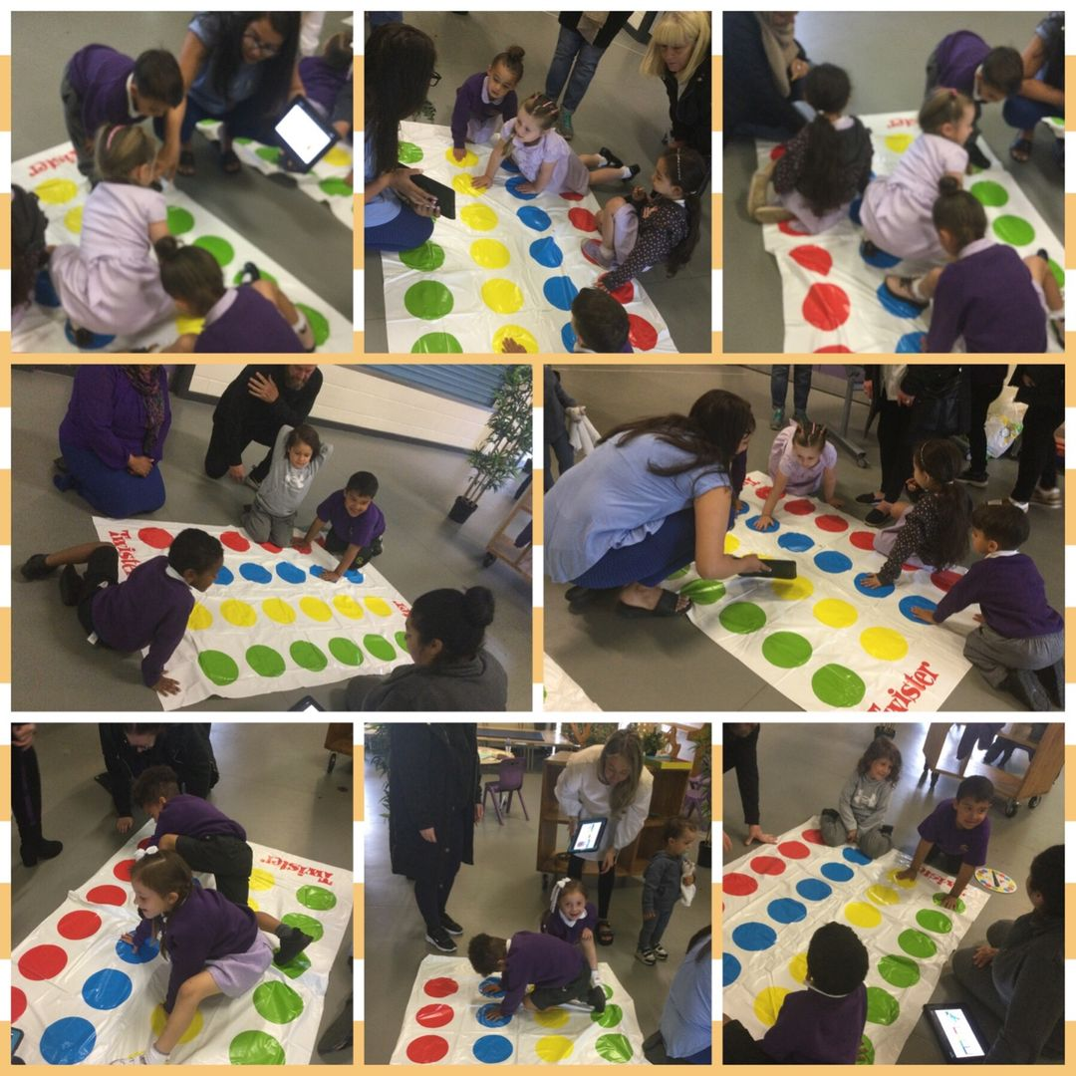
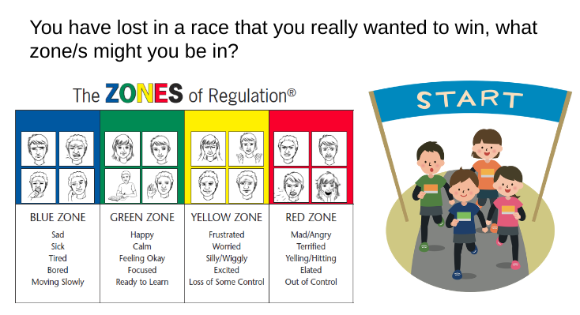
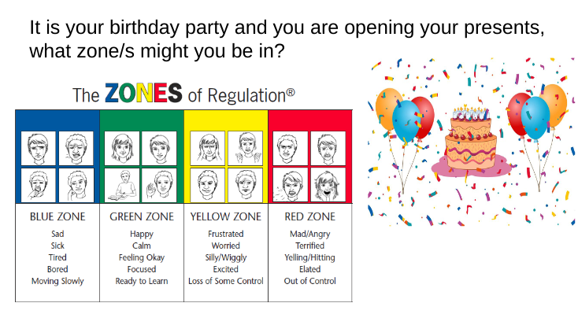
Session 1
Parent/Child Activity
Twister / Zones
Session 1 Overview of Project
Powerpoint
What are the zones?
Why do we teach them in school?
How can you use them at home?
IQM National Inclusion Conference
IQM National Inclusion Conference
Notes:
Gives opportunity to model when children are playing twister

Slide 26
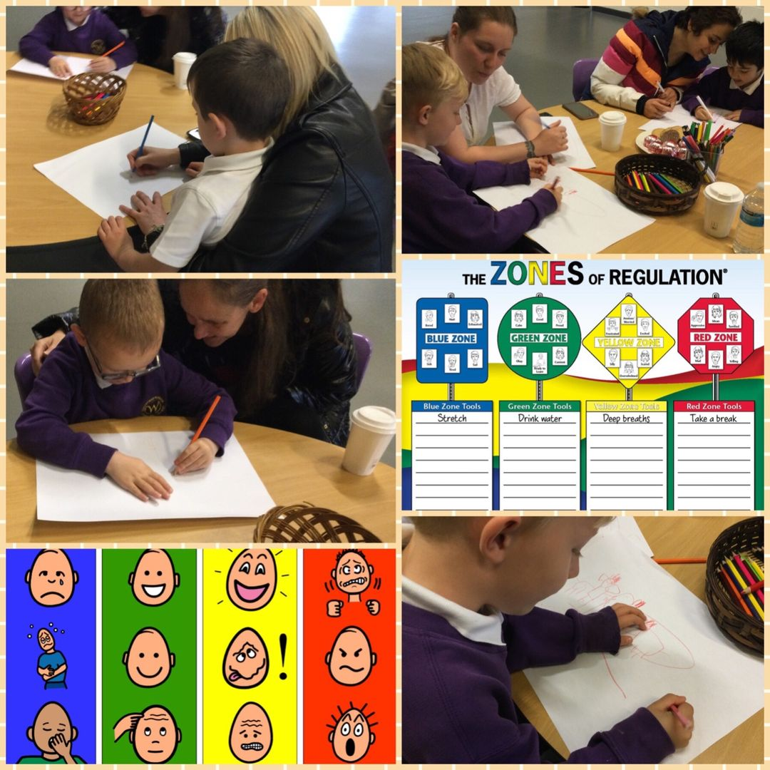
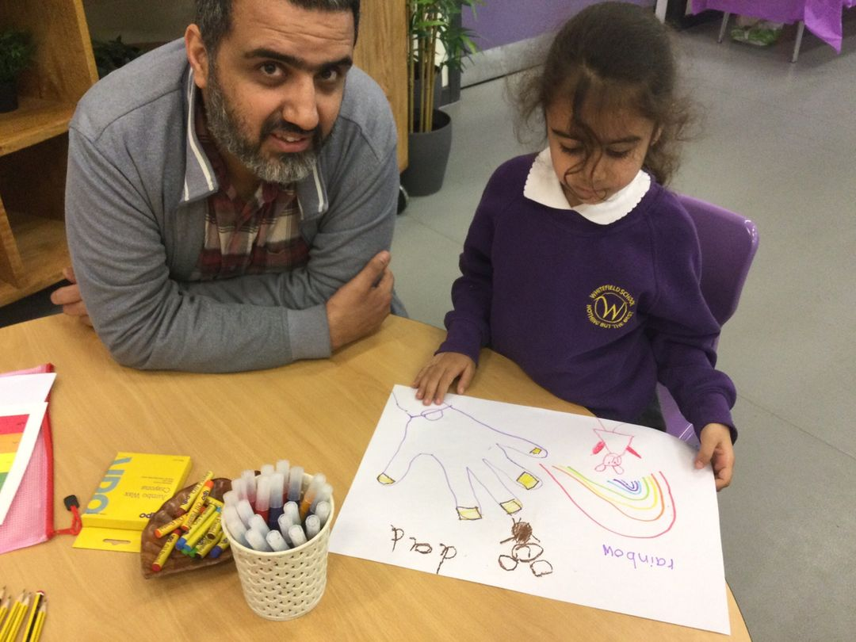
Session 2
Session 2 Our Toolbox - Strategies
Powerpoint -
Understanding how we can support as parents.
Exploring strategies and resources that can be used at home.
Understanding how everybody’s toolbelt will be different.
What works for you?
Parent/Child Activity
After discussion create a family toolbox to use as a reminder at home of what supports us to return to the green zone.
IQM National Inclusion Conference
Notes:
Key message is that everybody's toolbox will look different
Knowing what strategies will support your child in that moment of big emotions or to act as a preventative method

Slide 27
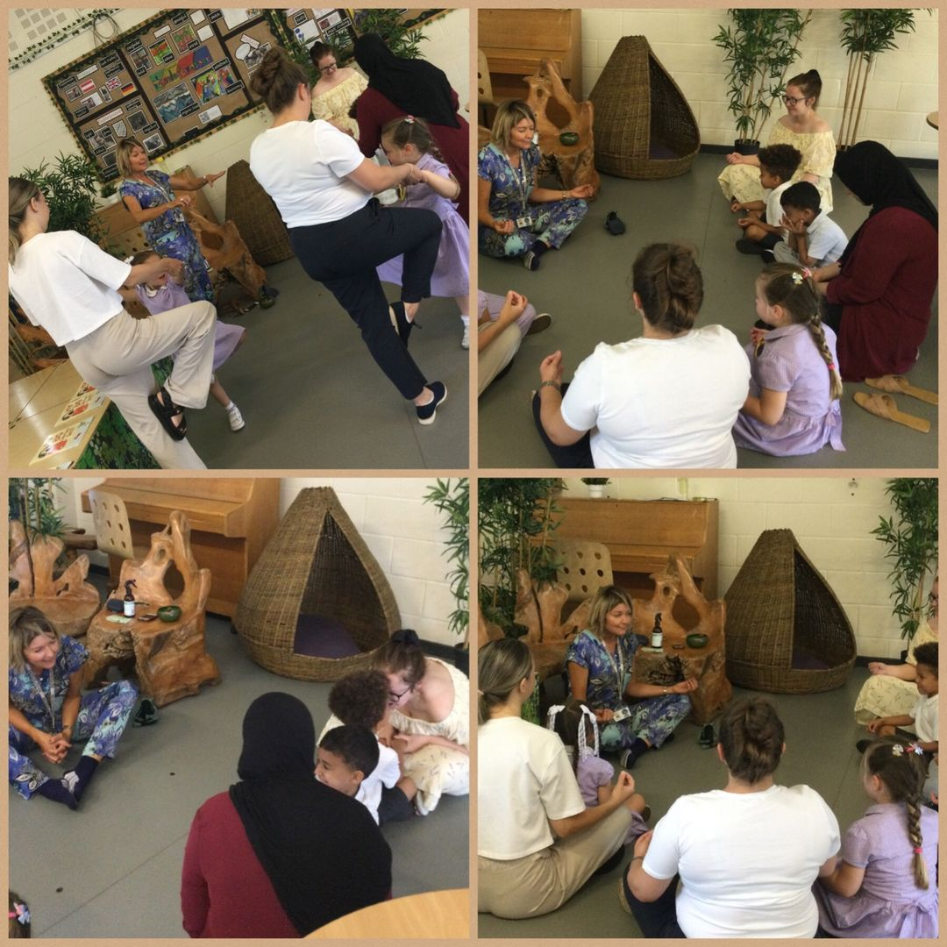
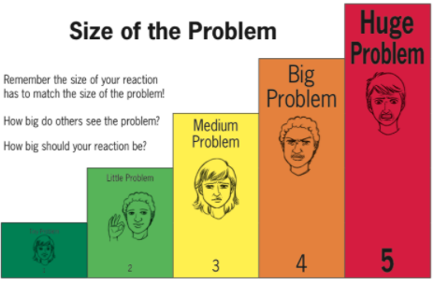
Session 3
Session 3 - Size of the Problem
Powerpoint -
Understanding ‘Size of the Problem’ and how this links with ‘The Zones of Regulation’
Consideration of our reactions as Parents, do they always match the size of the problem?
Parent/Child Activity
Guided Yoga breathing techniques and mindfulness session
IQM National Inclusion Conference
Notes:
Opportunity to feel the benefits of mindfulness practices and yoga first hand - reminders of what is available on line, where they can find appropriate yoga/mindfulness/breathing exercises to do with their child
Understanding that these practices can become part of family time/life

Slide 28
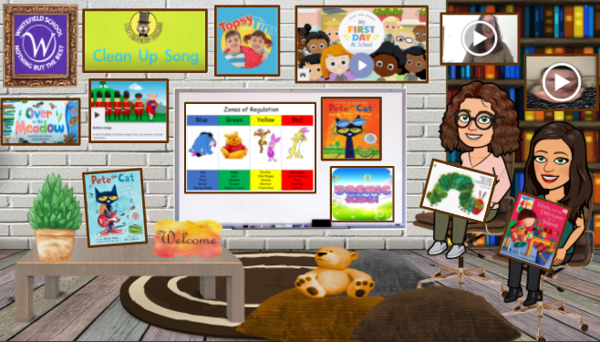
EYFS: Virtual Transition Classroom
IQM National Inclusion Conference
Notes:
Our virtual transition classroom was shared with families in preparation for their children starting in September

Slide 29
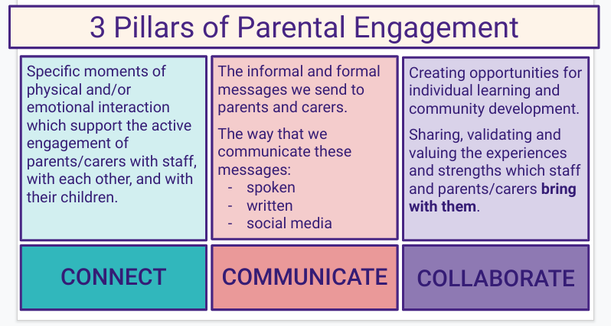
IQM National Inclusion Conference

Slide 30
Impact
Thankyou, I really enjoyed it and so far it’s working at home with Nellie, I’ve even told my sister about it and she’s been trying the zones at home with her children
We’ve loved it! Thank you for giving us all the information and tools , like u said we could talk for hours about this topic.
Thank you, I really enjoyed it and we've been using it home now too! I think it will really help us and I think it's a clever idea to help the children and parents. We have the poster up and have already been referring back to it, feel like its a step in the right direction and I look forward to next week 🙂 Charlotte x
Thank you! Elias was very excited when he seen me after school he instantly remembered he wanted to complete his drawings, and he also showed me some new breathing patterns! Bilal was surprised when I asked him to do some monkey mindfulness 😂
IQM National Inclusion Conference

Slide 31
Next steps
Scaling project:
Year 1
TERM ONE - Spring 24
Train 5 additional schools to implement emotional literacy approaches in class.
Make coaching visits to each school and share materials developed in the original project.
Run drop-in and Q&A sessions to support school champions.
Continue to support and visit existing schools.
5 new schools involved.
TERM TWO – Summer 24
Embed practice with those schools and have introductory meetings with next 5 schools.
IQM National Inclusion Conference

Slide 32
Next steps
Scaling project:
Academic Year 2/3
TERM THREE Sept 25
Train 5 additional schools to implement emotional literacy approaches in class.
END of YEAR 1 - total of 10 additional new schools involved
Bring together all 10 schools to pool experiences and plan parental sessions
TERMS 4 - 6
Embed practice with schools
Train 8 additional schools to implement emotional literacy approaches in class.
Run in the 18 schools for whole academic year and assess. These schools will be recruited using existing
networks, timing has been aligned with network meetings. Additional schools have expressed interest.
In this phase we will trial implementation in a more hands off model of initial training and offering materials
IQM National Inclusion Conference

Slide 33
Secondary Transition
Children report that the strategies they have been using at primary school are no longer recognised and so they “get in trouble”
Exclusions and Detentions, lower attendance
Parents come back to us
Shared language and approaches to be used between primary school and their new setting in order to maintain impact.
Start with one secondary and share with 3 more over next 3 years
Will be seeking additional Secondary Schools to work with
IQM National Inclusion Conference

Slide 34
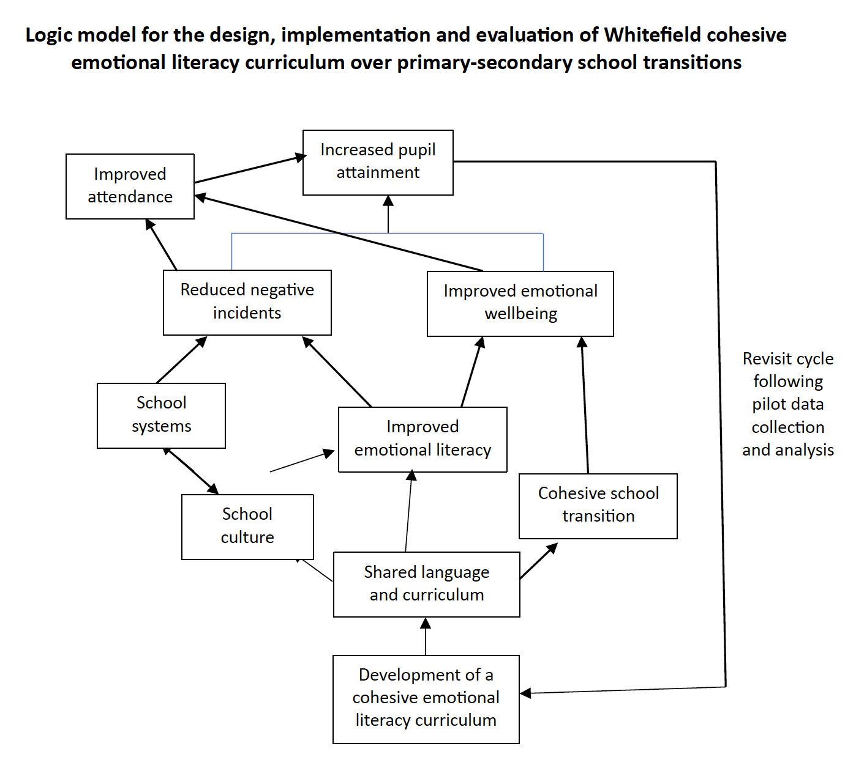
Secondary Transition
IQM National Inclusion Conference

Slide 35
IQM National Inclusion Conference
Notes:
Children use the space here to match emotion stones to the zones of regulation cards.
They often use this space to talk with peers and practitioners about how they are feeling and what they might try to bring themselves back to the green zone.
Children explore our sensory den and enjoy the different smells. sounds, sights and textures.

Slide 36
Quick Wins
Express interest in accessing Emotional Regulation Parent EYFS resources and project
Express interest in knowing more about our Emotional Regulation Transition Project
(Email mbeale@whitefieldprimaryschool, or complete form on Slido)
Consider play – is what you are doing intentional? Does it enable children to develop regulation?
Review your environment. Does is support children in flight or fight mode. Train staff to understand how to co-regulate.
Explore `EEF toolkit https://educationendowmentfoundation.org.uk/education-evidence/teaching-learning-toolkit/metacognition-and-self-regulation
Talk to parents and carers about what your school does to help children manage their emotions
IQM National Inclusion Conference

Slide 37
Questions
#IQMFamily
IQM National Inclusion Conference

