Slide 1
Embedding Cultural Diversity Across the Formal and Informal Curriculum
Presented by Nicola Coton and Hannah Monk,
from Sir Jonathan North College
th
IQM National Inclusion Conference, 27
November 2023
#IQMFamily

Slide 2
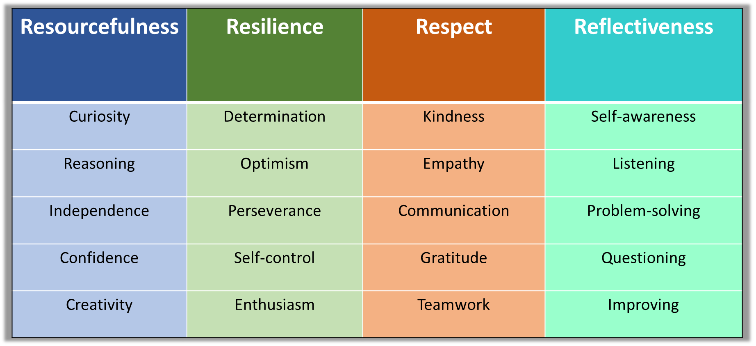
Our aim
Our values
Creating ‘good people’ by aiming for excellence in everything we do.
to be successful, independent, adaptable young learners who are able to embrace challenges and to be responsible citizens
Our direction
Successful
Journey
Nurtured
Growth
Challenged
IQM National Inclusion Conference
Notes:
A larger than average sized 11-16 comprehensive with 1200 students on roll.
Unique as the only girls‘ non faith state school serving a diverse community in Leicester and Leicestershire.
Committed and enthusiastic staff.
Graded as an Outstanding school by Ofsted in October 2013.
Joined Lionheart Education Trust 2019
We are experts in how girls learn best (achievement and standards). National research tells us and we know that girls often lack confidence in themselves and suffer low self-esteem. Girls learn best in single sex schools because they are also more prepared to take educational risks. Research and national results for several years says they achieve better than girls attending mixed schools in all subjects.
and we take on board their feedback and suggestions to improve what we offer e.g. from opinions about our healthy food menus to styles of effective t and l in the classroom.
Our staff are caring and committed. They know students well and enjoy good relationships with them both in and out of the classroom.
We encourage students to have a voice, an opinion – we have an active student council and encourage them to tell us what they think about all aspects of college life.
We enjoy close links with our feeder primary schools albeit we have 54 of them.
Successful both academically and personally - High quality teaching and tutoring. Our students need to be able to talk, write, read well and be numerate – these are the key skills for life
Journey through the 5 years students are with us they must have a strong curriculum which they receive feedback on. The schemes of learning must identify the opportunities for feedback – at least two per unit of work – in line with the marking and feedback policy and opportunities and strategies to make learning stick.
We must continue to provide the nurture through effective tutoring and pastoral support.
We want to see the progression and growth through both the pastoral and subject teaching curriculums.
We need to continue to challenge ourselves and our students to be the best versions of themselves and provide them with the opportunity from Year 7 to hit the top grades based on available research.

Slide 3
Priorities:
To continue to promote holistic development across the school to support all students to become good people.
Ensure the curriculum is reflective of the diversity of the College
Promote diversity within the personal development curriculum and across the school
IQM National Inclusion Conference

Slide 4
Rational:
Since SJN was founded in 1904, almost every single building since then has been named after an upper-class white man, many of whom were discriminatory.
For example:
Simon de Montfort expelled Jews from Leicester in the thirteenth century.
Thomas Babington Macaulay forced the English education system upon a community in India, believing their culture and language were 'worthless'
Criteria
must have made an impact that is seen as inspirational and relevant to students within our school.​
any gender​
if possible, should be connected to subjects taught within a particular block.​
desirable but not essential if first or last names start with the same letter as current block initials.​
can be from across the world.​
no longer alive.​
an inspirational figure who is not often represented in the media that we could raise awareness about through naming one of our buildings after them.​
w/b 21.02.22
launched to staff and students. Ideas submitted on microsoft form
Closing date 11.03.22
w/ b 14.03.22
Student council to filter nominations, complete due diligence on suggestions and draw up a shortlist of 5 for each block.
On 30.03.22
microsoft form shortlist to be sent to all staff and students for voting.
Voting closes on 06.04.22
Results communicated to Mrs Angus for checking.
Students and staff informed once decisions signed off by Mrs Angus.
IQM National Inclusion Conference
Notes:
Student council exec- student leadership

Slide 5
Building Names
Greenwood Lounge:
Ada Lovelace 1815-1852 British
First computer programmer.
L block: Dorothy Hodgkin 1910-1994 British
Nobel Prize-winning chemist.
W block – Wilma Pearl 1945-2010
Native American activist first woman to be elected as a Principal Chief in the Cherokee nation.
D block: Zaha Hadid 1950-2016
Iraqi British architect, artist and designer.
M block: Murasaki Shikibu c978 – c1014 Japanese
She wrote what is considered to be one of the world’s first novels.
IQM National Inclusion Conference
Notes:
Impact

Slide 6
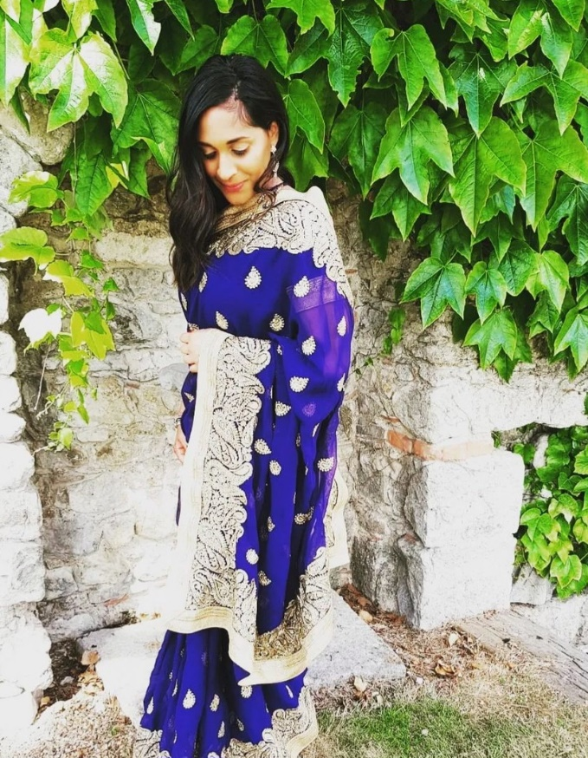
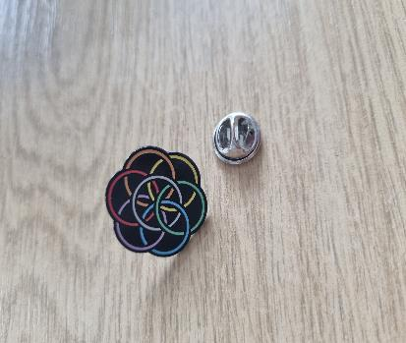
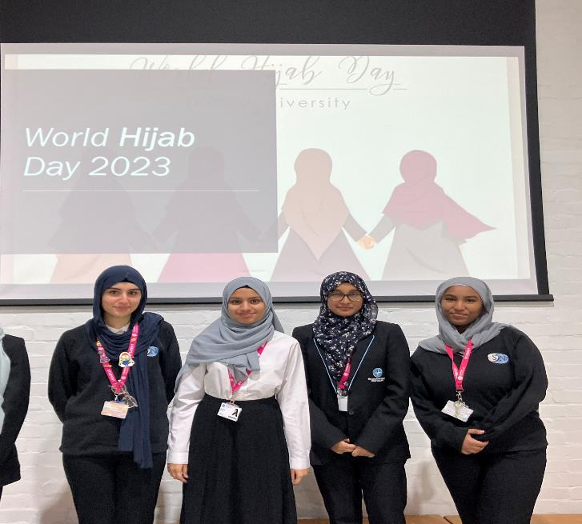
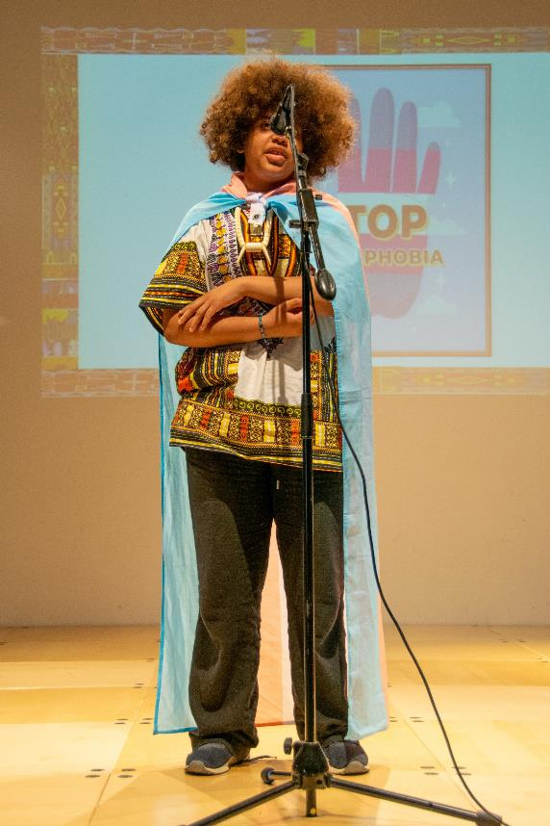
Ms Ladha (Teacher of English)
I am of Indian heritage
My Parents were Ugandan refugees who came here due to the 90-day expulsion set by Idi Amin
My Dad is a car mechanic
My Mum is a carer for the elderly
I speak Gujarati and Kutchi
I come from a working class background and grew up and lived in Aylestone, just off Saffron Lane.
Notes:
Following on from our achievements from last year, our successes have blossomed so much so in the last academic year, that we could not fit them all onto one slide!
To ensure that our vision is as successful, cohesive and as far reaching as possible we have employed the following strategy to ensure maximum success this year: At the beginning of the academic year a survey was sent round to all students about their opinions on diversity and the results of this have been acted on through the actions of our Diversity group
The group has liaised closely with Student Council Execs to ensure our goals for Diversity and Inclusion is streamlined and thorough
A democratic voting process was executed in every form group electing a Diversity Ambassador; This has allowed greater representation across the year groups
DAs have met the Diversity Staff Team every half term and have been updated on our successes and plans going forward
Every half term, an article has been written in the Student Edit by a DA about our successes of the half term so far so that all students and staff are up to date with how we are practising inclusivity
The Das have been eager to create and deliver the following since September:
To celebrate Diwali, Rangoli patterns in tutor time/displays made
Das created and delivered on assemblies on Eid, Diwali, Christmas, World Hijab Day, LGBTQ+ month, Ramadan and Hidden illnesses have all been created and delivered by the DA (Pride assembly still to come before the end of year)
Displays are also being created by students and Meena and displayed in the Main Entrance. You may have seen the one that has been created by the Das and our librarian Mrs Vyas on Ramadan in the Main foyer
Assemblies and displays are being shared on social media so that all parents/guardians are aware of how we celebrate diversity
RAN and NLA visited Stephen Lawrence centre in February. Going forward there will be a tutor time programme to observe Stephen Lawrence Day as well activities in the library around this on April 22nd
Staff Diversity Board has been created with 19 members of staff taking part and celebrating their protected characteristics
Sub group has been created solely for students identifying with LGBTQ+ and is being run by RBH and RRA

Slide 7
REFLECTION POINT
What are you doing in your school setting to address Cultural Diversity across the informal curriculum?
IQM National Inclusion Conference

Slide 8
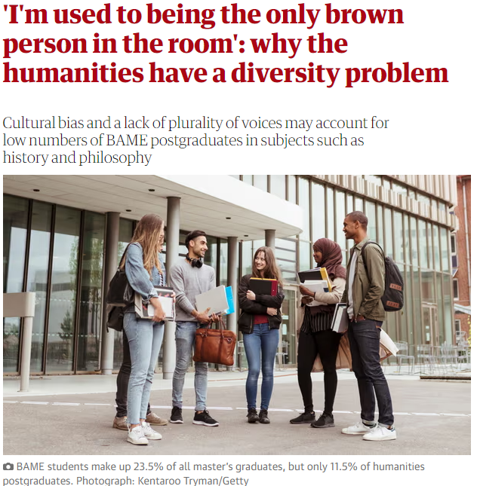
“If students never see anyone who looks like them in textbooks, they’ll think the subject’s not for them. They won’t feel welcome.
By the time students graduate from a history degree, they may have studied Nazi Germany three or four times,”
Dr Shahmima Akhtar, a doctoral fellow working with the Royal Historical Society
Notes:
https://www.theguardian.com/global/2020/jan/27/im-used-to-being-the-only-brown-person-in-the-room-why-the-humanities-have-a-diversity-problem
In today's interconnected world, the ability to navigate diverse cultural landscapes is essential.
Humanities education equips students with the knowledge and skills needed to engage with people from different backgrounds and cultures.
Can you name a philosopher? If Plato or Aristotle come to mind, but Franz Fanon or Gayatri Spivak do not, like many of us, you may have a case of Eurocentrism – an understanding of the world that centres the west, at the expense of other cultures.
Unfortunately in our humanities there is a blind spot.
“It’s down to the naive belief that if black or ethnic philosophers were any good, they’d be up there with the rest of them.”
“I’m used to being the only brown person in the room,” says Dr Shahmima Akhtar, a doctoral fellow working with the Royal Historical Society, whose race, ethnicity and equality report found history is one of the least diverse subjects in the UK – black historians make up less than 1% of university history staff.
Akhtar believes the problem in her subject starts in schools, where the history taught is predominantly white and Eurocentric, and is the start of an enduring and implicit bias against history from the perspective of those who are not white.
“If students never see anyone who looks like them in textbooks, they’ll think the subject’s not for them. They won’t feel welcome. By the time students graduate from a history degree, they may have studied Nazi Germany three or four times,”
It’s easy for BAME students to feel they aren’t studying their own culture.”
Ironically, master’s courses allow for more diversity, but by then too many BAME students are no longer in education.
But we want a society that is cohesive and multicultural, We’re divided on so many levels – history has the power to create that cohesion.
The 2014 YouGov survey that found 59% of Britons believe the British empire was something to be proud of!
Culture shapes our lives as much as politics, Humanities are about human stories, and we are all human. If you don’t have diversity, you don’t have the full human experience.

Slide 9
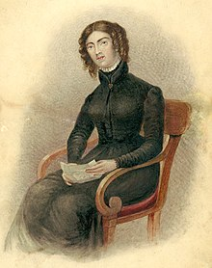
We did some student voice…
“We do gay people and stuff but only if we finish the other stuff”
Felt our diversity was an add on
Felt tokenistic
Notes:
So we tried to be more diverse, we added a topic on Ann Lister dubbed "the first modern lesbian” when we looked at the industrial revolution.
Felt our diversity was an add on
Felt tokenistic
Now we look at empowered women as part of the topic e.g. Match girls strike. We integrate diversity and key figures into our topics.
But this is still white british history. We needed to do more.

Slide 10
Diversity in the Geography Curriculum
IQM National Inclusion Conference

Slide 11
KS3 curriculum maps which show we cover a wide range of countries around the world.

Slide 12
Diversity in the Curriculum CPD session
Notes:
SMO attended the geography hub meeting on diversity in the geography curriculum . Great local training –recommend taking a look
CPD structure and aims

Slide 13
In KS4 we look at…
How is the UK’s cultural influence changing?
How is multiculturalism positive for the UK?
How has ethnicity influenced UK food?
How are ethnic groups contributing to cultural life of the UK?
How has ethnicity improved the UK?
We look at the different areas in Leicester and the ethnic diversity in these areas
Notes:
Why have people migrated to Leicester from other countries?
The Caribbean – post WW2. Windrush generation. For employment post war – invited by the British Government.
South Asia – mainly from the 1950s onwards. For employment then later due to family links.
Uganda – 1972 Ugandan Asians were forced to leave Uganda. Many moved to Leicester.
Eastern European countries – 1990s onwards. EU migration for employment.

Slide 15
Can you recognise where the following dishes are from?
Where?
Where?
Where?
Where?
Where?
Where?
Where?
Where?

Slide 16
Within this topic is a power point that we use all about food!
Something our students can access and try locally

Slide 17
Diversity in the History Curriculum
IQM National Inclusion Conference

Slide 18
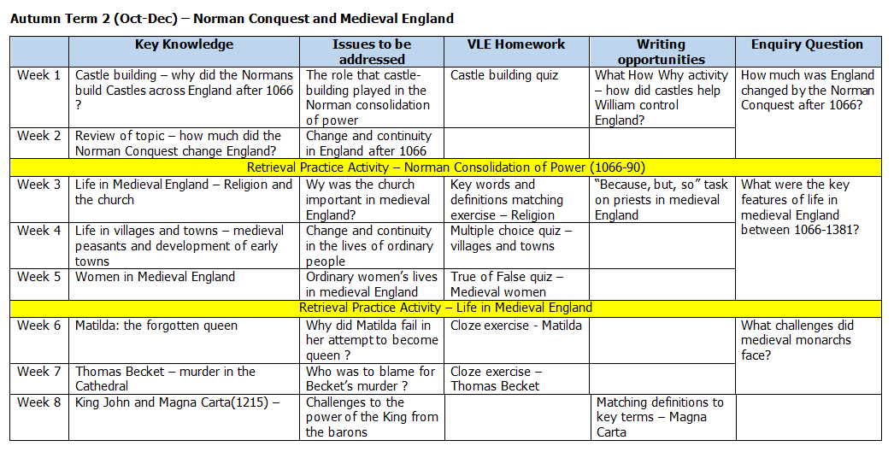
y7

Slide 19
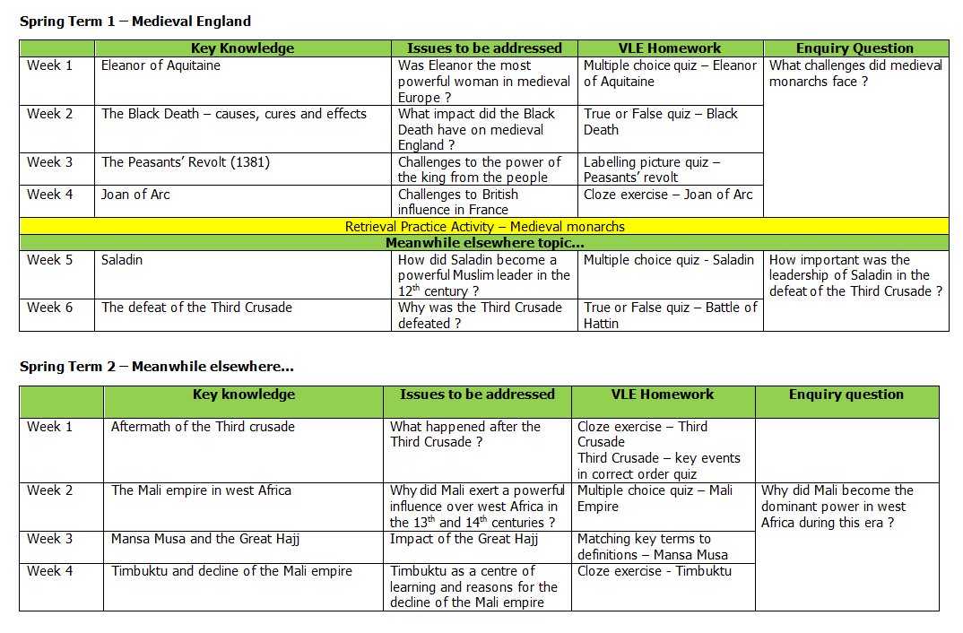

Slide 20
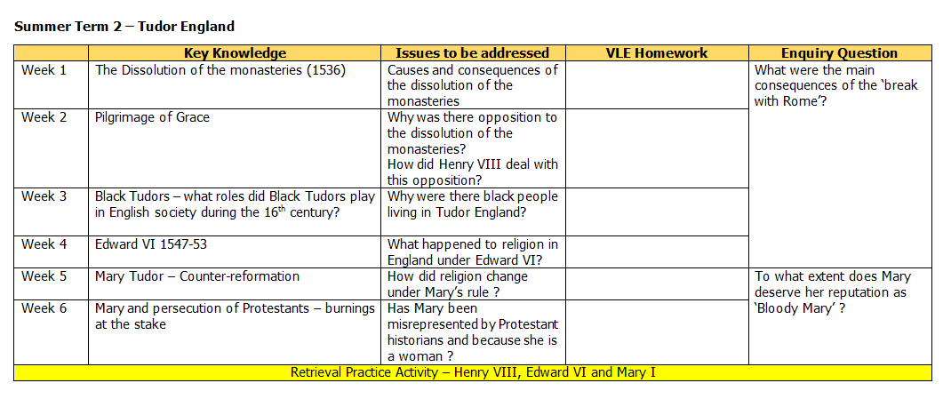
Teaching them to recognise ingrained sexism in historical accounts and to question and analyse it.

Slide 21
A rebranding of historical ideas?

Slide 22
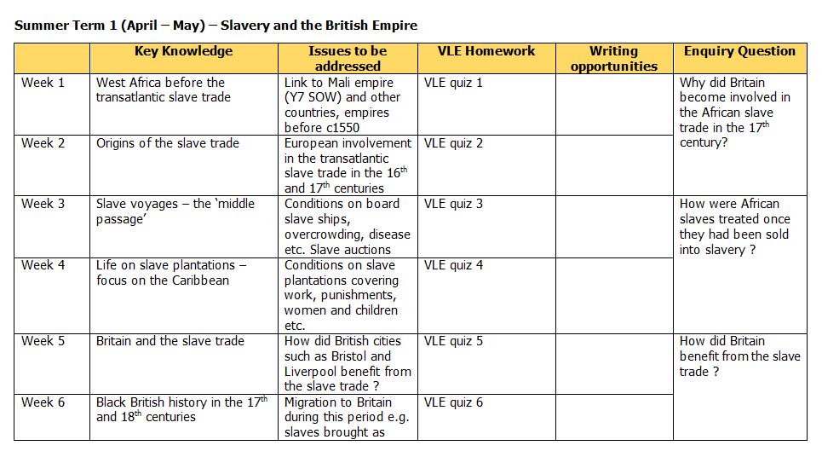
Devotion to black history
Notes:
But we could make this better – not just victims

Slide 23
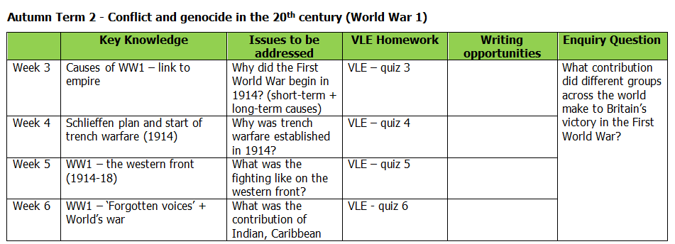
Thematic approach so connections can be made about the issues of colonisation, the contributions of women etc. The same themes are followed in WW2

Slide 24
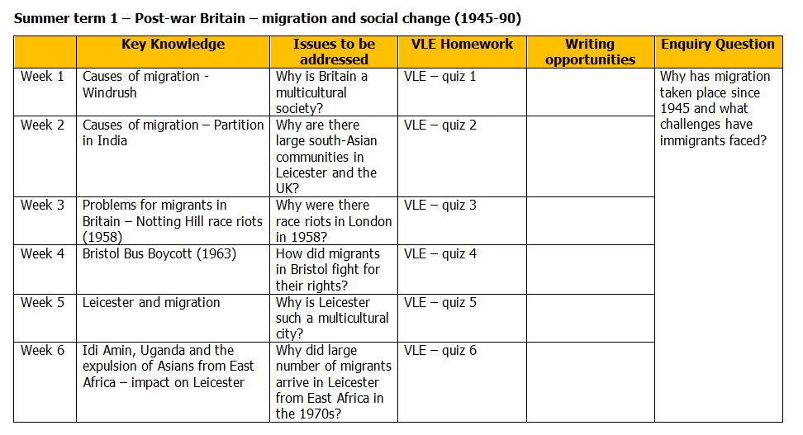
We hope our students feel seen
Notes:
And links to geog and citizenship

Slide 25
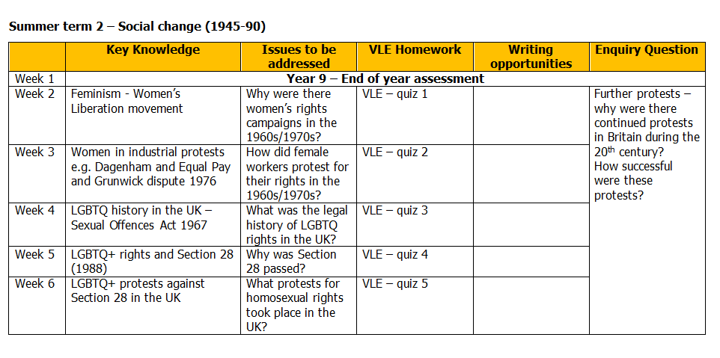

Slide 26
Diversity in the RS Curriculum
IQM National Inclusion Conference

Slide 28
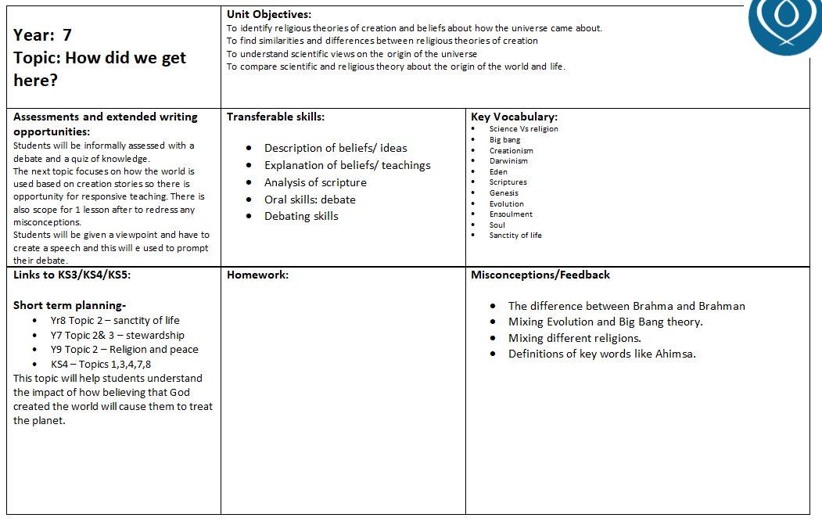
Presence of secular views

Slide 30
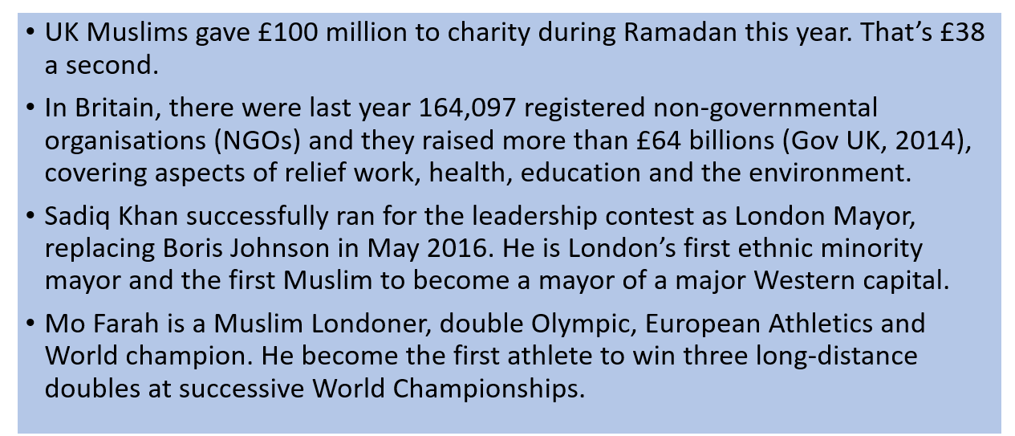
Twenty-first century Muslim
Notes:
Look at the art and creations.
Voices of not stories about

Slide 31
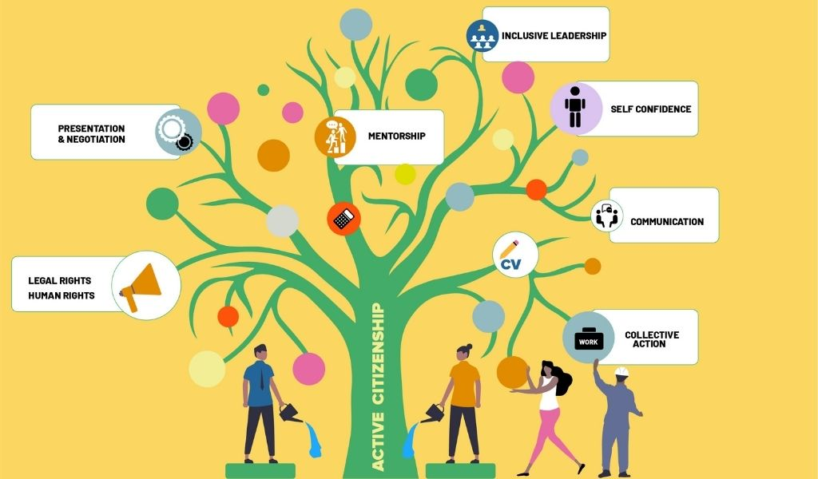
Diversity in the Citizenship Curriculum
IQM National Inclusion Conference

Slide 32
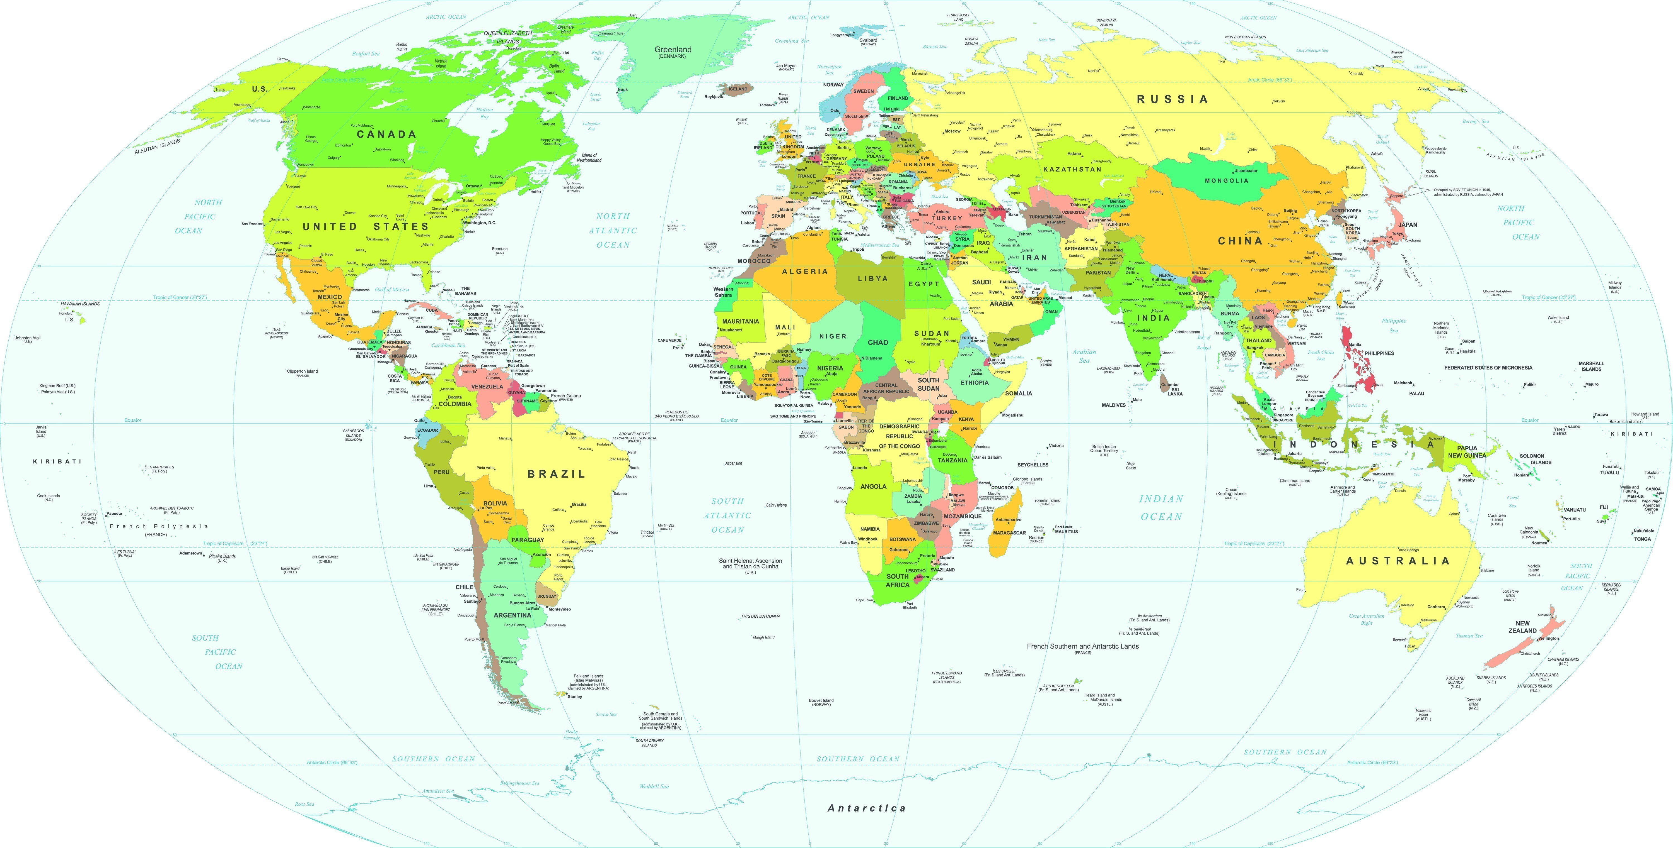
Where in the world do we have links with? Mark on the board where you have relatives.

Slide 33
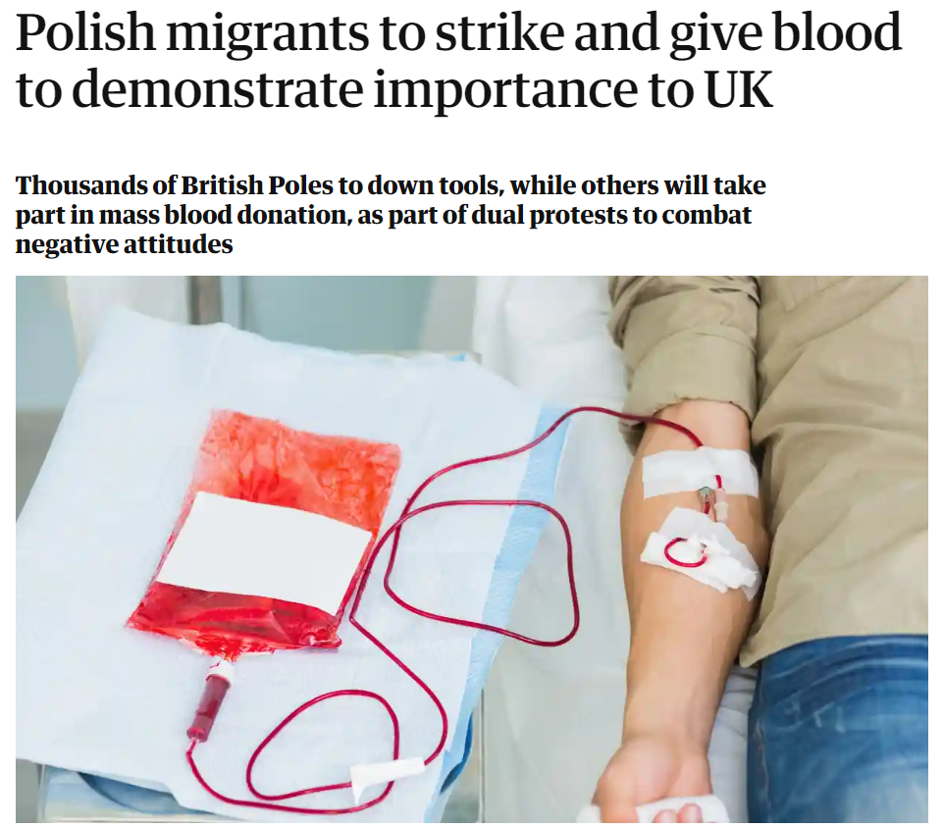
What you need
Article – Polish migrants strike and give blood to demonstrate importance to UK
Reciprocal Reading
Use the article to pick out a selection of questions from the article
Reciprocal Reading Reminder
Predict
Read
Clarify
Question
Summarise
Polish Blood Campaign
1) Predict

Slide 34
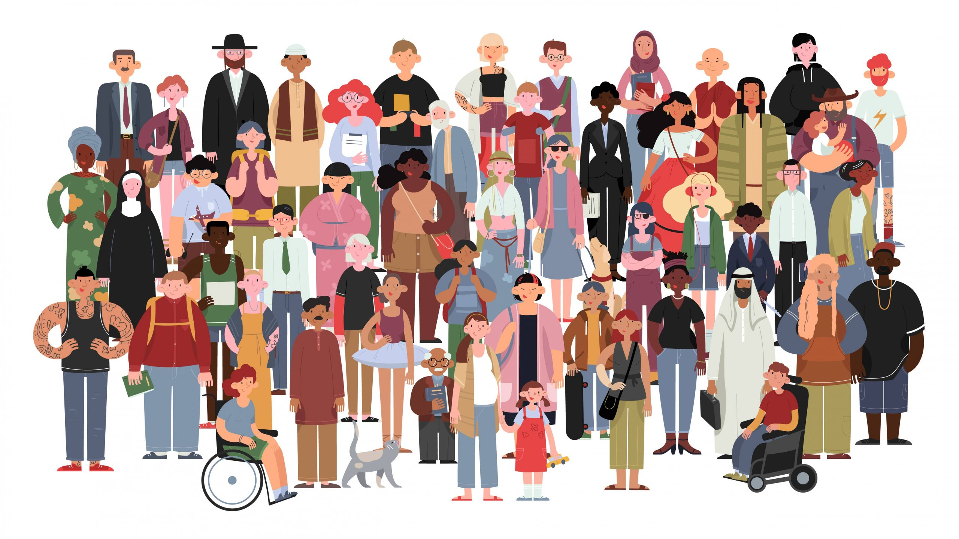
Culture shapes our lives as much as politics. The Humanities are about human stories, and we are all human. If you don’t have diversity, you don’t have the full human experience.
IQM National Inclusion Conference
Notes:
And finally

Slide 35
REFLECTION POINT
What are you doing in your school setting to embed Cultural Diversity across the formal curriculum?
IQM National Inclusion Conference

Slide 36
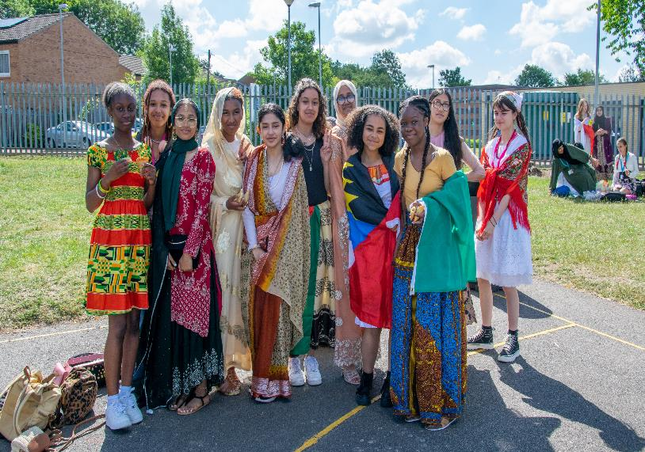
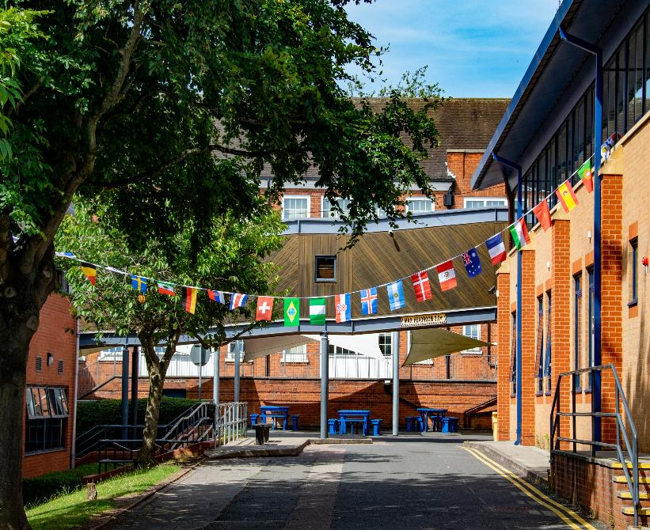
Quick Wins
Note : Please see the slides after questions at the end of this presentation for examples of these
Diversity focus group for staff
Diversity Ambassadors – student leadership opportunities
Annual culture day with parental involvement
Every half term our Diversity Ambassadors write an article for the Student Edit informing students, parents and guardians of our successes​
Student voice on diversity
IQM National Inclusion Conference

Slide 37
Questions
#IQMFamily
IQM National Inclusion Conference

Slide 38
Ms Ladha (Teacher of English)
I am of Indian heritage
My Parents were Ugandan refugees who came here due to the 90-day expulsion set by Idi Amin
My Dad is a car mechanic
My Mum is a carer for the elderly
I speak Gujarati and Kutchi
I come from a working class background and grew up and lived in Aylestone, just off Saffron Lane.
Notes:
Example of staff notice board

Slide 39
Diversity Ambassador
This is a unique opportunity to become a Student Diversity Ambassador and make a difference to the culture of SJNGC.
During the year, your voice will be heard in helping SJNGC become more diverse and celebratory of all the protected characteristics! You can be involved in:
-Creating and delivering assemblies
-Writing articles for the Student Edit about how we are celebrating diversity throughout the school year
-To plan and help deliver activities for the tutor time programme
-Helping to create, run and deliver the flagship event CULTURE DAY at the end of the academic year
-Liaising (meeting) with the Student Council Executive to plan how to make our college more diverse and inclusive
-You will receive a Diversity Ambassador badge!
-You will be asked to attend meetings each half term from 30-60 minutes after school every half term. The first one will be on the 23rd November.
Notes:
Example of Diversity Ambassadors selection process Slide 22-24

Slide 40
The Voting Process
Each form will elect one Diversity Ambassador only.
Each prospective candidate should be nominated by at least two people and their names must be written on the board.
All students must be given a secret ballot slip. Students may vote for one candidate only – completed ballot slips must be collected in.
The form tutor (or 2 responsible students) will be responsible for counting of the votes and announcing the result.
Once a Diversity Ambassador is elected, Form Tutors please email the result to Ms Rhodes AND Ms Harris.

Slide 41
THE VOTE
SJNGC is committed to eliminating discrimination and encouraging diversity amongst our students. Our aim is that the Diversity Ambassadors will be truly representative of all sections of society. No applicant will be discriminated against regardless of their age, colour, disability, ethnicity, gender or gender identity, race, religion or belief or gender.
Name of Candidates | No. of votes cast

Slide 42
Every half term our Diversity Ambassadors write an article for the Student Edit informing students, parents and guardians of our successes
Notes:
Communication with parents, students

