Slide 2
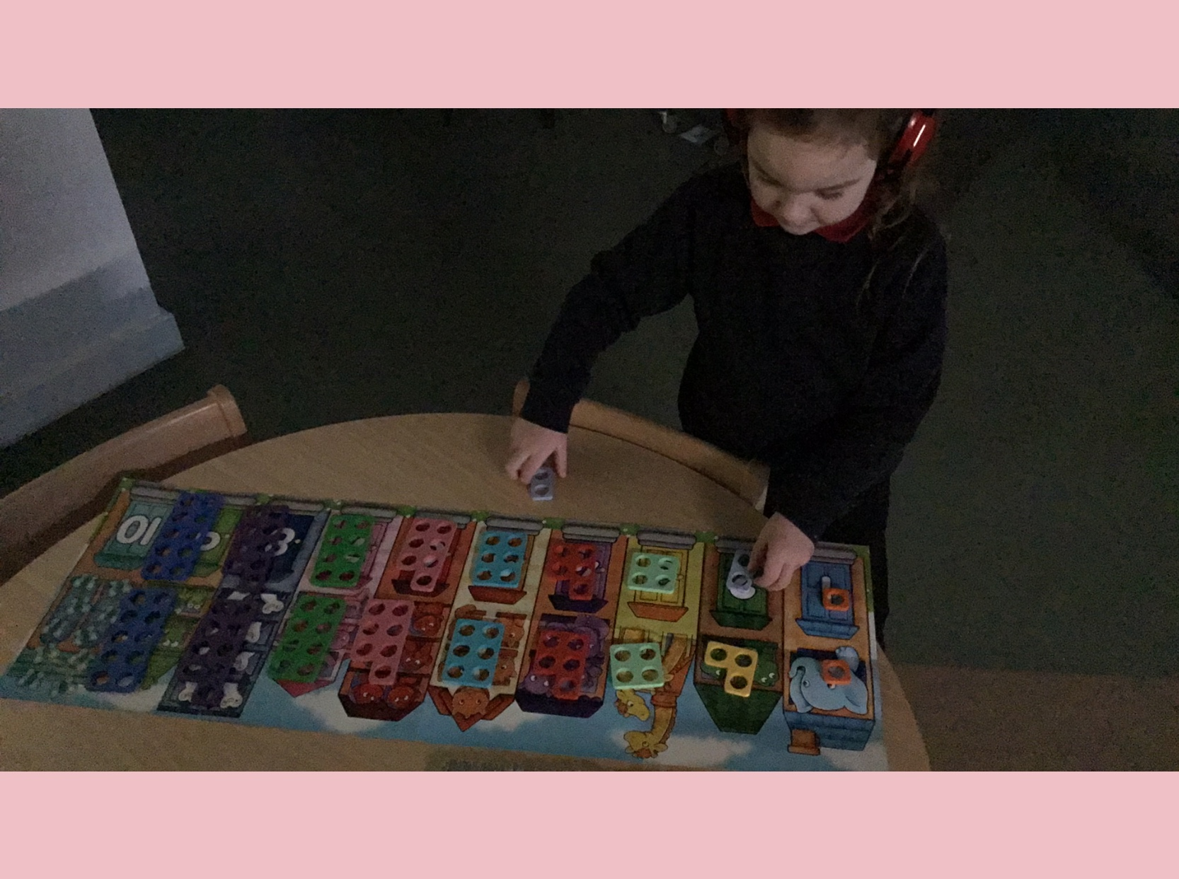
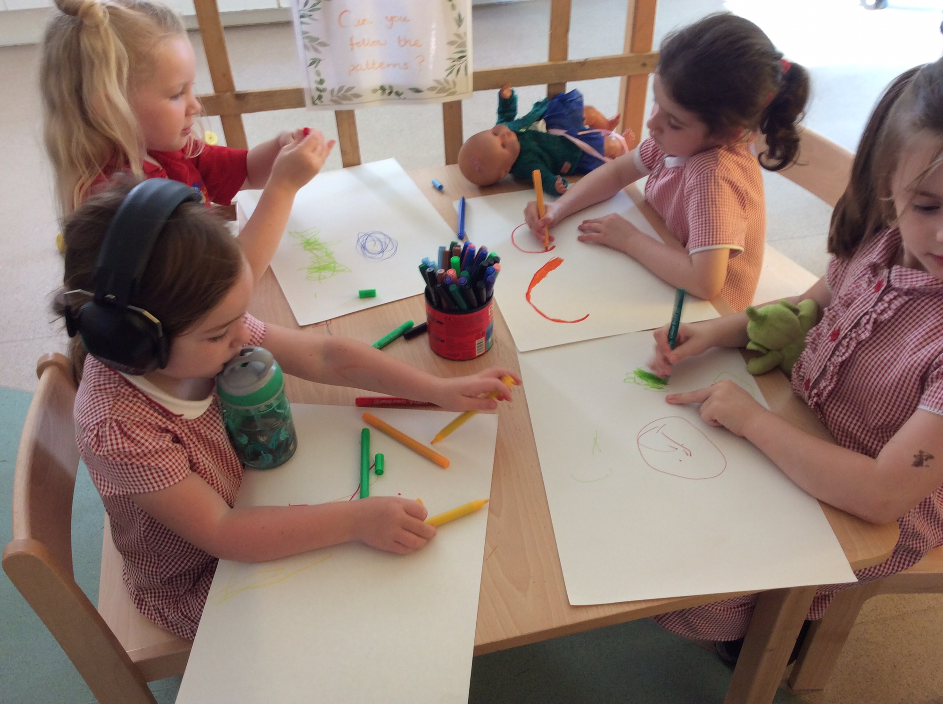
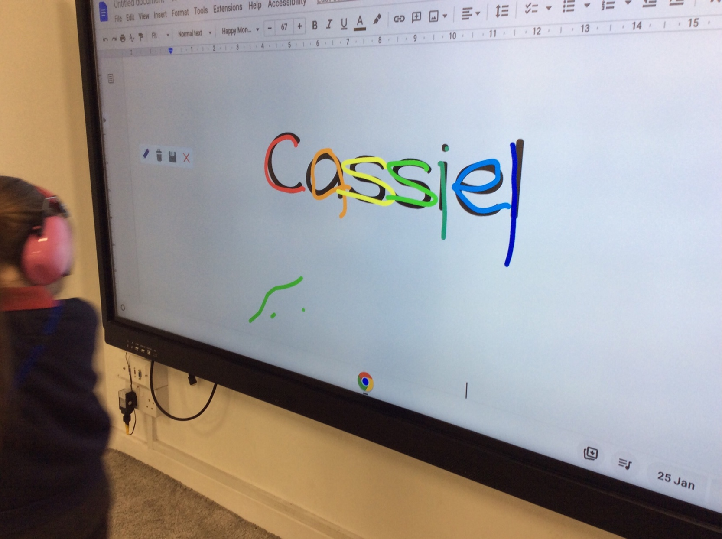
Cassiel’s needs
Setting up an enhanced, in-school provision within our mainstream school
Staff training for the adults who support her
Curriculum - same but different
Intervention
Working with stakeholders
IQM National Inclusion Conference

