Slide 1
Outstanding Personal Development and Character Programme
Presented by Carlington Anderson, from Northampton Academy
th
IQM National Inclusion Conference, 27
November 2023
#IQMFamily
Notes:
Hello everyone I am Carlington and today I would like to share with you a very short workshop on our personal development or as we call it Character Programme. During the presentation, I will share What is the Character Curriculum? How is it Taught, Caught and Sought? Some Impact Quick wins and try to answer some questions you might have. You will also hear from some of our students (JIT) who are at the heart of student leadership in the school.
I would like to start with a video that charts our journey and sums up our remarkable story. I would like to apologise in advance for the moments in the presentation where it might appear that I am boasting- I truly am excited and proud of the journey and having a relentless focus on virtues have paid off.

Slide 2
Context of the Academy
OFSTED 2023 - OUTSTANDING
Over-subscribed Academy in Northampton Eastern District
1700 students (1470 in KS3 & KS4)
35 - 38% Pupil Premium (dependent on year group)
High level of deprivation – most deprived (highest 20%) in terms of pupil base
52% White British
18 of 18 ethnicities at the Academy
Over 60 languages spoken
Multiple active gangs in the local area (26 currently)
Blackthorn (one of the main feeder estates) is one of the most deprived in the country – no-go zones for services
Notes:
However, 6 years later we are proud to be recognised by Ofsted as an outstanding school, we are oversubscribed, even though we have 35-38% PPM, high levels of deprivation, 40/50 split in ethnicity, over 60 languages spoken, multiple active gangs, and our main feeder estate is a no- go for services.

Slide 3
Key Metrics
Impact of the Character Programme and Personal Development
2016-2017 | 2022-23 to date
6.61 FTEs per week (2 times NA)
123 students had a FTE (10.25%)
49 students >1 FTE (4.08%)
94.2% attendance
0 students knew values or vision
Dates | Progress 8 Score
2016-17 | +0.06
2018-19 | +0.64
2020-21 | +1.06
2022-23 | +0.97
2.55 FTEs per week (sig below NA)
39 students have had a FTE (2.71%)
14 students >1 FTE (0.97%)
94.1% attendance
100% students know school's values and can explain their meaning
Admissions – 2016/17 – 307 applications for Year 7 – no year group was full
Admissions – 2022/23 – 878 applications for Year 7 – heavily oversubscribed every year group
Notes:
Even though this is not the reason we do character education it is great to see that it translate into better grade for the students

Slide 4
OFSTED REPORT -2023
Notes:
Most importantly Ofsted has recognised the impact that Character development has on children. I was meant to highlight a few bits but ended highlighting the whole thing.

Slide 5
One of the reasons for the rapid and sustained progress in the Academy is the Character Programme
The Character Education Programme
Underpins everything that is done at the school- “It is not just another thing; it is everything”
The school have 5 virtues- not values, that permeates all facet of the academy
The 5 virtues ( Pillars of Virtues) are used to help young people develop Phronesis (practical wisdom) “Doing the right thing, at the right time for the right reason”.
Is evaluated and graded –Focusing, Developing, Establishing, Enhancing and Enhancing Plus once a term by the SLT (see Character Action Plan), evidence is collected to support each area and action given to move each area forward.
Has a ‘Tri-Axiom’ or pivots through which the programme is delivered: character taught, caught and sought
Ensure that students flourish and become their best selves, because they are held to account using the virtues as the standard.
Example of Character Action Plan.
Notes:
One of the reasons for the rapid and sustained progress in the academy is due to the relentless focus of leaders to drive excellence. What the character programme does is that it provides the underpinning of everything the school does and the 5 virtues permeate all facets of the organisation. Leadership, ethos, values, culture, visible and hidden curriculum, governors, parents, staff etc. The programme is evaluated and graded once a term. It is delivered through a tri-axiom or pivots we call- taught, caught and sought. \but most importantly the character programme ensures that there is a standard to hold young people and staff accountable to. It provides that language/ or north star for both praise, reward and sanctions.

Slide 6
What is Character Education and Why Develop it in People?
Character Education is a comprehensive school-based approach to fostering the moral development of students.
A person with “good character” acts, thinks, and feels in a way that matches some commonly accepted “good” traits, like being honest, respectful, responsible, humble, compassionate, ambitious, determined etc…
‘Character virtues should be reinforced everywhere: on the playing fields, in classrooms, corridors, interactions between teachers and students, in assemblies, posters, head teacher messages and communications, staff training, and in relations with parents’
Jubilee Centre, 2017
‘Character Education- ‘Is Everything, Not Another Thing…’
Notes:
So what is Character Education and Why develop it? It is about fostering the moral development of students. The aim is to ensure that all students flourish. That happens when it is reinforced everywhere, on the playing fields, in classrooms, corridors, in interactions between teachers and students, in assemblies, posters, head teacher messages and communications, staff training, and in relations with parents
Students flourish when Character Education is everything, not just another thing!

Slide 7
‘Character Education- ‘Is Everything, Not Another Thing…’
Virtues as central permeate all facets of school e.g. Assemblies, Curriculum
Character sought through experiences within & outside formal curriculum
1. Character Taught
2. Character Caught
3. Character Sought
Character taught through curriculum using teaching & learning strategies
SOUGHT
Virtues
Respect
Ambition Determination
Tolerance
Integrity
TAUGHT
Virtues as central permeate all facets of school e.g. Student Leadership, Enrichment
Virtues as central permeate all facets of school e.g., Praise & Reward
CAUGHT
Character caught through modelling positive relationships & clear ethos

Slide 8
Character Caught – Questions to Consider
1. How and why were your initial virtues/values chosen? Do they meet the needs and context of the pupils and community that the school serves?
4. Is your focus on Personal Development Character Programme, embraced and driven by the headteacher/Principal?
2. Is your approach to enabling positive behaviour virtue-led and not sanction-driven?
3. How will you know your Personal development programme is working? Will you use the wider matrices of a thriving school(attainment, behaviour, staff turnover, pupil intake numbers etc)? Will you use a specific evaluation framework? Will you use staff and pupil surveys?
5. How are you empowering staff to become character champions in their areas of responsibility?

Slide 9
Character Taught – Questions to Consider
Is character explicitly woven into subject areas? Have staff been trained to be able to do this proficiently and confidently?
5. Can pupils engage with moral dilemmas and/or other means by which they can use to refine their understanding of what the right action?
2. How frequently and to what extent do pupils have the opportunity to reflect on aspects of their character?
.4. To what extent is your assembly programme linked to your focus on character?
3. To what extent is your character education curriculum sequenced to secure progression and deepening of understanding over time? How does it prevent repetition and ensure it matches the intellectual and emotional development of pupils as they journey through school

Slide 10
Character Sought – Questions to Consider
To what extent is your extra-curricular offer linked to character development and the school’s virtues/values?
5. How often do pupils have the opportunity to take part in social action or volunteering? To what extent is this explicitly linked to your character programme
2. How does the school link careers and employability explicitly with character?
3. What student leadership development opportunities are there? How do they link with your focus on character? Do they go beyond a student council or equivalent? How are students selected? If they have to apply do they need to say why they have the right character strength
4. How are you empowering staff to become character champions in their areas of responsibility?

Slide 11
‘Character Education- ‘Is Everything, Not Another Thing…’
Virtues as central permeate all facets of school e.g. Assemblies, Curriculum
Character Taught Examples
Explicitly in the curriculum-Character Development Programme
At least 1 lesson in KS3
All Assemblies all linked to virtues and used to add to the taught aspect
Reading Programme- developing oracy
Language of virtues as part of the behaviour curriculum
My Culture Day
Social Actions- Work with 3 charities per year
Community Actions-( Litter picks, School Food and Uniform banks)
International Links- Germany & France
Character sought through experiences within & outside formal curriculum
Character taught through curriculum using teaching & learning strategies
SOUGHT
Virtues
Respect
Ambition Determination
Tolerance
Integrity
TAUGHT
Virtues as central permeate all facets of school e.g. Student Leadership, Enrichment
Virtues as central permeate all facets of school e.g., Praise & Reward
Character Caught Examples
Deliberate practice- Modelling the virtues
Virtue Champion- All teachers nominate each other
Principal Awards
½ Termly Character Challenges
Environment- virtues visible everywhere
Vision, Ethos and Culture
Behaviour and Reward (Praise Points linked to virtues)
BiE Award
My Culture Day- celebrates diversity linked to virtues
Planning &Evaluation
Systematic evaluation of Character Action Plan by SLT termly
Stake holder involvement
SPECTRUM (teacher working party group)
JIT- Junior Inclusion Team( Student Working Party)
Parent Ambassador ( Parents Group)
Character Sought Examples
Student Leadership- Meaningful Leadership Opportunities for students ( Charter)
Junior Inclusion Team (JIT) drive through inclusion priorities
Inclusion Charter-
All Enrichment Opportunities linked with virtues
Character Passport App- Students evaluate their own character and seek opportunity to develop them – CDP lesson x 2 per term
Character Graduation
CAUGHT
Character caught through modelling positive relationships & clear ethos
Notes:
The diagram above shows how virtues are central to everything and how they feature in all aspects of the school- so not another add-on but everything.
These are some examples of how character is driven through- Taught, Caught and Sought and after this, I will show some specific pictorial examples of how it is lived in the academy. I also will have physical examples that you can take away-quick wins

Slide 12
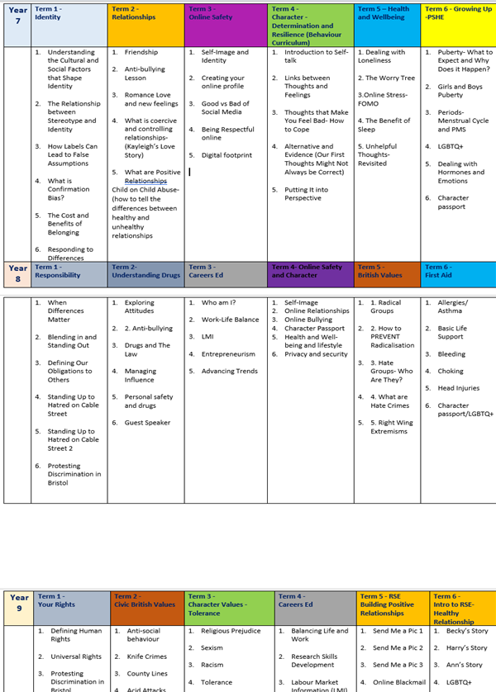
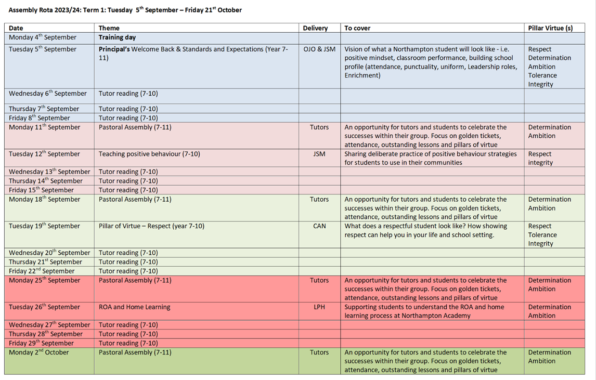
Example of Character Taught
Character Curriculum-SoW
Character education is taught through:
A discrete and bespoke timetabled subject, CDP (Character Development Programme) which focus explicitly on the teaching of character and virtue
In KS3 existing subjects identifying opportunities to include character and virtue within the curriculum. This is mapped out in their curriculum intent document
Assemblies:
We bring the whole school community together – all are planned around our virtues
Whole School Reading Programme and Oracy
A diverse set of books for all years systematically chosen to explore the virtues that you have chosen as a school
Example of CDP mapped against PSHE
Extensive reading programme- books are chosen around the character virtues and diversity .
Students have tutor reading x3 times a week and 5 times for 10 mins –D.E,A,R. Time
Example of Assembly rota showing virtues linked to

Slide 13
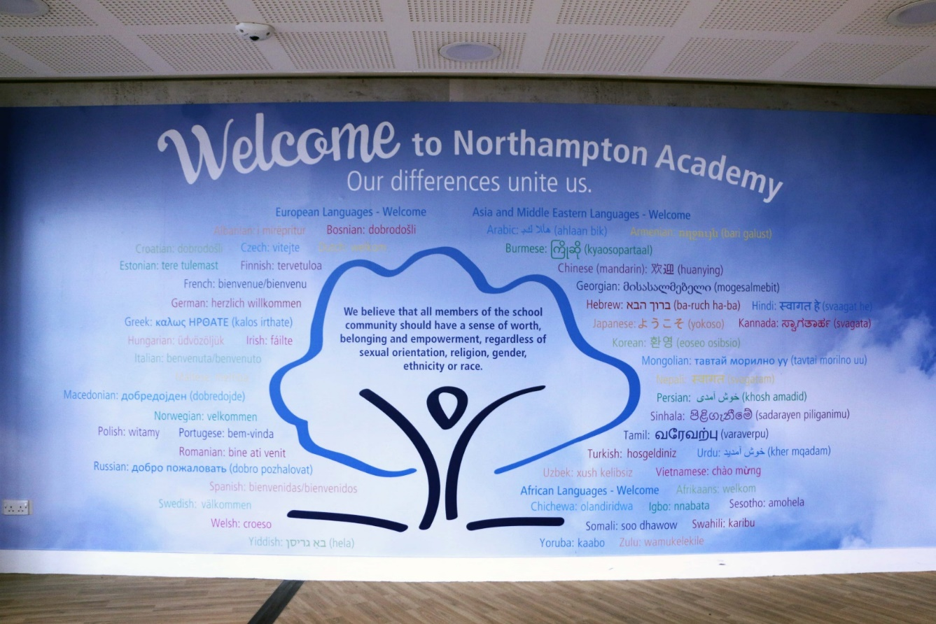
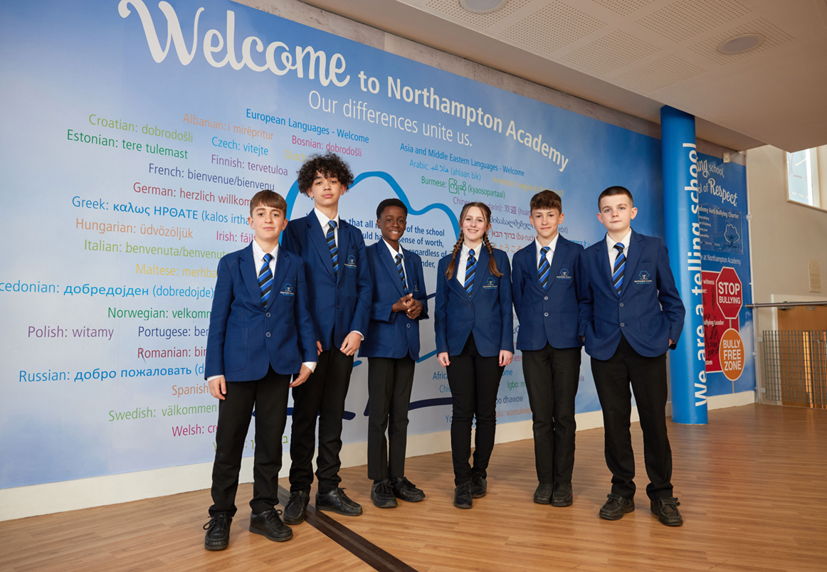
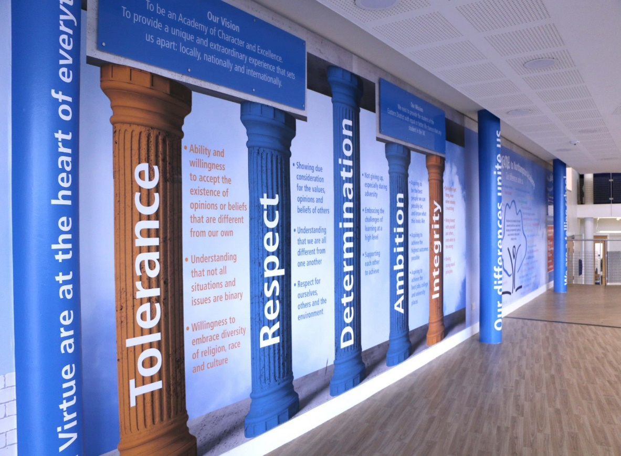
Example of Character Caught
Environment-
A cared-for, safe and well-designed physical environment promotes a sense of belonging
Vision, Ethos, Culture:
The whole school community led by the SLT defined priority virtues for all to aspire towards. The virtues selected are aligned to the context of the school
A whole school-shared language was developed
We establish clear ethical and moral expectations for staff and pupils informed by priority virtues and vision and mission statements
Relationships: Chosen virtues are modelled by all
Form meaningful, respectful relationships built on trust and compassion among staff, pupils and their families
Welcome in various language spoken in the academy with Inclusion Charter and Inclusion strap-line –”Our Differences Unite Us”
Creates a sense of belonging and purpose
Pillars of virtues visible on every classroom door
Student leadership- Creating meaningful leadership opportunity for all students- e.g. STLT, JIT, Antibullying , Wellbeing Leadership, environment
Pillars of virtues strategically displayed around school

Slide 14
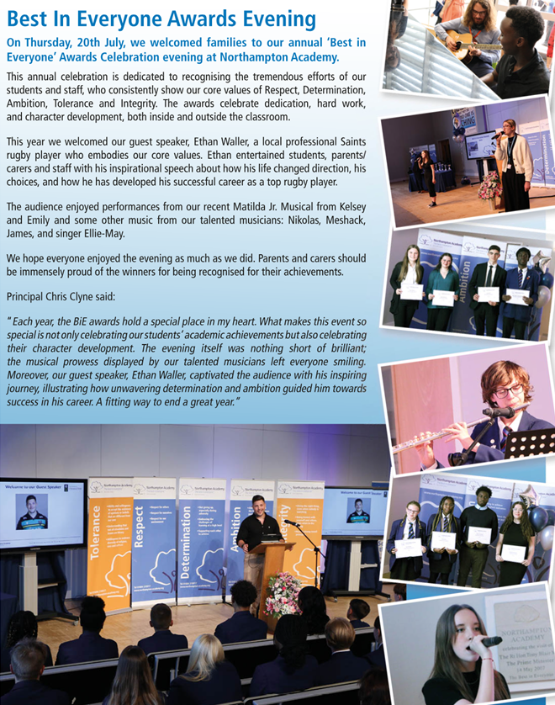
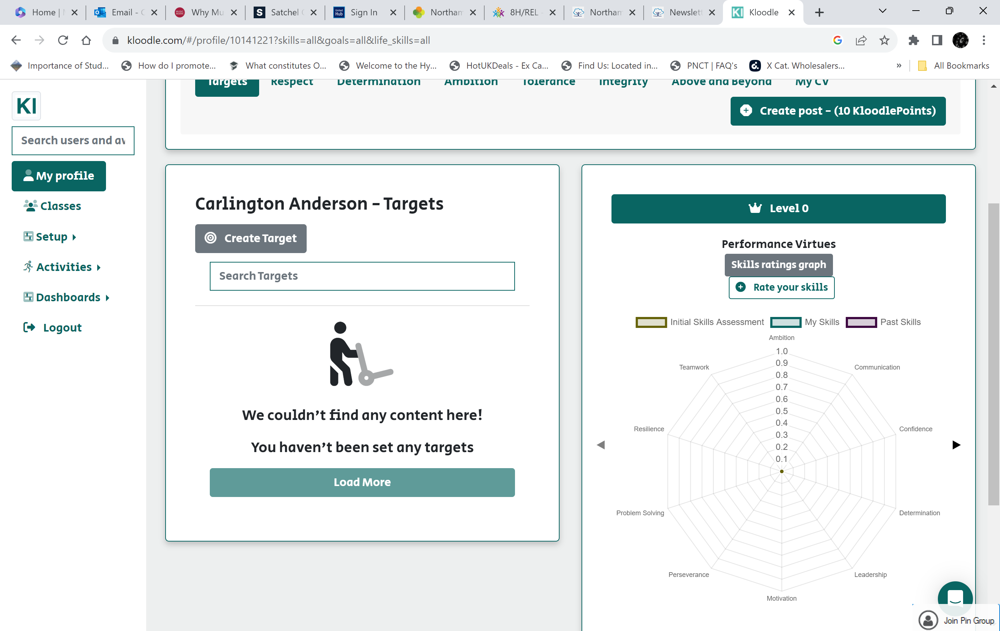
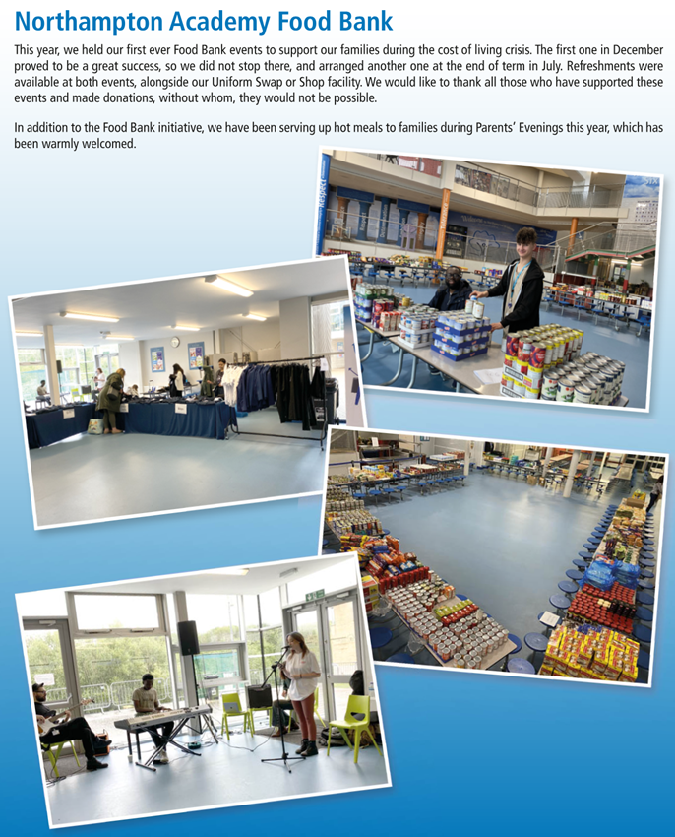
Character Passport and graduation
Character App- Character Passport. Students evaluate their character based on their virtues. They complete character challenges and evidence of how they have developed their virtues. Each year there is an opportunity for graduation
Social Action & Volunteering: Community-based experience encourages civic engagement all linked to the virtues
The school leads experiences that promote social awareness and help students to make positive differences in their communities- e.g. School Food and uniform Banks, Litter Picking with the Wombles, supporting local, national and international charities etc.
Awards and Celebration
Praise Point & Best in Everyone Award (BiE) linked to the virtues
Teachers nominate students by recognising and celebrating pupil’s participation when they have consistently shown the virtues
My Culture Day: A day planned annually by the JIT to celebrate diversity and as social action for International charity
Example of Character Sought
Character App- Character Passport. Students evaluate their character based on the virtues. They complete character challenges and evidence how they have developed their virtues.
My Culture Day: A Cross-curricular day planned annually by the student leadership team to showcase and celebrate diversity in the school
Awards & Celebrations around virtues: A spectacular evening - The BiE Award celebrates the best of the students.
Deliberate opportunities are created for students to develop their civic engagement and responsibility to their local and global community- Social Action.

Slide 15
A 3-Year Strategy to Outstanding
Component | Progress Descriptors- year1 | Progress Descriptors- year 1-3
Virtues/Values | The school has a clear plan how it will engage with stakeholders to develop or refresh its virtues/values | All members of the school community know the virtues Clear evidence that the virtues are part of common and habitual language. They shape policies and plans
Reward & Behaviour | School has a behaviour system that rewards good behaviour but doesn’t always link it to values/virtues and good character | School has a behaviour and reward system which explicitly rewards virtuous behaviour. When transgression of behaviour occurs, it is used as an opportunity to reflect on and develop specific virtues going forwards
Physical Environment | There is a clear plan for how and where its virtues/values will be displayed | The virtues/values are visible across some communal areas and within some classrooms
Website | The school website features a section on vision and values | The school has a dedicated section on the website for Character Education
Staff Appraisals |  | Majority of staff naturally role model the school’s virtues/values due to the culture in the school
Recruitment and induction | The school’s virtues/values and character education are referenced in job descriptions. The school’s character programme is covered in the induction process. There is an explicit expectation about modelling the school’s values | The school’s character programme is covered in the induction process. There is an explicit expectation about modelling the school’s values
Cultural Routines | The school reflects on how to amend existing cultural routines to enhance character caught opportunities | School introduces and embeds routines that reinforce the school’s virtues/values into the school day

Slide 16
A 3-Year Strategy to Outstanding
Component | Progress Descriptors- year1 | Progress Descriptors- year 1-3
Extra-curricular | The school broadens its extracurricular offer to ensure arts, sports and volunteering are all represented | The school broadens its extracurricular activities and pupils are able to demonstrate an understanding of how activities help develop their character
Pupil Leadership | Opportunities to develop leadership exist but are ad hc, implicit and don’t include the majority of pupils | Pupil leadership is consciously and intentionally developed both implicitly and explicitly through dedicated programmes. Character and virtues is woven into the application process for pupil leadership responsibilities
Social Action | Partnerships are developed with charities and volunteering-based initiatives | There is evidence that pupils have the opportunities to support charities and undertake social action. These activities are explicitly linked to the development of character and virtues
Governors | Governors work with SLT to develop a planned and phased approach to introducing a whole-school character strategy. They receive training on what a character education is and why it is important | Governors play a key role in helping set the vision and purpose of the school’s character education. They hold SLT to account on the success of the Character provision
Parents | Parents/carers are informed about activities that implicitly develop character | Parents/carers are explicitly informed about the school’s virtues /values and how they are developed, primarily through newsletters and other forms of communication.

Slide 17
Character Action Plan
Character 3-Year Strategy
Character graduations across the school
The Character App
The impact of virtues, not values – Impact on me, Impact on the school approach
Staff Virtue Champions celebrated in briefings
My Culture Day
Praise quick wins?
Quick Wins
IQM National Inclusion Conference

Slide 18
Questions
#IQMFamily
IQM National Inclusion Conference

